Slide 1
How to talk about open science and make research more open
Iryna Kuchma, EIFL Open Access Programme Manager
Attribution 4.0 International

Slide 2
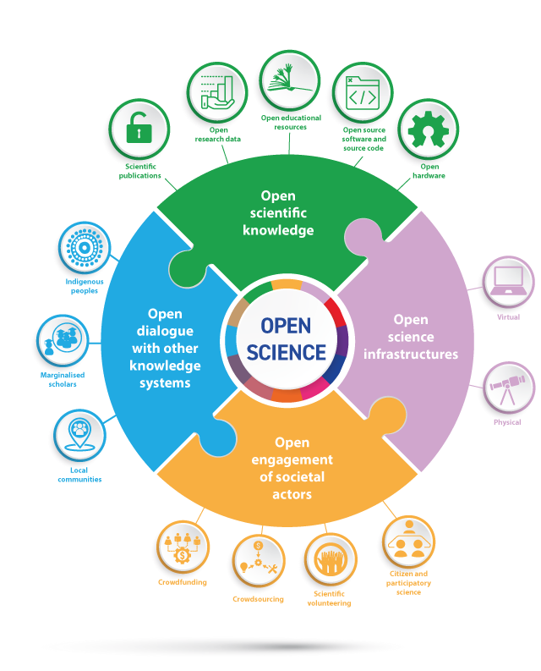
Definition of Open Science
Open Science:
makes scientific knowledge openly available, accessible and reusable for everyone,
increases scientific collaborations and sharing of information for the benefits of science and society,
opens the processes of scientific knowledge creation, evaluation and communication to societal actors beyond the traditional scientific community.
Notes:
Presenter
2022-06-13 11:33:55
--------------------------------------------
The recommendation provides and inclusive definition of open science as a construct that combines various movements and practices aiming to make multilingual scientific knowledge openly available, accessible and reusable for everyone, to increase scientific collaborations and sharing of information for the benefits of science and society, and to open the processes of scientific knowledge creation, evaluation and communication to societal actors beyond the traditional scientific community…

Slide 3
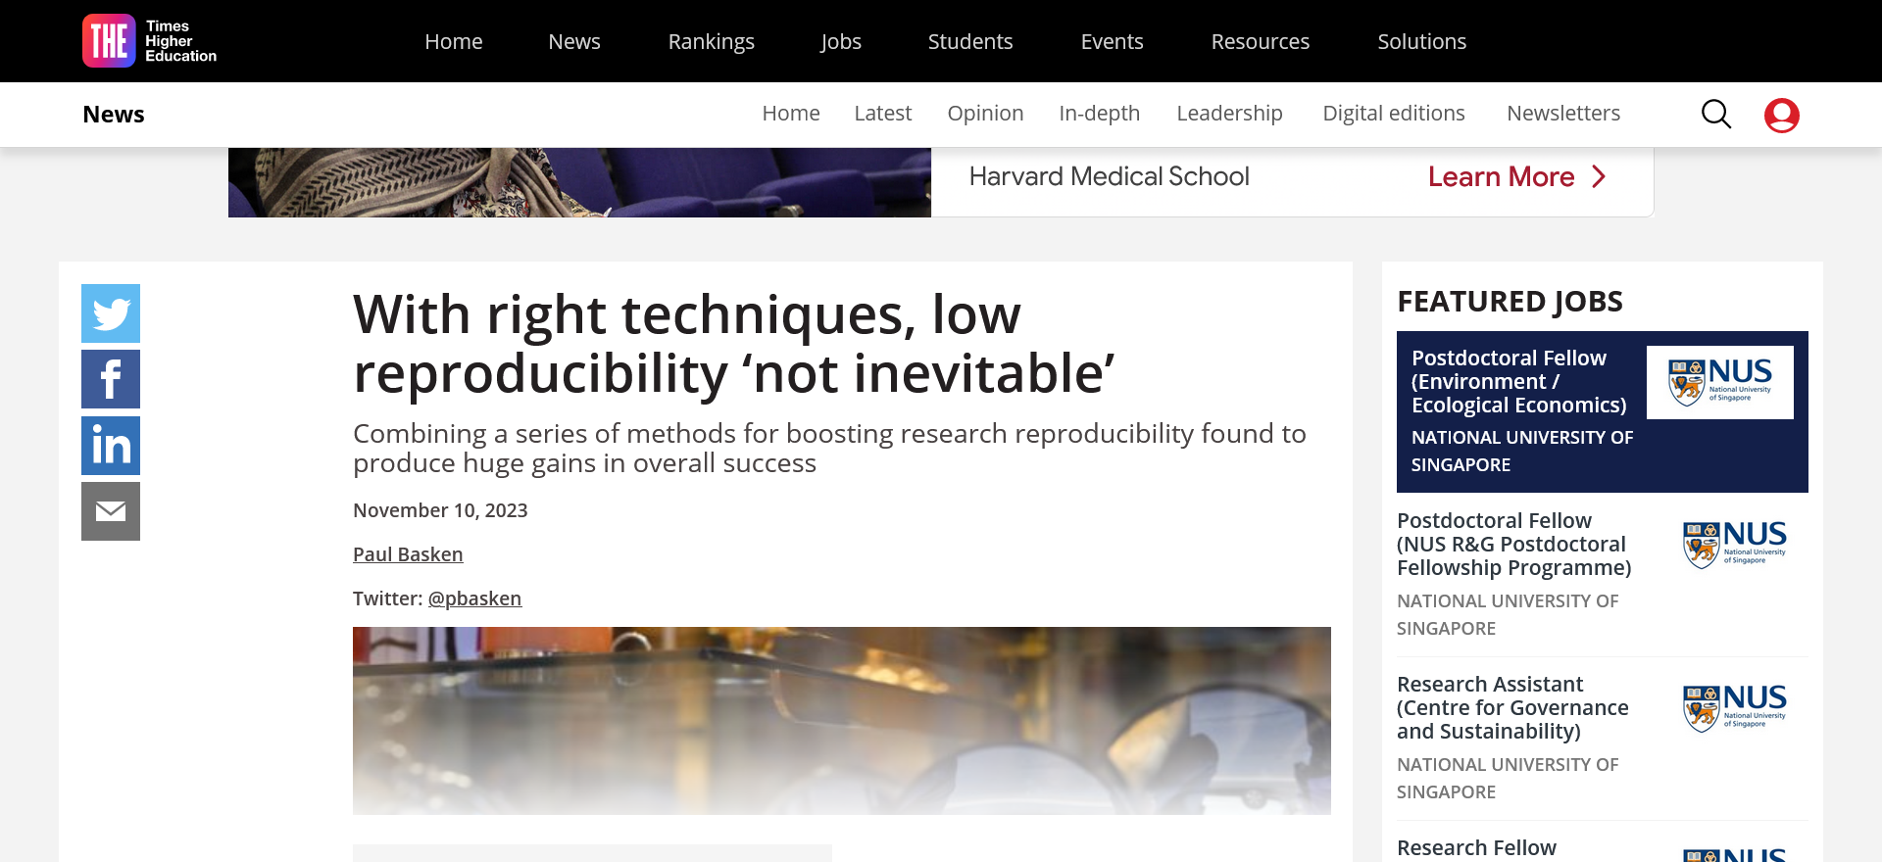
https://www.timeshighereducation.com/news/right-techniques-low-reproducibility-not-inevitable

Slide 4
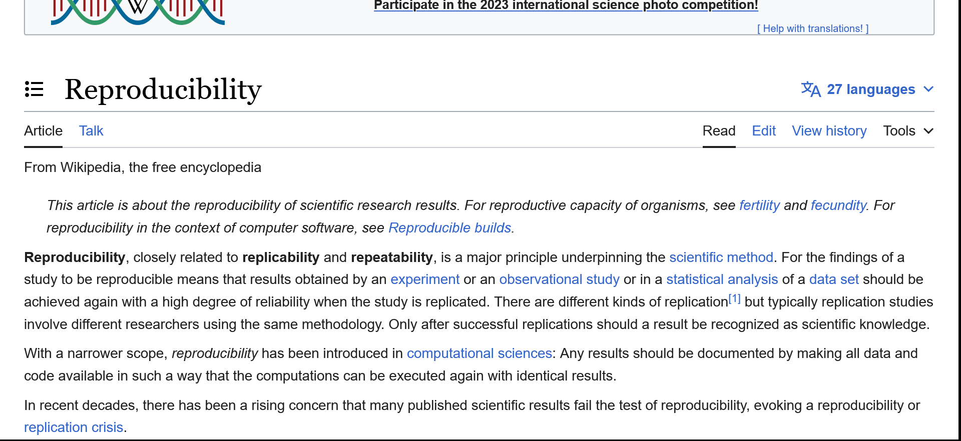
https://en.wikipedia.org/wiki/Reproducibility

Slide 5
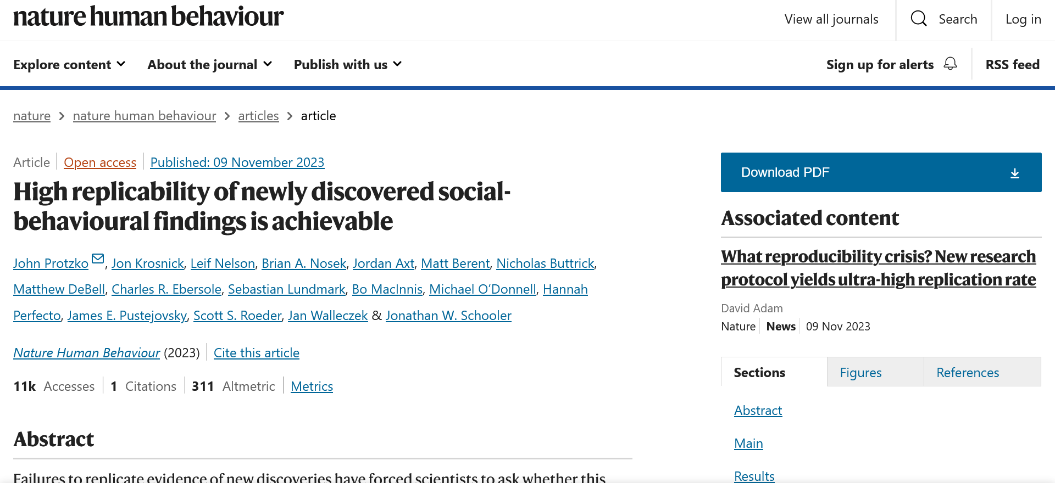
Protzko, J., Krosnick, J., Nelson, L. et al. High replicability of newly discovered social-behavioural findings is achievable. Nat Hum Behav (2023). https://doi.org/10.1038/s41562-023-01749-9

Slide 6
“Some leading strategies in that direction include requirements for researchers to preregister their work – meaning a public declaration in advance of what question or questions they expect a particular study to answer, to prevent subsequent efforts to attach importance to unexpected outcomes that may have randomly appeared in their data.”
Protzko, J., Krosnick, J., Nelson, L. et al. High replicability of newly discovered social-behavioural findings is achievable. Nat Hum Behav (2023). https://doi.org/10.1038/s41562-023-01749-9

Slide 7
Preregistration

Slide 8
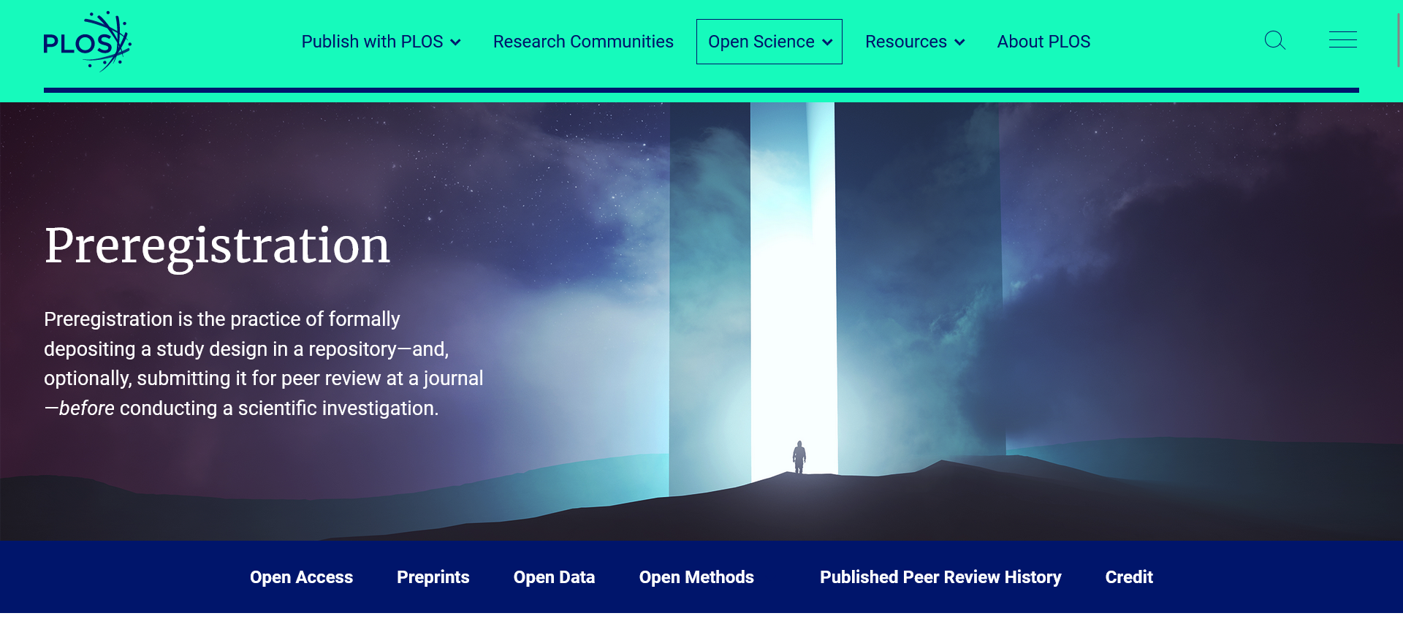
https://plos.org/open-science/preregistration

Slide 9
https://plos.org/open-science/preregistration

Slide 10
https://plos.org/open-science/preregistration

Slide 11
https://plos.org/open-science/preregistration

Slide 12
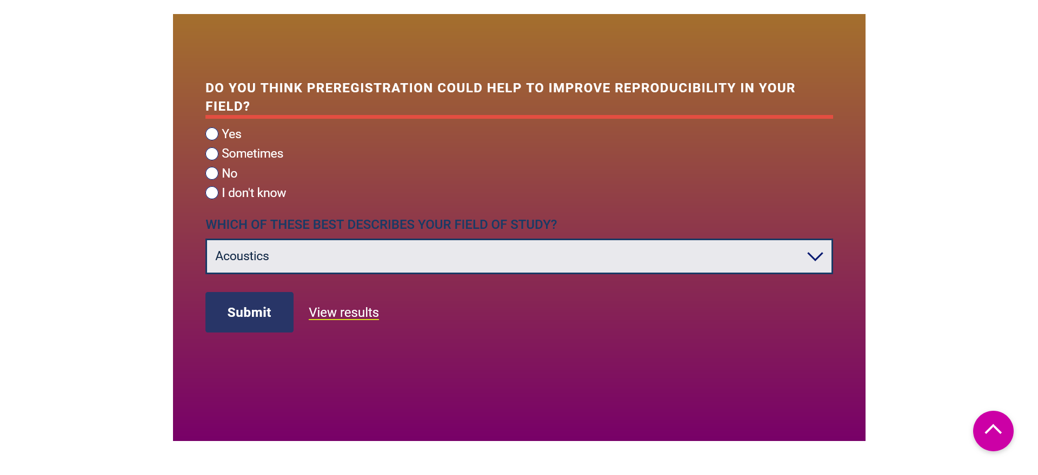
https://plos.org/open-science/preregistration

Slide 13
https://www.cos.io/initiatives/prereg

Slide 14
https://www.cos.io/initiatives/prereg

Slide 15
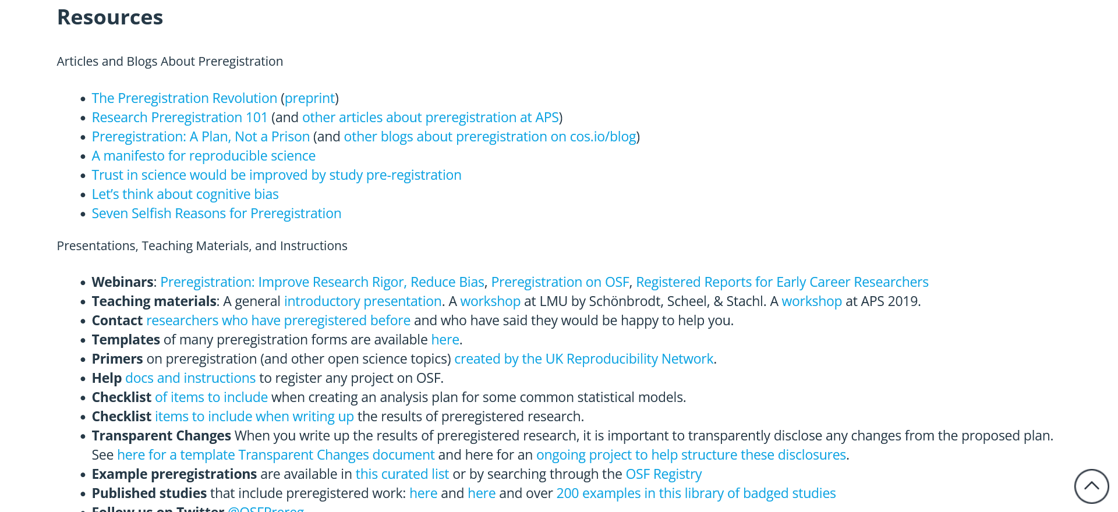
https://www.cos.io/initiatives/prereg

Slide 16
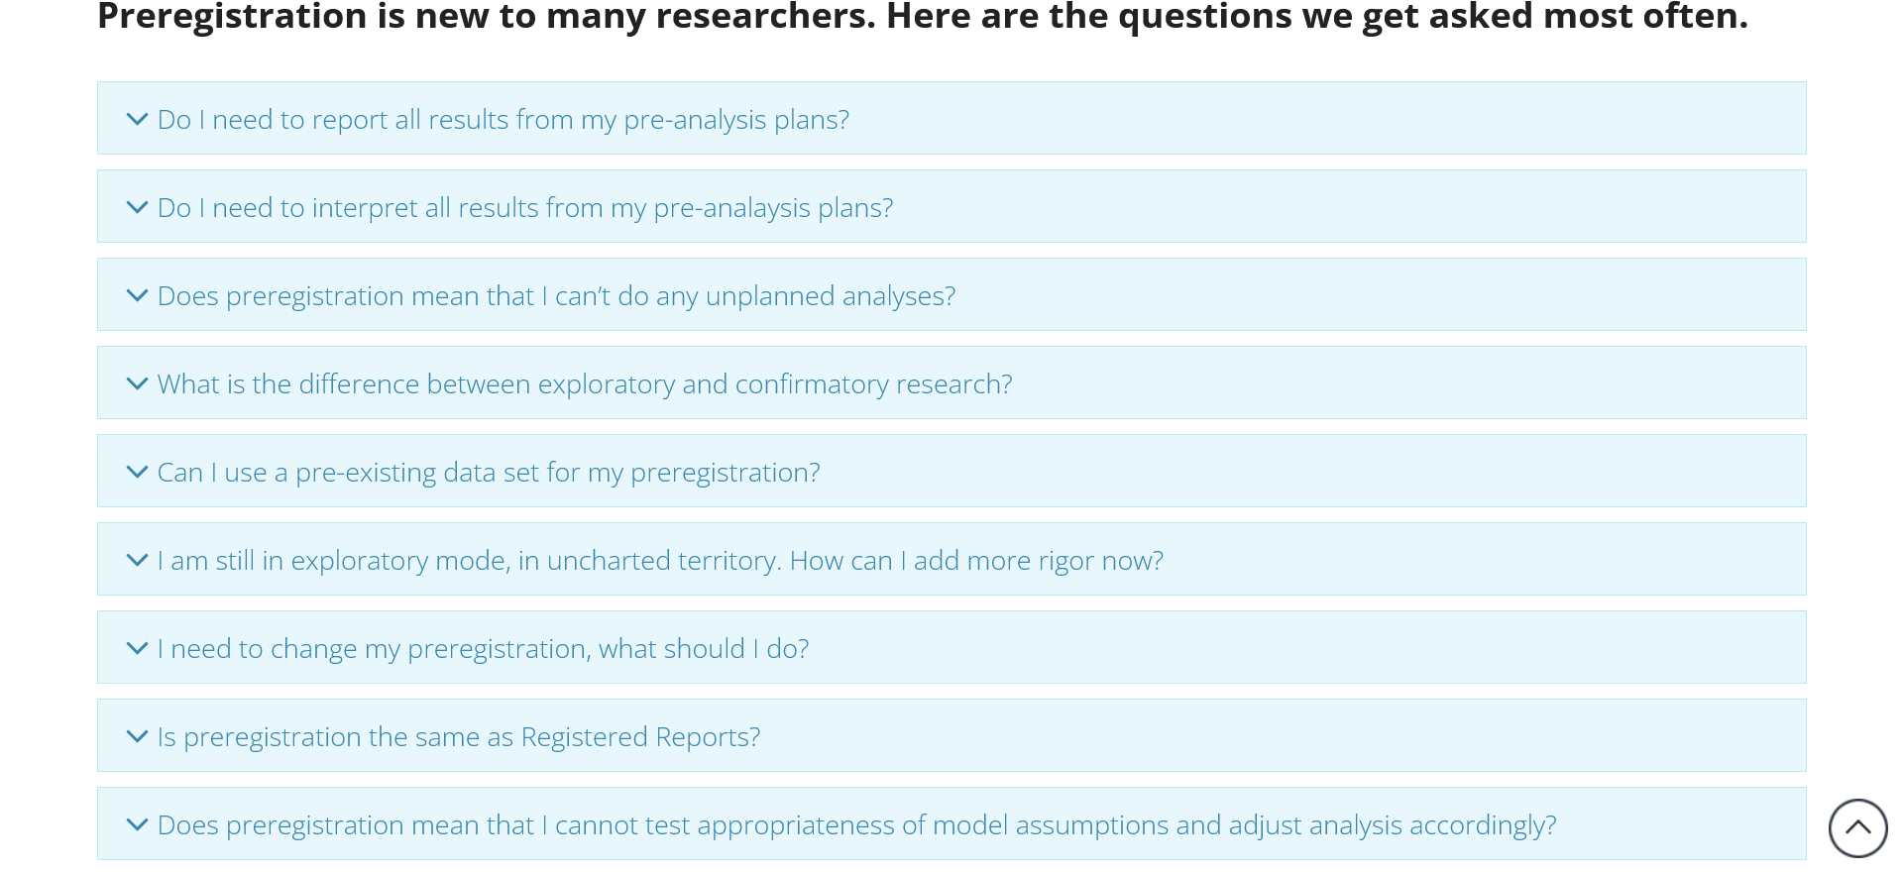
https://www.cos.io/initiatives/prereg

Slide 17
https://osf.io/7cd6q

Slide 18
https://osf.io/7cd6q

Slide 19
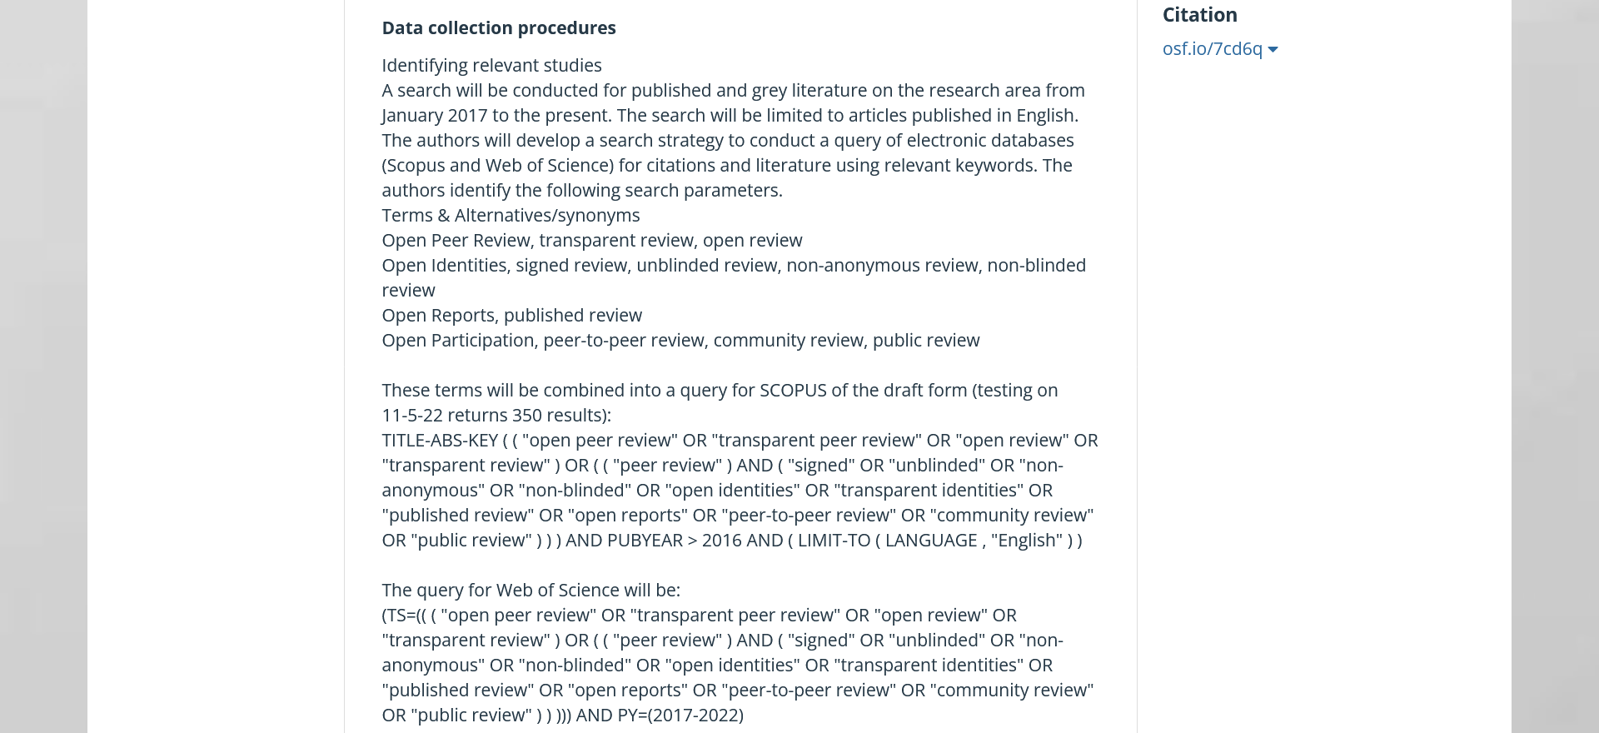
https://osf.io/7cd6q

Slide 20
https://osf.io/7cd6q

Slide 21
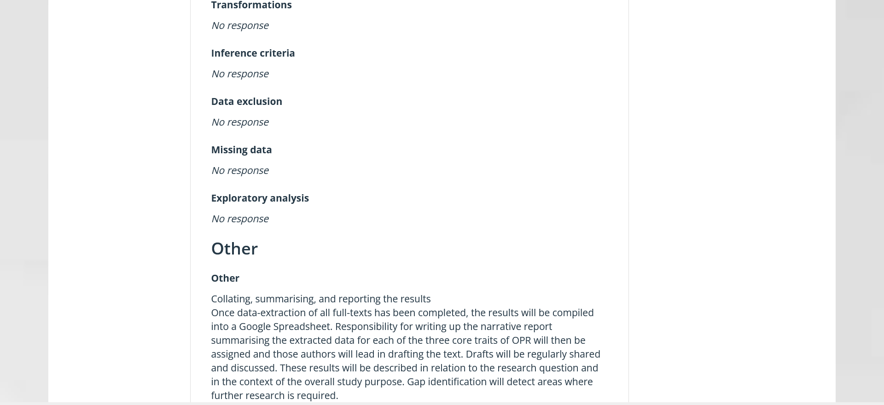
https://osf.io/7cd6q

Slide 22
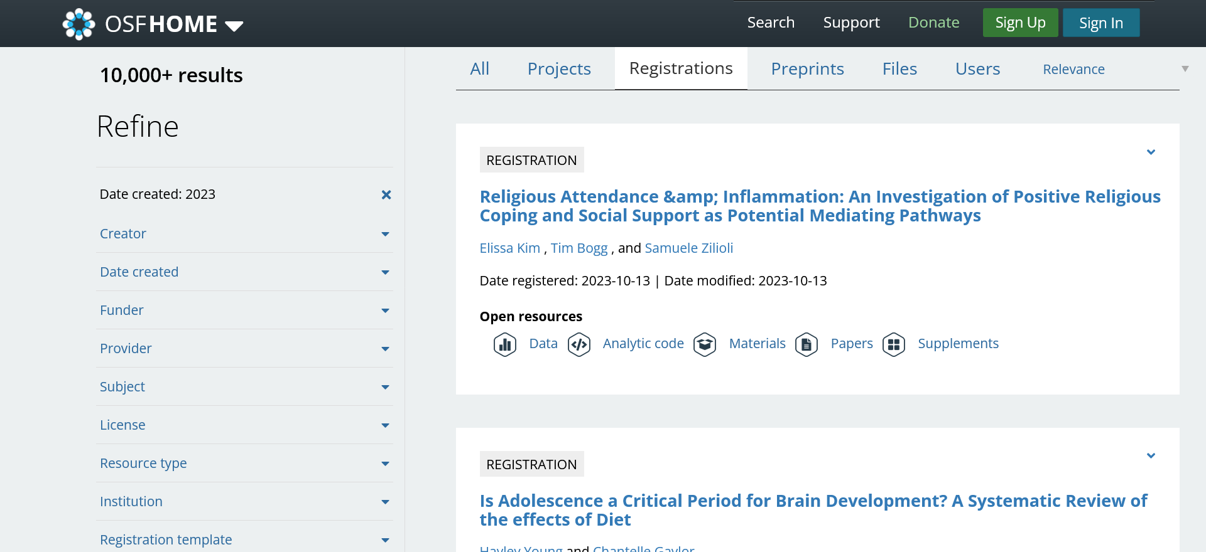
https://osf.io/search?resourceType=Registration%2CRegistrationComponent

Slide 23
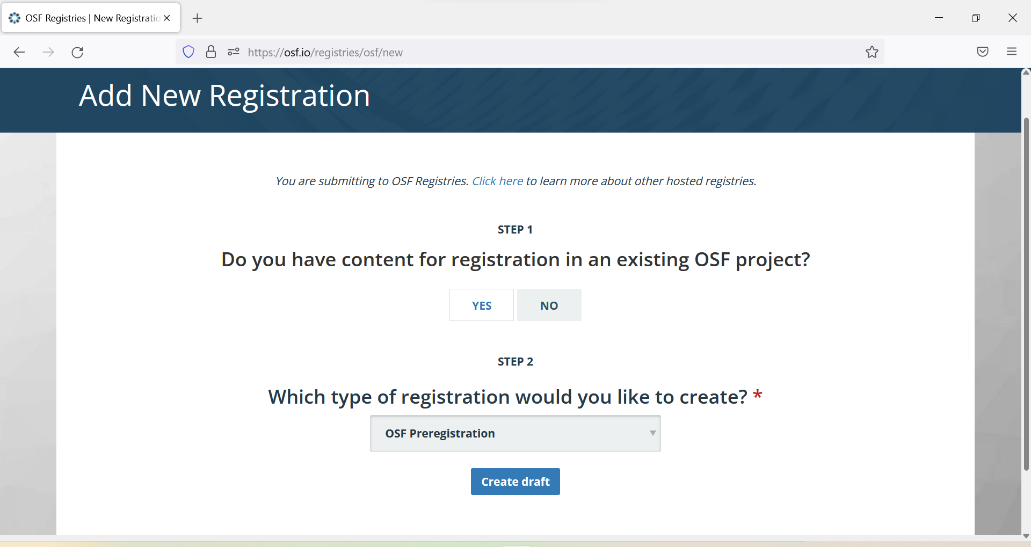
https://osf.io/prereg

Slide 24
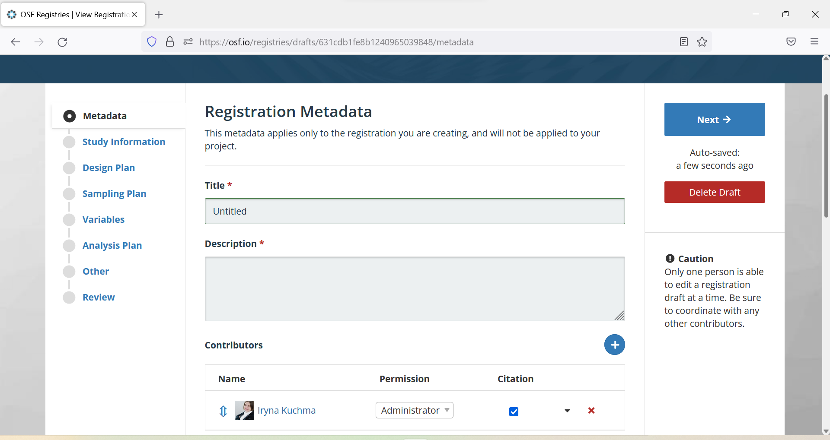
https://osf.io/prereg

Slide 25
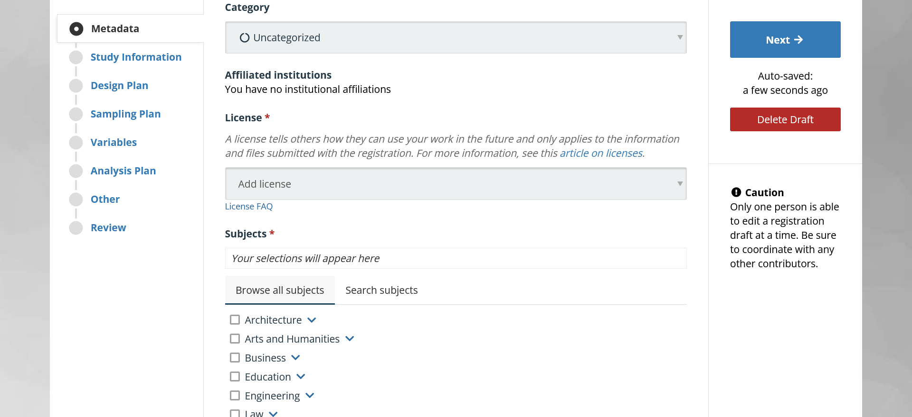
https://osf.io/prereg

Slide 26
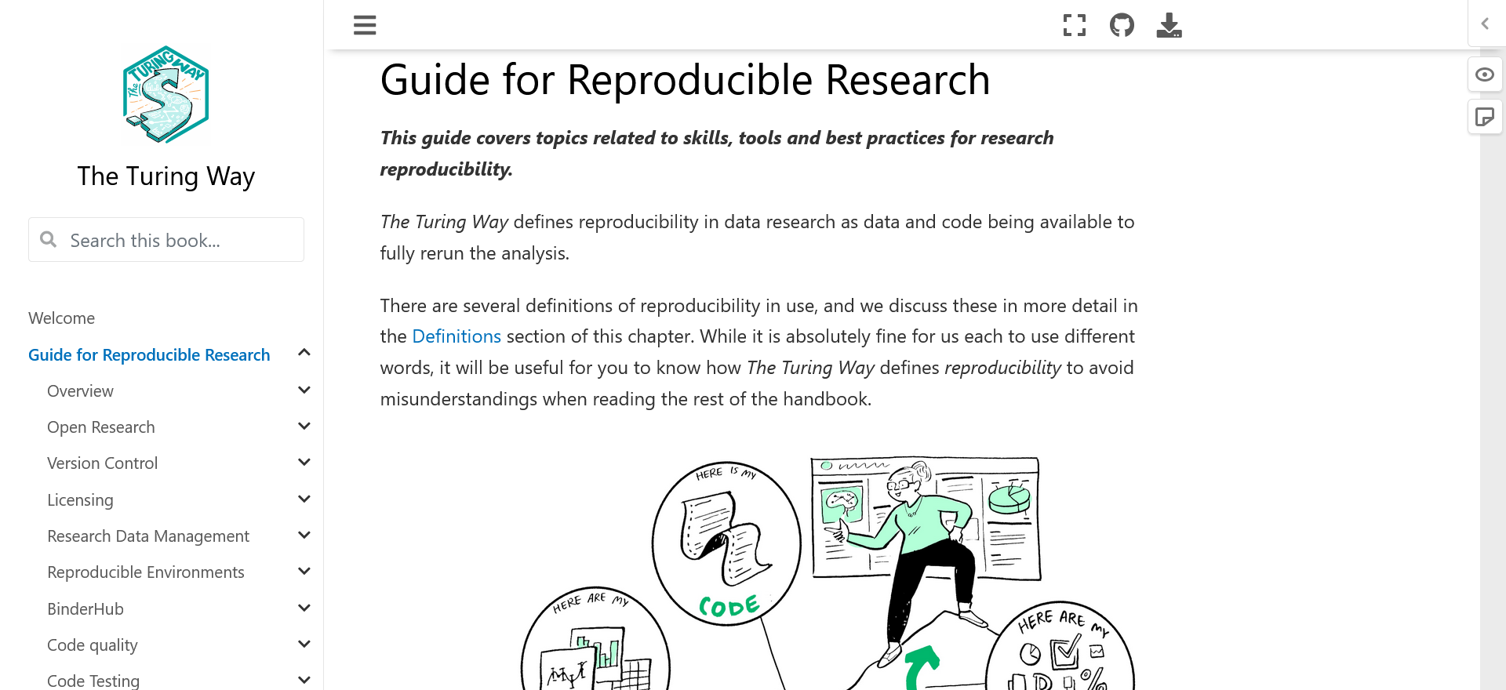
https://the-turing-way.netlify.app/reproducible-research/reproducible-research.html

Slide 27
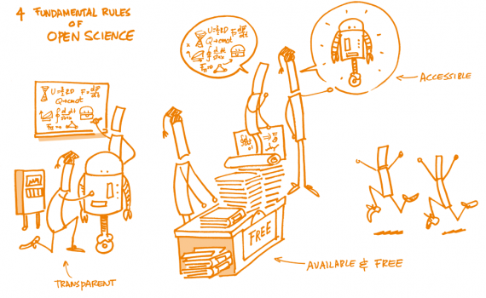
Worries about doing Open Science
“How do I sell this to my advisor?”
“Won’t it make it harder to publish my research?”
"What if I get it wrong?“
Kathawalla, U.K., Silverstein, P. and Syed, M., 2021. Easing into open science: A guide for graduate students and their advisors. Collabra: Psychology, 7(1). https://doi.org/10.1525/collabra.18684

Slide 28
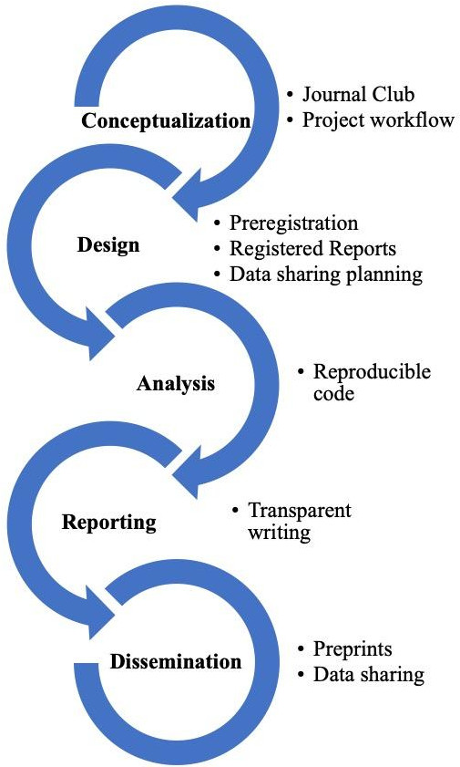
Ummul-Kiram Kathawalla,Priya Silverstein,Moin Syed, Easing Into Open Science: A Guide for Graduate Students and Their Advisors, Collabra: Psychology, 2021,
Notes:
Figure Caption:
Figure 1. Open Science research practices across the research cycle
Unless stated otherwise in the caption above, the following copyright applies to the content of this slide: This is an open access article distributed under the terms of the Creative Commons Attribution License (4.0), which permits unrestricted use, distribution, and reproduction in any medium, provided the original author and source are credited.

Slide 29
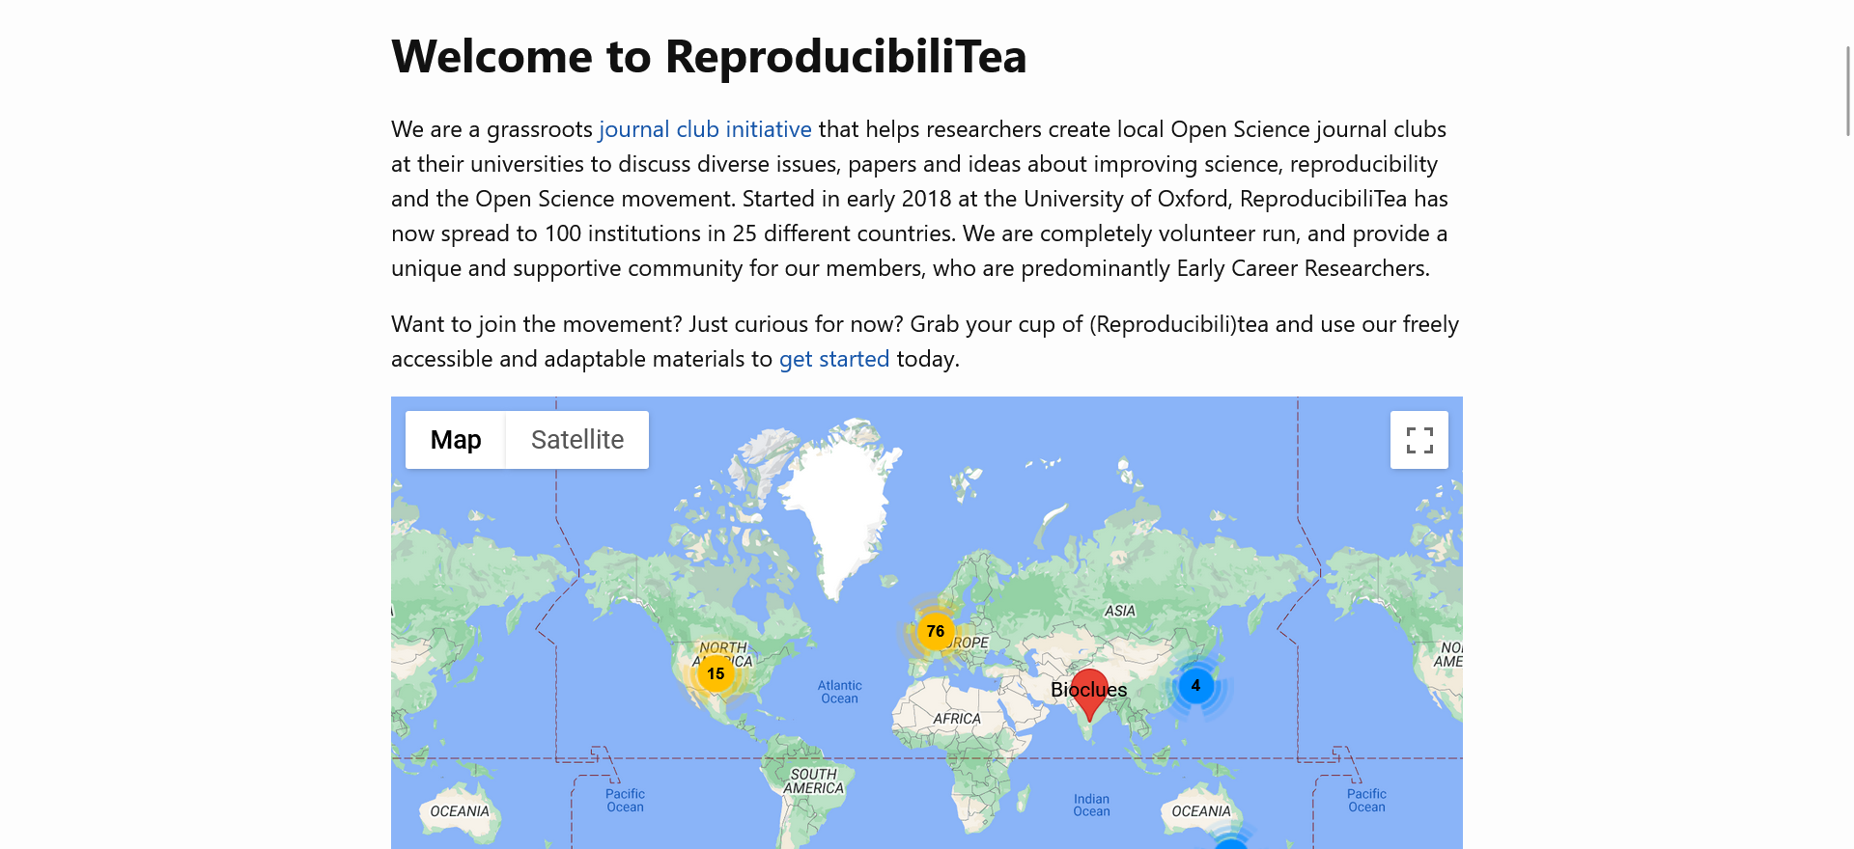
Discuss with researchers and students issues surrounding reproducibility and open science
https://reproducibilitea.org

Slide 30
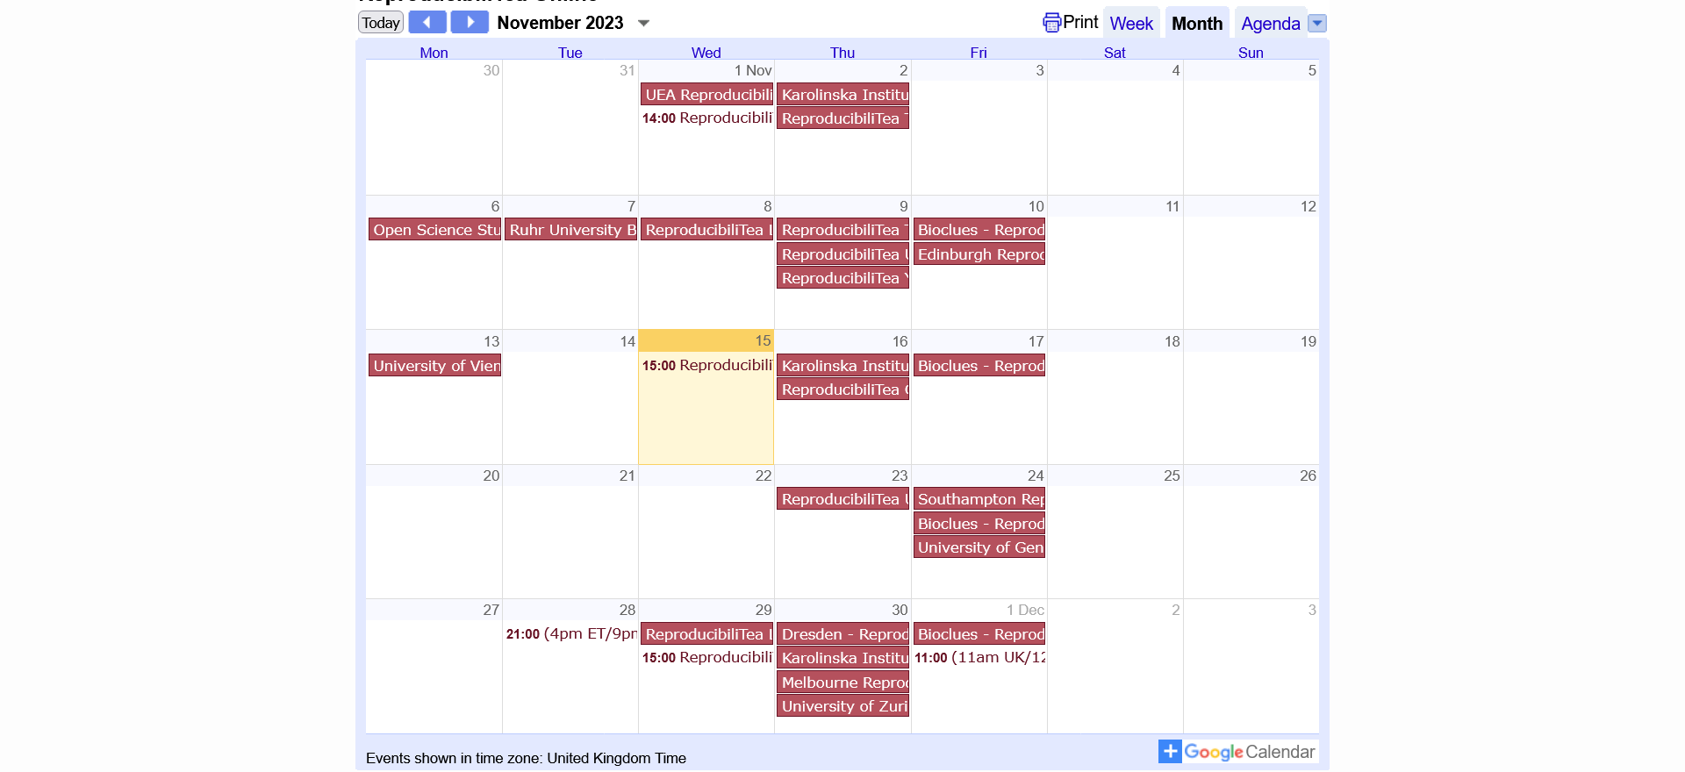
Discuss with researchers and students issues surrounding reproducibility and open science

Slide 31
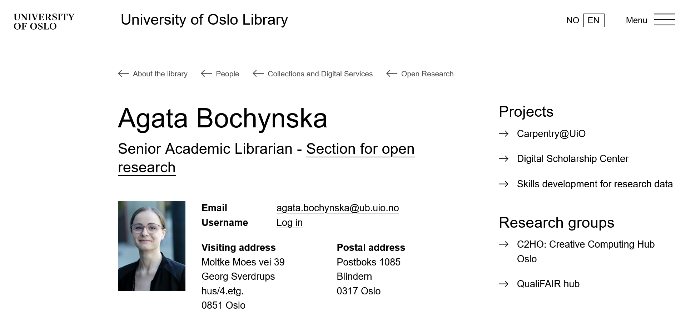

Slide 33
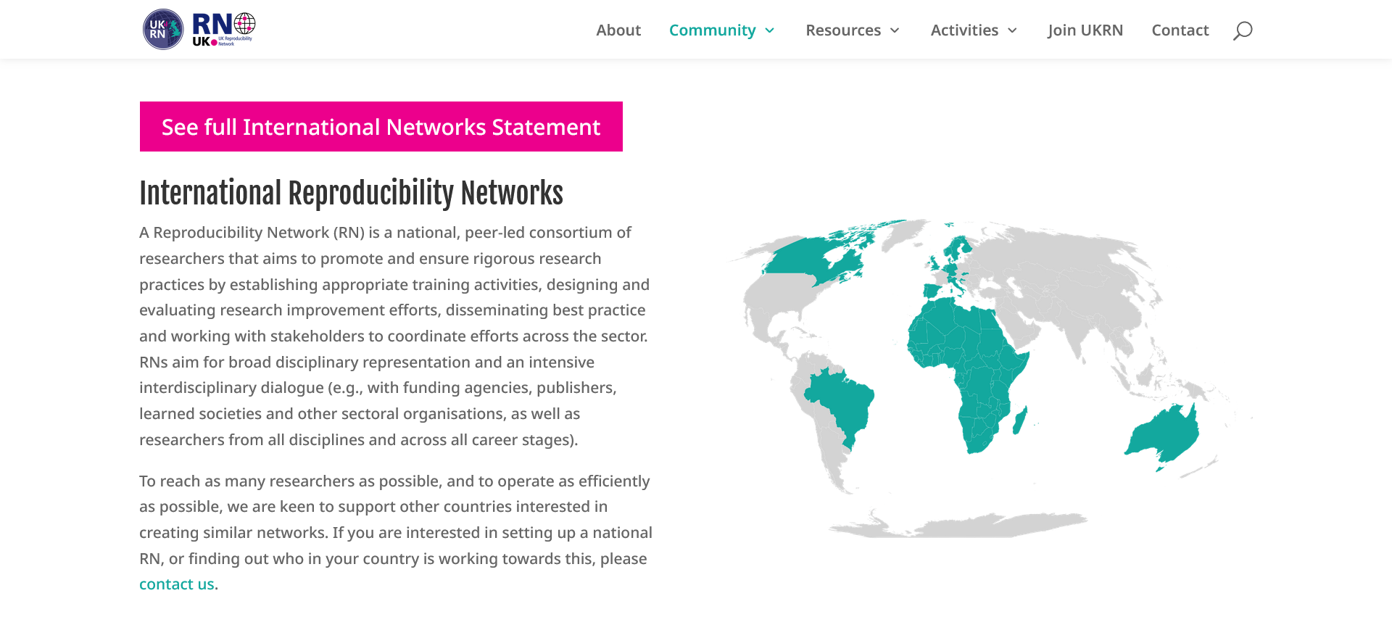
https://www.ukrn.org/international-networks

Slide 34
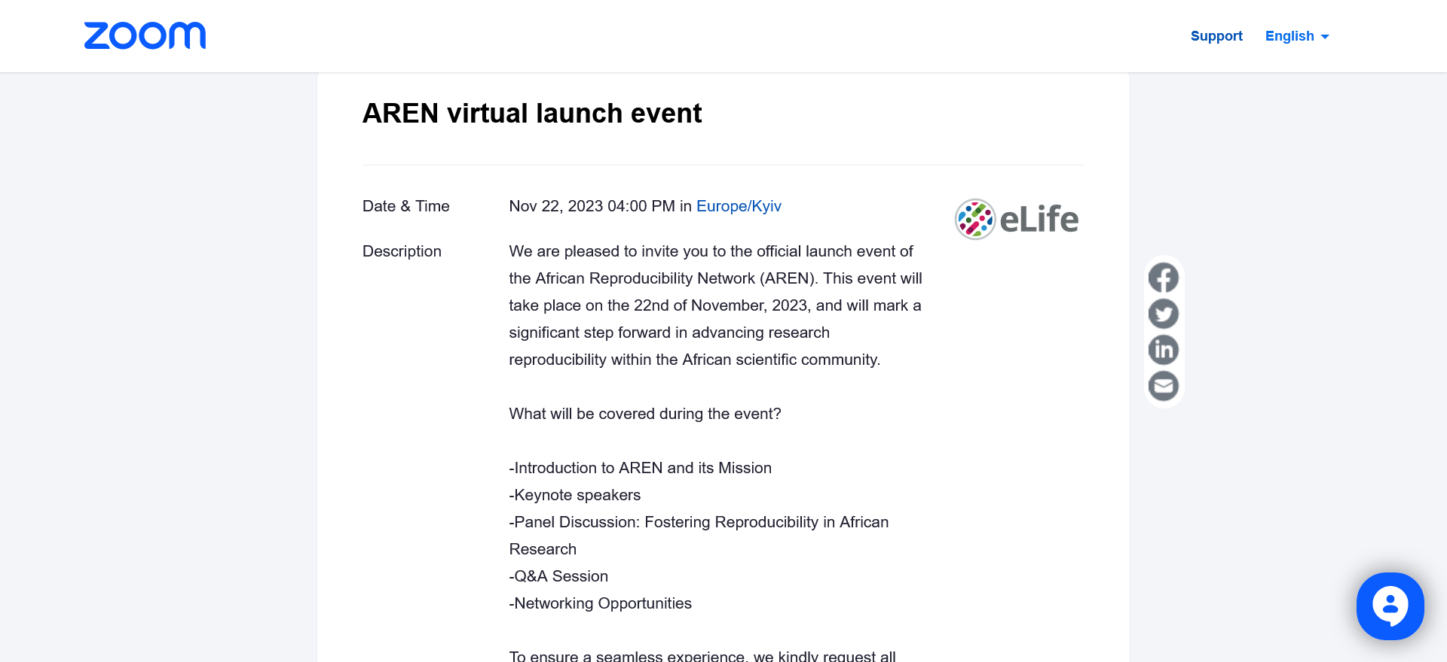
https://us02web.zoom.us/webinar/register/WN_ZvM-gBqCSY2vN41G7ztTFA#/registration

Slide 35
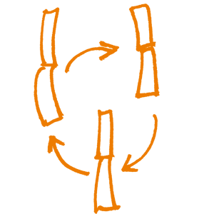
Project workflow

Slide 36
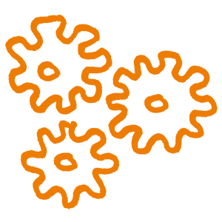
How you organize projects and move through the various stages of your research cycle: your file folder structure, document naming conventions, version control, cloud storage, and other details.
The choice of who has access to the project (e.g., collaborators, the public) and when in the process they have access (e.g., at all times, upon publication).

Slide 37
Research data lifecycle
RE-USING DATA: follow-up research, new research, undertake research reviews, scrutinising findings, teaching & learning
CREATING DATA: designing research, DMPs, planning consent, locate existing data, data collection and management, capturing and creating metadata
CREATING DATA
PROCESSING DATA
ANALYSING DATA
PRESERVING DATA
GIVING ACCESS TO DATA
RE-USING DATA
PROCESSING DATA: entering, transcribing, checking, validating and cleaning data, anonymising data, describing data, manage and store data
ANALYSING DATA: interpreting, & deriving data, producing outputs, authoring publications, preparing for sharing
ACCESS TO DATA: distributing data, sharing data, controlling access, establishing copyright, promoting data
PRESERVING DATA: data storage, back-up & archiving, migrating to best format & medium, creating metadata and documentation
Ref: UK Data Archive: http://www.data-archive.ac.uk/create-manage/life-cycle
Notes:
This research data lifecycle is taken from the UK Data Archive. It shows you the different processes and activities you’ll go through. As I’m sure you all know, data has a life beyond the project end.
Depending on your line of work, you may enter the cycle at ‘half past ten’, by re-using existing data, or at 12 o’clock:
Creating data: This is when you’ll design the research, write Data Management Plans, negotiate consent agreements, find any existing data you want to reuse, collect/capture your data and create any associated metadata
Processing data: When processing your data, you’ll be entering, transcribing, checking, validating and cleaning it, you may also need to anonymise your data, you should describe it and make sure it’s properly managed and stored.
Analysing data: when you analyse your data you’ll be interpreting it and creating derived data and outputs, you’ll probably also author publications and prepare the data for deposit and sharing.
Preserving data: data repositories play a key role in preserving data: they will make sure it’s properly stored and archived, they will migrate the formats and storage medium and create associated metadata and documentation to explain any changes made
Access to data: it may be that you share your data via a repository or handle access requests yourself. Either way, you need to establish copyright, decide who can have access and promote the data.
Re-using data: data can be re-used in follow-up studies, new research, research reviews, to evidence findings or for teaching and learning. Try to keep an open mind about the different ways in which your data could be re-used and make it as open as possible.

Slide 38
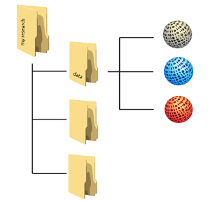
Planning trick: think backwards
What data organisation would a re-user like?
CREATING DATA
PROCESSING DATA
ANALYSING DATA
PRESERVING DATA
GIVING ACCESS TO DATA
RE-USING DATA
Notes:
Let’s adopt the perspective of a future data user – maybe yourself: what should your data organisation – folders with data, metadata and documentation – look like at the moment that you start sharing - outside your team - and archiving?
When you are part of a large project which has been going on for some years already, this may be obvious, but for many researchers it isn’t clear from the start.
To answer that broad question, you want to come up, at an early stage, with answers regarding:
Types and formats of data;
New and/or existing;
Expected size;
Metadata;
Documentation;
Software.

Slide 39
Data organisation
http://datasupport.researchdata.nl/en/start-de-cursus/iii-onderzoeksfase/organising-data

Slide 40
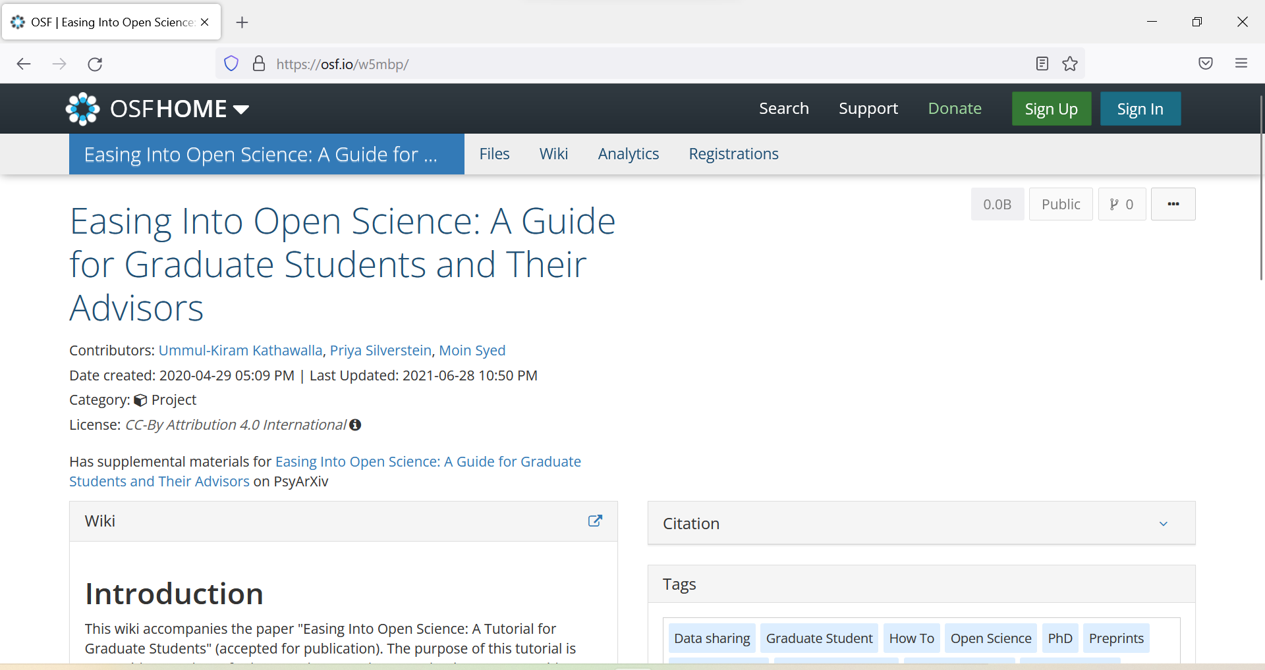
https://osf.io/w5mbp

Slide 41
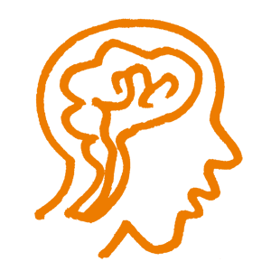
Registered reports

Slide 42
https://www.cos.io/initiatives/registered-reports

Slide 43
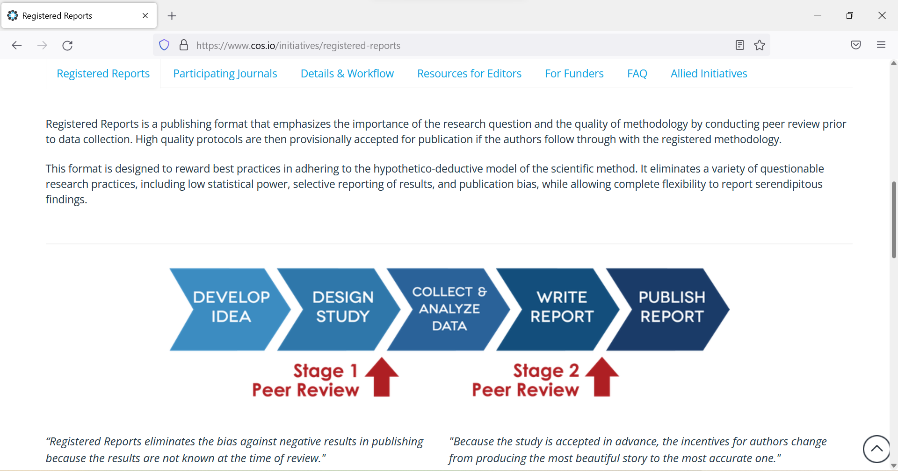
https://www.cos.io/initiatives/registered-reports

Slide 44
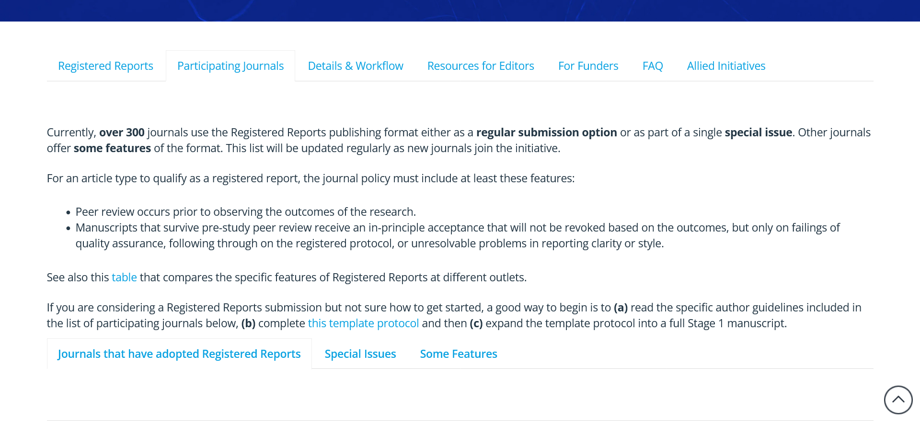
https://www.cos.io/initiatives/registered-reports

Slide 45
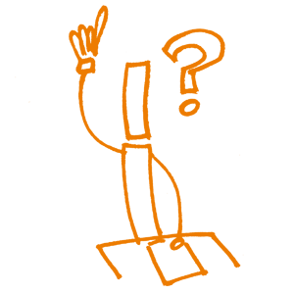
Preprints

Slide 46
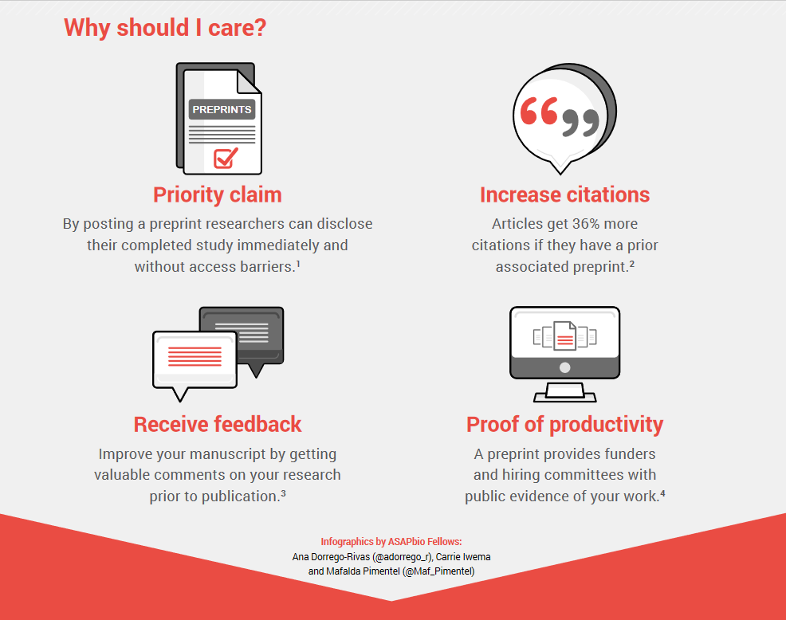

Slide 47
Iratxe Puebla @ASAPbio Community Call: Preprints in Progress

Slide 48
Iratxe Puebla @ASAPbio Community Call: Preprints in Progress

Slide 49
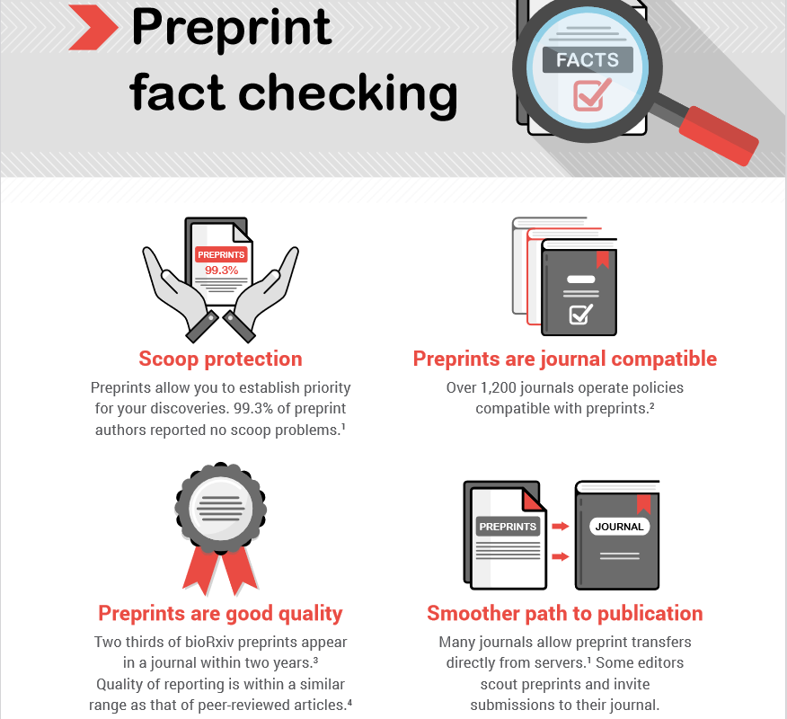
https://asapbio.org/wp-content/uploads/2021/01/ASAPbio-fact-check-preprints-english-v2.pdf

Slide 50
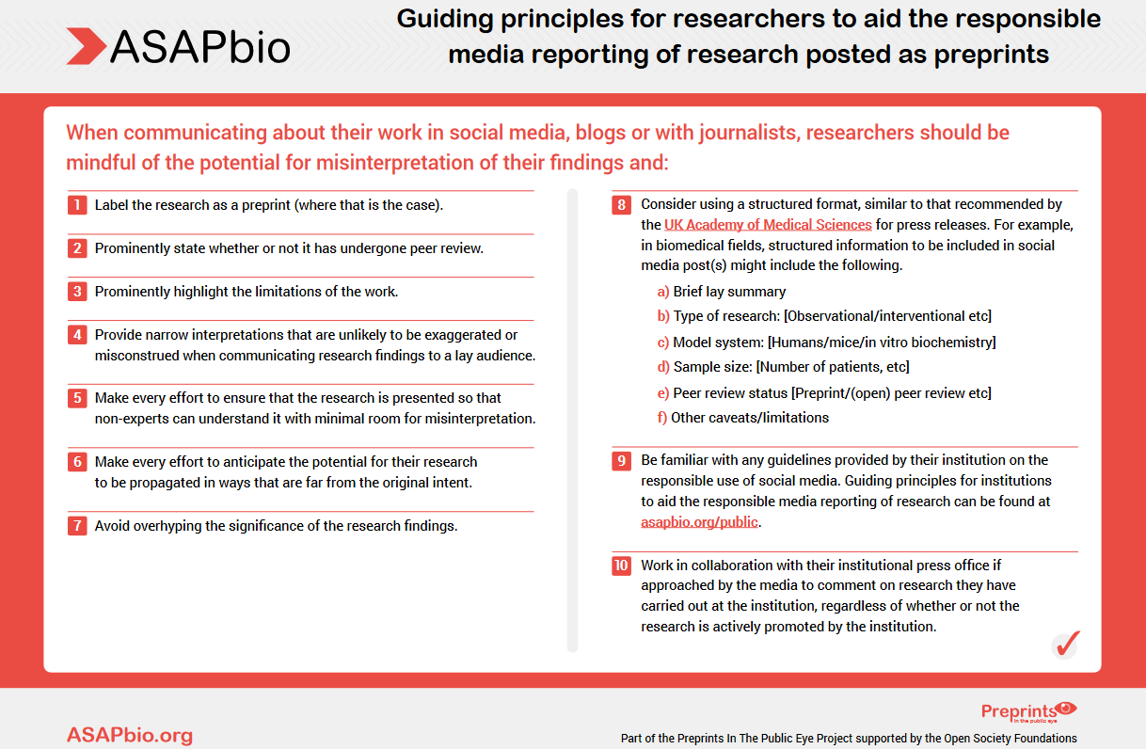
https://asapbio.org/wp-content/uploads/2021/03/Preprints-in-the-Public-Eye-Researchers-infographic.pdf

Slide 51
https://www.nature.com/articles/d41586-022-01920-8

Slide 52
https://www.mathunion.org/imu-awards/fields-medal/fields-medals-2022
Immediate acclaim after the preprint appeared on March 14, 2016 https://arxiv.org/abs/1603.04246

Slide 53
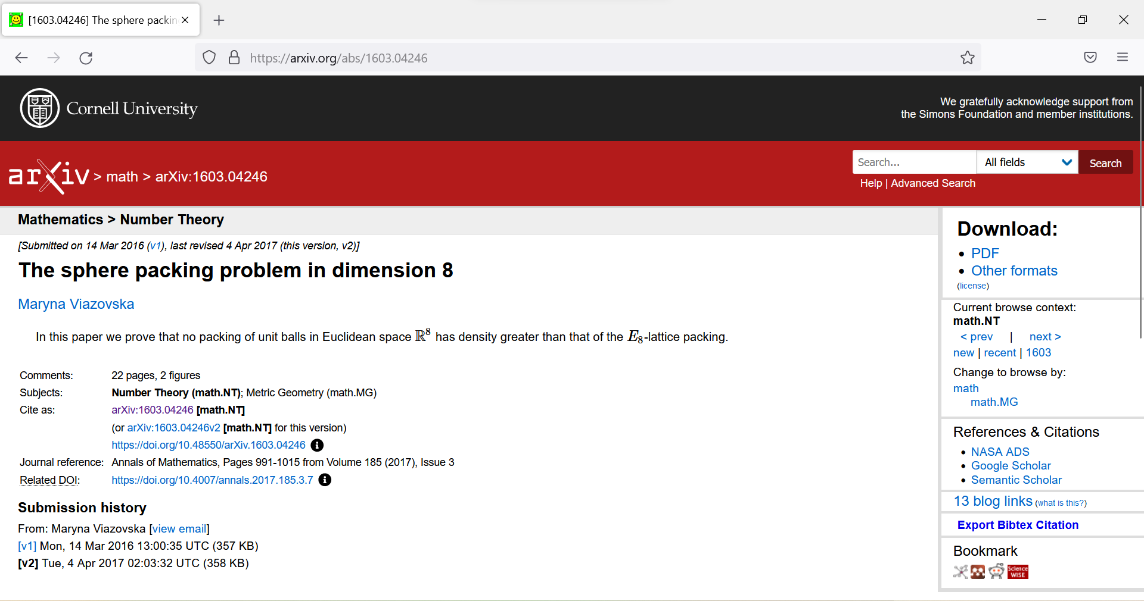
https://arxiv.org/abs/1603.04246

Slide 54
https://asapbio.org/preprint-info#action

Slide 55
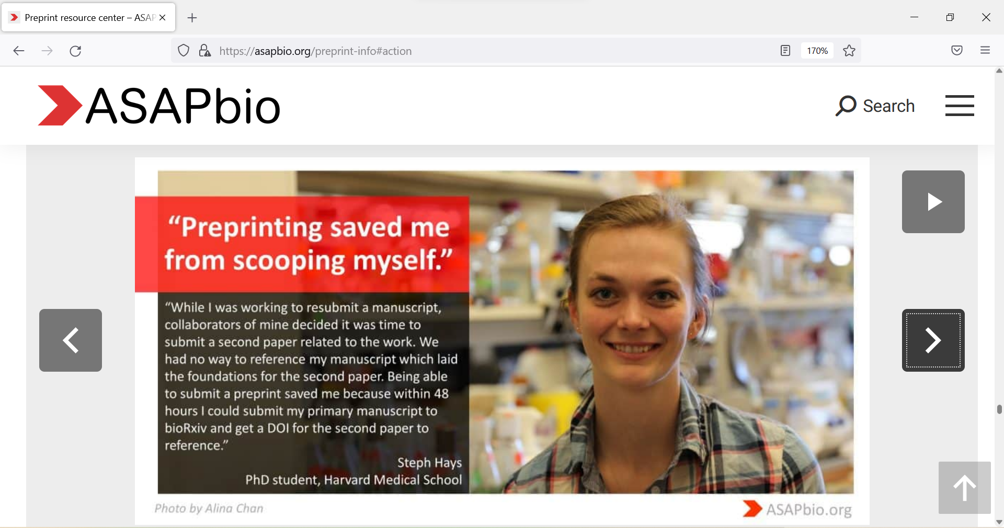
https://asapbio.org/preprint-info#action

Slide 56
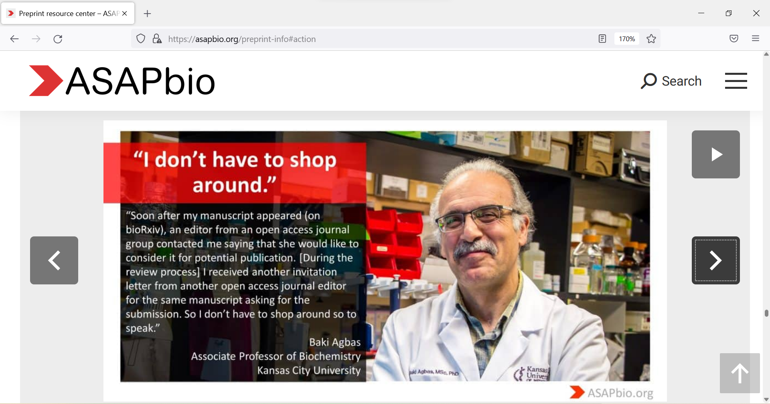
https://asapbio.org/preprint-info#action

Slide 57
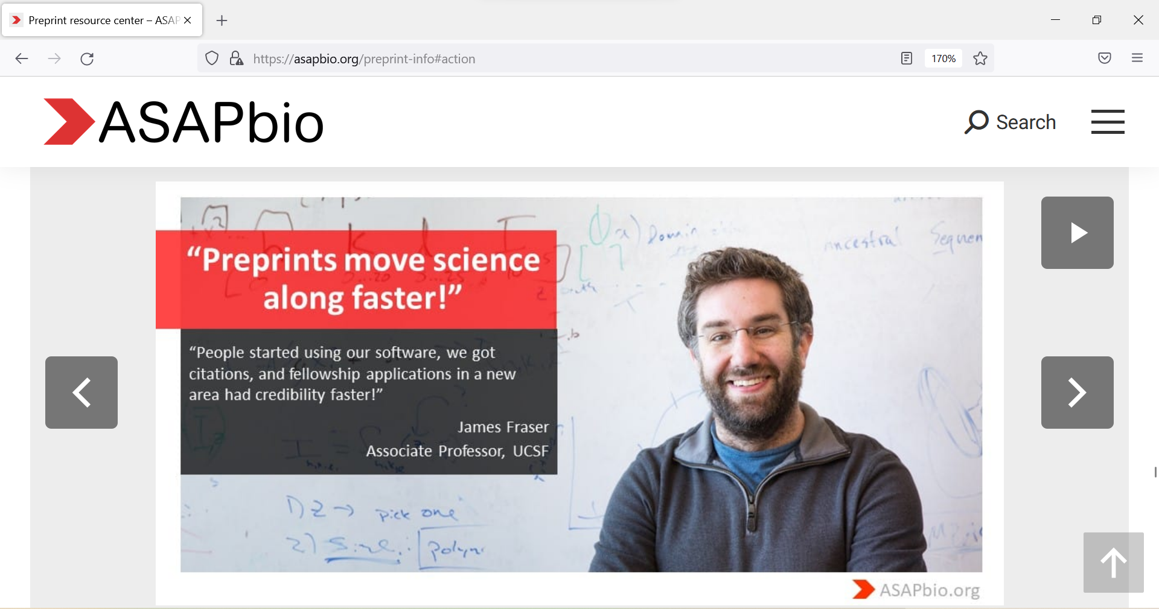
https://asapbio.org/preprint-info#action

Slide 58
https://asapbio.org/preprint-info#action

Slide 59
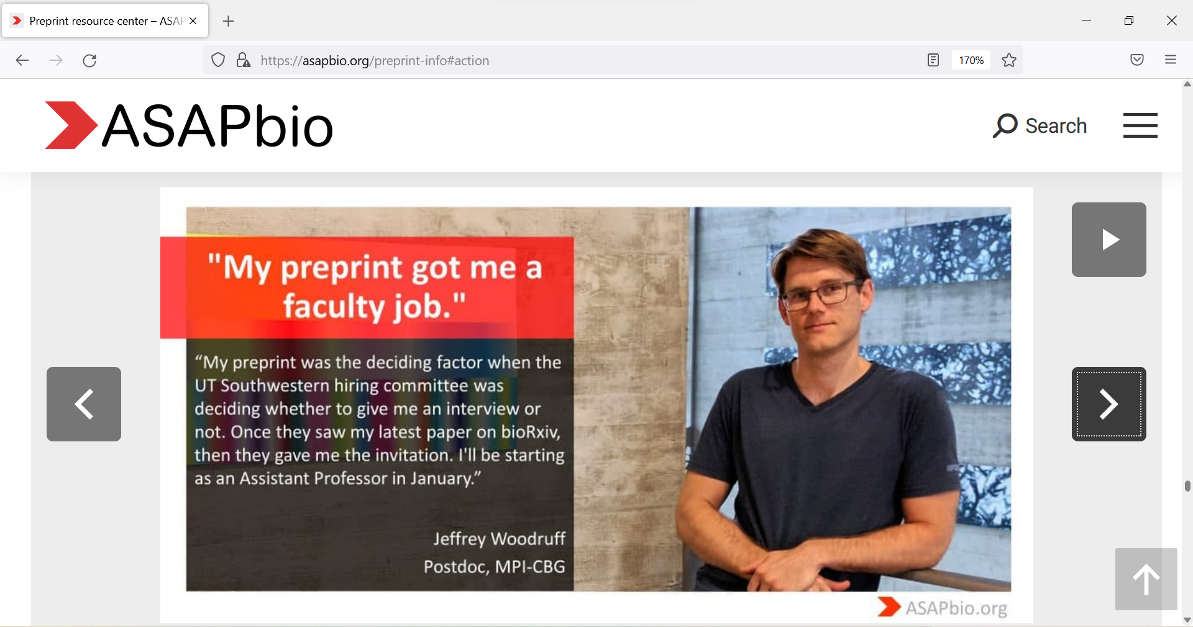
https://asapbio.org/preprint-info#action

Slide 60
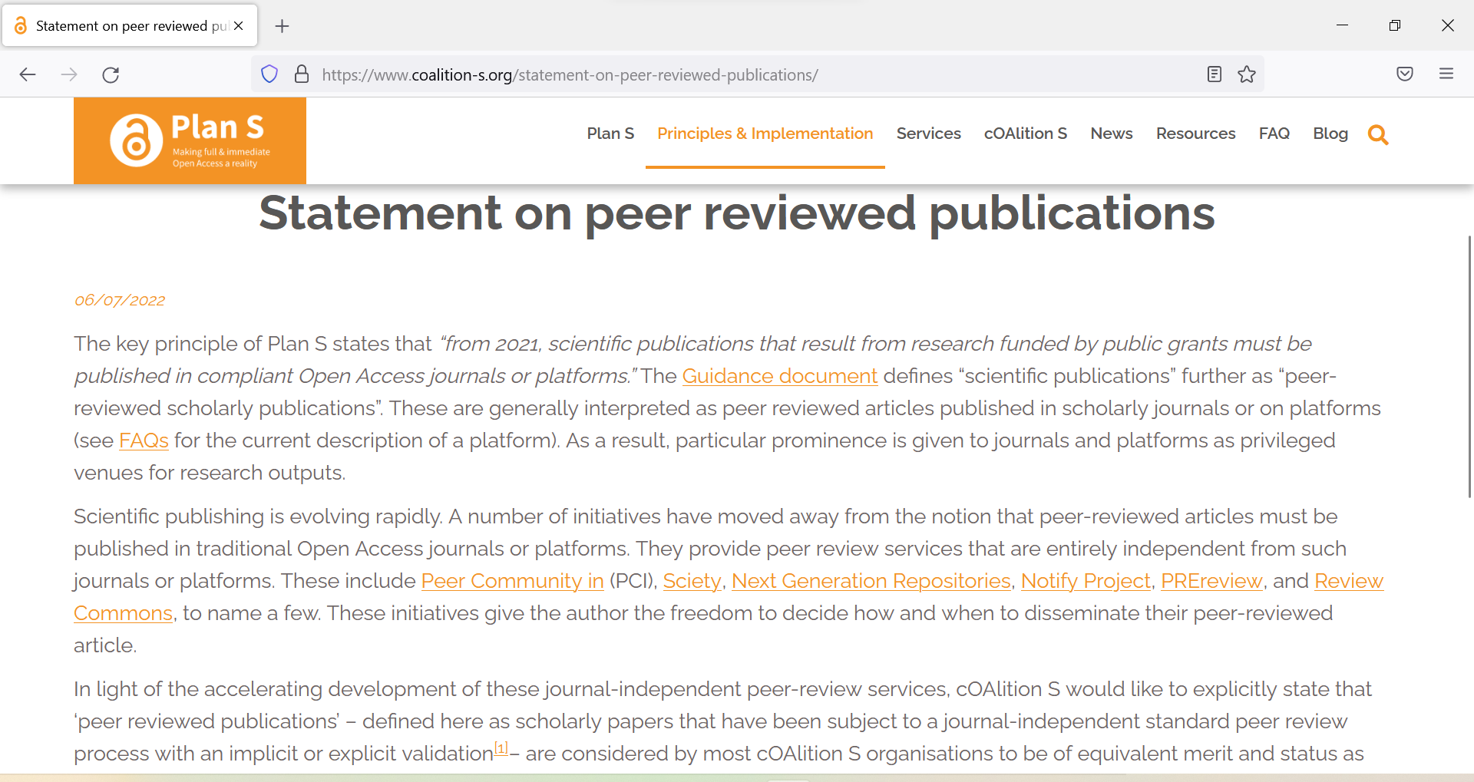
https://www.coalition-s.org/statement-on-peer-reviewed-publications

Slide 61
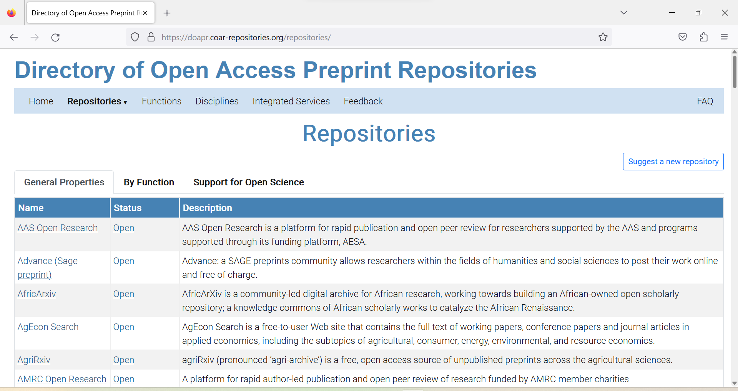
https://doapr.coar-repositories.org/repositories

Slide 62
Questions?

Slide 63
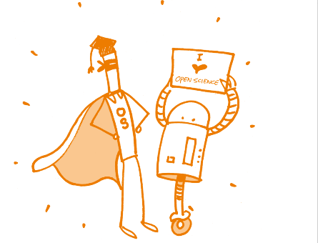
Open Peer Review

Slide 64
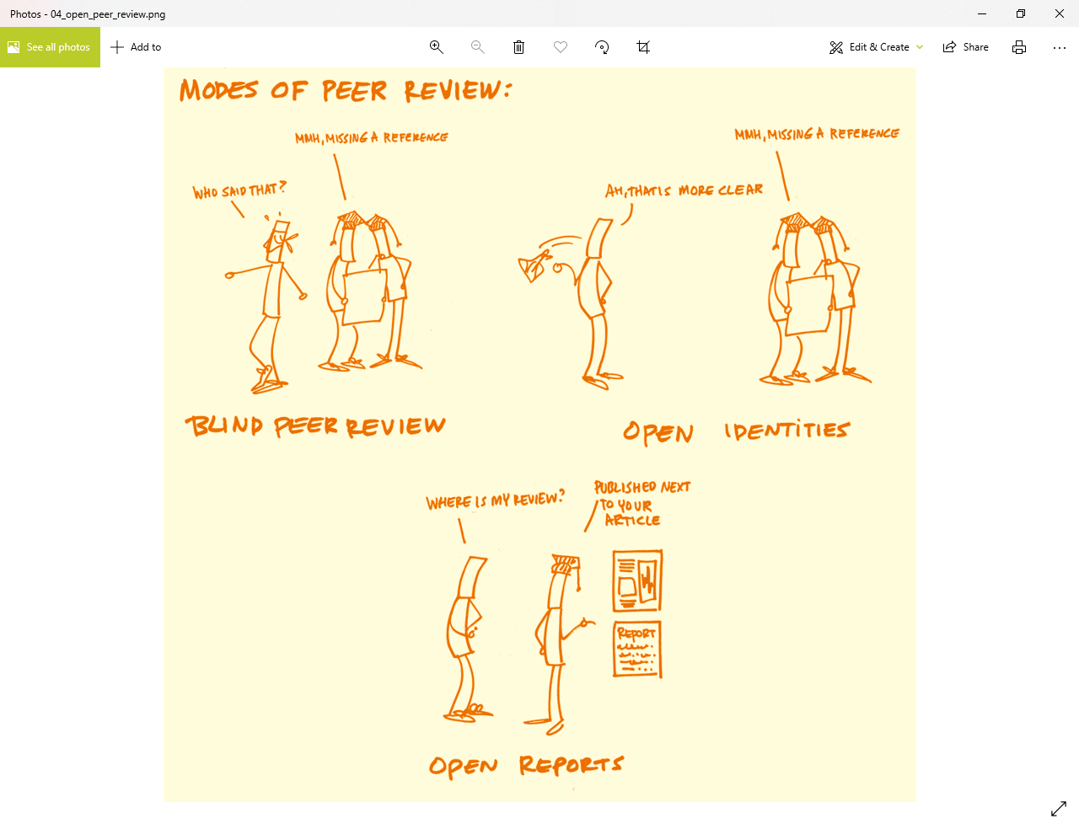
Ross-Hellauer T. What is open peer review? A systematic review [version 2; peer review: 4 approved]. F1000Research 2017, 6:588 (https://doi.org/10.12688/f1000research.11369.2)

Slide 65
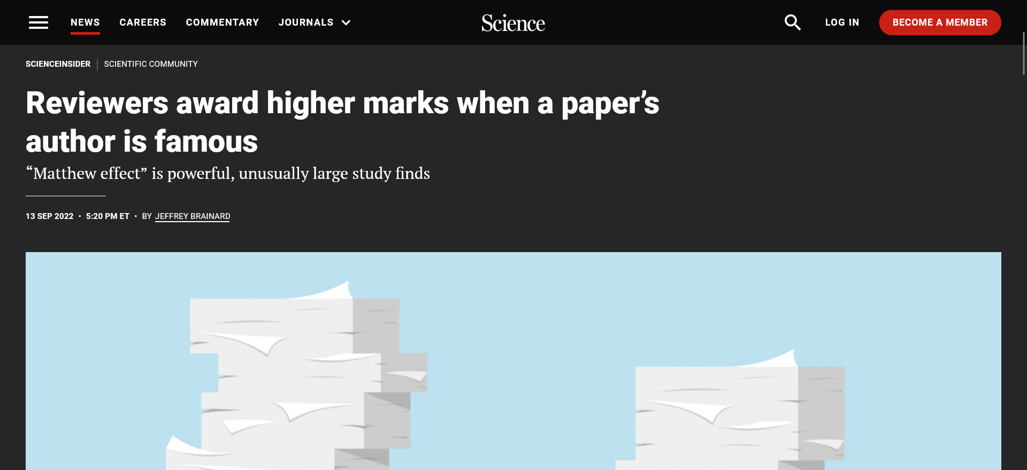
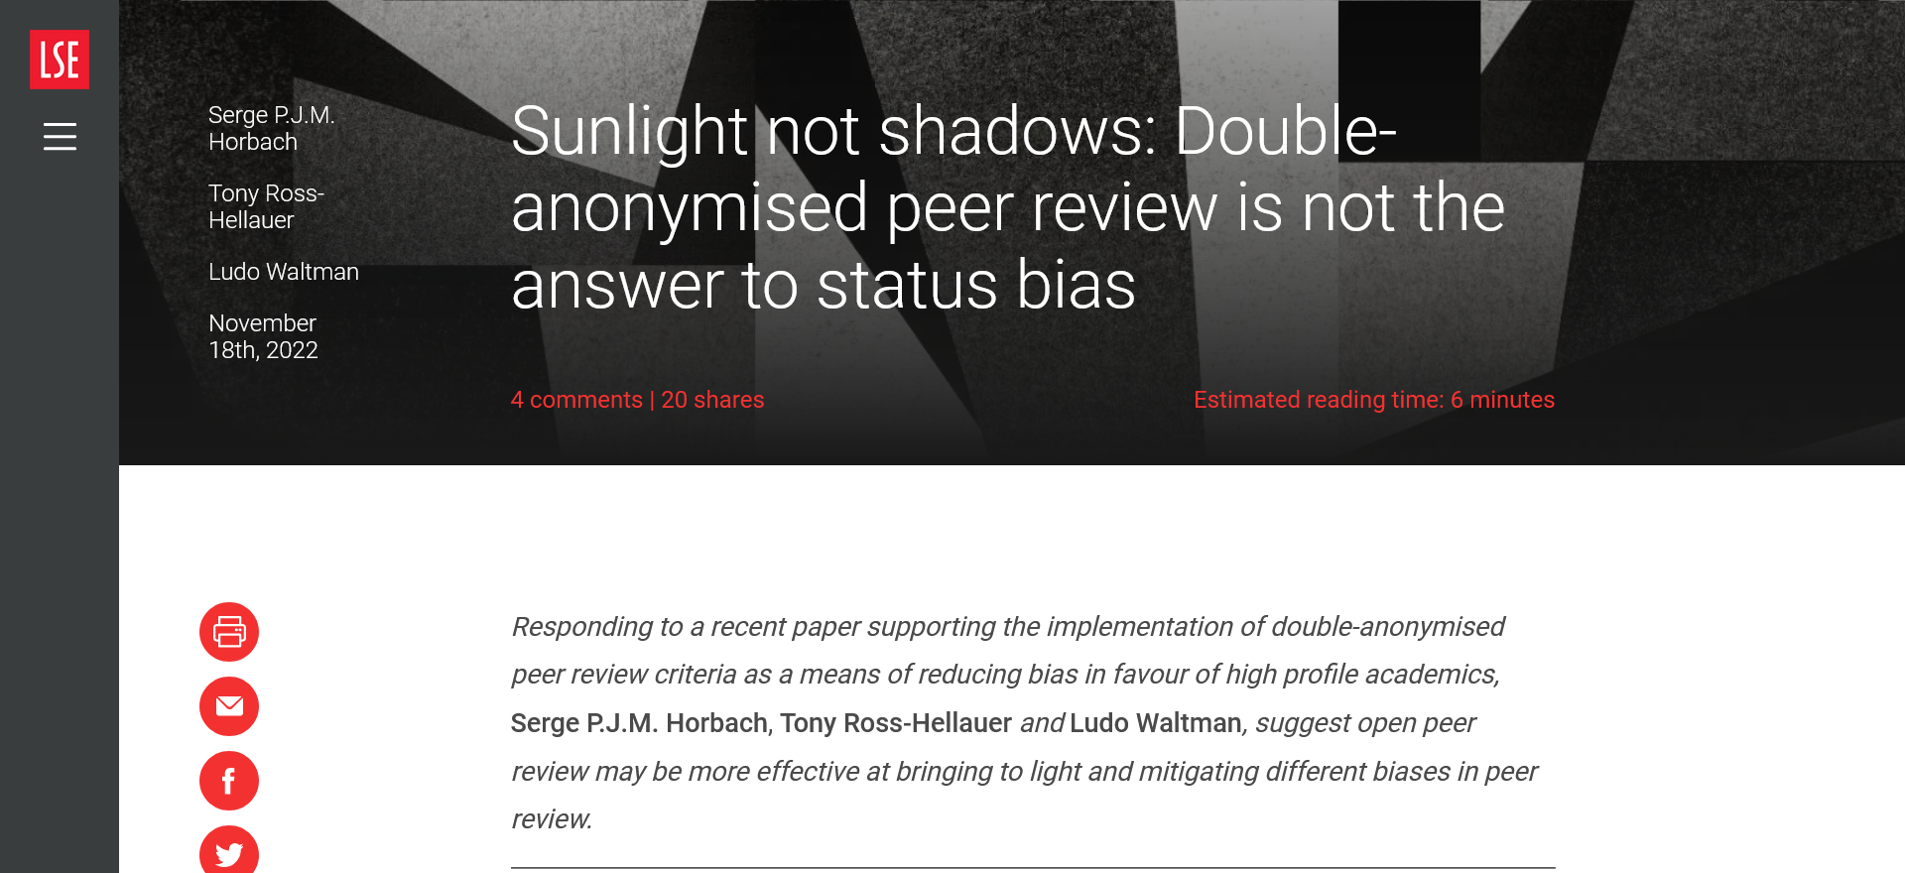
https://www.science.org/content/article/reviewers-award-higher-marks-when-paper-s-author-famous
https://blogs.lse.ac.uk/impactofsocialsciences/2022/11/18/sunlight-not-shadows-double-anonymised-peer-review-is-not-the-answer-to-status-bias/

Slide 66
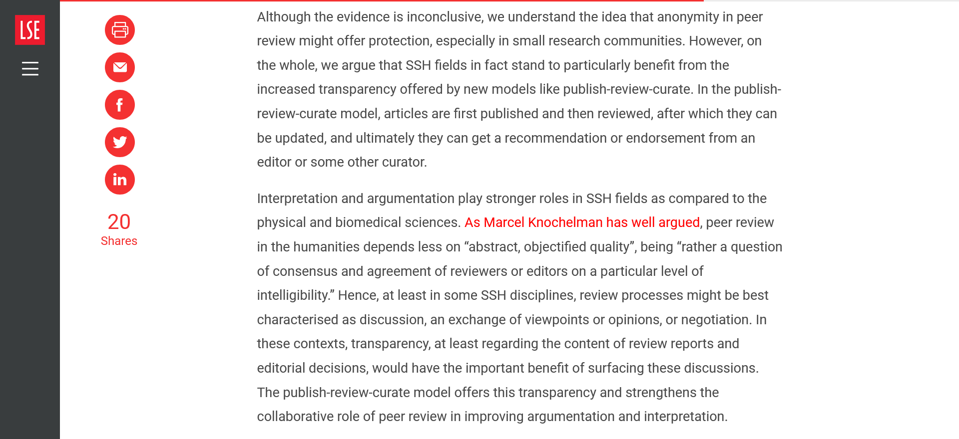
https://blogs.lse.ac.uk/impactofsocialsciences/2022/11/18/sunlight-not-shadows-double-anonymised-peer-review-is-not-the-answer-to-status-bias/

Slide 67
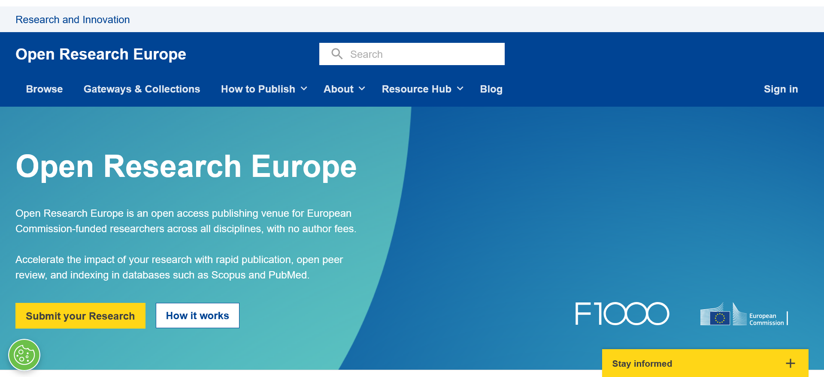
https://open-research-europe.ec.europa.eu

Slide 68
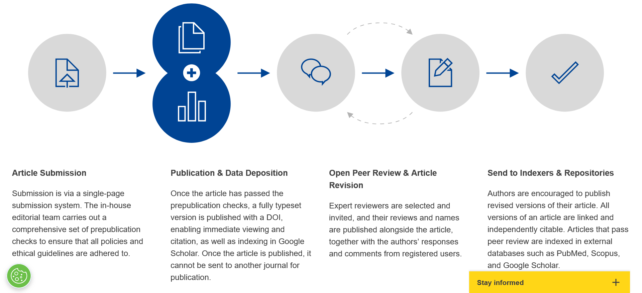
https://open-research-europe.ec.europa.eu/about

Slide 69
https://think.f1000research.com/open-research-europe-submission/open-research-europe-open-peer-review

Slide 70
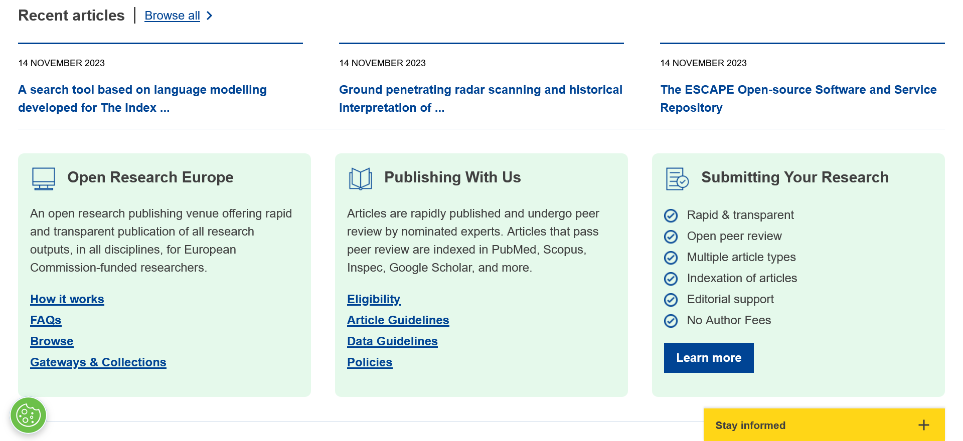
https://open-research-europe.ec.europa.eu

Slide 71
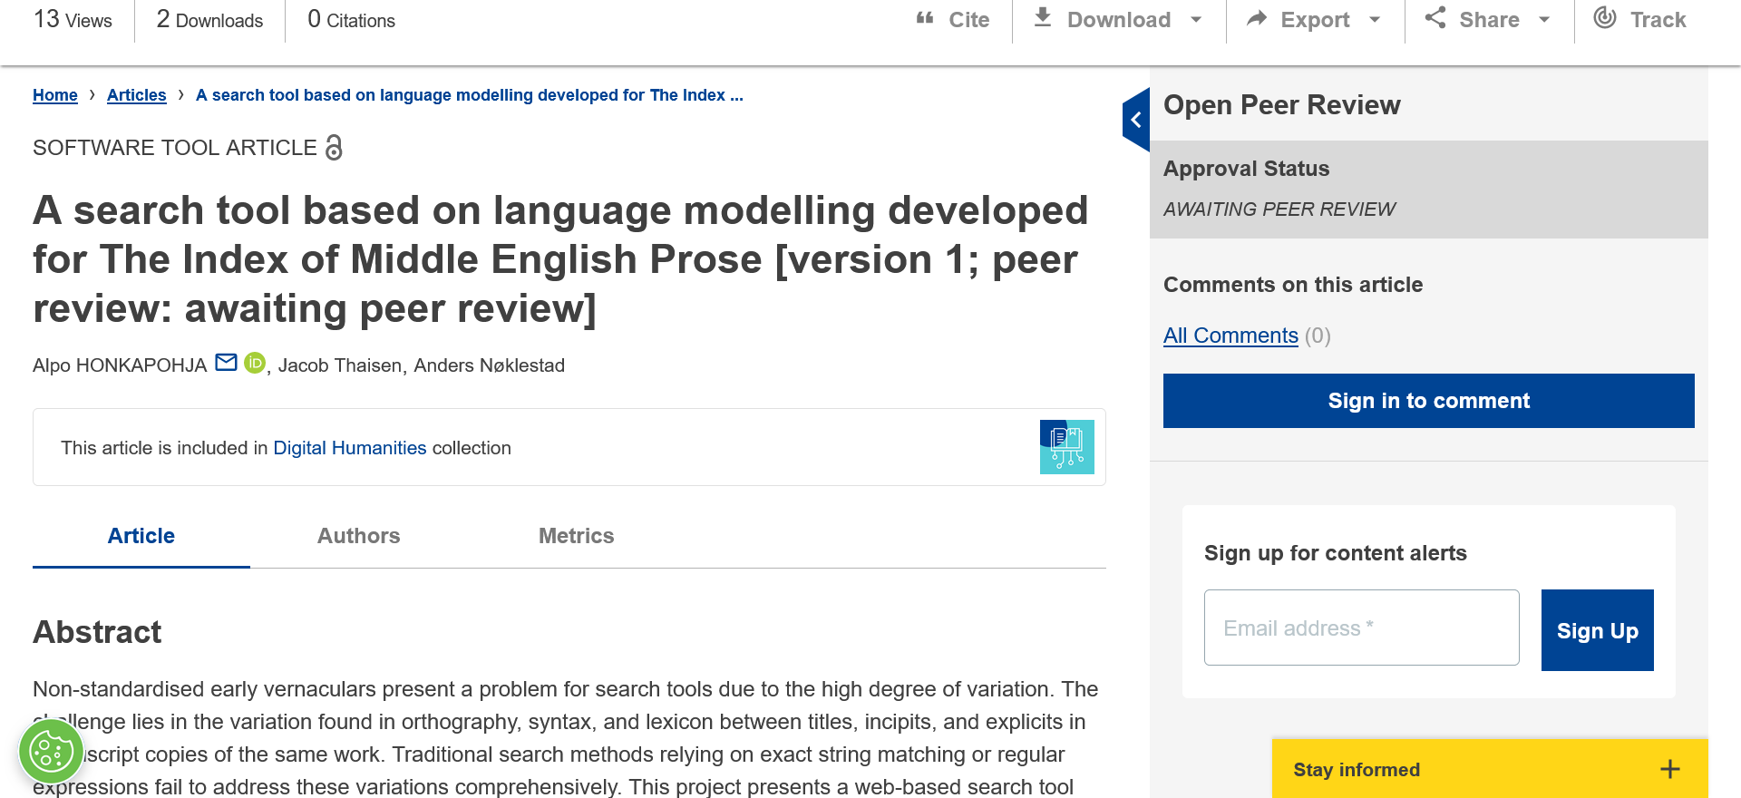
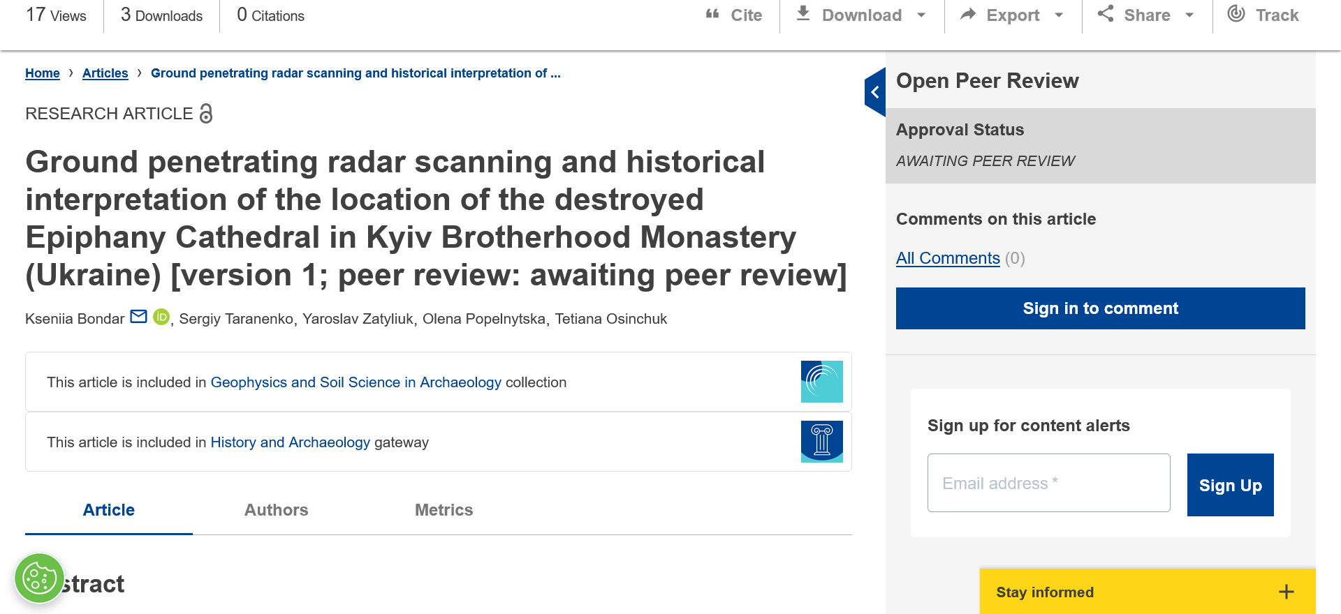
https://doi.org/10.12688/openreseurope.16590.1
https://doi.org/10.12688/openreseurope.16592.1

Slide 72
https://doi.org/10.12688/openreseurope.15692.2

Slide 73
https://doi.org/10.12688/openreseurope.14769.2

Slide 74
https://journals.plos.org/plosone/article?id=10.1371/journal.pone.0272730

Slide 76
Reproducible code and open research software

Slide 77
Reproducible code

Slide 79
The Turing Way Community, & Scriberia. (2020, November). Illustrations from the Turing Way book dashes. Zenodo. http://doi.org/10.5281/zenodo.4323154

Slide 80
https://www.softwareheritage.org

Slide 81
David Schindler, Erjia Yan, Sascha Spors, Frank Krüger; Retracted articles use less free and open-source software and cite it worse. Quantitative Science Studies 2023; doi: https://doi.org/10.1162/qss_a_00275

Slide 82
https://www.researchinformation.info/interview/so-much-current-system-discourages-best-research-practice

Slide 83
“Can you explain briefly how the Octopus model works?
Very briefly, Octopus, funded by Research England and supported by Jisc, allows researchers to publish in smaller units. So, instead of putting a lot of resources into finding a team to collaborate on a project that can be published in a traditional ‘paper’, then dedicating time to writing it up, followed by months of peer review and rewriting, researchers can be much more agile. They can publish idea, protocols, datasets, analyses etc, in a co-ordinated and connected way, and for free.
The idea is to minimise the costs of publishing to help get more work shared (and therefore used), and also to ensure that good work is rewarded – recognising that there are many different forms that research takes these days (such as writing code, designing protocols). It is hopefully more meritocratic and will produce more a robust research base.”
https://www.researchinformation.info/interview/so-much-current-system-discourages-best-research-practice

Slide 84
https://www.octopus.ac/

Slide 85
“You recently talked of your ‘heartbreak’ over how researchers feel about the current publishing system/culture. Could you expand on that?
Although researchers are usually really sold on the idea of Octopus – they see that it is a much better way of doing things than the current system – many don’t feel they have the agency to change to using it. When the University of Bristol interviewed people to find out how they felt about their work and the current system, we heard such terrible stories. People felt that they had to ‘cheat’ and commit ‘questionable research practices’ in order to get publications. The ‘novelty’ of their work and their institution’s reputation were seen as critical to them being published and being able to continue to work as researchers.
It seems that so much in the current system discourages best research practice. Those that want to do things in the best way possible have to fight, to put in a lot of extra (unrewarded) work, to pay fees to make work open and so on. That causes inequities, because you have to be in a privileged position to do all that - such as having a secure job, secure funding, being at a well-resourced institution, or already having an academic reputation and contacts.”
https://www.researchinformation.info/interview/so-much-current-system-discourages-best-research-practice

Slide 86
“How does the Octopus system specifically alleviate researchers’ problems in this regard? And how does it benefit the advancement of science on a wider scale?
Octopus is designed to tackle a lot of those inequalities and reset the incentive structure to ensure that people get rewarded for good work and not for anything else. In the long run, it will change the culture to one that is more collaborative than competitive, and where open sharing and research best practices become the norm. This will mean that knowledge will advance more quickly, and findings will be based on more robust methods and data.
But, in the short and medium term, we have to ensure that researchers get a benefit from using Octopus alongside the traditional publishing system which still controls their careers. Part of that is down to us to make it easy to use and useful, but part of that is also down to institutions and funders, who control researchers’ career prospects, to recognise and reward those who are demonstrating best practice within Octopus (such as those sharing data and code, pre-registering their hypotheses or methods, or peer reviewing).”
https://www.researchinformation.info/interview/so-much-current-system-discourages-best-research-practice

Slide 87
https://coara.eu

Slide 88
https://www.heliosopen.org/

Slide 89
https://ec.europa.eu/info/funding-tenders/opportunities/docs/2021-2027/horizon/guidance/programme-guide_horizon_en.pdf

Slide 90
Recommended open science practices
Involving all relevant knowledge actors, including citizens, civil society and end users in the co-creation of R&I agendas and contents (such as citizen science)
Early and open sharing of research, for example, through preregistration, registered reports, pre-prints, or crowd-sourcing)
Research output management beyond publications and research data
Measures to ensure reproducibility of research outputs
Providing open access to research outputs beyond publications and research data (for example software, models, algorithms, and workflows)
Participation in open peer review
https://ec.europa.eu/info/funding-tenders/opportunities/docs/2021-2027/horizon/guidance/programme-guide_horizon_en.pdf
https://ec.europa.eu/info/funding-tenders/opportunities/docs/2021-2027/common/guidance/aga_en.pdf

Slide 91
https://eu-citizen.science

Slide 92
“Lastly, looking forward, how would you like to see the scholarly communications ecosystem develop over the next few years?
I’d like to see a move to recognising that a pdf of words and graphs is not the best way to share, or to assess the quality of, a lot of contemporary research work. We should think about the vast range of skills and roles that we need in our research community, how best to reward people for developing them, and how best to bring them together to work on research problems.
The digital tools at our disposal are incredibly powerful – people can work together across space and time, communicate despite language differences, and AI can help do what would have taken humans inordinate amounts of time. But, if researchers are not getting rewarded for sharing digital assets or communicating their real experience, this will all be lost and we’ll be condemned to repeat mistakes and learn from scratch over and over.
Researchers will continue to be unhappy and feel they cannot ‘afford’ to do things ‘right’.”
https://www.researchinformation.info/interview/so-much-current-system-discourages-best-research-practice

Slide 93
Misconception: Open Science is mainly pain with little gain
There’s no denying that getting acquainted with new ways of working costs time. But at the end of the day, it will also save you time. For instance, preregistration forces you to consider issues that could otherwise have bitten you in the ass afterwards (e.g., a lack of statistical power). Moreover, a detailed plan allows for a swift analysis once the data comes in. There is an increasing number of open-source tools available that will help you make your workflow more reproducible and efficient at the same time. And there’s another gain for those interested in an academic career: more and more universities and funders are seeking candidates who implement Open Science practices in their work.
https://openscience-groningen.nl/10-open-science-myths

Slide 94
What researchers/students can do
Deposit a preprint in a preprint repository
Publish their papers open access
Share their data, especially data underpinning a paper they published
Upload their scientific code / scripts / models openly in a code repository
Tell other researchers and students about open science
Help develop and implement an open science policy for their organization

Slide 95
https://openclimatecampaign.org

Slide 97
Questions for researchers
Do you practice open science? Which aspects?
Are there any open science practices that you would like to try this/next year?
What would you need to do so?

Slide 98
https://www.osc-international.com

Slide 99
Thank you! Questions? Your thoughts? Your questions and also difficult questions you receive from others
Contact: iryna.kuchma@eifl.net
www.eifl.net

