Slide 1
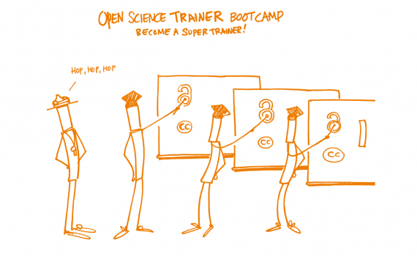
EIFL OPEN SCIENCE TRAIN-THE-TRAINER BOOTCAMP
January 30th - February 3rd 2023
REPOSITORIES
Ljiljana Radisavljević
Librarian and Repository Manager
Institute for Vegetable Crops Smederevska Palanka
SERBIA
Part of the team of the end-user support at the Computer Centre of Belgrade University
picture: https://www.eifl.net/events/eifl-open-science-train-trainer-bootcamp

Slide 2
What is repository?
an archive for collecting, preserving, and disseminating digital material
sort of digital library
(collecting, classifying, describing, curating, preserving, and providing access)
true power of repositories lies in:
open access (Open access - Wikipedia)
(free, immediate and permanent access to digitalized documents for anyone to use, download and distribute respecting the authorship rights)
interoperability (information exchange) - connecting and tying together - the ability to interact

Slide 3
Typology
Institutional (Institutional repository - Wikipedia) - contains intellectual output of an institution, particularly a research institution
Thematic / Disciplinary - material in the same scientific field (chemistry, biology, spacial planning…) for example: AquaDocs
Generalist - general purpose open repositories - enable researchers from all disciplines to share and preserve their research outputs, regardless of size, format or subject.
(Zenodo, Figshare, etc.)

Slide 4
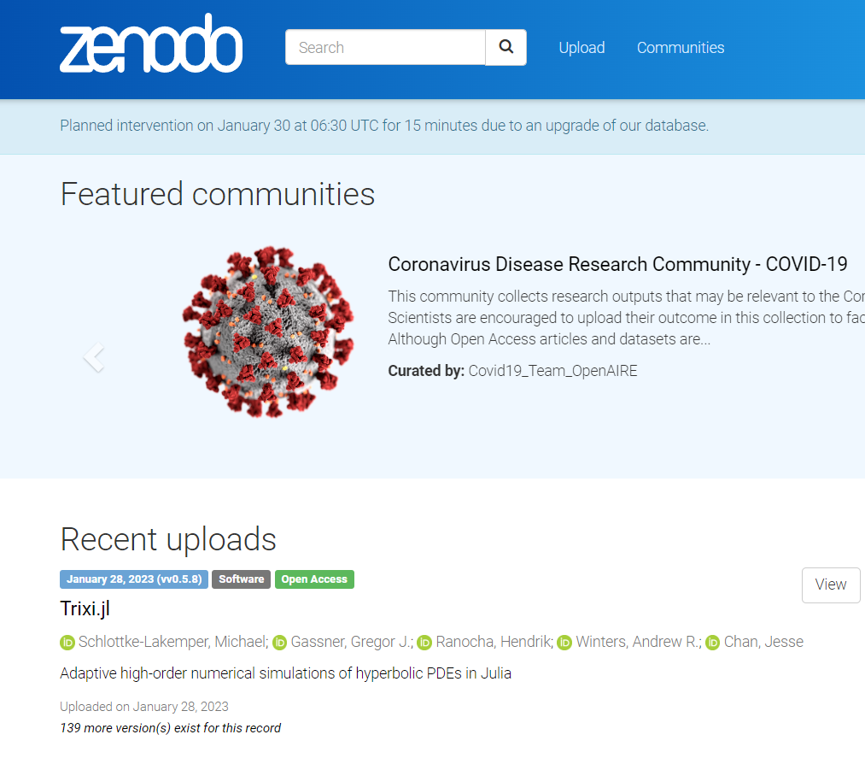
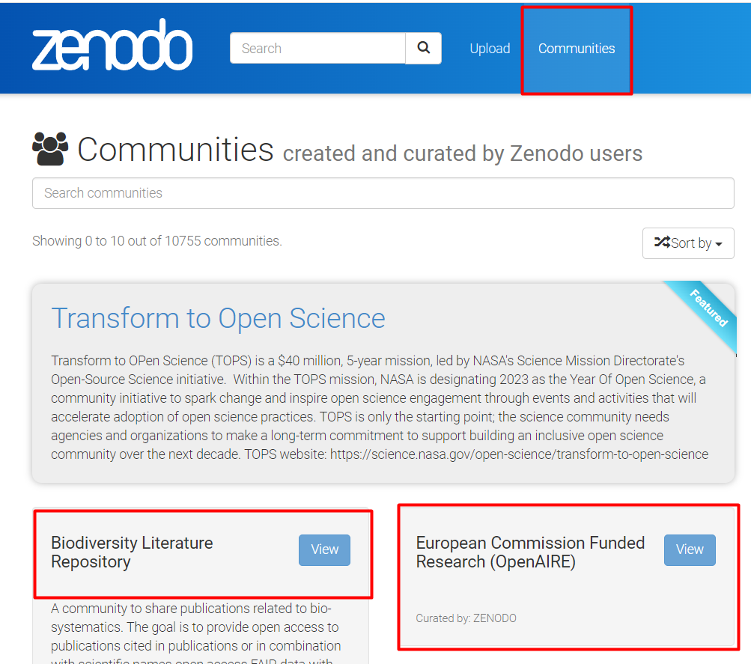

Slide 5
Context | Audience | Format | Topics
No institutional repository | Researchers | Lecture Demo | Benefits of Open Access / Open Science Repositories and visibility Good practice examples Repositories vs. social media Zenodo Q&A
Institutional repository | Repository managers | One-on-one training Hands-on training Consultations | OA policies and mandates (in detail) Self-archiving policies, VoR/AAM, Sherpa Romeo (in detail) Procedures (depositing, approving deposits, metadata corrections and updates, additional tools and services) Tips and tricks
 | Researchers | Lecture Demo Hands-on training | OA policies and mandates (brief intro) Repository features and functions Depositing Self-archiving, VoR/AAM, Sherpa Romeo (brief intro) Visibility, interoperability and integrations (aggregators, ORCID, Google Scholar) Repositories vs. social media; repositories vs. failed national CRIS systems Q&A + deconstructing misconceptions
 | Decision- makers | Lecture Consultations | OA policies and mandates Repository features and functions (brief intro) Visibility, interoperability and integrations
Table by Milica Ševkušić: https://docs.google.com/presentation/d/1CQSWYOAvryK-ZCMxXy_Gwg8aSoyeCexx_e_qvnjeO2I/edit#slide=id.g7a1c1ab41f_0_21

Slide 6
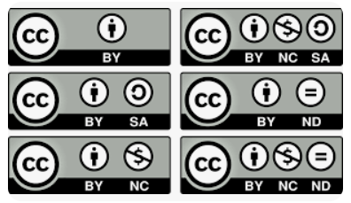
How to structure the training
Basic information about the repository
What is available to unregistered users
What is available to registered users?
How to search
How to register
How to deposit / submit (entry of metadata and document)
Copyright, licenses, data protection
Which version of the publication may be deposited in the repository?
Visibility
User support

Slide 7
How to prepare training materials
Detalied material with screenshots
Separate material for RM and end-users
User - manual (for RM and for Researchers)
Internal share of training videos
Publicaly available if agreed so

Slide 8
For Repository Managers
One-on-one trainings
Hands-on trainings
As many training as they need
Consultations
Zoom meetings with possibility to record
User manual for repository managers, on Google Drive, easily updated and extensible: https://bit.ly/3tpUQQp

Slide 9
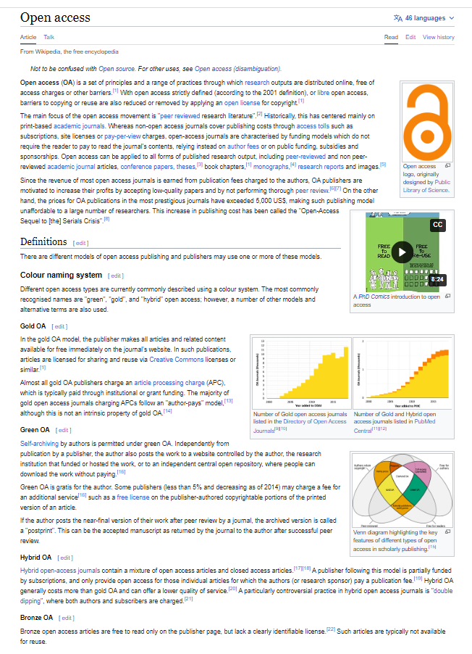
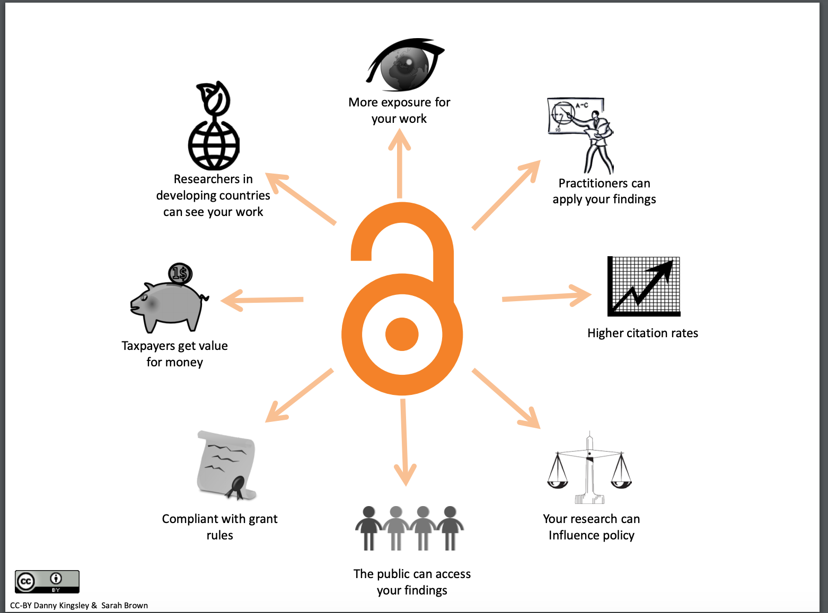
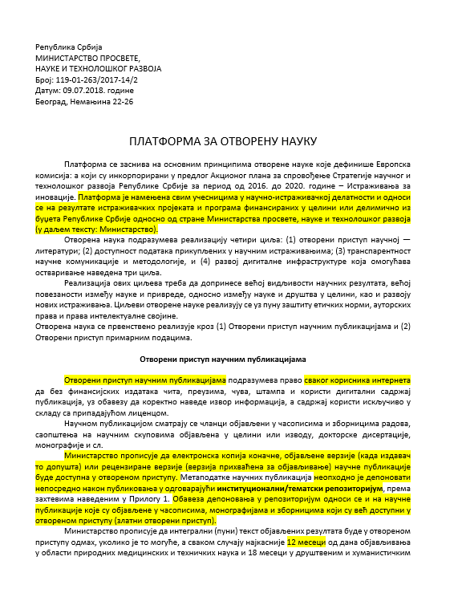
Open access policies and mandates in detail

Slide 10
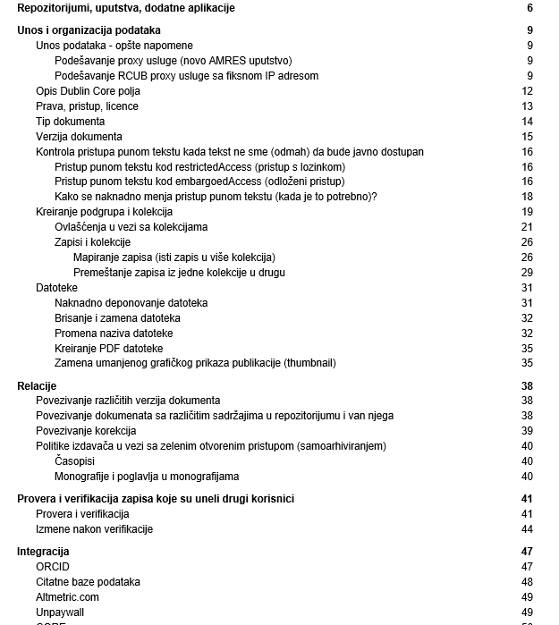
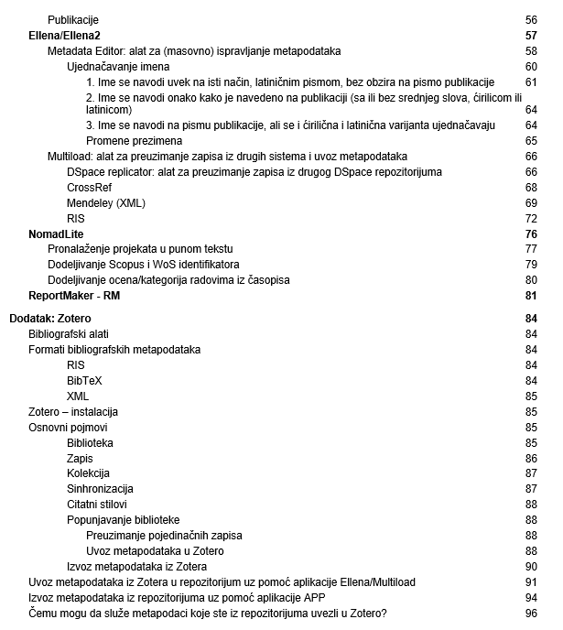
Trainig material
For repository managers:
Detailed USER MANUAL - constantly updated as the system grows

Slide 11
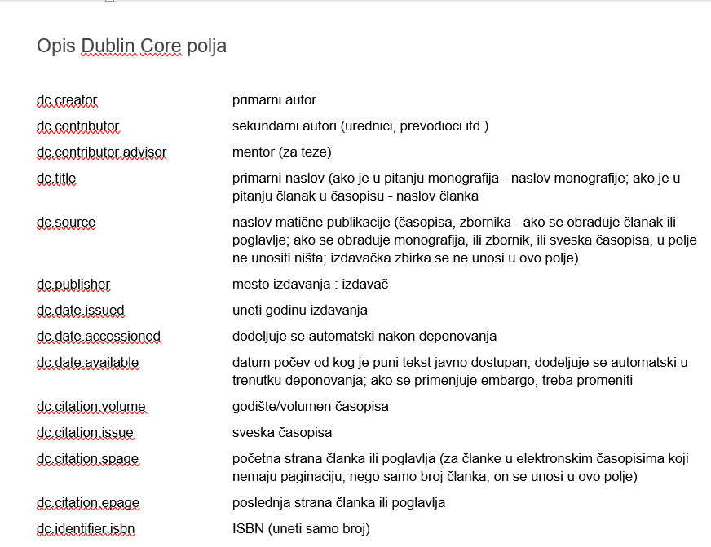
Dublin Core fields explained in detail:

Slide 12
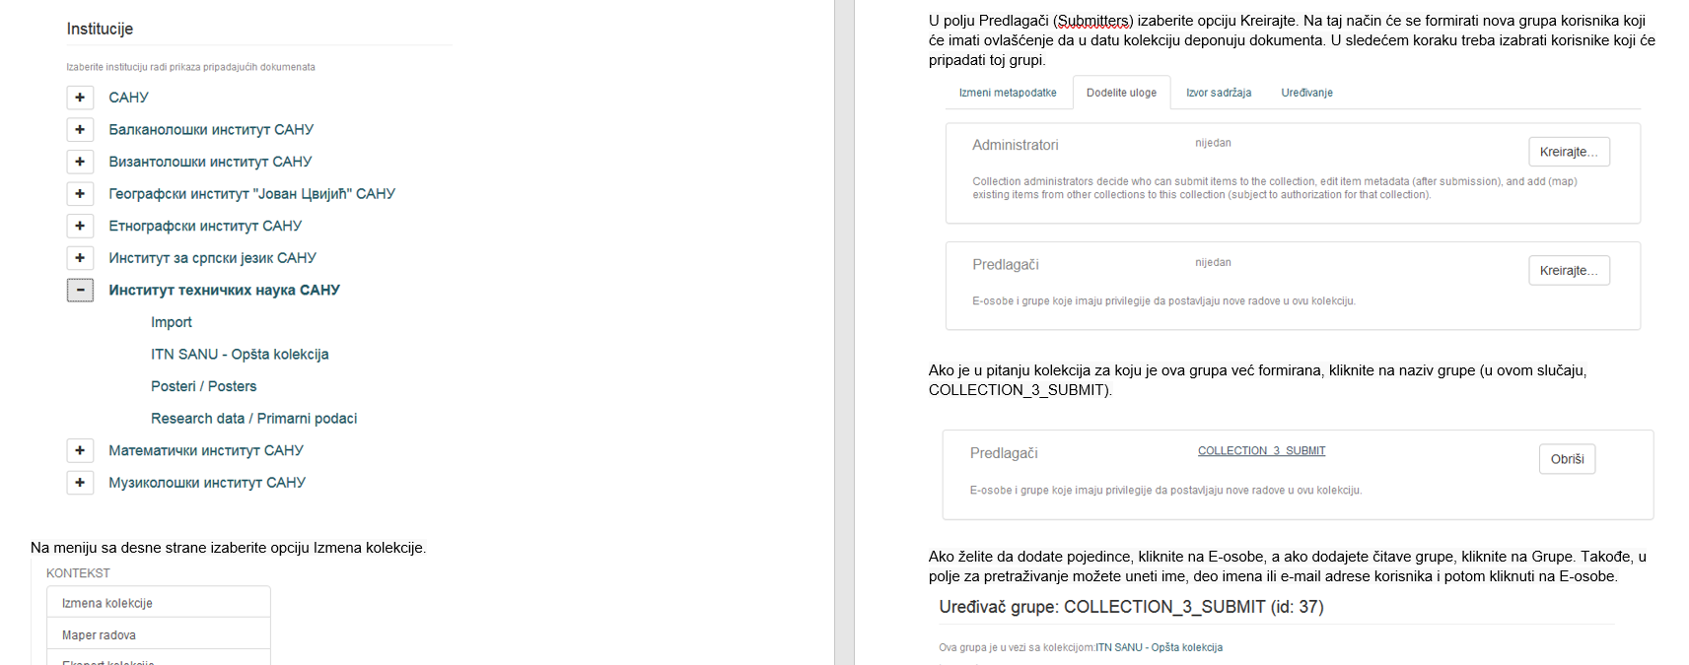
How to make collections and give privileges to registered users

Slide 13
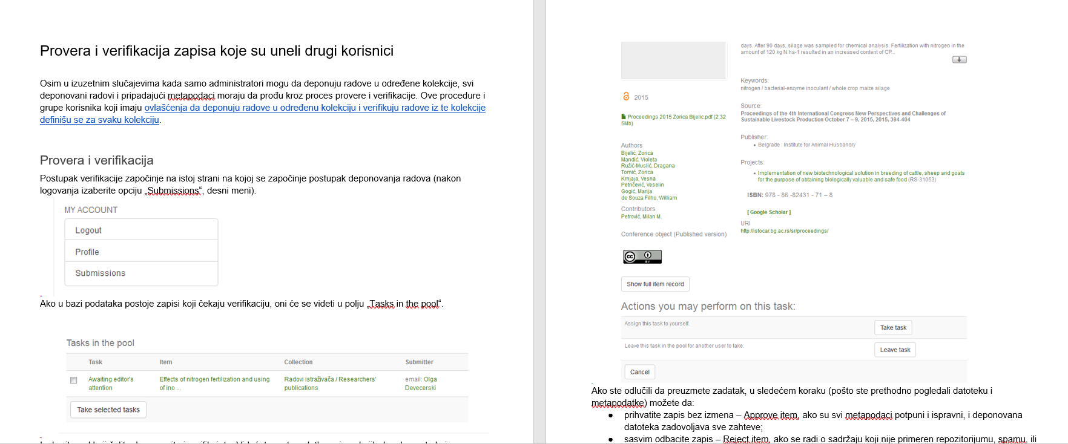
Procedures (depositing, approving deposits, metadata corrections and updates)

Slide 14
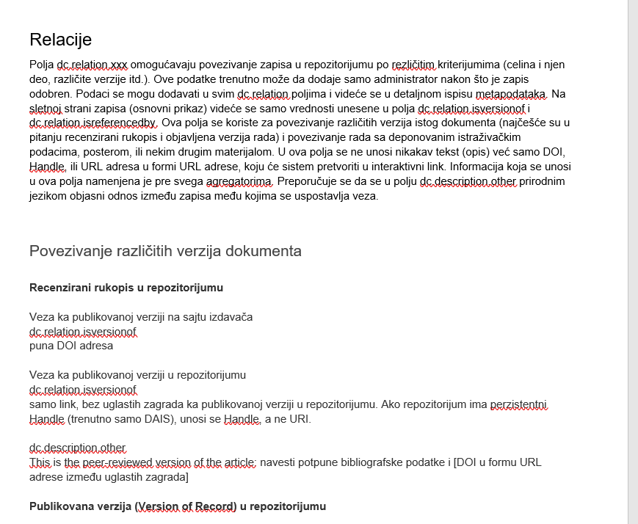
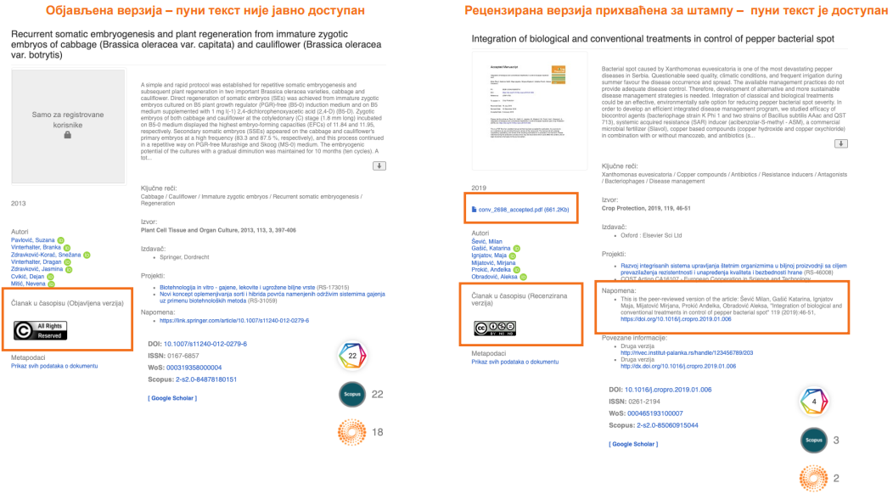
Different versions of manuscripts and how to relate them (AAM, VoR)

Slide 15
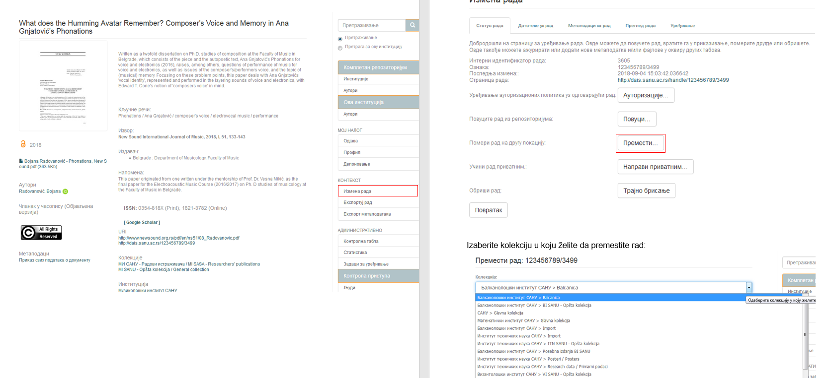
How to map an item in other collections

Slide 16
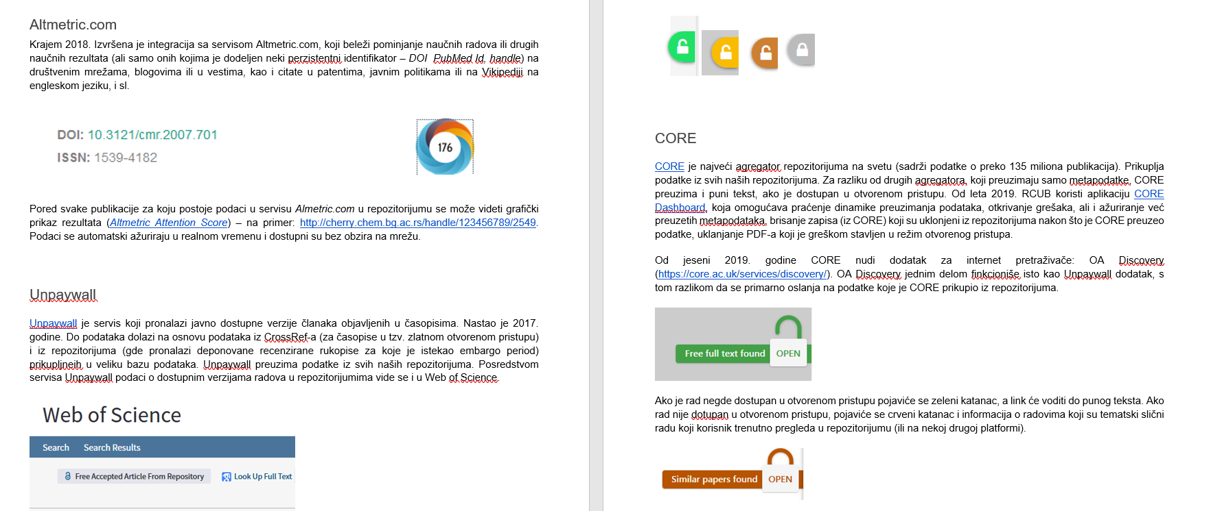
Additional detailed information about other services, such as: Scopus, Web of Science, Core, Unpaywall ...

Slide 17
For Researchers
OA policies and mandates (brief intro)
Repository features and functions - User manual
Depositing
Self-archiving, VoR/AAM, Sherpa Romeo (brief intro)
Visibility, interoperability and integrations (aggregators, ORCID, Google Scholar)
Repositories vs. social media; repositories vs. failed national CRIS systems
Q&A + deconstructing misconceptions

Slide 18
User manual as a training material
Using open-source software and crowdsourced materials to create a manual:
software: locally hosted MediaWiki;
in case hosting is not available, alternatives include free mediawiki hosting options (https://biowikifarm.net/meta/Biowikifarm, https://miraheze.org/, https://neowiki.neoseeker.com/wiki/Alternative_To_Wikia)
Materials created by multiple trainers over a period of two years are compiled and edited.
Advantages: no cost, easy to edit and update, unlimited space for extensible materials

Slide 19
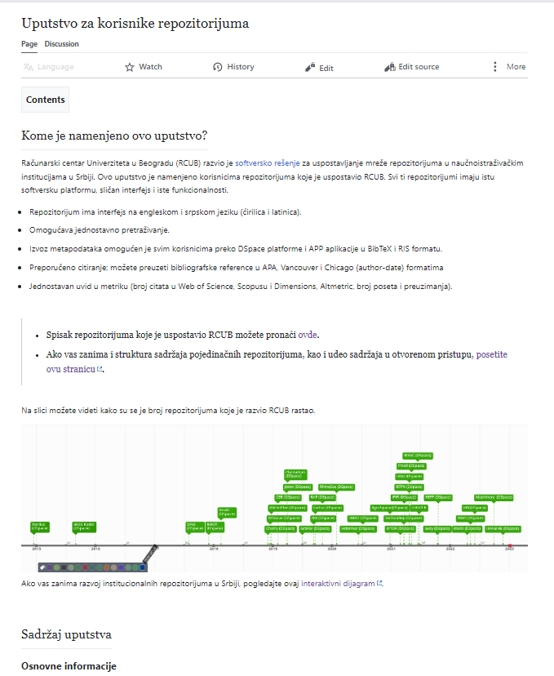
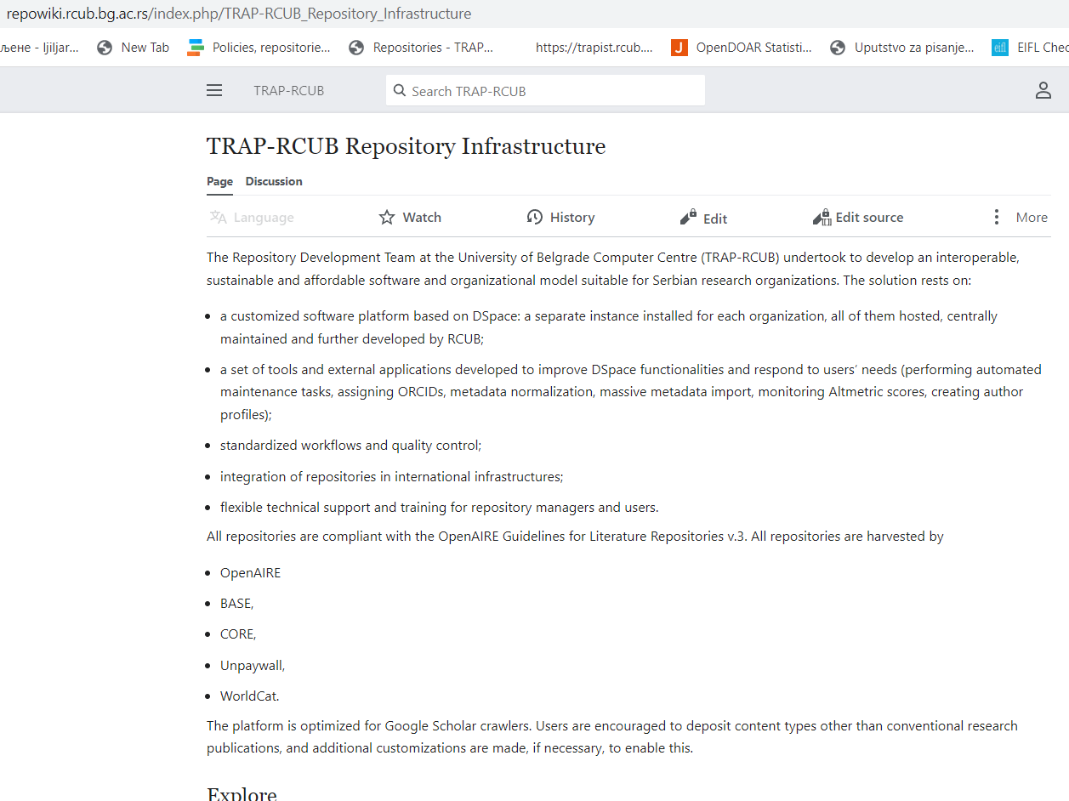
User manual - online
https://repowiki.rcub.bg.ac.rs/index.php/Uputstvo_za_korisnike_repozitorijuma
https://repowiki.rcub.bg.ac.rs/index.php/TRAP-RCUB_Repository_Infrastructure

Slide 20
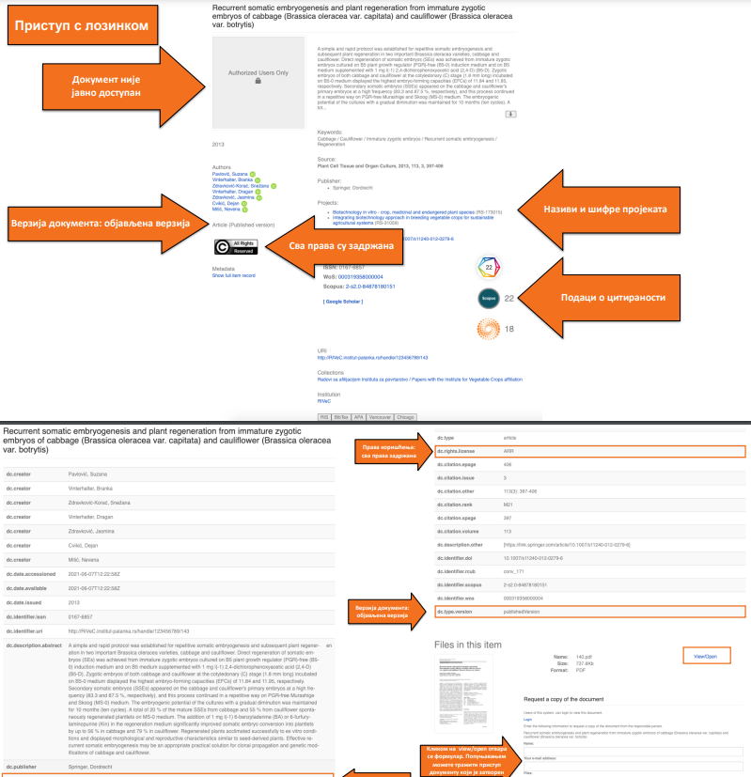

Slide 21
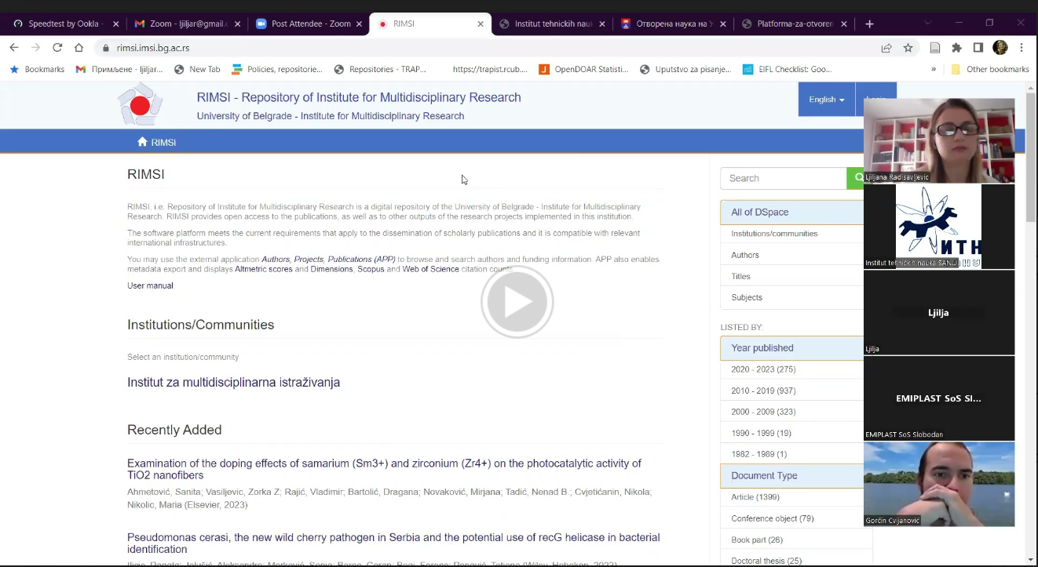
Zoom video calls - proved to be a very useful tool
Photo by Chris Montgomery on Unsplash

Slide 22
Training challenges
Photo by Agence Olloweb on Unsplash

Slide 23
Misconceptions about copyright
Researchers think they can not publish unless they transfer their copyrights to publishers
Solution:
Good knowledge of
OA policies;
Rights Retention Strategy;
intellectual property

Slide 24
One trainer and many trainees and questions
Many topics - not enough time
Wide range of important things to know
Too many questions, not enough time to reach to everyone
Solutions:
Team work
Include Librarian (RM)
Always anser questions for the chat
User support
Follow-up trainings

Slide 25
Challenge: technical issues
no internet connection
PDF user manual
slides to play off line
help from your team - someone from your team can “step in”
alternative communication chanel (viber)
no electricity
printed material

Slide 26
Not the same level of knowledge
Researchers
Not keeping track of all new issues regarding publishing
Possible solutions:
follow up trainings regarding other issues
Training of the young academics and researchers
Repository managers
Not motivated for another obligation
Not educated in this field and unable to understand

Slide 27
Why deposit?
Increase impact - higher chance to get cited
Increase opportunity - more collaboration and funding
Increase readership - making research freely available to readers
Increase visibility

