Slide 1
Open Access Publishing
Milica Ševkušić, EIFL
EIFL Open Science Bootcamp

Slide 2
Outline
Concepts of training on Open Access publishing
Intellectual property rights (copyright, self-archiving, rights retention)
Diversity of Open Access publishing models
Gold Open Access
Hybrid Open Access
Diamond Open Access
What about books?
Emerging areas
Open peer review
Preprints and innovative publishing platforms
Bibliodiversity

Slide 3
Training challenges
Complexity of IPR issues
Poor understanding of IPR
Complexity of OA business models (many “colours”)
Terminology (preprint, postprint, preproof, AAM, VoR, etc.)
Confusing and misleading guidance to authors (provided by publishers)
Misconceptions
Reliance on peer advice
Reconciling OA and promotion criteria

Slide 4
Training topics: usual concept
Publication versions (VoR, AAM, postprint, preprint)
Self-archiving policies & Sherpa/Romeo
Licences and copyright + embargo
Repositories
Misconceptions
Funder requirements
Rights retention
SELF-ARCHIVING
or
Green Open Access
mitigate
PUBLISHERS OWN COPYRIGHT
PUBLISH IN OPEN ACCESS
Gold OA
Hybrid OA
Diamond OA
Publishing fees (APC/BPC)
Waivers and discounts
Double dipping
Disputable (“predatory”) journals
Think. Check. Submit
Journal Checker Tool
Misconceptions about OA publishing
No-fee OA publishing options
Copyright and licences
Funder requirements
Plan S (Europe)
avoid
avoid
ORE
PREPRINTS
The future of scholarly publishing
Open peer review
Open science as a context
Bibliodiversity
Research evaluation
OPEN ACCESS POLICIES
Research outputs must be publicly available
Notes:
A common concept of training on Open Access publishing: mitigating the situation
Initial assumption: “Publishers own copyright. This is natural and it has always been so.”
But Open access policies (defined by funders, institutions, government, etc.) require us to make our publications publicly available.
What shall we do?
We can try to make compromise and self-archive our publications in a repository.
We can also try to avoid copyright transfer by publishing in an Open Access journal or on a OA platform. We may also publish a preprint.
The boxes on the right show the topics we usually cover when training about particular types of Open Access publishing.

Slide 5
Rights retention
Misconceptions about IPR
Funder requirements
Plan S (Europe)
Licences
Self-archiving policies & Sherpa/Romeo & no embargo
Journal Checker Tool
Training topics: focus on copyright
PREPRINTS
ORE
The future of scholarly publishing
Open peer review
Open science as a context
Bibliodiversity
PUBLISH IN OPEN ACCESS
Gold OA
Hybrid OA
Diamond OA
AUTHORS OWN COPYRIGHT
Publishing fees (APC/BPC)
Waivers and discounts
Double dipping
Disputable (“predatory”) journals
No-fee OA publishing options
PUBLISHERS OWN COPYRIGHT
due to copyright transfer
SELF-ARCHIVING
or
Green Open Access
Publication versions (VoR, AAM, postprint, preprint)
Repositories
Self-archiving policies & Sherpa/Romeo
Licences & copyright
OPEN ACCESS POLICIES
Research outputs must be publicly available
Notes:
Shifting focus to copyright and rights retention: preventing full copyright transfer to make OA easier
Let’s not forget that authors are the original owners of copyright. Publishers become copyright holders only if authors transfer the rights by signing a written agreement.
Open Access publishing is not an option inferior to publishing in subscription-based journals but a legitimate choice of an author.
First train authors to become more aware of Intellectual Property Rights and to know how to retain copyright, and only then explain various publishing options.

Slide 6
Intellectual property rights

Slide 7
Who owns copyright?
According to the IPR legislation, the intellectual property belongs to the author, who is ‘the first owner of copyright’.
In case copyrighted materials are created by employees as part of their employment duties (work for hire), there is usually an agreement between the employee and the employer and in most cases copyright belongs to the employer.
Researchers = authors
Researchers’ institutions = employers
Publishers ≠ (researchers’) employers
Publishers own copyright only if authors sign off their rights (by signing the copyright transfer agreement).

Slide 8
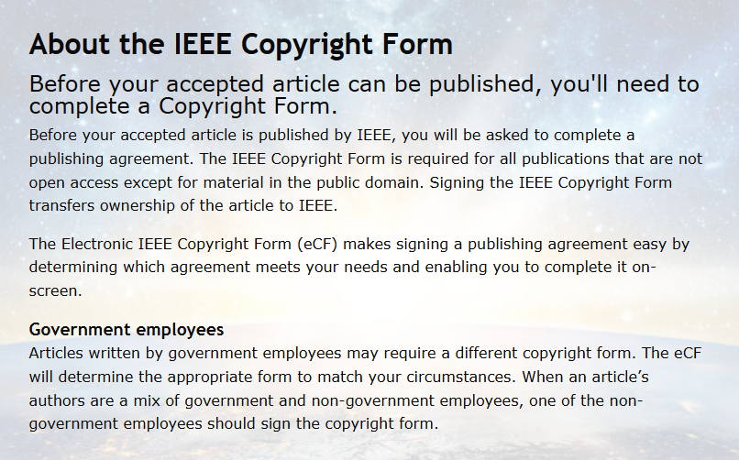
Copyright transfer agreement
The author transfers the monetary rights.
Authors are often required by publishers to transfer copyright (sometimes even by OA publishers).
Due to this they can’t make the published version of the publication publicly available.
They often have to ask permission from publishers to reuse their own publications (or their parts).

Slide 9
The author who has retained copyright can:
Rights retention
reuse the publication
translate it
distributed under a licence of their choice
Even in case of copyright transfer, the author can retain some rights.

Slide 10
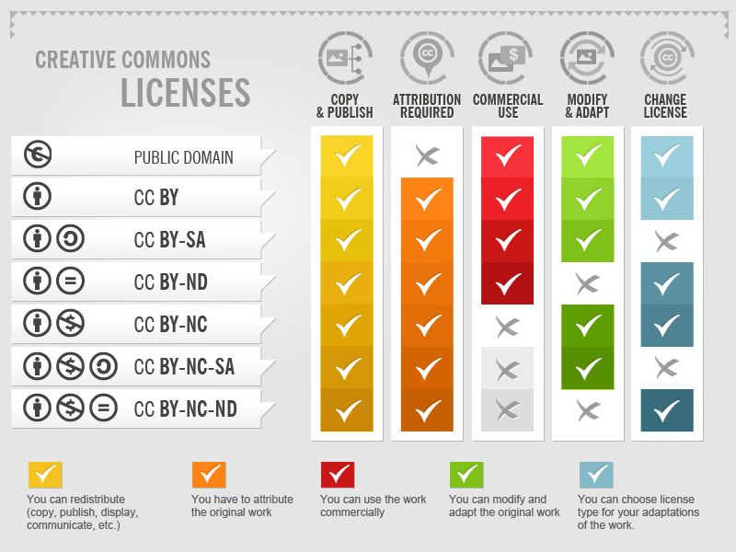
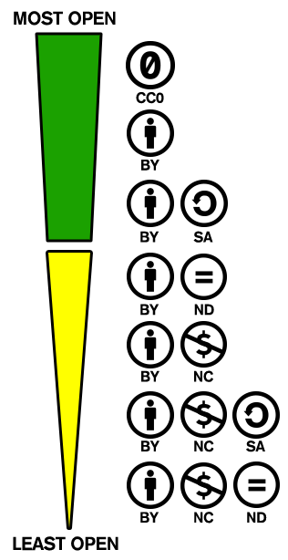
Creative Commons licences
Creative Commons licenses, Foter (CC-BY-SA)
https://creativecommons.org/spectrum-with0/

Slide 11
Self-archiving and rights retention

Slide 12
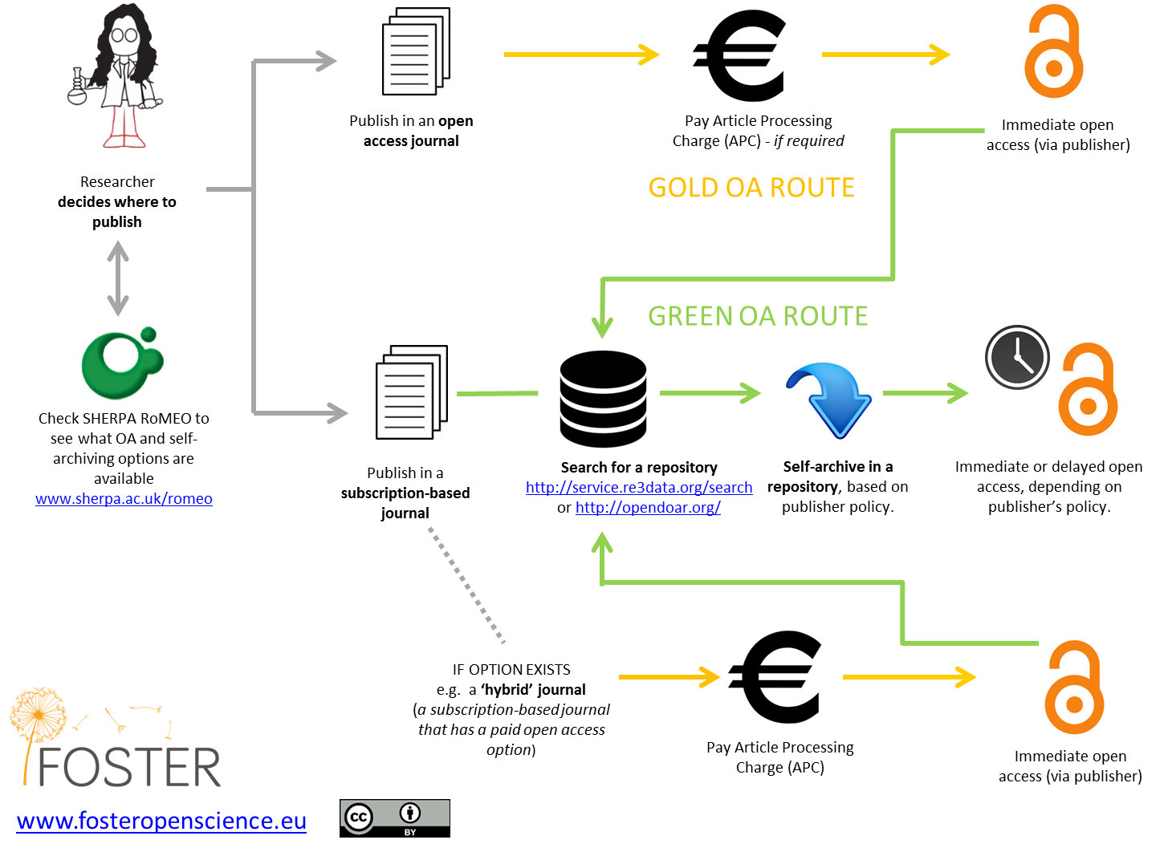
Green Open Access

Slide 13
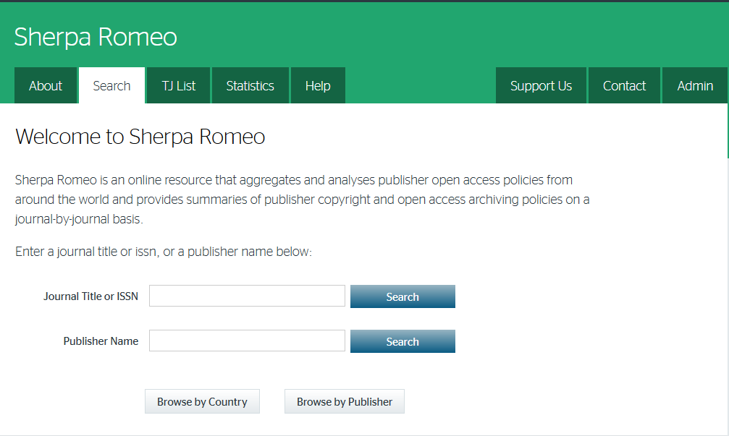
Legal basis for self-archiving
Even is the author has transferred copyright to a publisher, the ownership of a manuscript ≠ the ownership of copyright.
Journal policies and copyright transfer agreements usually make provisions for self-archiving.
Sherpa Romeo: a searchable database of self-archiving policies.
Check journal websites, too.
Self-archiving for books is still a vague area
https://v2.sherpa.ac.uk

Slide 14
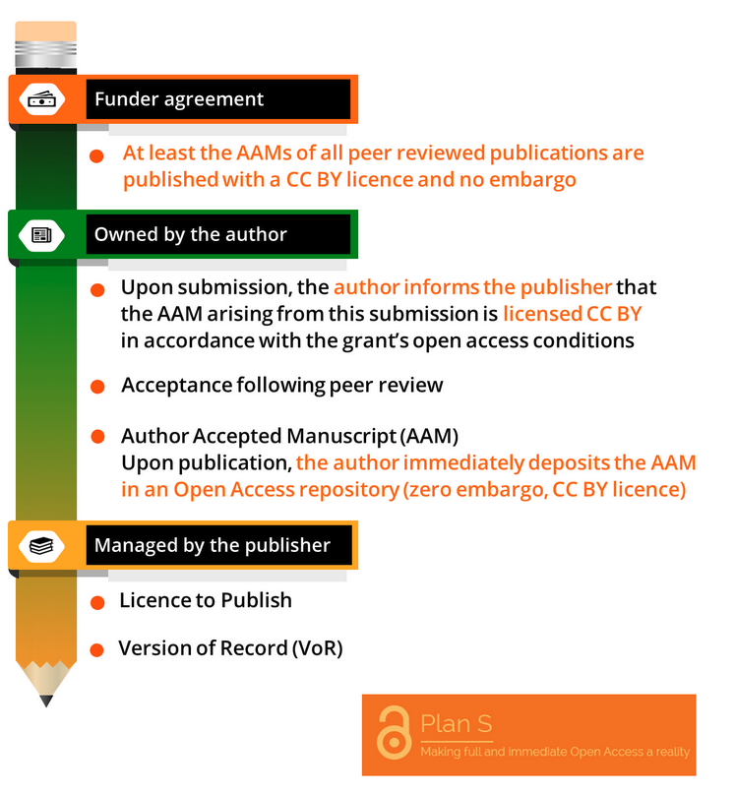
Rights retention: example
cOAlition S Rights Retention Strategy
Authors who publish in subscription-based journals should retain SUFFICIENT rights to be able to immediately (no embargo) self-archive at least AAM under the CC BY licence.
Exemption clause in the publishing agreement:
“[Insert publisher name] acknowledges that, notwithstanding any other terms or conditions in this agreement: Author Accepted Manuscript versions, which arise from submissions based on results from research funded fully or partially by cOAlition S Organisations, can be made freely available at the time of publication through any Open Access repository of the author’s choice; the Author Accepted Manuscript can be shared under a CC BY or equivalent licence; CC BY-ND upon agreement by the cOAlition S Organisation).”
https://www.coalition-s.org/wp-content/uploads/2020/10/RightsRetentionGraphic.png, CC BY 4.0

Slide 15
Resources
Templates prepared by cOAlition S to make communication with publishers easier for authors: https://www.coalition-s.org/resources/rights-retention-strategy/
cOAlition S resources, part of the online campaign “Publish with Power: Protect your rights“: https://www.coalition-s.org/resources/rights-retention-strategy/
Journal Checker Tool to check the compliance of journal policies with Plan S.
Fighting publishers’ ‘smoke and mirrors’: https://www.coalition-s.org/the-rrs-and-publisher-equivocation-an-open-letter-to-researchers/

Slide 16
Diversity of Open Access publishing models

Slide 17
The colours of Open Access
Symbol | Name | Characteristics | Who pays what?
 | GOLD | Publishing in OA journals Licence (most commonly Creative Commons) | No cost for readers. Authors or their institutions pay a fee (APC) The cost of maintaining infrastructure is borne by publishers.
 | GREEN | Self-archiving Licence (most commonly Creative Commons) | No cost for readers. The cost of maintaining infrastructure is borne by repository owners. No cost for publishers.
N/A | DIAMOND / PLATINUM | Publishing in OA journals Licence (most commonly Creative Commons) Also referred to as APC-free OA, no-fee OA, publisher-pays model | No cost for readers. No cost for authors and their institution. The cost of maintaining infrastructure is borne by publishers (and/or their sponsors).
 | BRONZE | Free to read All rights reserved, implied or explicit Not really OA | No cost for readers. In most cases, no cost for authors and their institutions. The cost of maintaining infrastructure is borne by publishers (and/or their sponsors).
N/A | HYBRID | Publishing in subscription-based journals with an Open Access option Licence (most commonly Creative Commons) | No cost for readers for OA articles, but no discount for the non-OA content. Authors or their institutions pay a fee (APC) The cost of maintaining infrastructure is borne by publishers.
 | BLACK | Illegal piracy websites Copyright violation by posting copyrighted content on social media (ResearchGate, Academia.edu, etc.) Not really OA | No cost for readers. No cost for authors and their institution. Publishers bear the cost of infrastructure and legal proceedings against copyright infringement. Platforms offering copyrighted content illegally bear the cost of the underlying infrastructure and legal proceedings against copyright infringement.

Slide 18
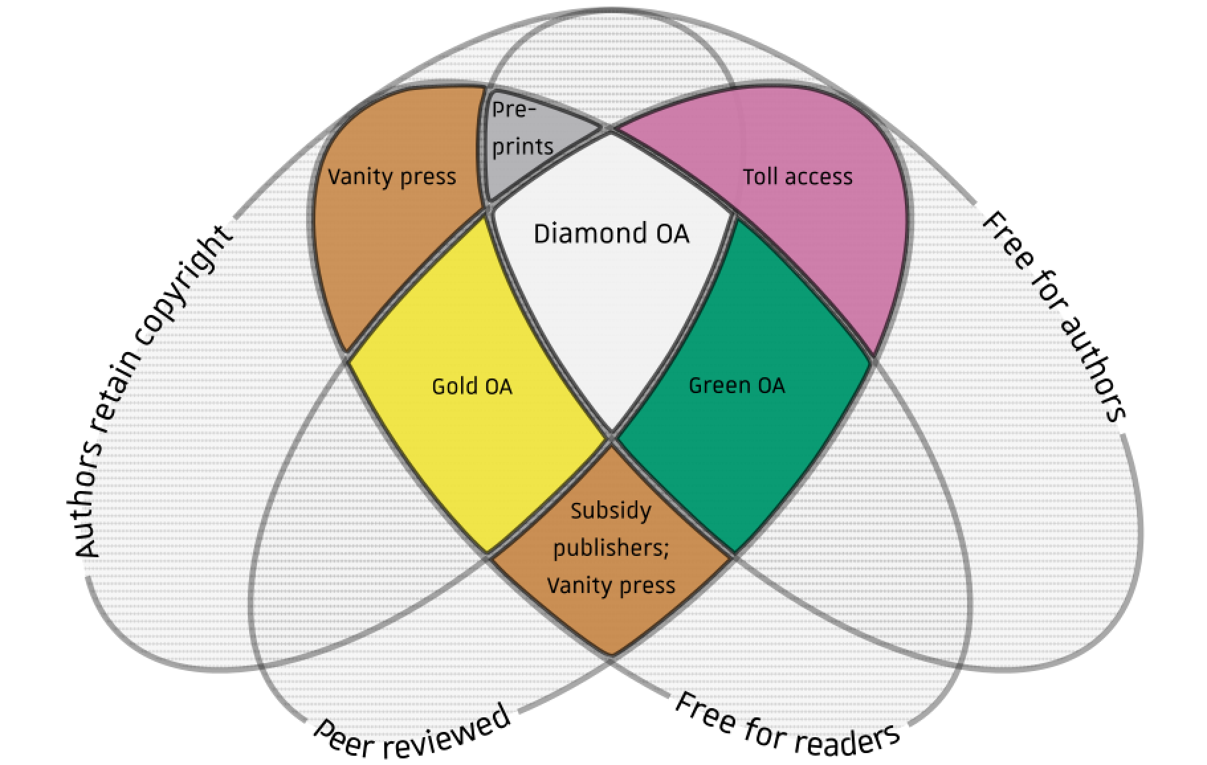
Different levels of open access in scholarly publishing, as a function of cost to the readers and authors, copyright retention, and peer review.
Further reading:
Martín-Martín, Alberto, Rodrigo Costas, Thed N. van Leeuwen, and Emilio Delgado López-Cózar. 2018. ‘Unbundling Open Access Dimensions: A Conceptual Discussion to Reduce Terminology Inconsistencies’. https://doi.org/10.17605/OSF.IO/7B4AJ
Tay, Aaron. 2021. ‘Why Open Access Definitions Are Confusing’. 5 April 2021. http://musingsaboutlibrarianship.blogspot.com/2021/04/why-open-access-definitions-are.html.
Source: Farquharson, Jamie (2018): Diamond open access venn. figshare. https://doi.org/10.6084/m9.figshare.6900566.v1 CC BY 4.0

Slide 19
Gold Open Access
Explain
Publishing fees (APC)
Waivers and discounts
Deceptive publishers and disputable (“predatory”) journals
Finding a “safe” journal (e.g. Think. Check. Submit)
Checking compliance with funder requirements (e.g. Journal Checker Tool)
Copyright and licences
Misconceptions about the quality of peer review

Slide 20
Hybrid Open Access
Why hybrid journals do not lead to full and immediate Open Access (cOAlition S)
Hybrid has not facilitated a transition to Open Access (OA)
The research community pays twice (double dipping)
Hybrid journals are more expensive than fully OA journals
Hybrid journals provide a poor quality of service
Hybrid journals crowd out new, full OA publishing models
Reader access: a hybrid journal is a “random OA” journal
https://www.coalition-s.org/why-hybrid-journals-do-not-lead-to-full-and-immediate-open-access/

Slide 21
Diamond / Platinum / Non-APC / No-fee
Authors, institutions, or funders do not pay an Open Access fee and the reader does not pay to read.
Disputes over classification: a distinct category or merely “Gold OA without fees”?
Who pays? - a variety of no-fee Open Access Publishing Models
More common in some parts of the world
Sustainability as a challenge

Slide 22
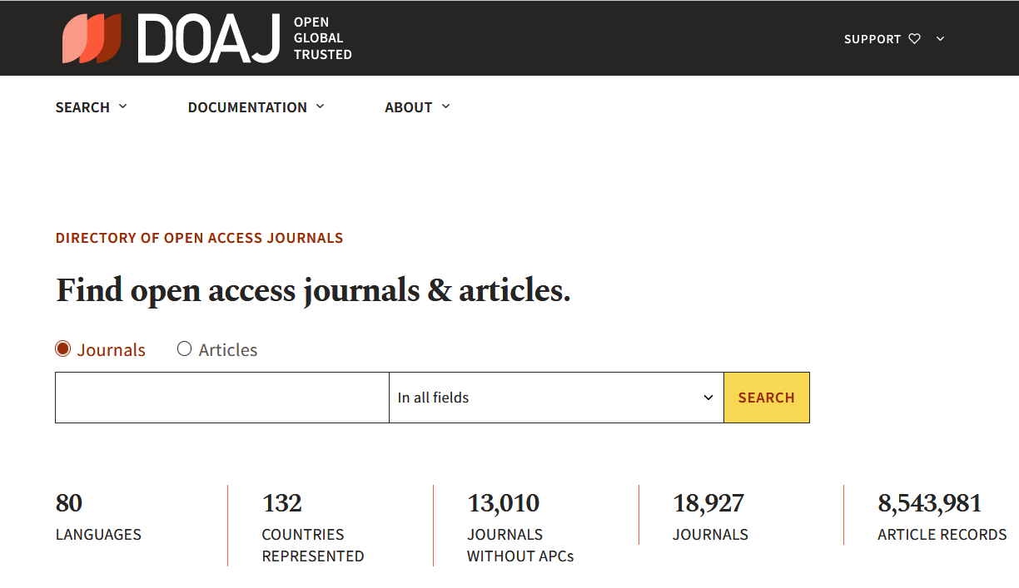
Finding Diamond / Platinum / Non-APC / No-fee OA journals
https://doaj.org

Slide 23
The OA Diamond Journals Study, 2021
A large-scale study on Open Access journals across the world commissioned by cOAlition S
Findings:
many relatively small journals serving diverse communities
on the road to full compliance with Plan S
A mix of scientific strengths and operational challenges
An economy that largely depends on volunteers, universities and government
Bosman, Jeroen, Frantsvåg, Jan Erik, Kramer, Bianca, Langlais, Pierre-Carl, & Proudman, Vanessa. (2021). OA Diamond Journals Study. Part 1: Findings. Zenodo. https://doi.org/10.5281/zenodo.4558704

Slide 24
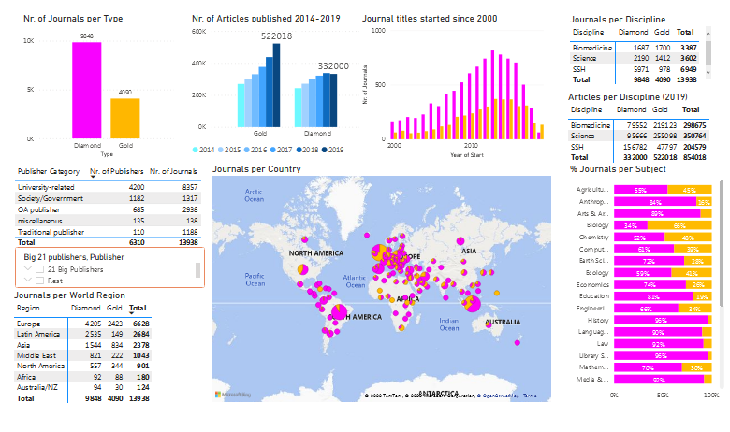
Diamond OA is a more common model is some parts of the world
Gold and Diamond open access journals landscape: Dashboard (based on DOAJ data)
Source: ‘Gold and Diamond Open Access Journals Landscape’. 2020. Research Consulting (blog). 22 September 2020. https://www.research-consulting.com/an-interactive-look-at-the-gold-and-diamond-journals-landscape/.
Source: Bosman, Jeroen, Frantsvåg, Jan Erik, Kramer, Bianca, Langlais, Pierre-Carl, & Proudman, Vanessa. (2021). OA Diamond Journals Study. Part 1: Findings. Zenodo. https://doi.org/10.5281/zenodo.4558704
Creative Commons Attribution 4.0 International

Slide 25
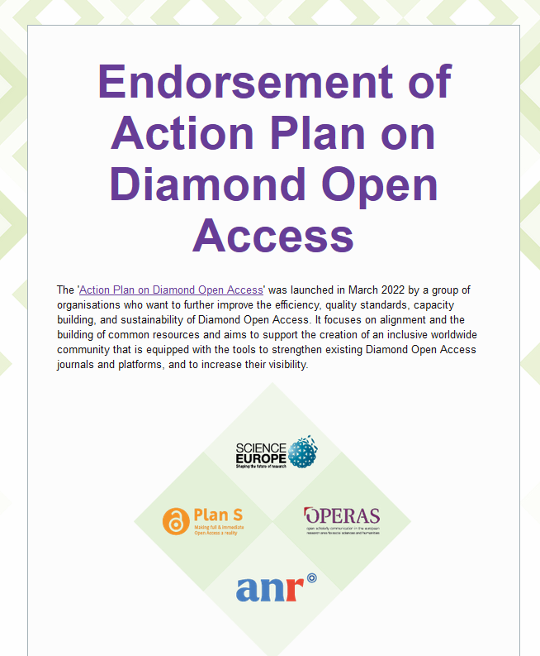
Action Plan for Diamond Open Access (2022)
Diamond OA conference was organized by Science Europe in September 2022. More details and presentations: https://www.scienceeurope.org/events/diamond-oa-conference/
Ancion, Zoé, Borrell-Damián, Lidia, Mounier, Pierre, Rooryck, Johan, & Saenen, Bregt. (2022). Action Plan for Diamond Open Access. Zenodo. https://doi.org/10.5281/zenodo.6282403
Endorse the plan: https://surveys.scienceeurope.org/index.php/241774

Slide 26
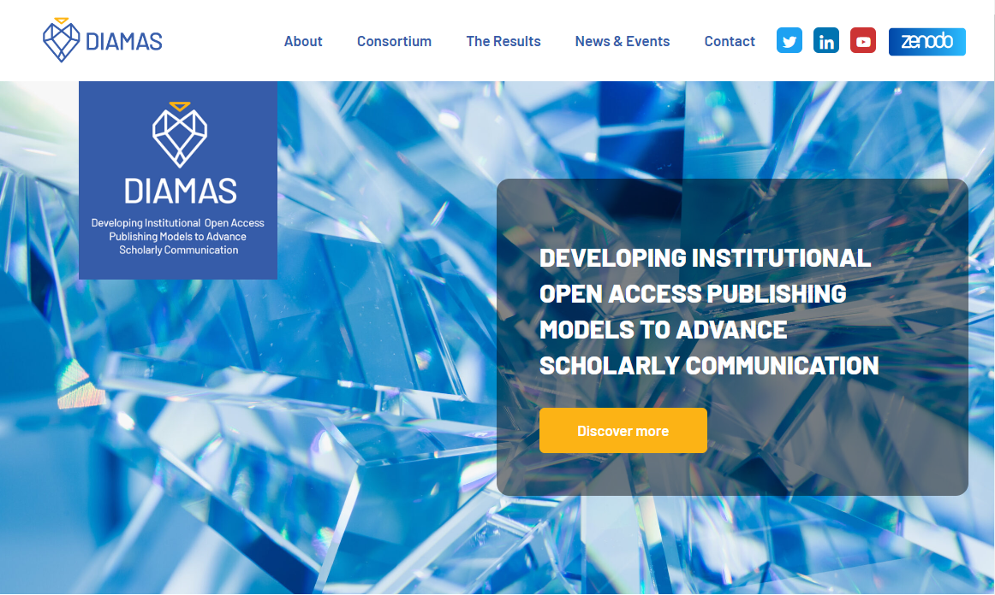
DIAMAS project
Map the current landscape of Institutional Publishing Service Providers (IPSPs)
Coordinate and improve the efficiency and quality of IPSPs by developing a European Quality Standard for Institutional Publishing (EQSIP)
Formulate community-led, actionable recommendations and strategies for institutional leaders, funders/sponsors/donors, and policymakers in the European Research Area (ER
In 36 months, DIAMAS will deliver an aligned, high-quality, and sustainable institutional OA scholarly publication ecosystem for the ERA, setting a new standard for OA publishing, shared and co-designed with all stakeholders.
https://diamasproject.eu/

Slide 27
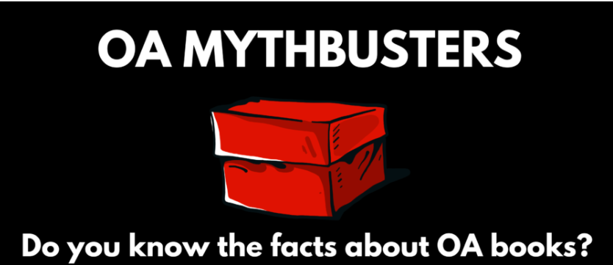
What about books?
More attention should be paid to OA books (e.g. discuss it on dedicated training sessions).
Self-archiving policies for books are more restrictive and less transparent.
Promote book publishing platforms such as OAPEN and discovery services, e.g. DOAB
Be aware of the new developments in the area
Resources: Open Access Books Network

Slide 28
Emerging areas

Slide 29
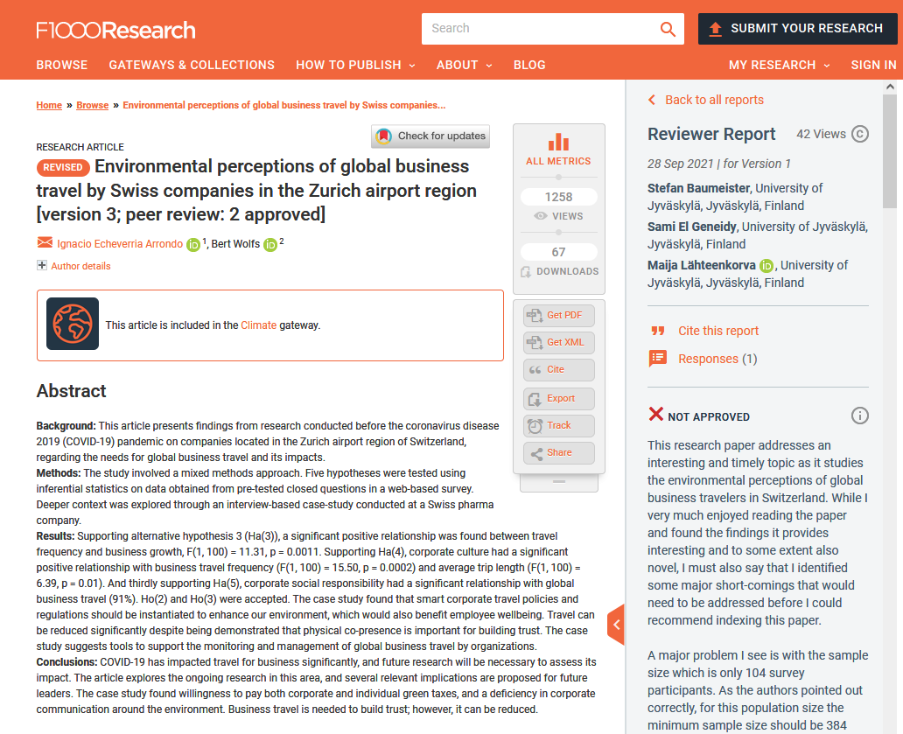
Open peer review
Some publishers offer it as an option (MDPI)
Use cases:
PeerJ
F1000 (preprint platform)
Open Research Europe
Learn more:
FOSTER course on open peer review
Ross-Hellauer, Tony. 2017. ‘What Is Open Peer Review? A Systematic Review’. F1000Research. https://doi.org/10.12688/f1000research.11369.2.
Include open peer in your training on Open Access publishing!

Slide 30
Preprints
Preprint is a version of a scholarly paper that has not yet been peer reviewed and published in a peer-reviewed journal. The preprint is usually publicly available on a preprint platform or a repository before a paper is published in a journal. This practice makes it possible to communicate research results early on, without waiting for the formal peer review.
Preprint platforms:
bioRxiv
AfricArXiv
F1000
PsyArXiv
SSRN (owned by Elsevier)
List of preprint repositories on Wikipedia
Materials in several languages on ASAPbio website
Issues to explain
Some researchers don’t understand the concept of preprints and their status in career development
Unfounded fear of academic theft
History of preprints (e.g. arXiv)
Role in scholarly communication
Misuse of early research results in media
Include preprints in your training on Open Access publishing

Slide 31
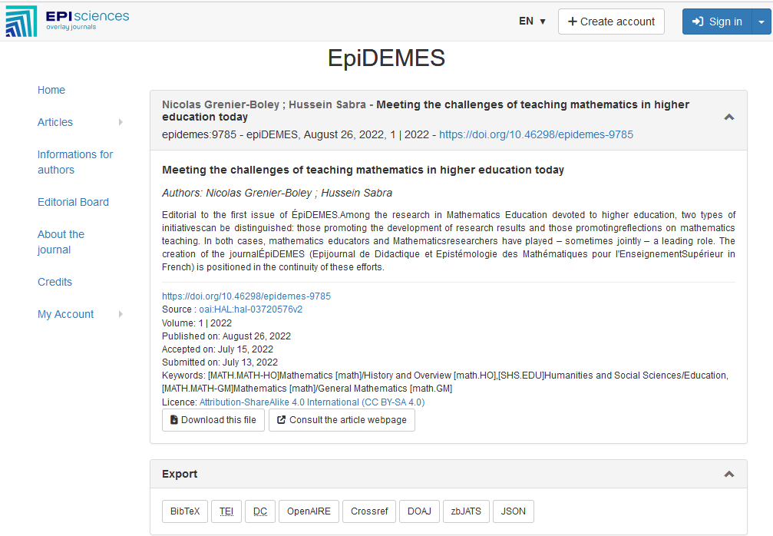
Overlay journals
“An overlay journal is an open access, quality-assured journal whose articles are held in one or more repositories. An overlay journal does not host the articles on the journal’s website but links back to the relevant article in an open repository or preprint server.”
COAR https://www.coar-repositories.org/overlay-journals/
EPIsciences (a platform hosting overlay journals)

Slide 32
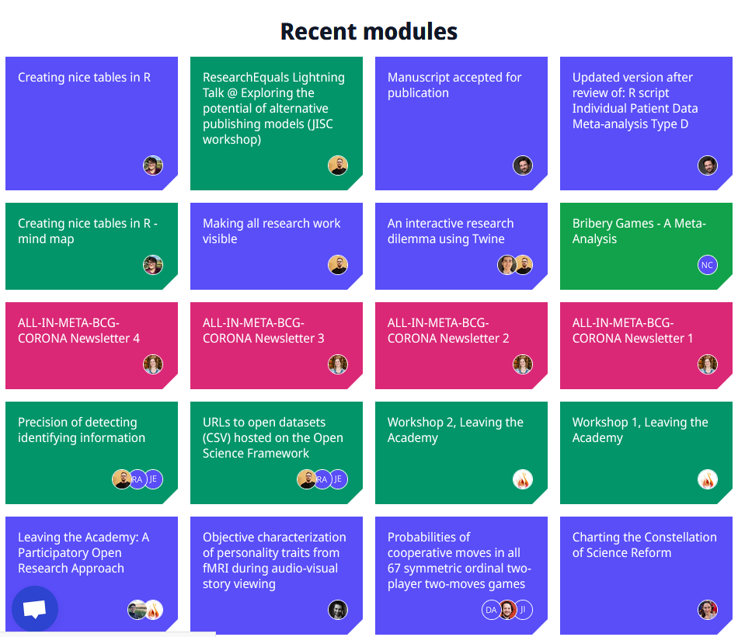
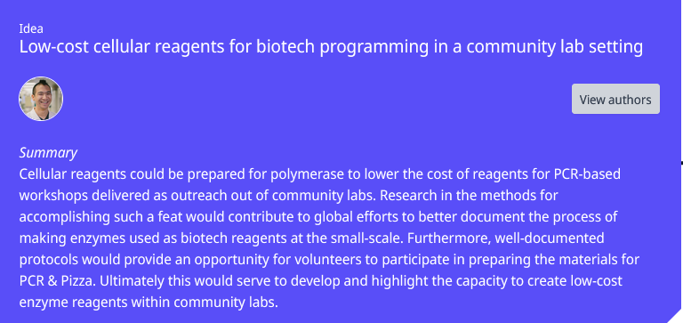
Innovative platforms
Platforms open by default (even “pay-to-close”)
Modular publishing
Diversity of outputs (abstract, analysis, research problem, hypothesis, data, method, interpretation, peer review, etc.)
Focus on the process (all steps made transparent)
Collaborative
Examples:
ResearchEquals
Octopus (under development)

Slide 33
Bibliodiversity
“cultural diversity applied to the world of books”
preserving diversity in scholarly communication
greater diversity of products (books, scripts, eBooks, apps, and oral literature) made available to readers
scholarly communication as an ecosystem resting on:
multilingualism
open and shared infrastructures and services
the diversity of business models in OA publishing
quality-based research assessment.
Shearer, Kathleen, Chan, Leslie, Kuchma, Iryna, & Mounier, Pierre. (2020). Fostering Bibliodiversity in Scholarly Communications: A Call for Action. Zenodo. https://doi.org/10.5281/zenodo.3752923

Slide 34
Training tips
Don’t forget that the purpose of scholarly publishing should be scholarly communication (and not profit)
Highlight and explain the diversity of publishing models
Uncover misconceptions
Present use cases
High-quality materials are available. Use them in you training!
The topic is huge. Try not to cover all in one session.
Be informed and cover new developments in you training!

Slide 35
Questions?
milica.sevkusic@eifl.net
Twitter: @lessormore4
Template Concentric Blue, designed by Jimena Catalina; Slides Carnival. CC BY.

