Slide 1
The OpenAIRE Graph
Paolo Manghi
OpenAIRE AMKE
ISTI - CNR

Slide 2
Data Backbone: The OpenAIRE Graph
A Scientific Knowledge Graph (SKG)
Timely and comprehensive coverage of research products beyond publications
Near monthly updates
Precision, depth & processing
Rigorous cleaning, deduplication, and enrichment for optimal accuracy
Full-text mining of links: Research results to projects, author affiliations, and classifications (FoS, SDG)
Robustness & openness
Professional infrastructure: maintenance, load balancing, backups, overseen by the OpenAIRE technology centre (ICM)
Open data, Open Source & transparent methodologies

Slide 3
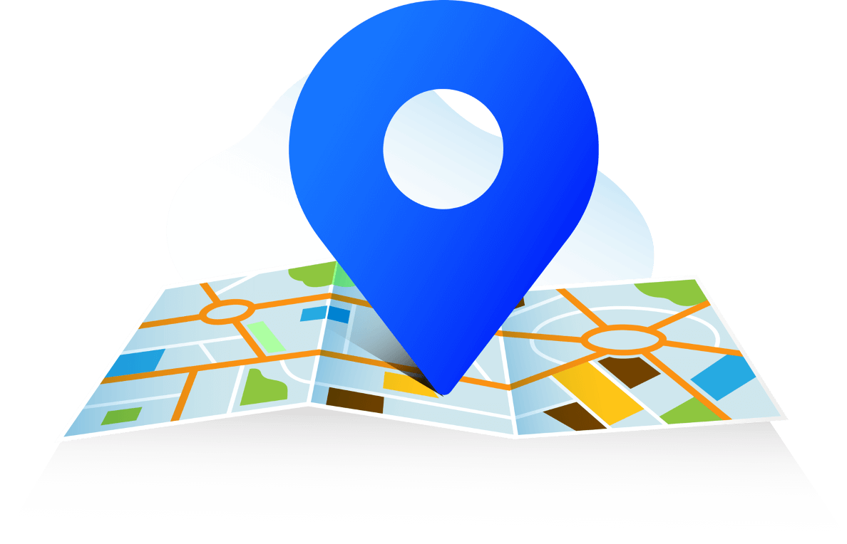
The OpenAIRE Graph: why?
Tracking
open research
Discovering
open research
Monitoring
(open) research
Reproducibility and transparency require tracking of all outcomes of science and related ”context”
Discovery of reproducible science outcomes must find new ways, driven by “scientific intentions” that go beyond the “find articles related to a research topic”
Monitoring quality, impact, and openness of science should be a transparent, reproducible process for all, inclusive of research “context”
OpenAIRE Community Call | 17 Jan 2024

Slide 4
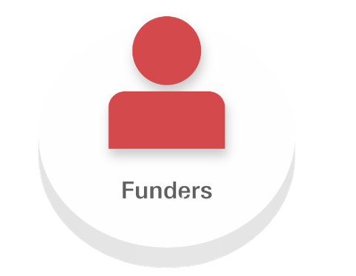
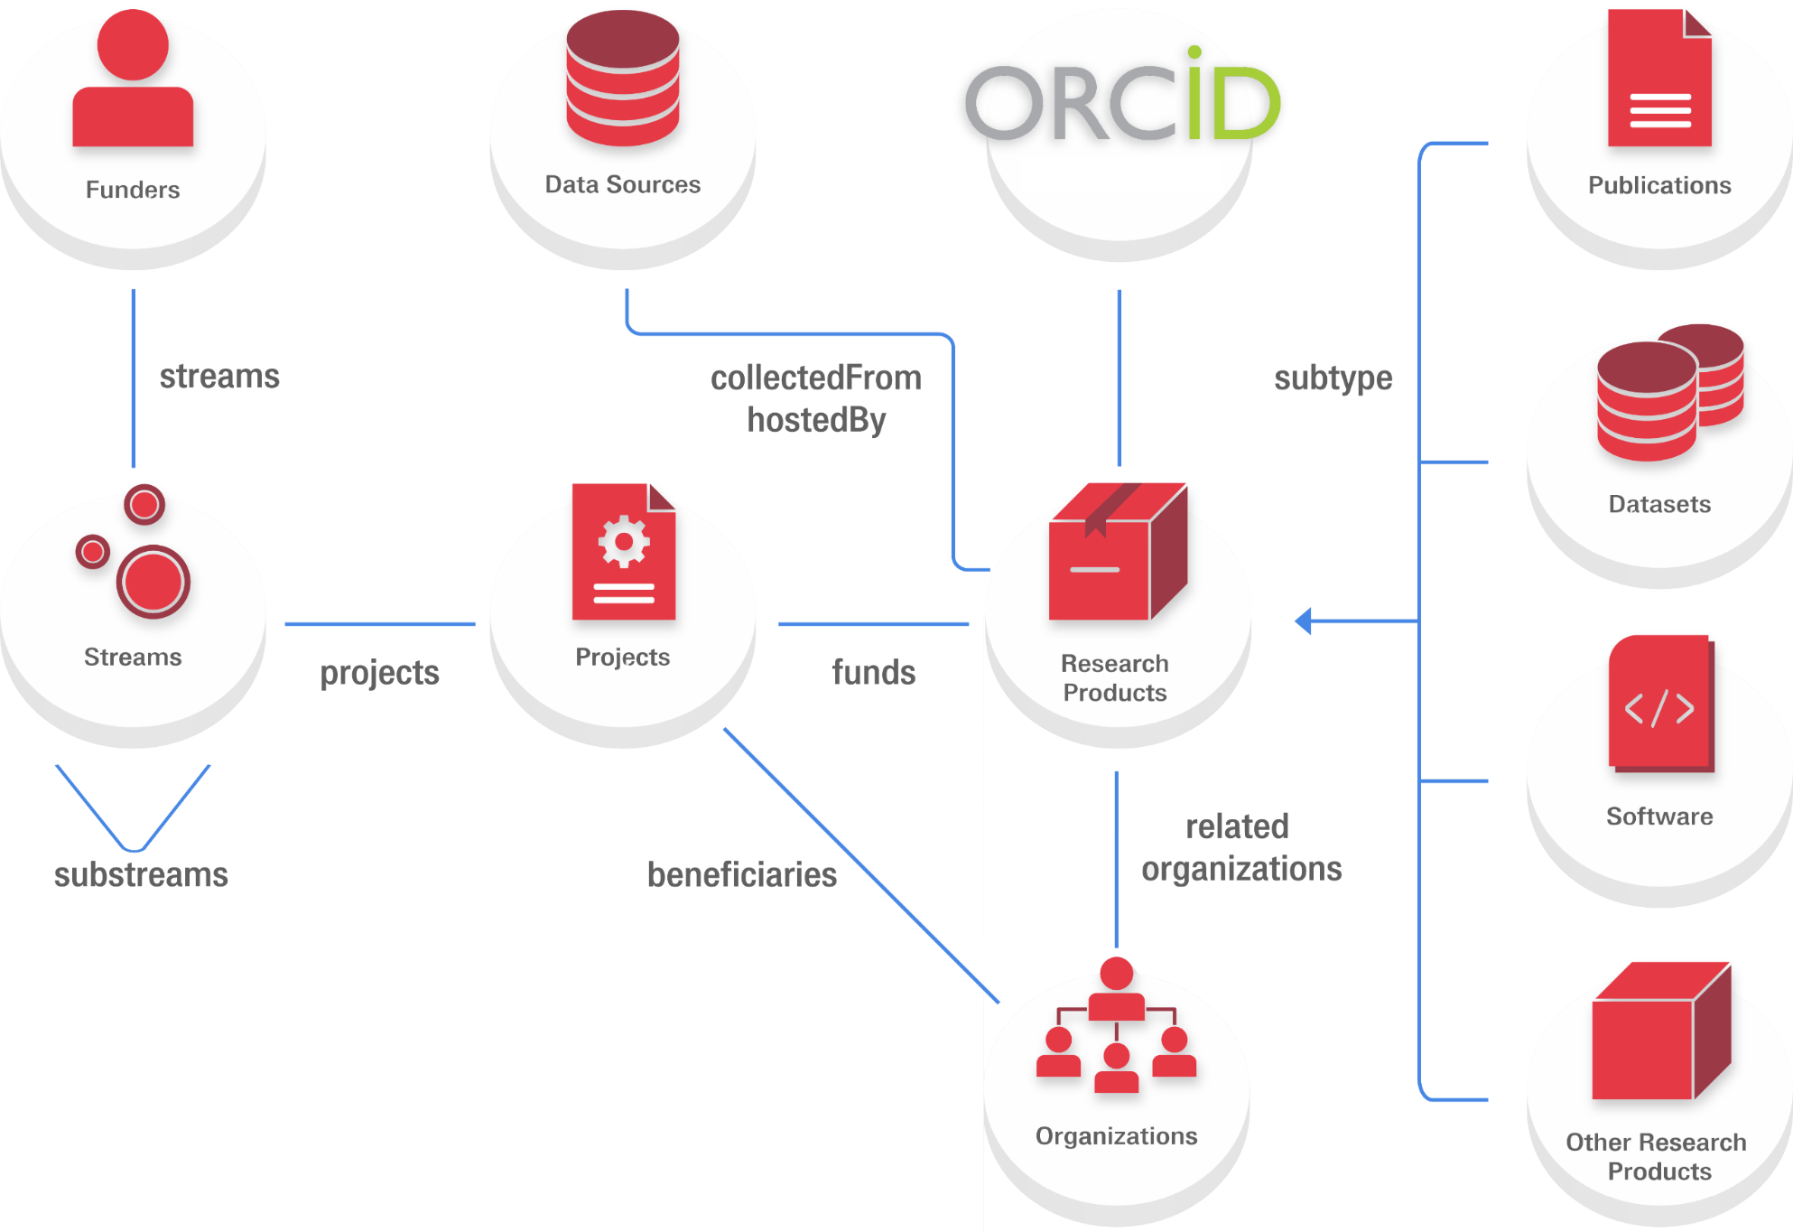
The data model moon’s view
Persons
Cites
VersionOf
SupplementTo
RefersTo
indicators
OpenAIRE Community Call | 17 Jan 2024

Slide 5
Data model features
Embeds indicators such as APCs (from OpenAPC), COUNTER metrics (from OpenAIRE UsageCounts), popularity (from BIP!), and citations (COCI)
Persistent identifiers include today DOI, ArXiv, PubMed, Handles for publications; DOI, accession numbers, handles for research data; DOI, handles, and software heritage IDs for research software (the data model can flexibly include any PID schema!)
Keeps stable identifiers using a combination of stateless identifiers and internal status

Slide 6
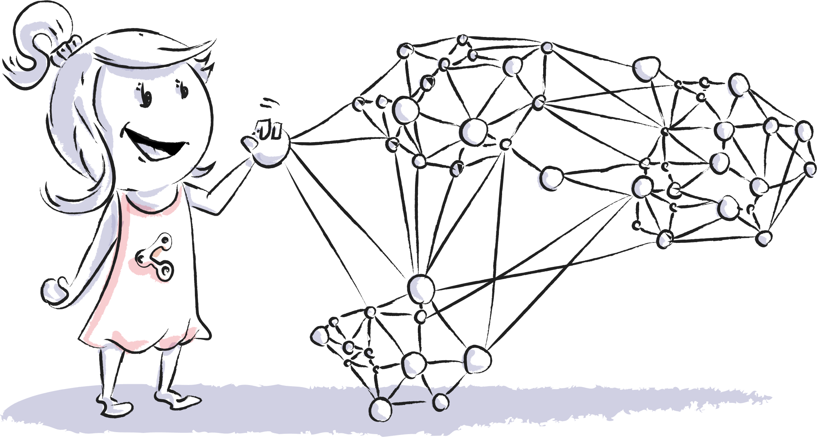
OpenAIRE Graph in numbers (as of 16 Jan 2024)*
173Mi publications
398k software
60Mi research data
8Mi other research products
168 funders (30 with projects)
3.4Mi grants
203K organizations
*View the most recent statistics here
OpenAIRE Community Call | 17 Jan 2024

Slide 7
Data sources contributing to the Graph
… and more tools and software sources
… and more publishers
… and more European and international funders
… and more registries
… and more research s
… and more aggregators
… and more thematic and institutional repositories
… and more einfra and RI sources
OpenAIRE Community Call | 17 Jan 2024

Slide 8
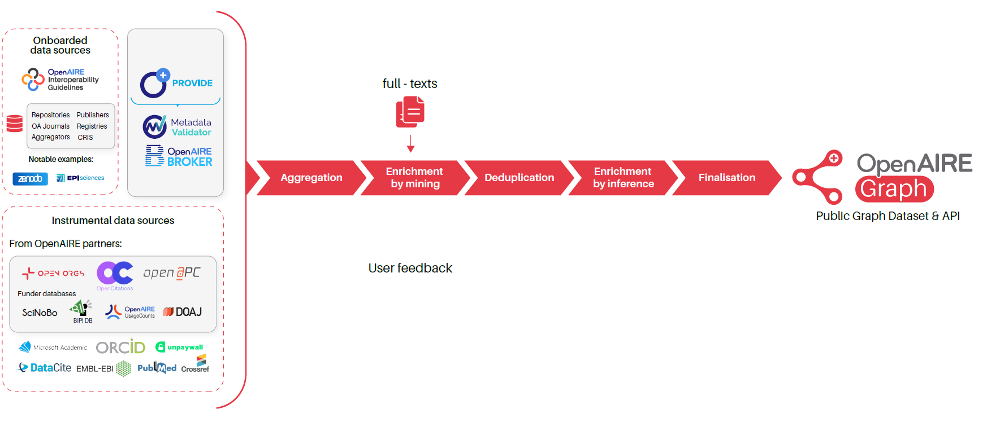
The Graph pipeline
publication – project/funder links
publication – data/software links
publication – publication citations
publication – organization affiliations
product – product similarity
FOS, SDGs
….
OpenAIRE Community Call | 17 Jan 2024

Slide 9
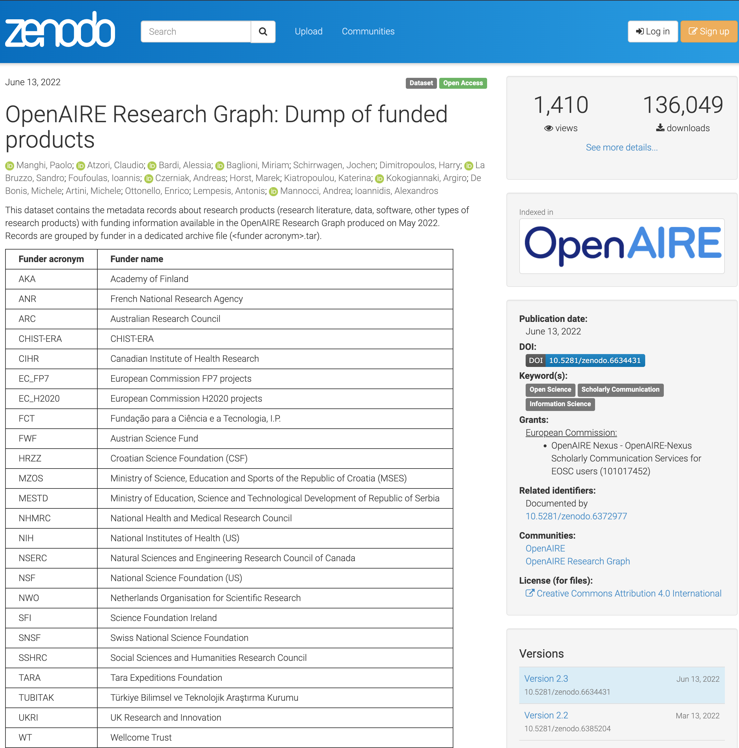
Access to the Graph
Dataset in Zenodo
Funded products
RI & RC related products
COVID-19 related products
Publication – Dataset links in Scholix format
Complete
Linked Open Data
zenodo.org/communities/openaire-research-
OpenAIRE Community Call | 17 Jan 2024

Slide 10
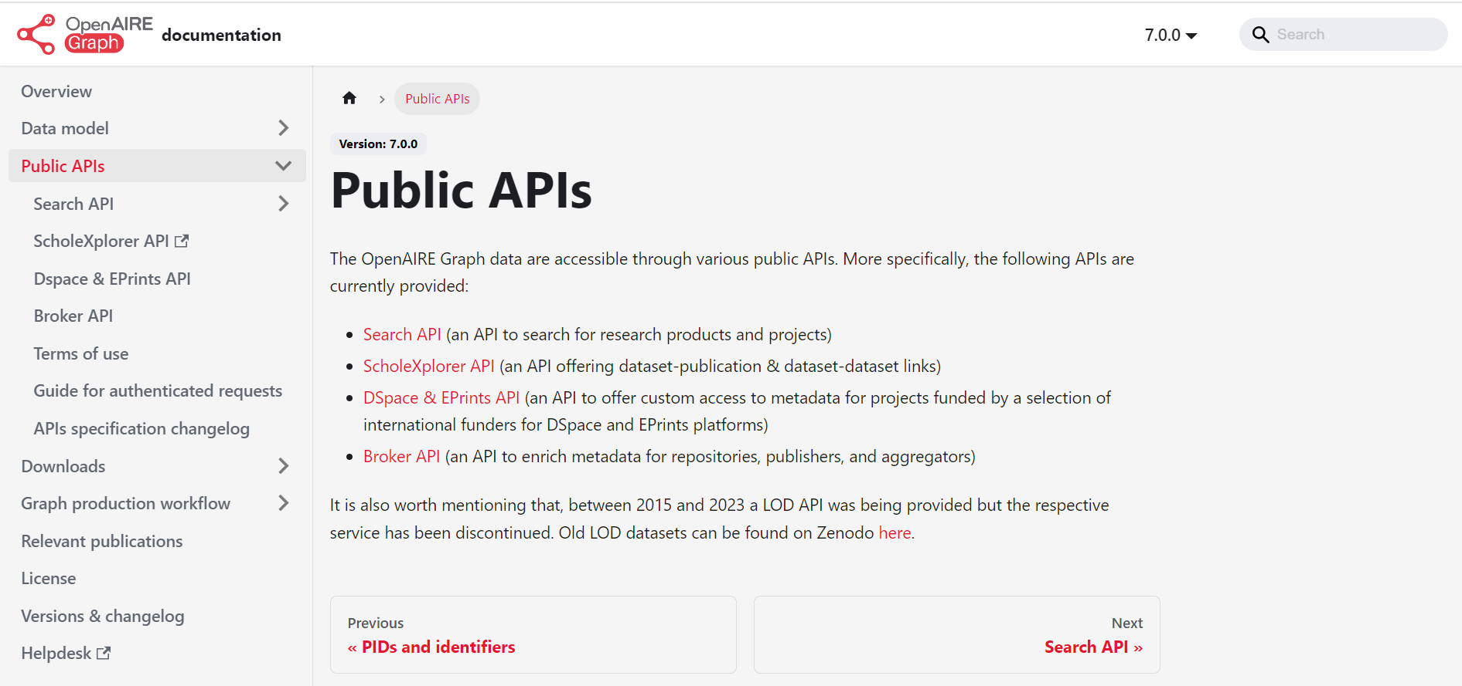
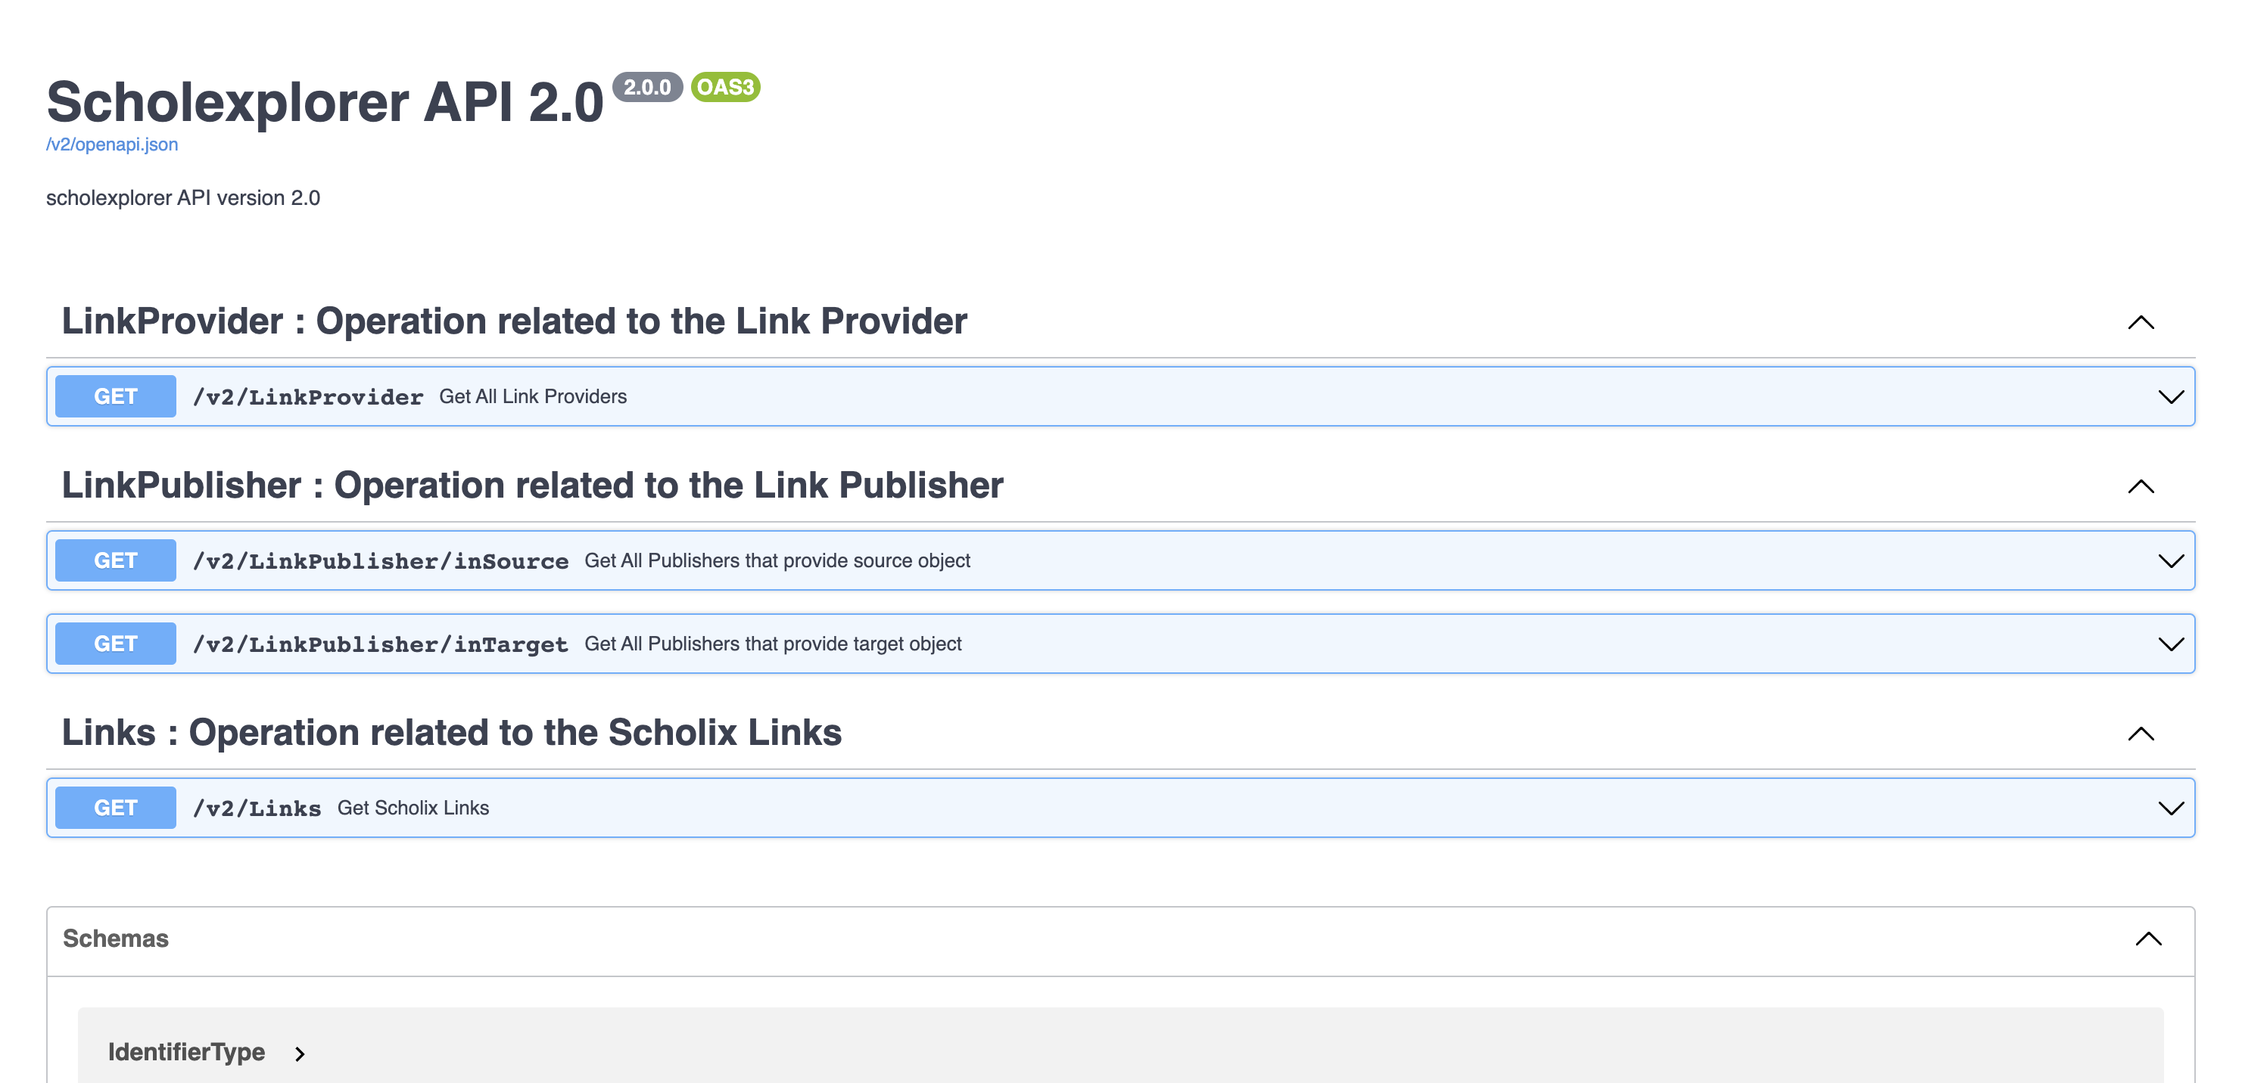
Access to the Graph
10
Scholexplorer: api.scholexplorer.openaire.eu/v2/ui/
Graph: graph.openaire.eu/docs/apis/home/
OpenAIRE Community Call | 17 Jan 2024

Slide 11
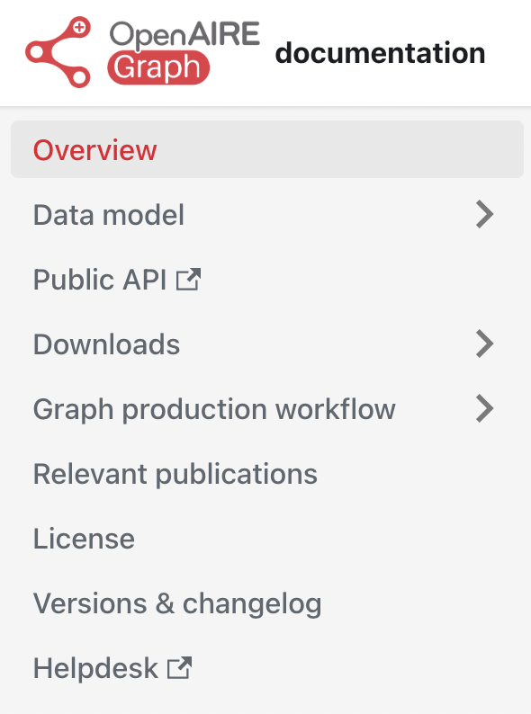
Documentation
For more…
https://graph.openaire.eu/docs/

Slide 12
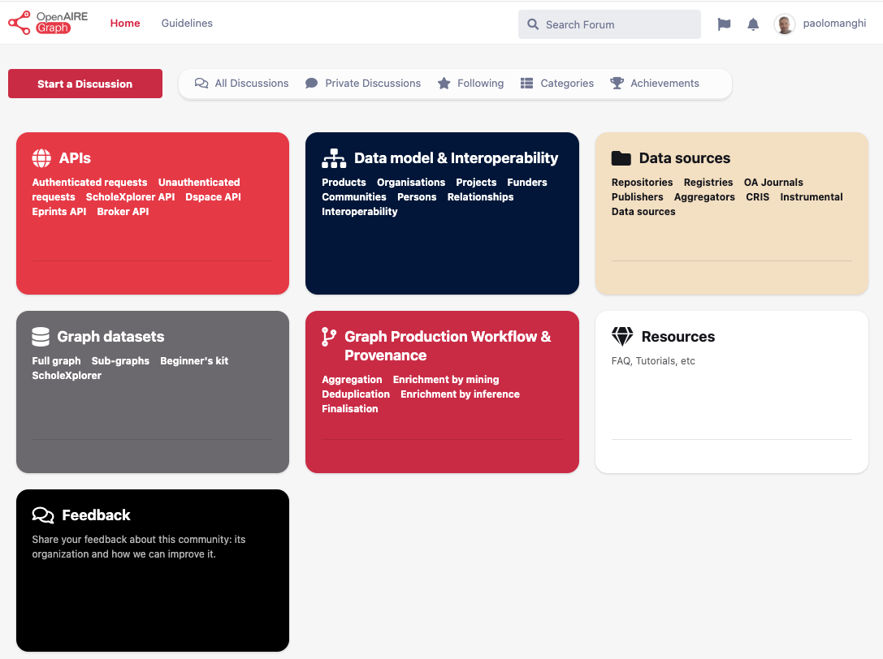
Forum
For more…
https://openaire.flarum.cloud/
OpenAIRE Community Call | 17 Jan 2024

Slide 13
New features (2023)

Slide 14
Novelties
Fields of Science
OpenAIRE Community Call | 17 Jan 2024

Slide 15
FoS Classification in the Graph
Why
Growth of # scientific publications
Need for policy-makers, funders, publishers, scholars, companies to classify it according to Field-of-Science Taxonomies
organization, search engines
monitoring (evolution of trends, identification of new fields, ..)
evaluation (funding allocation, weak spots, opportunities, ..)
policy-making
recommendation systems
What
~15Mi DOIs classified
Classification based on a 3 level hierarchy taxonomy
Based on “SciNoBo: A Hierarchical Multi-Label Classifier of Scientific Publications” 10.1145/3487553.3524677
Level of FOS | Number FOS Labels
Level 1 | 6
Level 2 | 42
Level 3 | 174
OpenAIRE Community Call | 17 Jan 2024
Notes:
The intuition behind the classifier is that a publication mostly cites thematically related publications
To create the classifier we employ a multilayer approach. We try to bridge venues and publications by constructing a multilayer network. The nodes in the can be Venues, FOS labels of the venues and publications
The edges reflect the Layers of the multilayer and can be Venue-Venue edges reflecting citing-cited relationships in their respective publications
Venue-FOS labels, which are provided by the ScienceMetrix Journal Classification Publications to venues edges, which are constructed during inference time
Hierarchical edges between Field of Science labels
And publication to FOS labels which are the end result
The classification step consists of classifying a publication based on the out-citations and in-citations. Where out-citations refer to the publishing venues of the publications it references
And in-citations to the publishing venues of the publications it get cited by.

Slide 16
SDG classification in the Graph
Why
Societal priorities (partly) set by UN Sustainable Development Goals
Need for policy-makers to classify research according SDGs
monitoring
evaluation (societal impact)
policy-making
What
~8Mi DOI classified
SDG Classification system
Build an SDG Silver Corpus of Keywords & Key phrases
uses publication title and abstract to classify it to (potentially multiple) SDGs
OpenAIRE Community Call | 17 Jan 2024

Slide 17
Applications: discovery and research assessment

Slide 18
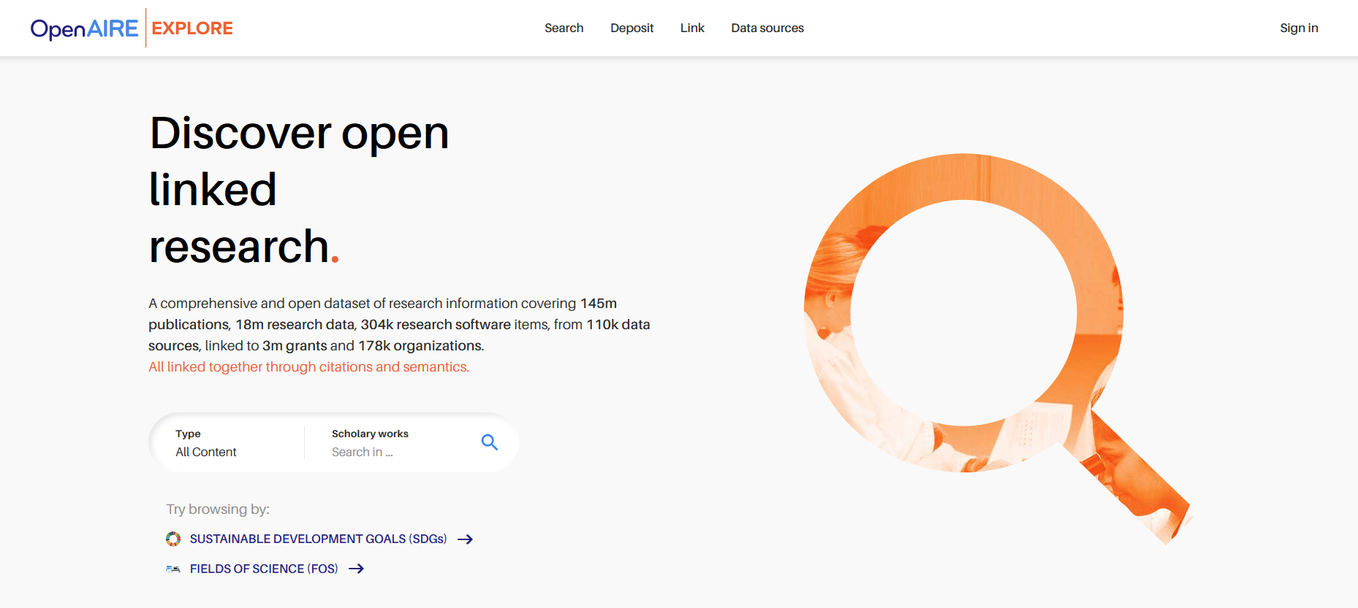
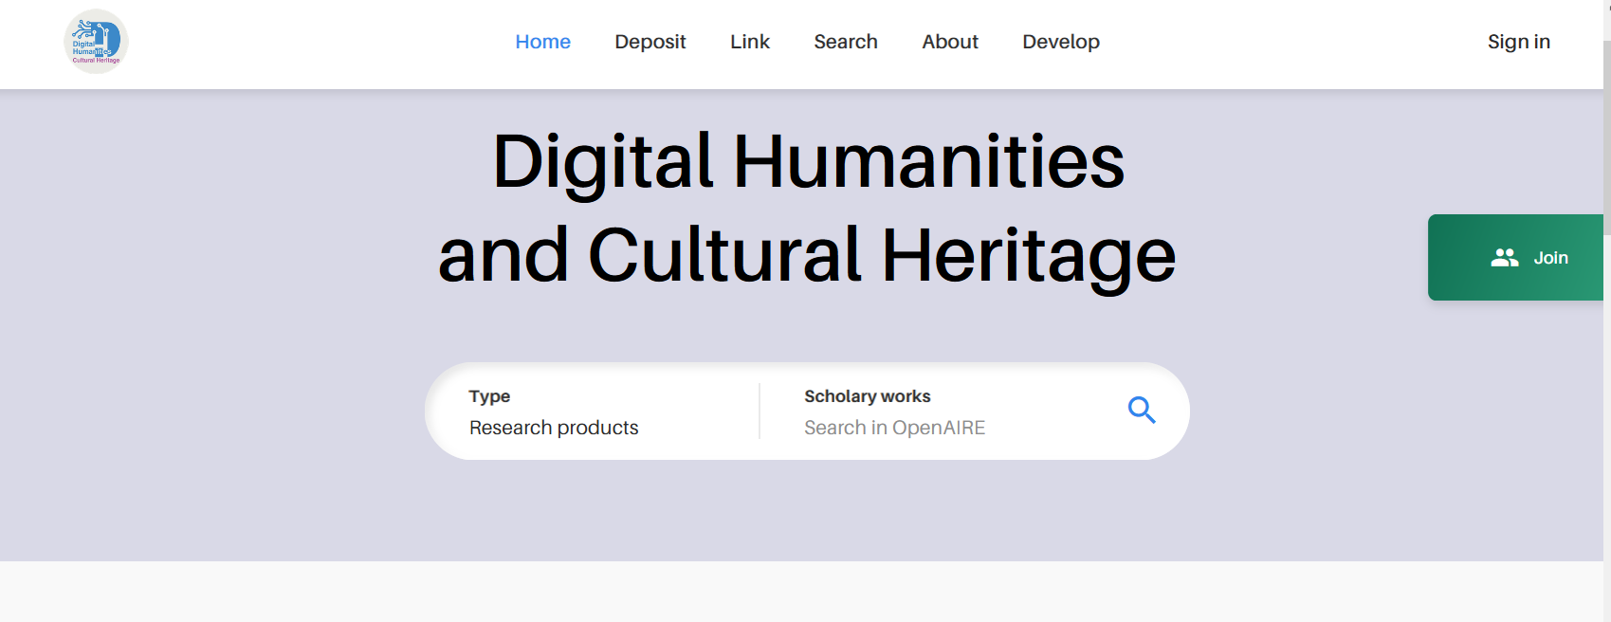
OpenAIRE EXPLORE and CONNECT
https://explore.openaire.eu/
https://dh-ch.openaire.eu/
OpenAIRE Community Call | 17 Jan 2024

Slide 19
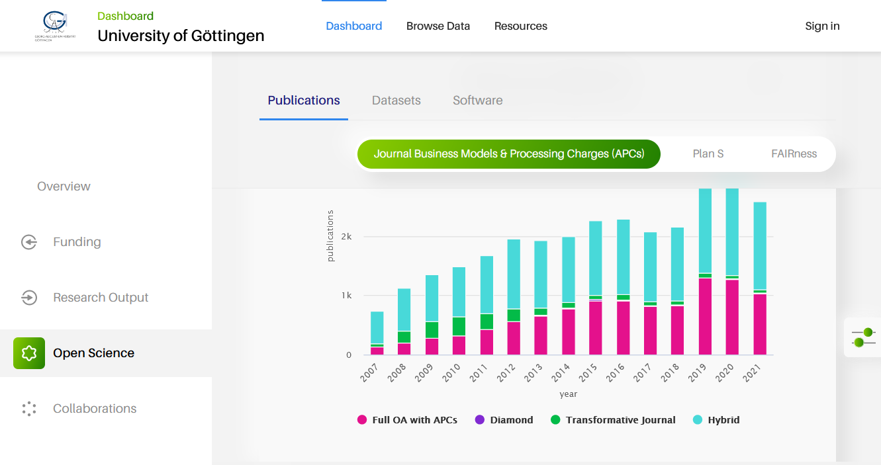
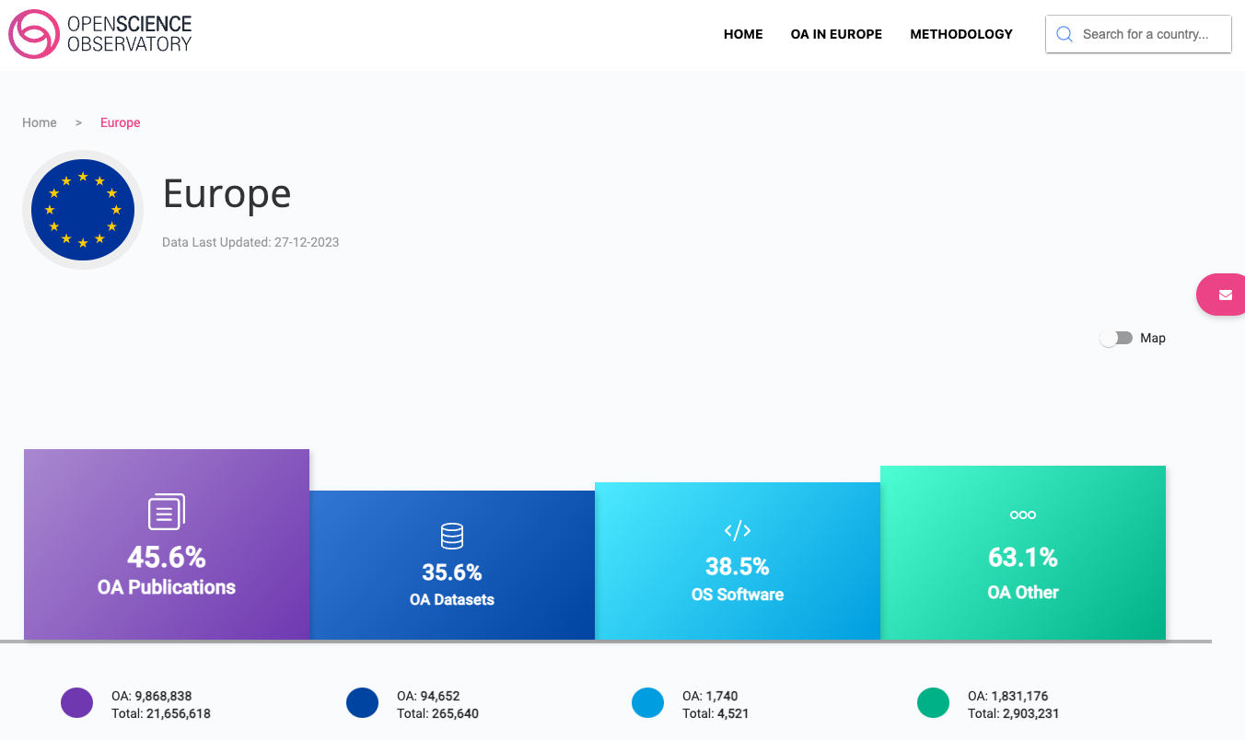
OpenAIRE MONITOR and OS Observatory
https://monitor.openaire.eu/
https://osobervatory.openaire.eu/

Slide 20
The Irish MONITOR Tender

Slide 21
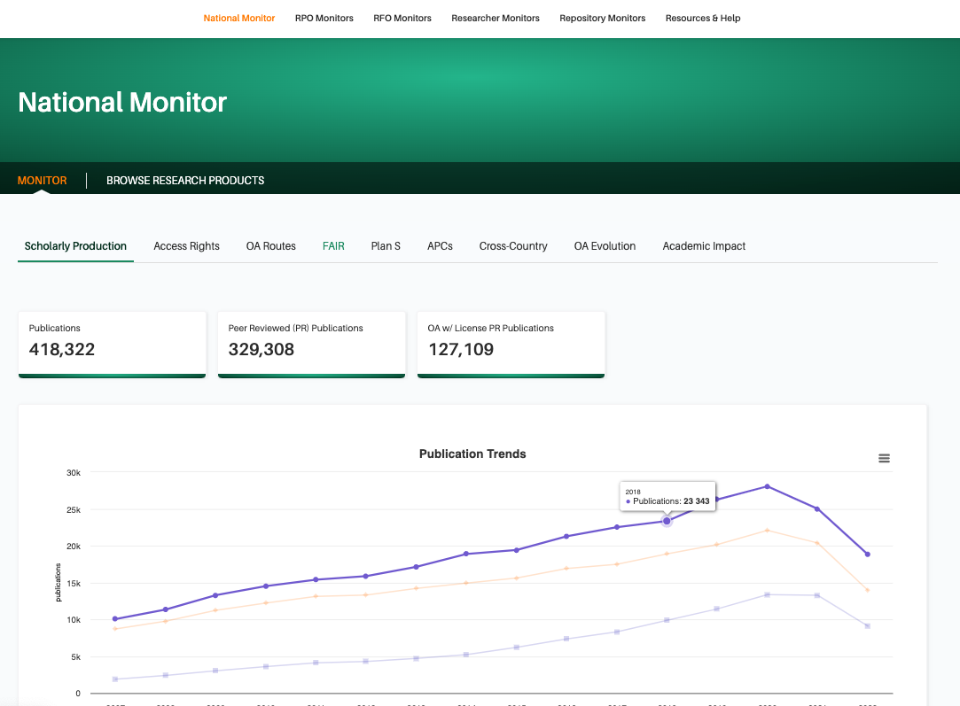
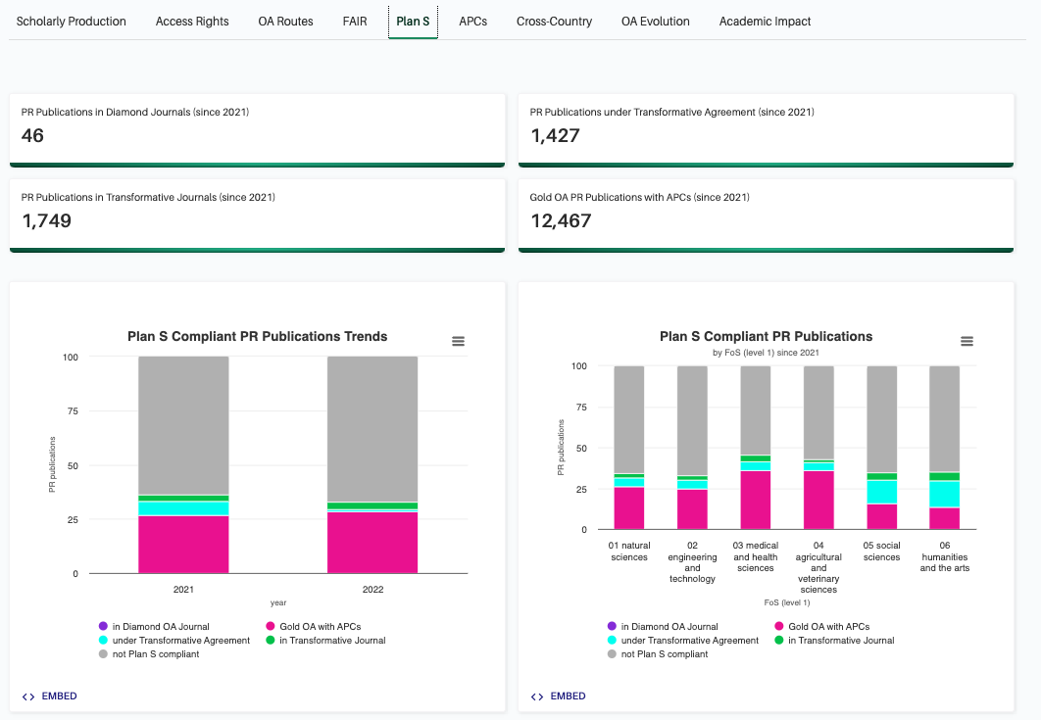
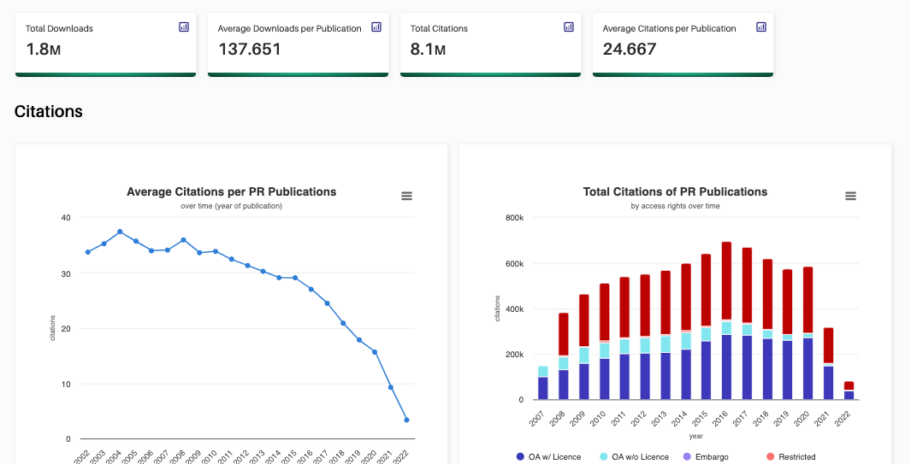
The Irish MONITOR Tender

Slide 22
Take home message
The OpenAIRE Graph is open
Accessible via APIs and datasets in Zenodo under CC-BY
The OpenAIRE Graph is transparent
We document the process of generation and track provenance of individual bits of information
The OpenAIRE Graph is a public good
The Graph a public infrastructure (like highways), operated by OpenAIRE AMKE, a no-profit company based on membership participation
The OpenAIRE Graph is participatory
We welcome and enable data contributions from communities, service providers, organizations, and researchers
The OpenAIRE Graph is the largest Open Science SKG
Broader coverage of publications, research data, and research software, together with links between them

