Slide 1
Discovery

Slide 2
Unlocking Scholarly Discovery with the OpenAIRE Graph

Slide 3
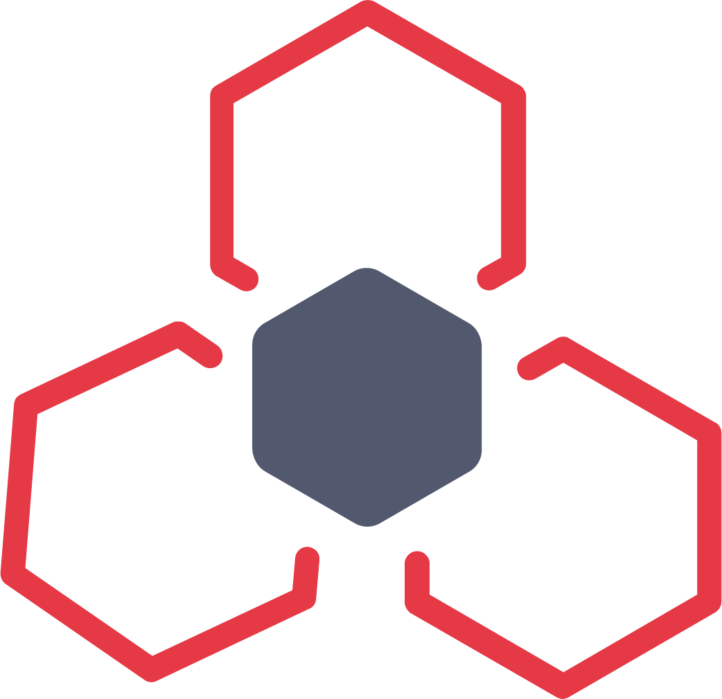
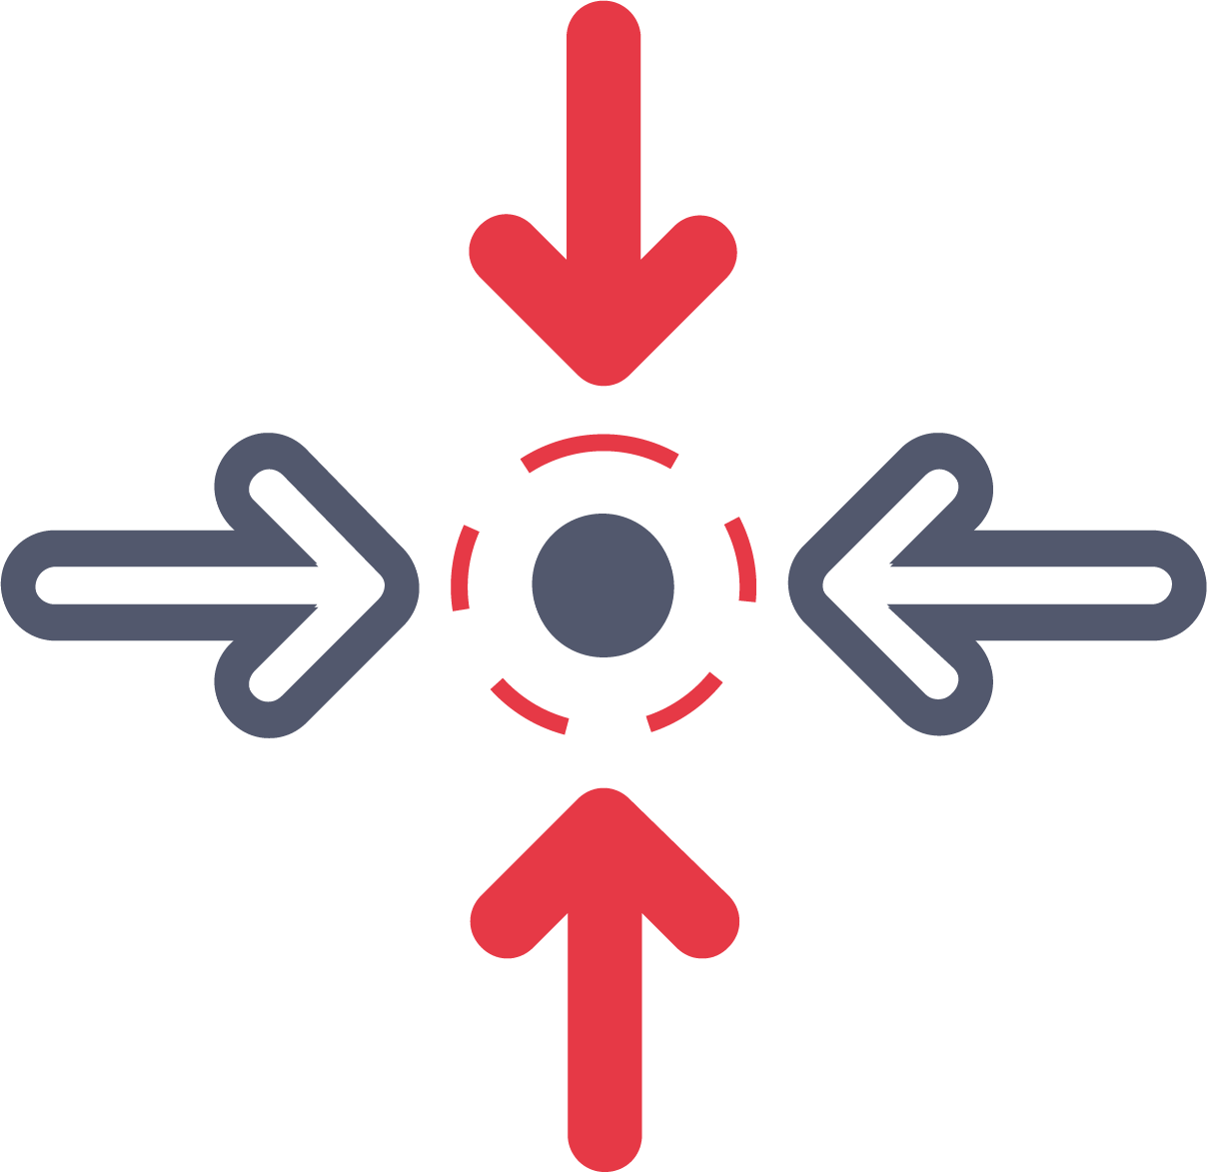
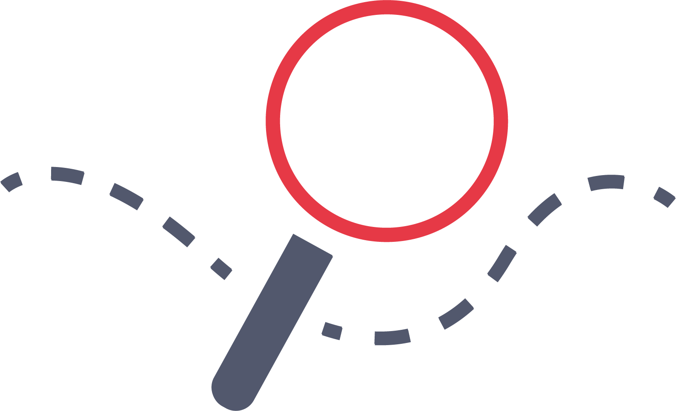
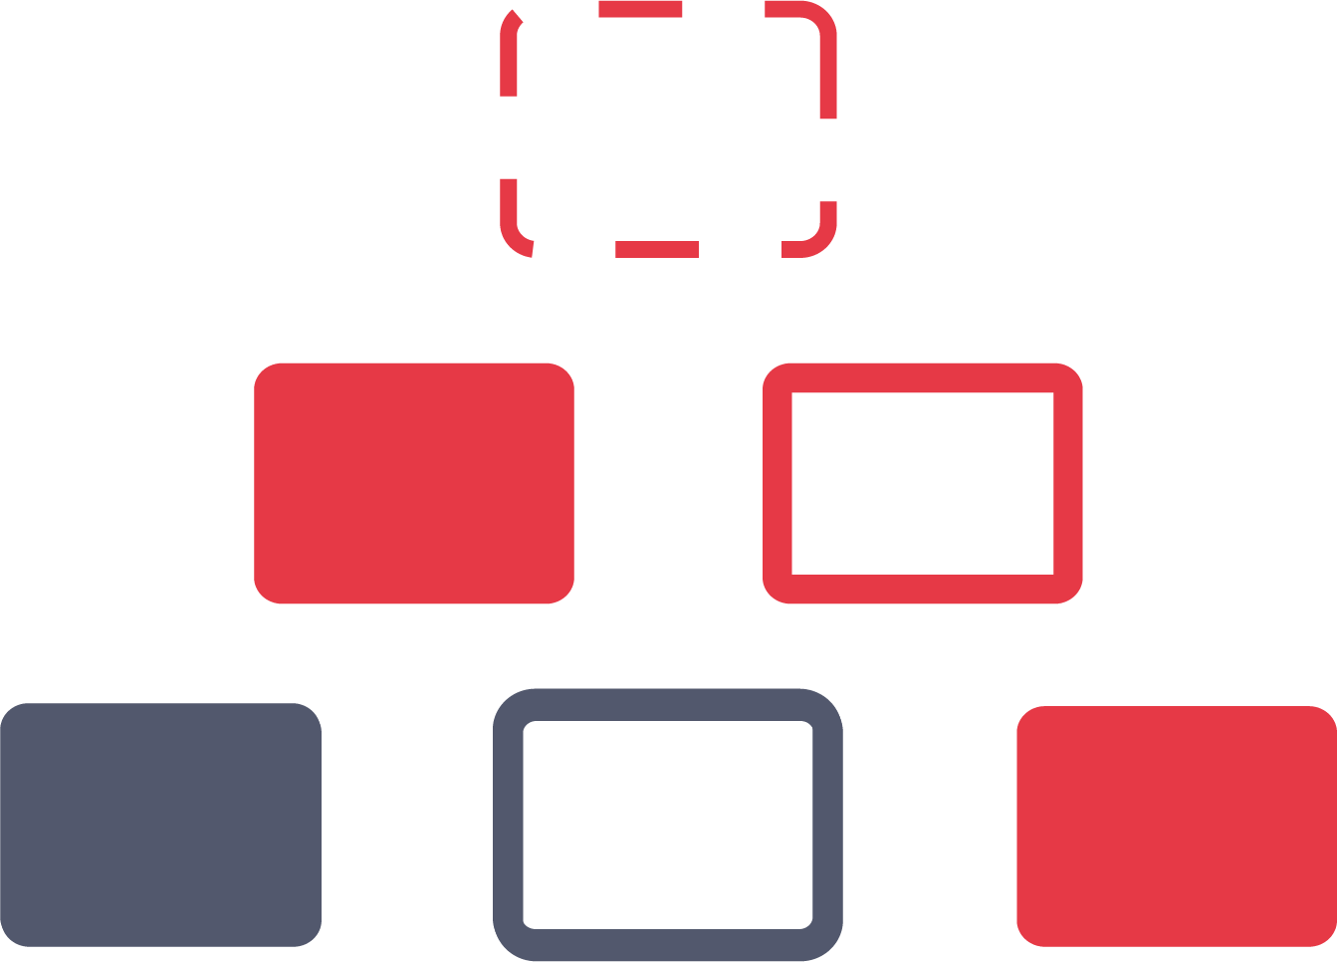
A Compass in the World of Open Science
Open Access Repositories
Tools & Software Registries & Repositories
Open Access Journals
Connecting researchers to a wealth of scholarly resources & data across disciplines.
Empowering scholars, innovators, and policymakers with seamless access to a universe of information.
Funding Databases
Aggregators
Research Communities
Identifier Registries
Research Infrastructures

Slide 4
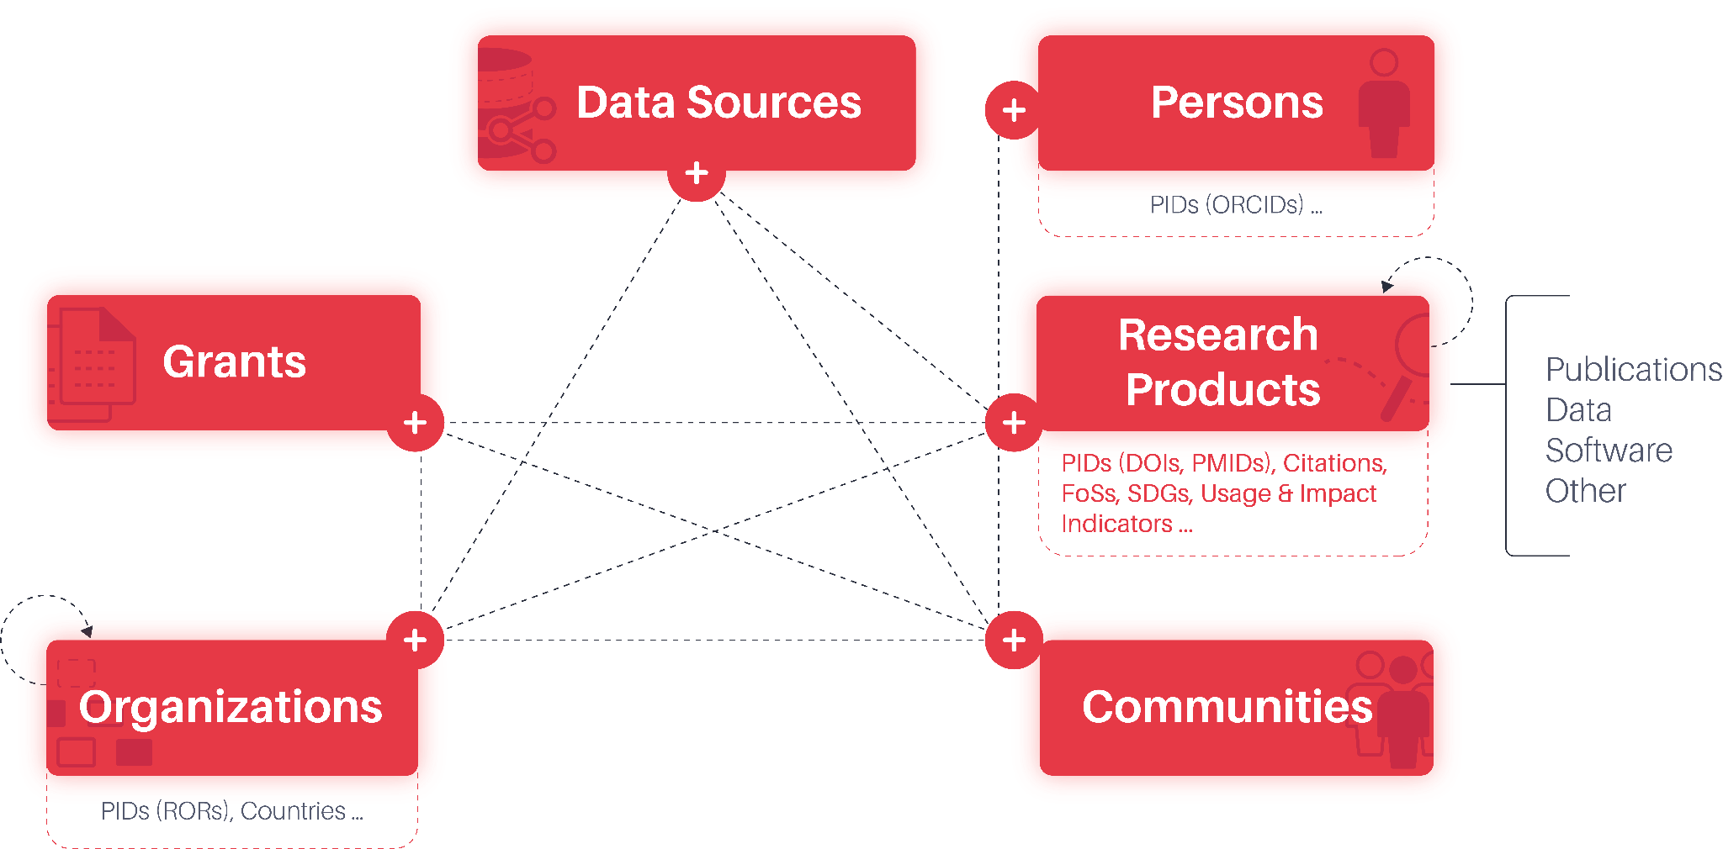
Illuminating the Web of Science
+256.7 M* records from +105k* data sources
The OpenAIRE Graph is an advanced data infrastructure, designed to map the scholarly communication landscape, creating an interconnected web of scientific knowledge.
Collecting everything, not just open research.
360° View of Research
*as of April 2024

Slide 5
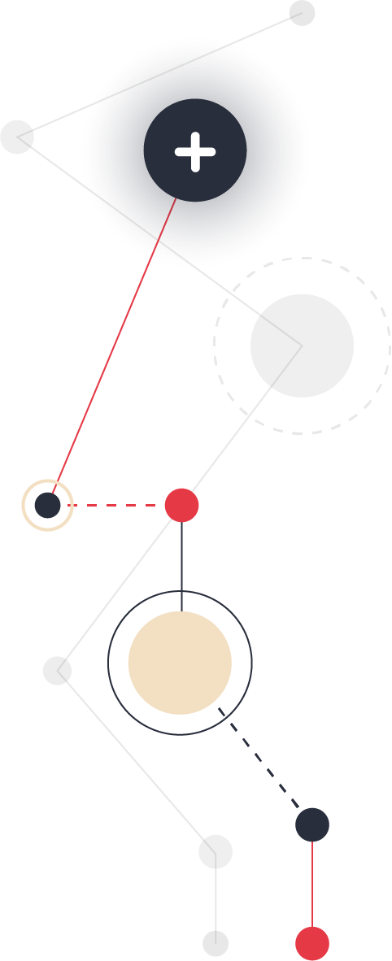
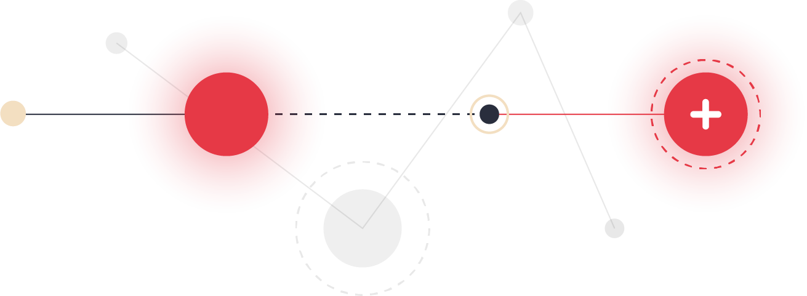
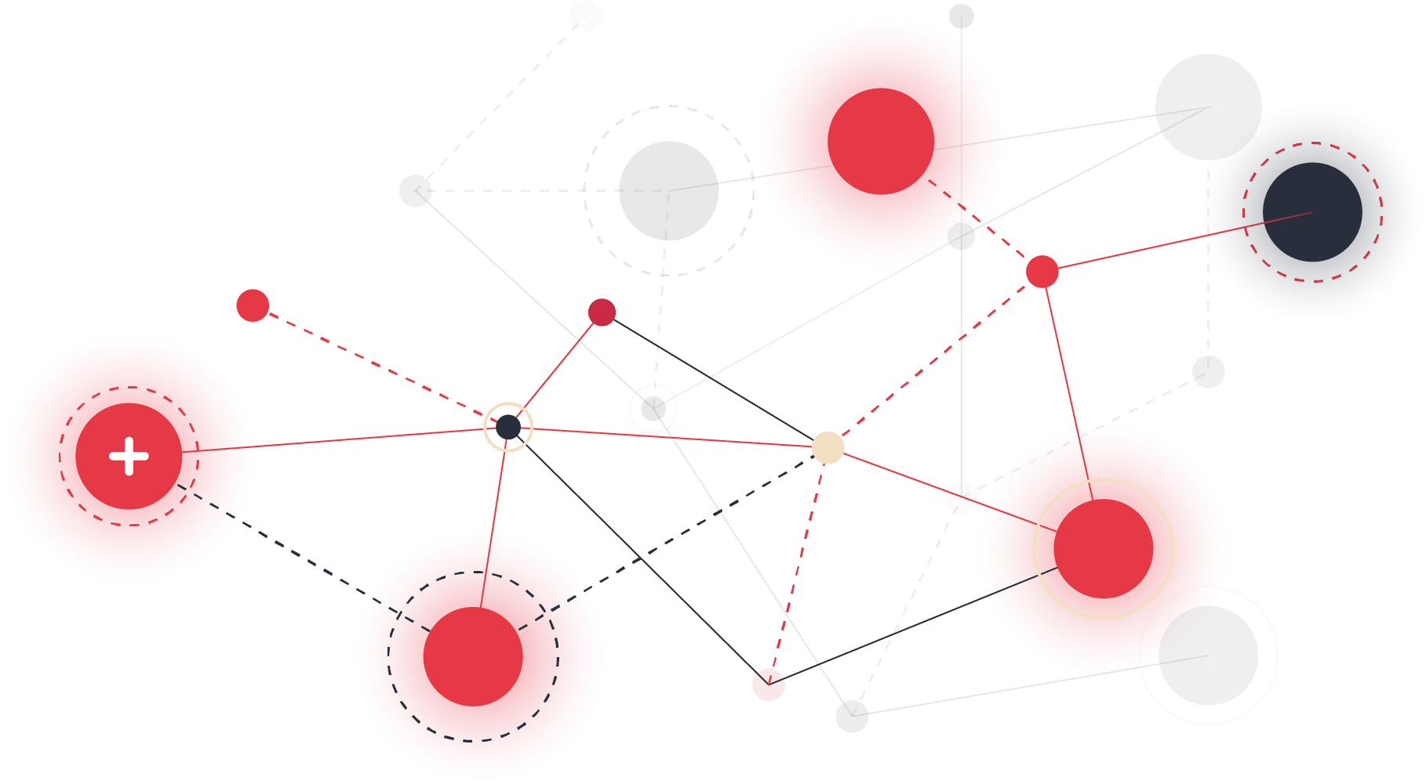
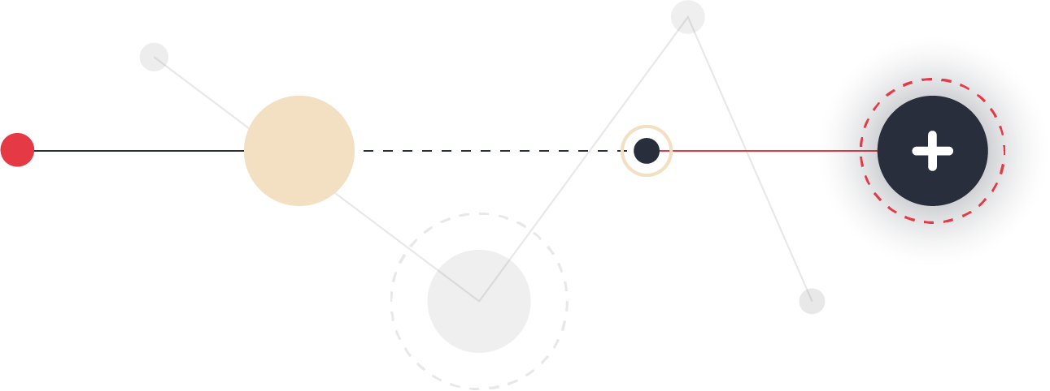
Innovative Architecture for Connected Scholarly Insights
Data Diversity: Provides a comprehensive mesh of scholarly works spanning across diverse disciplines.
Linking at Scale: Offers a new dimension of research connectivity on a large scale, uncovering hidden relationships and patterns.
Research Connectivity: Empowers your research journey with robust analytics and insights drawn from a rich tapestry of data.
Authors
Organisations
Software
Publications
Datasets
Projects

Slide 6
Aggregating Global Knowledge for Unprecedented Access
101 K Data Sources
Volume of Data: Access over the global core of research outputs, representing the global knowledge of science.
Source Diversity: Draw from a wide range of data sources, ensuring a multifaceted view of modern research.
Global Collaboration: Bridge geographical gaps with a platform that encapsulates international research efforts and expertise.
256 Mi Works
175 Mi Pubs
363 K Software
60 Mi Datasets
3.4 Mi
Grants
*Numbers as of April 2024. View the most recent statistics here.

Slide 7
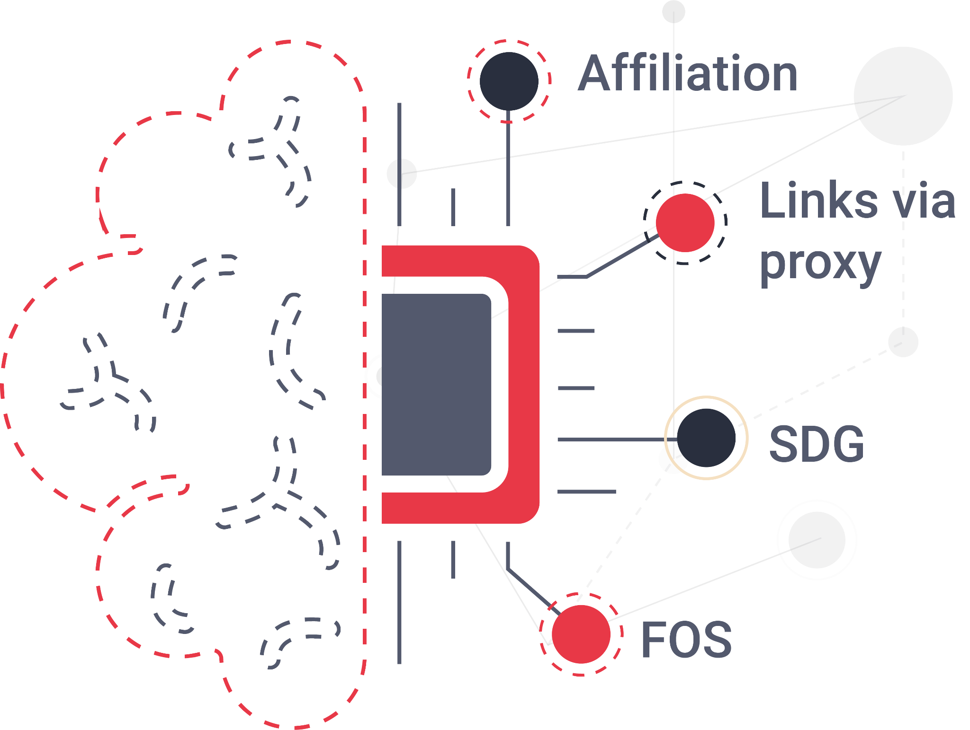
The Power of Linking
Harnesses the precision of AI-powered algorithms that ensure relevant and context-rich linkages between research entities.
Leverages the potential of machine learning to continuously refine and enhance the Graph's interconnectivity.
Utilises semantic technology that comprehends the data, providing you with connections that go beyond mere keywords to understand the essence of research outputs.

Slide 8
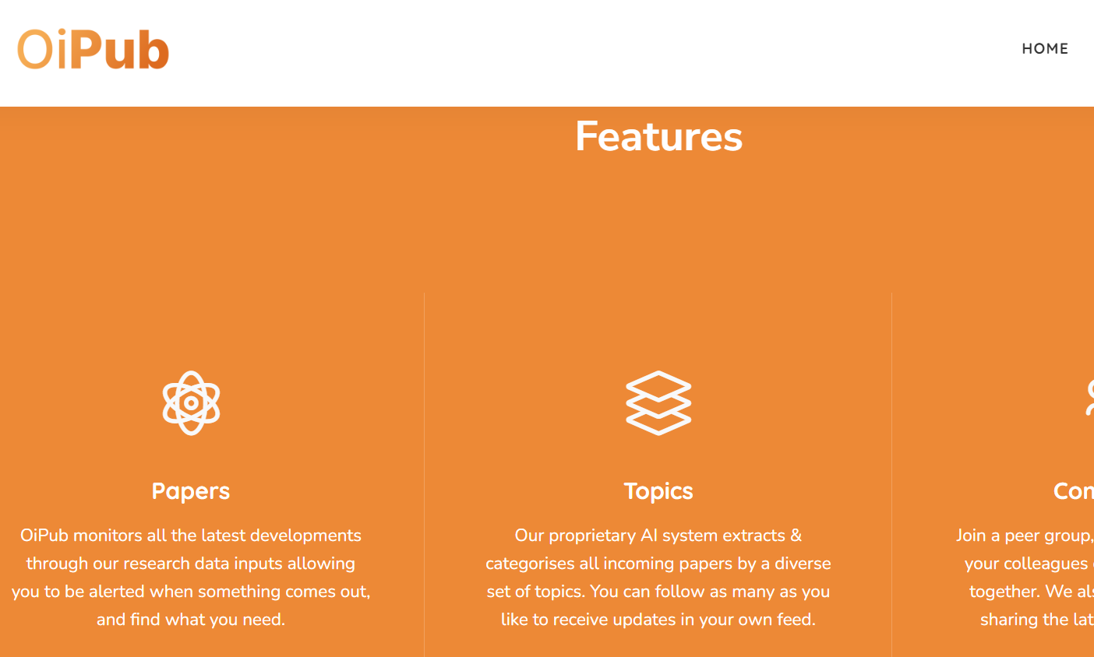
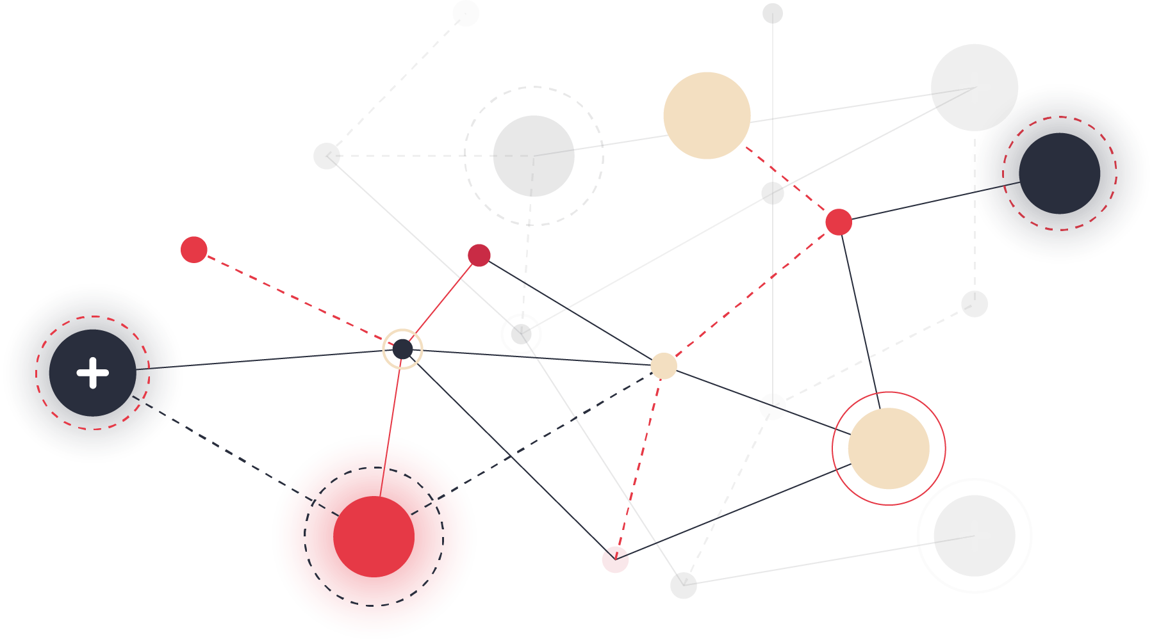
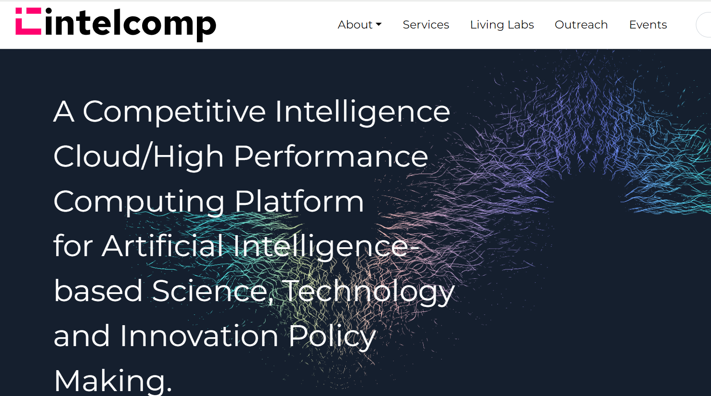
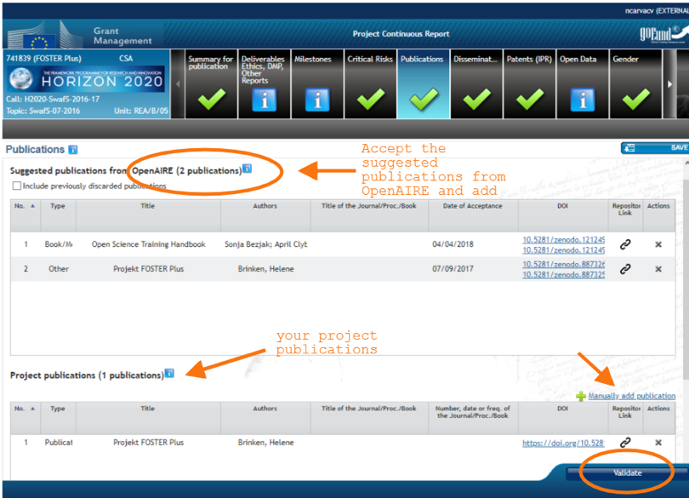
Where Cross-Disciplinary Boundaries Dissolve
OiPub
Intelcomp
Cross-Disciplinary Discovery: Navigate seamlessly across a spectrum of disciplines, uncovering hidden synergies and fostering new research dialogues.
Collaboration Networks: Connect the dots between disparate fields, identifying collaborative opportunities that push the boundaries of innovation.
Innovation through Diversity: Discover a mosaic of research insights that, when combined, fuel groundbreaking advancements and complex problem-solving
EU Participant Portal

Slide 9
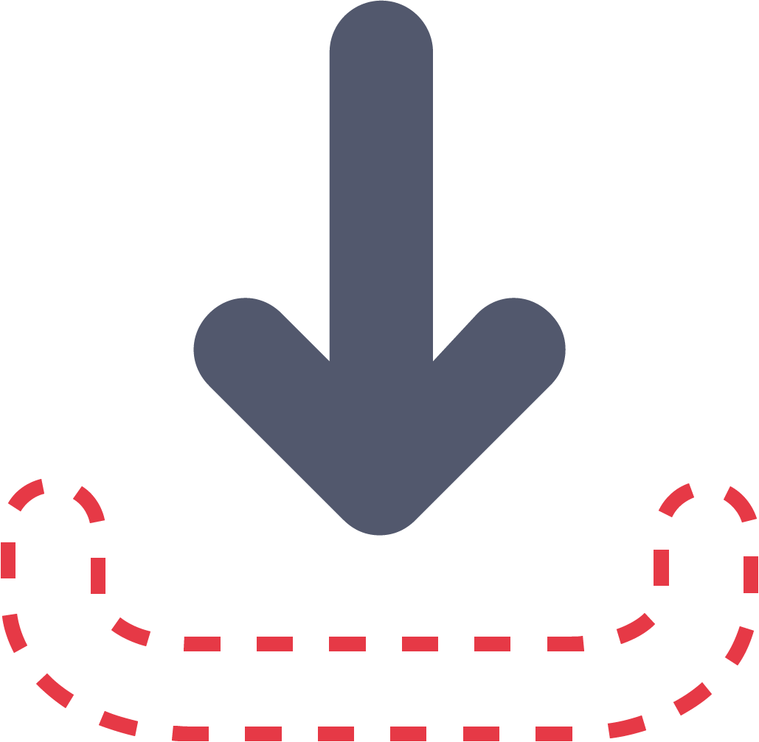
Support for Impact-Based Search and Discovery
Impact indicators are embedded into outputs measuring popularity, impulse, influence, downloads, and views.
See the scope of your own outputs and discover entities in the Graph with the largest and lowest impact to identify trends in your field.

Slide 10
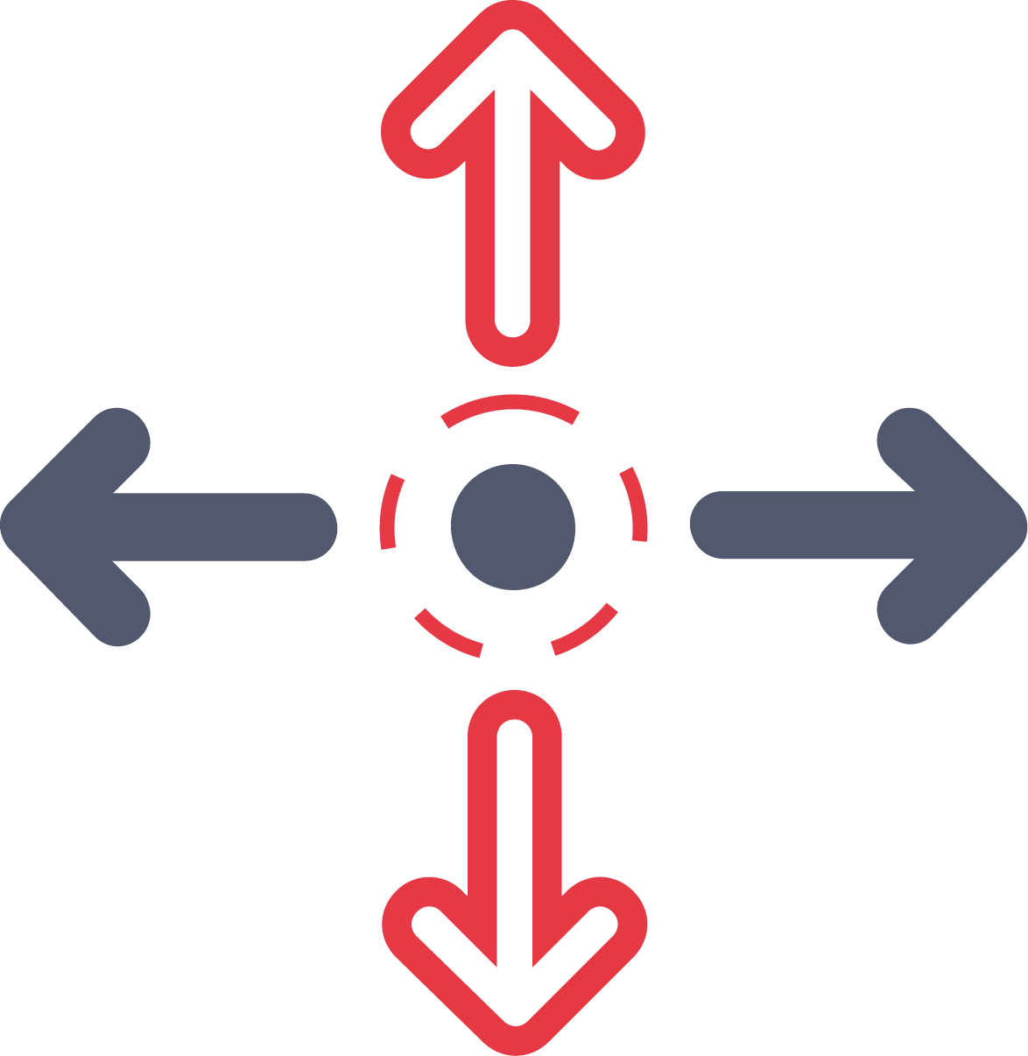
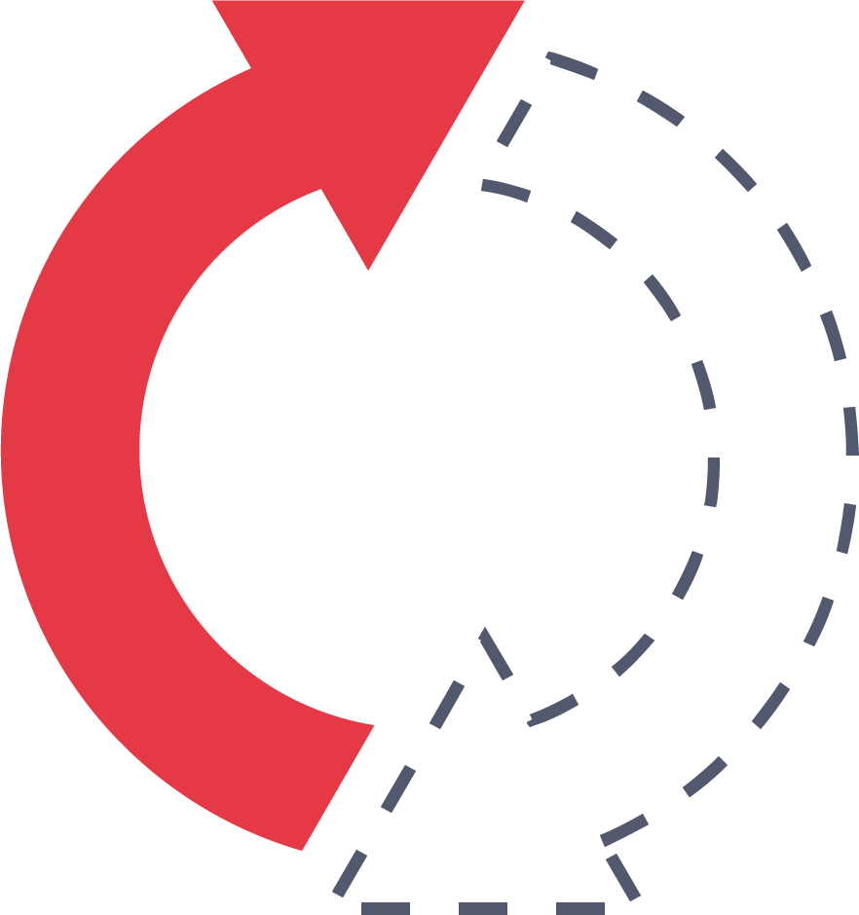
Elevating Research with Open Science and FAIR Principles
Findable
Drive your Research Forward: Rest assured that your work will contribute to a more open, collaborative, and transparent scientific ecosystem.
Leverage FAIR-Compliant Data: Ensure that your research is discoverable, accessible, and reusable, maximizing its impact and utility.
Engage with a platform that is designed from the ground up to support the principles of Open Science, facilitating a culture of shared knowledge and innovation.
Accessible
Interoperable
Reusable

Slide 11
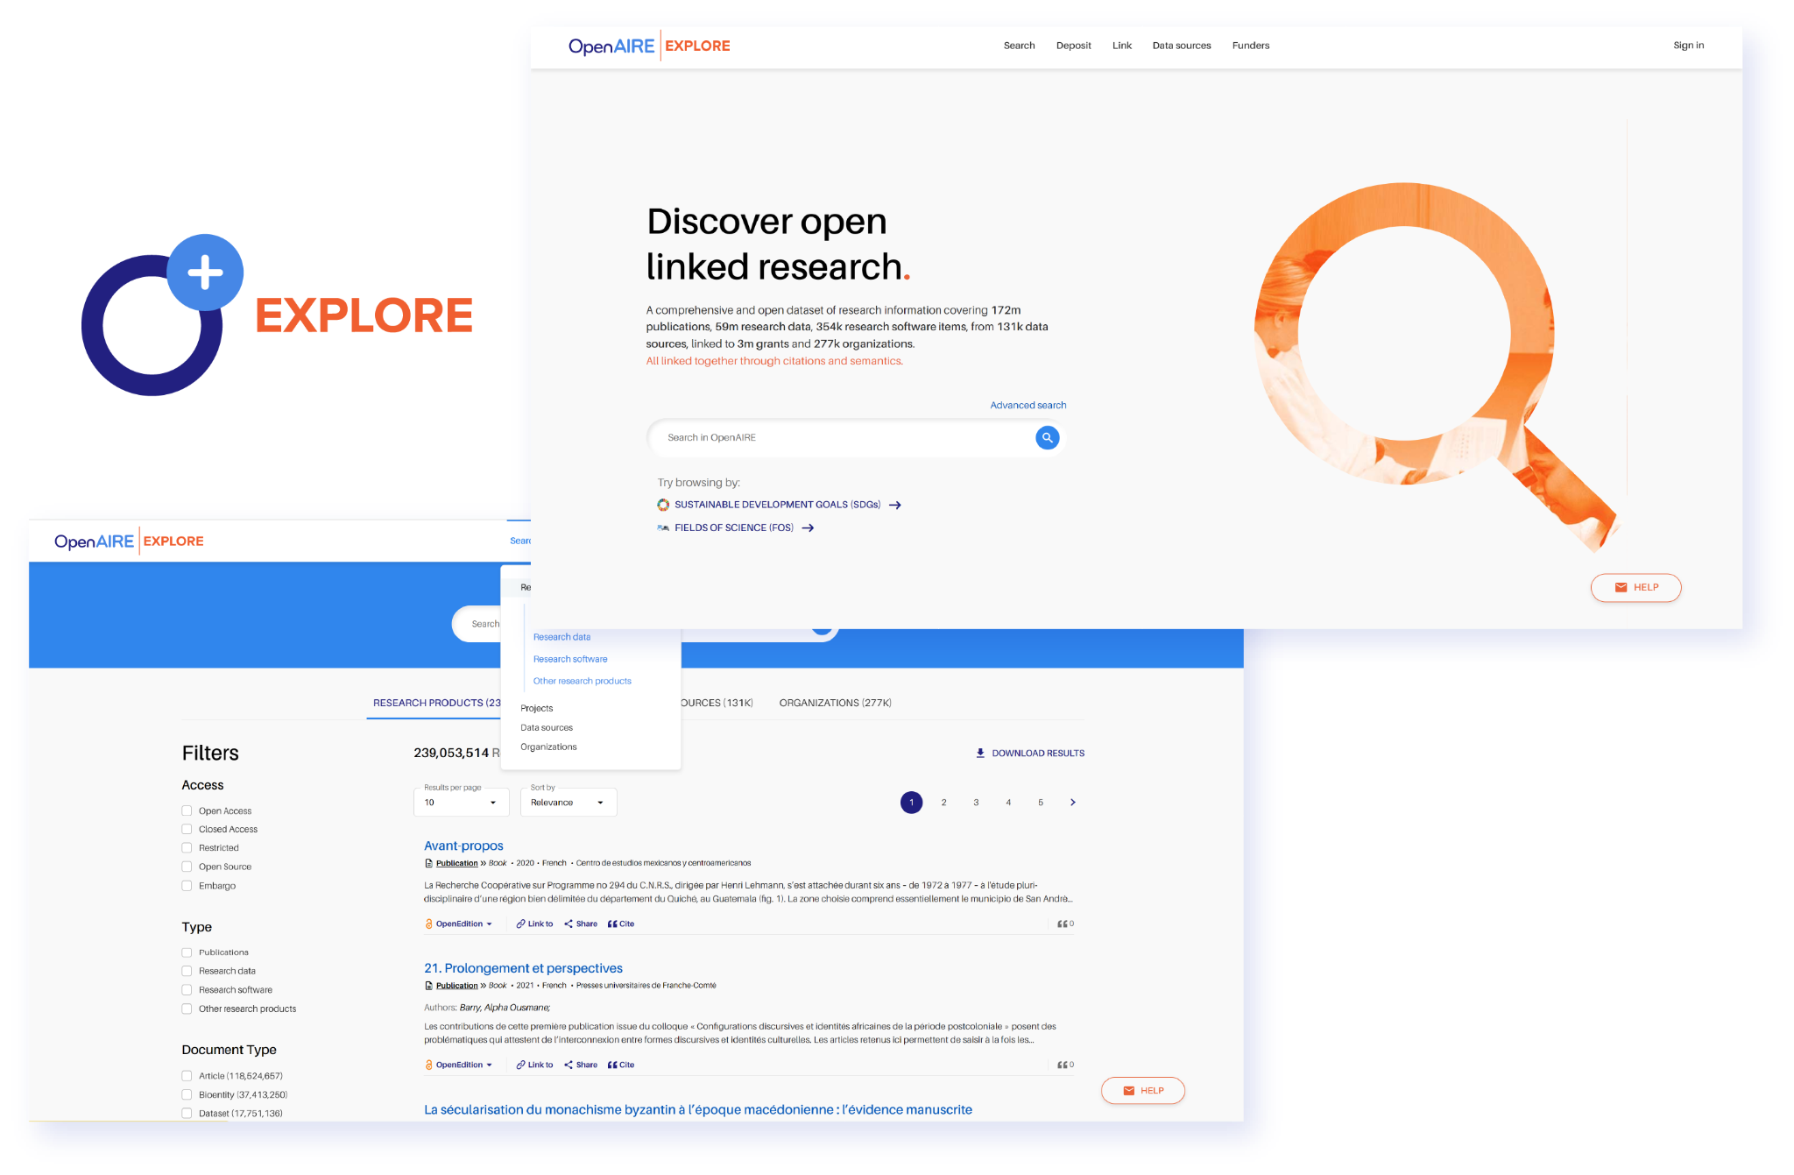
Use OpenAIRE Graph for Discovery
Quickly and easily navigate the
Graph’s wealth of knowledge with
OpenAIRE EXPLORE.
Discover research products, projects, data sources, organisations, and more.
… No technical background or powerful computing
infrastructure needed!

Slide 12
Use OpenAIRE Graph for Discovery
Link your work. Our Link service provides access to many external sources via APIs.
You can easily claim any missing result in OpenAIRE and connect your publications with datasets, software, and funded projects.
Learn how with our guide.

Slide 13
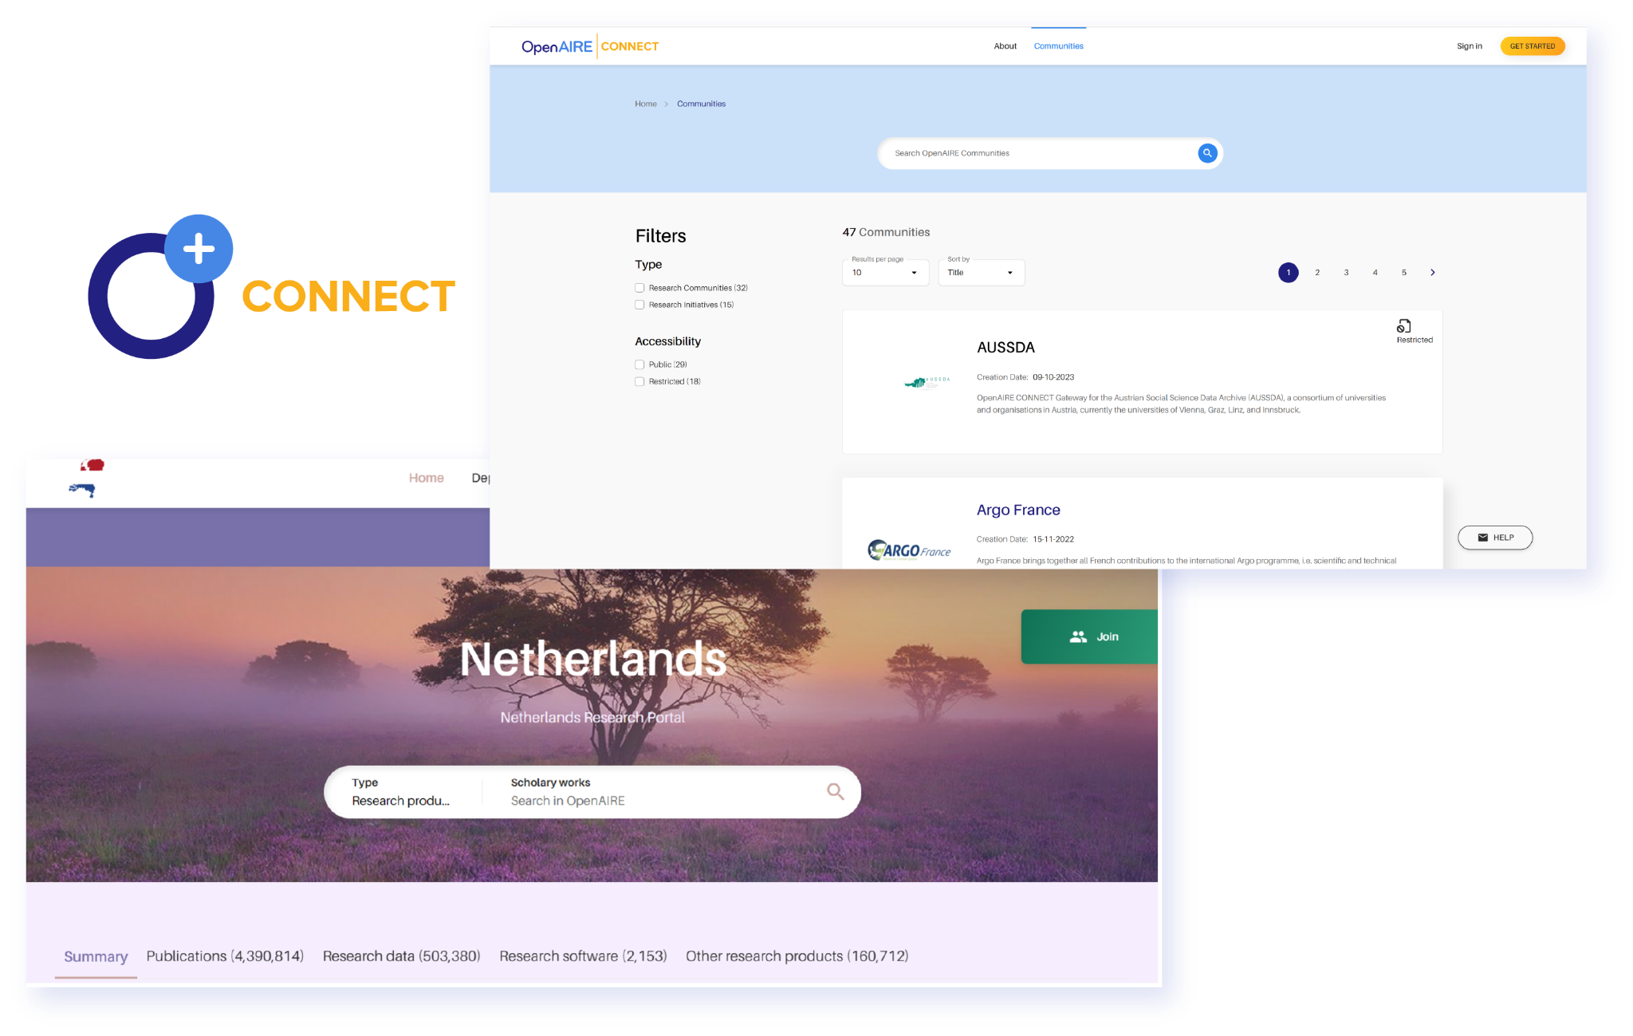
Use OpenAIRE Graph for Discovery
Create a sub-Graph for your community with OpenAIRE CONNECT.
Gather research outputs relevant to your field all in one spot.
Get in touch to build a gateway for your community

Slide 14
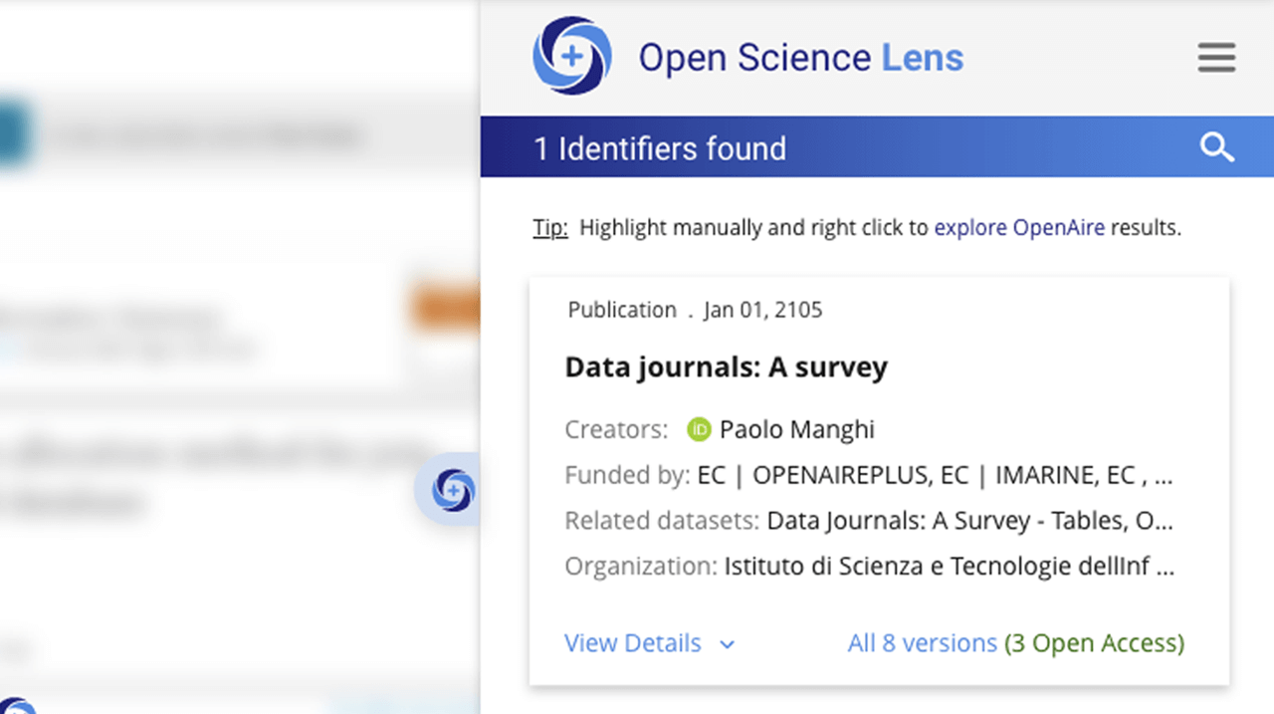
Use OpenAIRE Graph for Discovery
Use the Open Science Lens plugin to locate and explore information of relevance to Open Science as you browse the web.
Get the browser plugin, available for Chrome and Edge

Slide 15
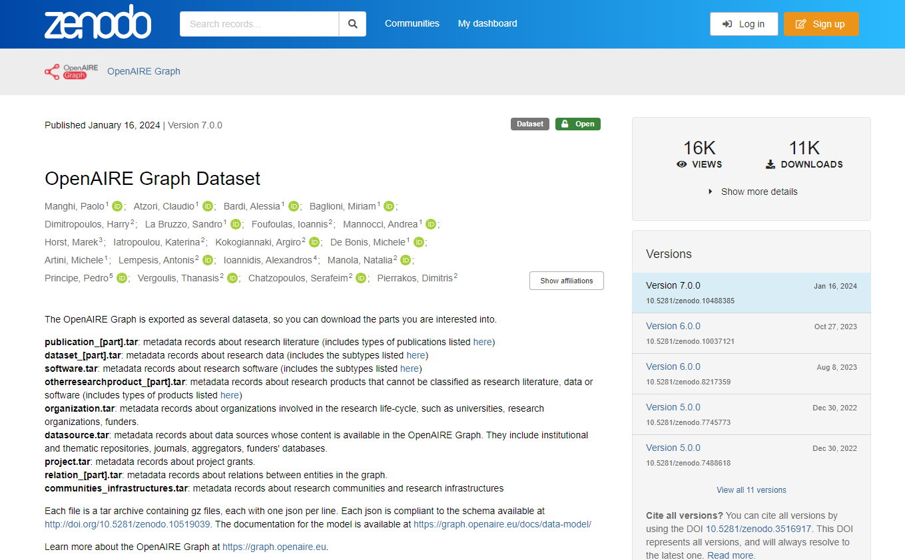
Use OpenAIRE Graph for Discovery
Do you have technical expertise?
Use OpenAIRE API to directly
explore data in the Graph dataset
Download the Graph dataset on
Zenodo to explore and process
data for your discovery objectives
Note: While the dataset is open and free to all, it requires a significant amount of processing power to handle the entirety of its data. If you don’t possess such capacities, you can access parts of the Graph via the Beginner’s Kit

Slide 16
Stay in touch
Your go-to for personalised technical support and service assistance
Helpdesk
graph.openaire.eu/helpdesk
helpdesk@openaire.eu
A space for Graph users to discuss functionalities, share insights,
ask questions, and learn together
User Forum
openaire.flarum.cloud

