Slide 1
Bibliometrics

Slide 2
Enter the new era of Research Assessment with the OpenAIRE Graph.
Transition away from proprietary databases, and include more than just publications when assessing bibliometrics

Slide 3
Use OpenAIRE Graph for Bibliometrics
We are the community driving Open Science in Europe for more than 15 years
We care about ensuring that openness is not just for researchers, but also for policy and decision makers
We use openness for the community’s advantage
We ensure that the OpenAIRE Graph is a community good, a collaborative effort, Open-source and community-driven aspects
Why?

Slide 4
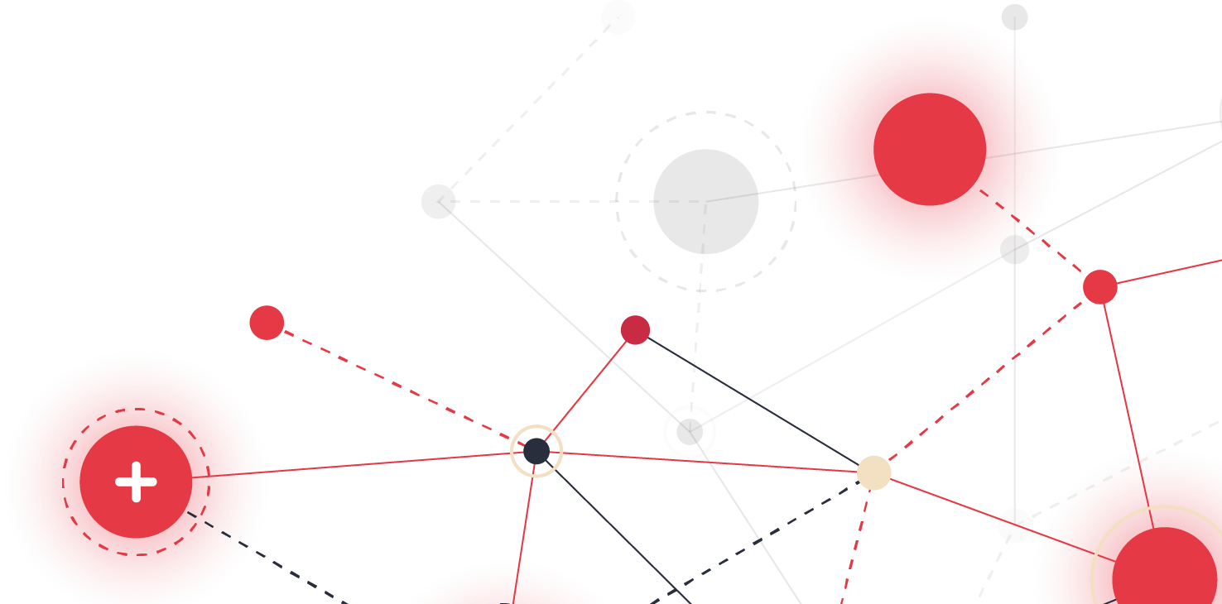
Features
A 360° View of Research
Open Access and Transparent
High Content Quality
Interlinked Data
Continuous Updates
Multi-Dimensional Analysis
Contextual Insights
EU and Global Research Focus
Community and Collaborative Effort
Cost-Effective
API Access

Slide 5
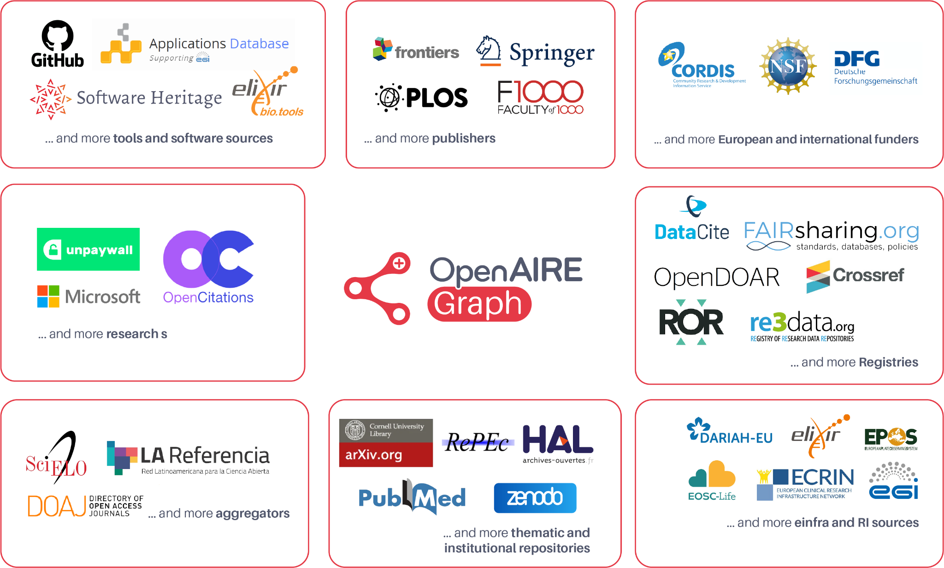
A 360° View of Research
Extensive and Diverse Data Sources
OpenAIRE Graph integrates information from a multitude of sources, including publications, research data, software, projects, organisations, and funders globally.
This provides a more holistic view of the research landscape compared to traditional bibliometric tools.
Data sources contributing to the graph
Collecting everything, not just open research

Slide 6
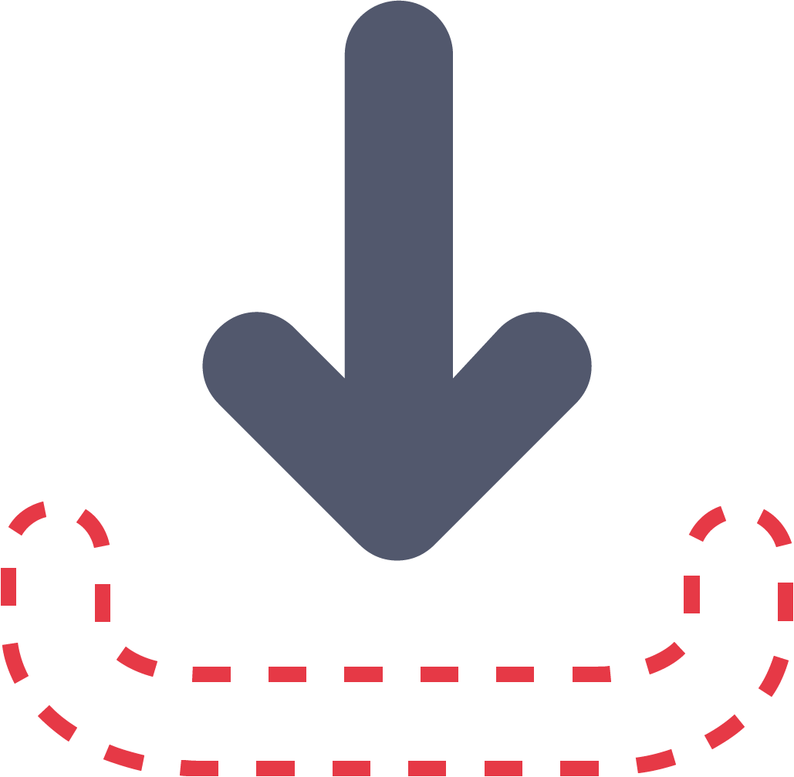
The World of Data Set Free
Open Access and Transparency
Open & Transparent
OpenAIRE supports Open Science principles, providing free and transparent access to its data.
This openness facilitates broader research and analysis opportunities, particularly for institutions or researchers with limited access to paid databases.
Data provenance is fully tracked and documented.
Unrestricted Access
Data is freely available for download and reuse, licensed under CC-BY

Slide 7
Constantly Improving Data
Deduplication: Avoids double-counting of citations across multiple versions of a single article.
Persistent Identifiers: Uses PIDs to effectively track publications, research data, and software.
Improving Content Quality Collaboratively
We are actively collaborating with the community and domain experts to check and evaluate the effectiveness of our internal processes in enhancing content quality.

Slide 8
Reveal Patterns & Trends
Interlinking of Data
OpenAIRE doesn't just collect data; it also interlinks it.
This means publications, data sets, projects, and funding information are connected, offering a unique opportunity to perform more complex, network-based analyses that can reveal patterns and trends not visible through simple citation counts or publication records.
AI
Recommendations
Data Analysis
Facilitation
Metadata Enrichment
Relationship Identification

Slide 9
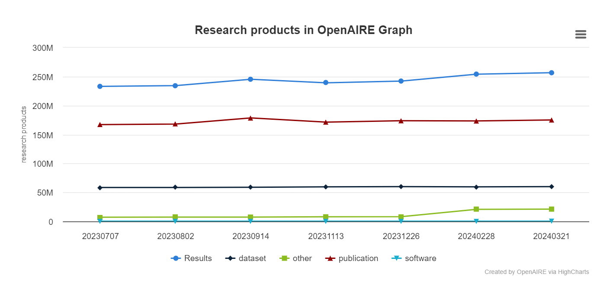
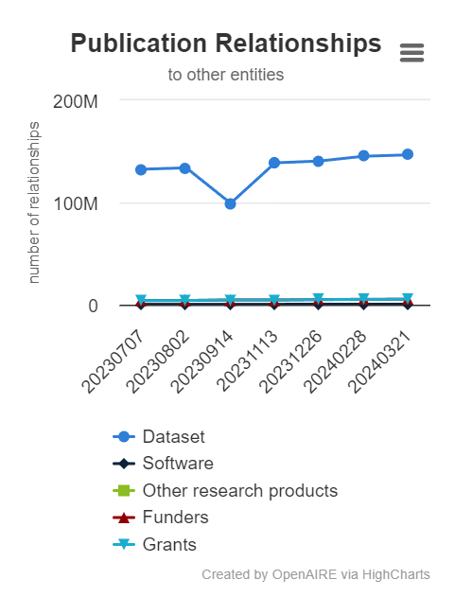
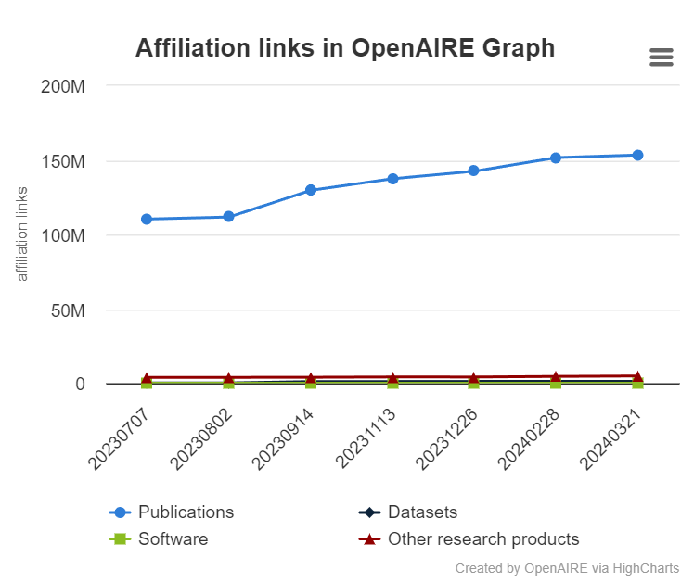
Access the Latest Data
Continuous Updates
The Graph is continuously updated, reflecting the latest changes and additions to the repository.
This feature is crucial for bibliometrics, where the timeliness of data can significantly impact the accuracy and relevance of the analysis.

Slide 10
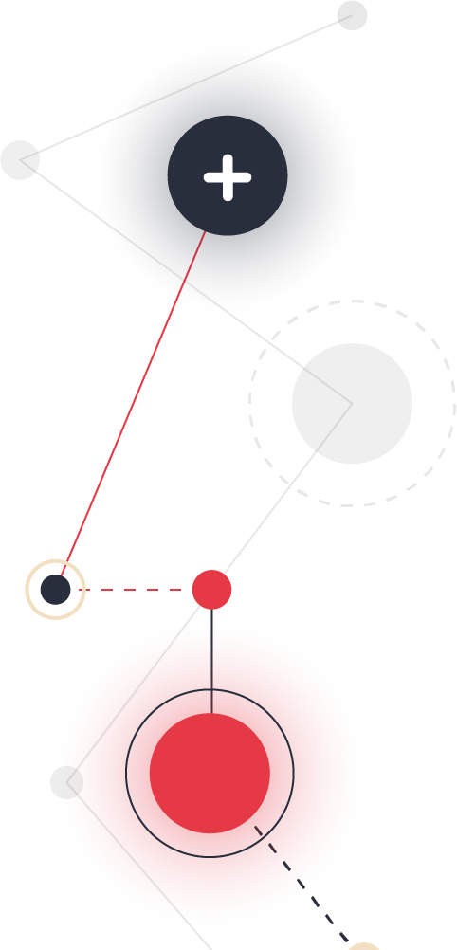
Conduct Analyses Beyond Citation Impact
Support for Multi-Dimensional Analysis
With its rich dataset and interlinked nature, the OpenAIRE Graph allows for multidimensional bibliometric analyses.
Researchers can explore beyond mere citation impact to examine aspects such as collaboration networks, interdisciplinary research impacts, and the influence of research funding on scientific outputs.
SciNoBo

Slide 11
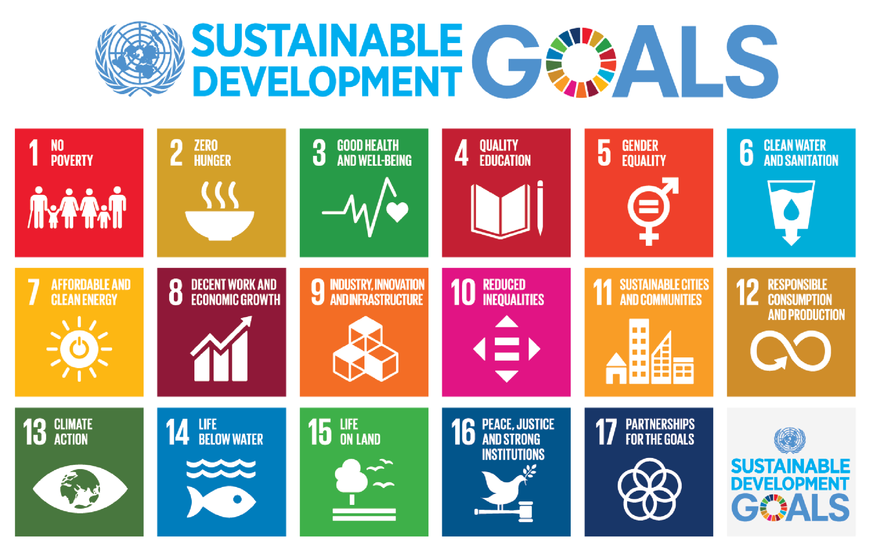
Get Deeper Insights into Publications
Contextual Insights
Enriches the context of publications by
classifying them according to Fields of
Science (FoS) and Sustainable Development Goals (SDG)
& Fields of Science (FoS)

Slide 12
Analyses Without Borders
EU and Global Research Focus
As an infrastructure that is aligned with the European Commission's Open Access mandates, the OpenAIRE Graph provides specific insights into the impact of European research initiatives.
Its extensive dataset also includes global research activities, making it a versatile tool for comparative studies on an international scale.

Slide 13
Created With and for You
Community and Collaborative Aspect
The OpenAIRE Graph encourages collaboration among researchers, librarians, and developers.
This community-driven aspect means that users can contribute to and benefit from improvements in data quality and functionality, promoting a more dynamic and responsive bibliometric tool.
Advance the OpenAIRE Guidelines to collaboratively improve standards for Open Access repositories, helping to support interoperability and increasing the visibility of research outputs.

Slide 14
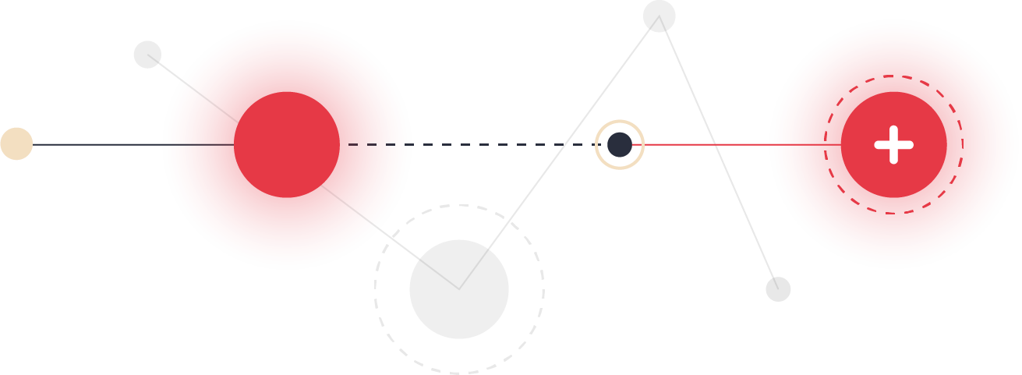
Unhindered Access
Cost-Effective
A cost-effective alternative to other bibliometric tools and databases that require expensive subscriptions.
This is particularly beneficial for organisations and researchers with limited funding but who need access to detailed bibliometric data.
If you would like to co-invest in the OpenAIRE Graph, you can contact us at amke@openaire.eu

Slide 15
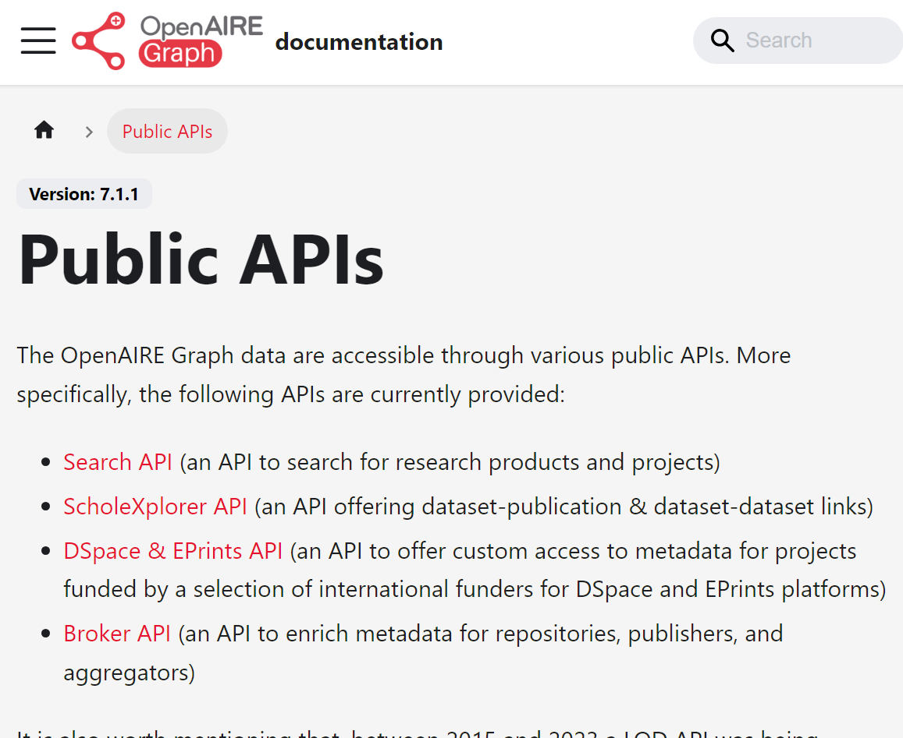
Access via APIs
Access the OpenAIRE Graph dataset through public APIs for your bibliometric analysis.
https://graph.openaire.eu/docs/apis/home

Slide 16
The OpenAIRE Graph in Numbers
256 Mi Works
Volume of Data: A collection of the global core of research outputs, representing the global knowledge of science.
Source Diversity: A wide range of data sources, ensuring a multifaceted view of modern research.
Global Collaboration: A platform encapsulating international research efforts and expertise, bridging geographical gaps.
175 Mi Pubs
363 K Software
60 Mi Datasets
101 K Data Sources
Global Aggregators
*Numbers as of April 2024. View the most recent statistics here.

Slide 17
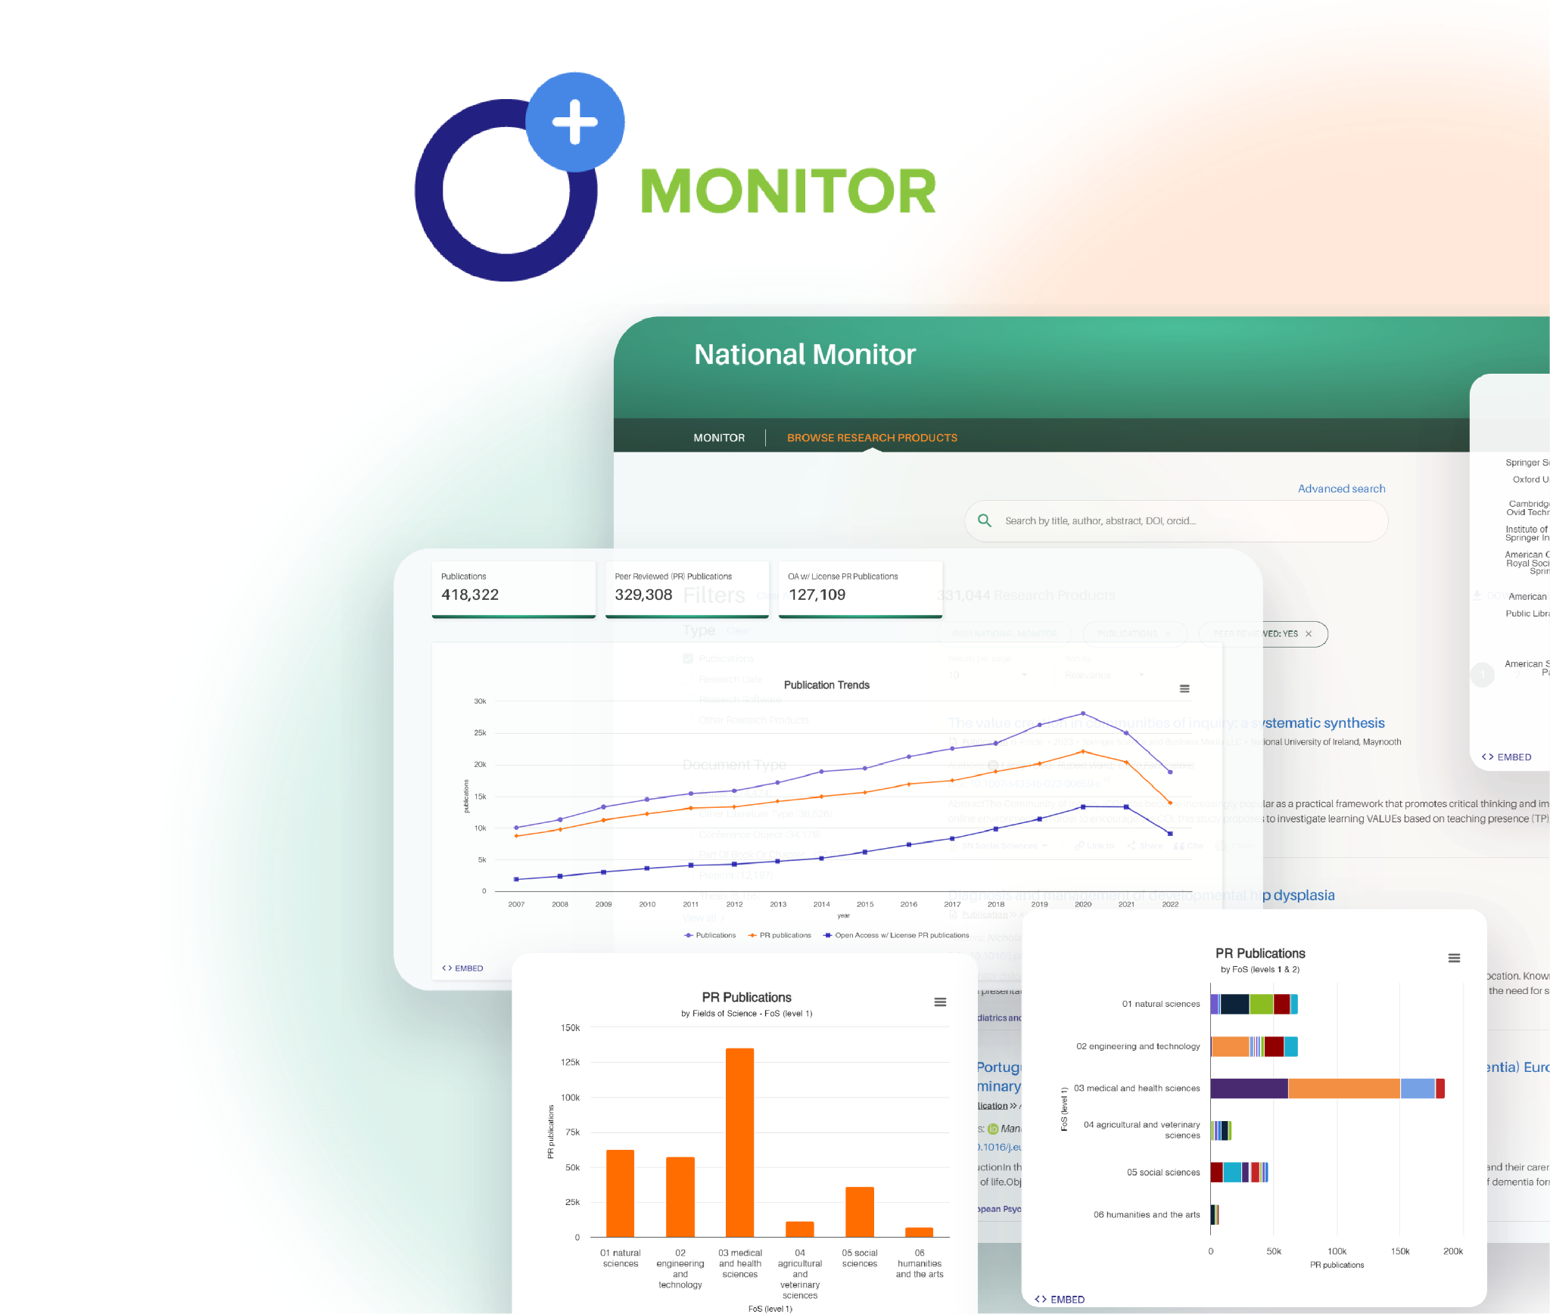
Use OpenAIRE Graph for Bibliometrics
Visualise the Graph’s data on the impact of your
organisation in the research ecosystem
via OpenAIRE MONITOR.
The Irish National Open Access Monitor example.
Supporting the nation’s shift towards Irish
scholarly research communication output
transparency and accessibility, aimed at being
100% Open Access.
… No technical background or powerful computing
infrastructure needed!

Slide 18
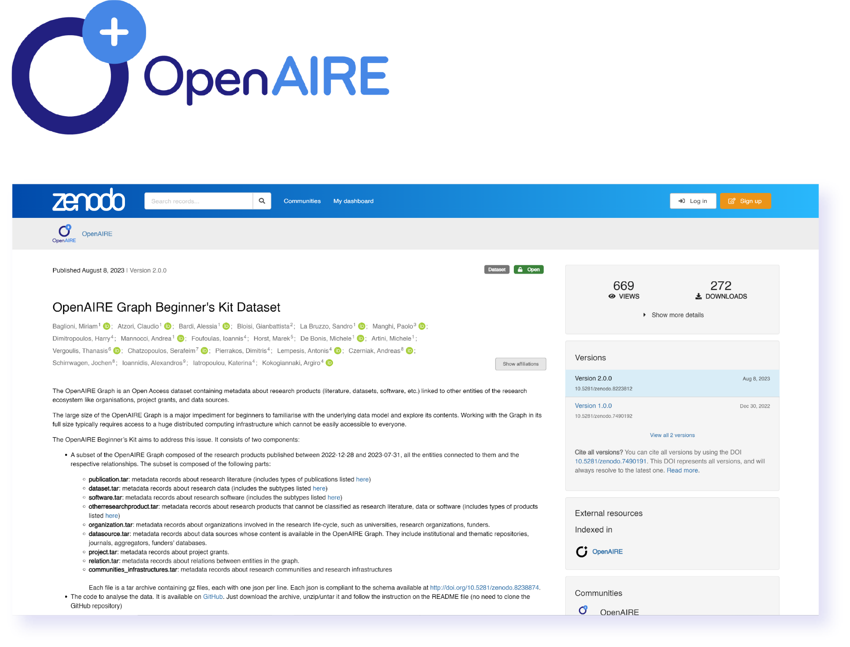
Use OpenAIRE Graph for Bibliometrics
Do you have technical expertise?
Access the OpenAIRE Graph dataset through OpenAIRE API for your bibliometric analysis.
Download the Graph dataset on Zenodo to
explore and process bibliometric data
Note: While the dataset is open and free to all, it requires a significant
amount of processing power to handle the entirety of its data. If you don’t possess such capacities, you can access parts of the Graph via the Beginner Kits.

Slide 19
Stay in touch
Your go-to for personalised technical support and service assistance
Helpdesk
graph.openaire.eu/helpdesk
helpdesk@openaire.eu
A space for Graph users to discuss functionalities, share insights,
ask questions, and learn together
User Forum
openaire.flarum.cloud

