Slide 1
Open Science
Monitoring

Slide 2
OpenAIRE Graph for Open Science Monitoring
Access essential data for tracking the adoption of Open Access and Open Science policies across the European Union, as well as within countries and organisations.

Slide 3
Aggregating Global Knowledge for Unprecedented Analyses
101 K Data Sources
The OpenAIRE Graph goes beyond publications, also including research data, software, and other outputs along with their citations.
256 Mi Works
175 Mi Pubs
363 K Software
60 Mi Datasets
2.4 Bi
Citations
*Numbers as of April 2024. View the most recent statistics here.

Slide 4
An Exhaustive and Mappable Dataset
Enhanced Accuracy: Deduplication prevents citations from being counted multiple times across different versions of the same article, ensuring accurate Open Science reports.
Comprehensive Data Collection: We gather information from a multitude of research products beyond just publications, such as datasets and software, to provide a holistic view of the research landscape.
Persistent Identifiers: PIDs ensure consistent tracking and monitoring of research products over time.

Slide 5
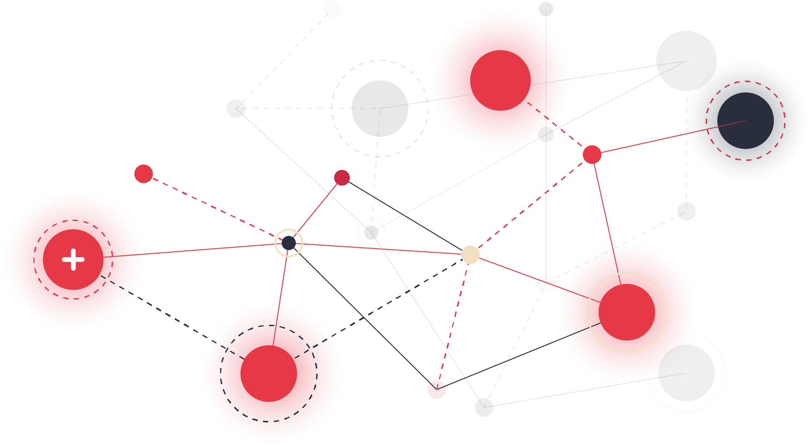
Harness Complete and FAIR Data
FAIR-ness: The OpenAIRE Graph by design is FAIR, meaning that it is Findable, Accessible, Interoperable, and Reusable
Complete Metadata: The Graph aims to be as complete as possible, collecting from all sources relevant to science. These include data from big players such as

Slide 6
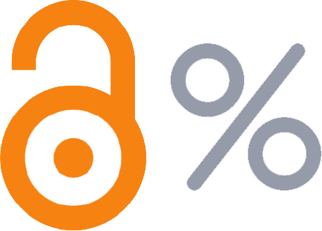
Get Deeper Insights into Open Access
Open Access Indicators for Organisations:
Assign each organisation a percentage value
that represents the proportion of their projects
which are Open Access.
Open Access Models Indicators: Identify
outputs published under certain Open Access
models (green, bronze, gold, hybrid, or
diamond).

Slide 7
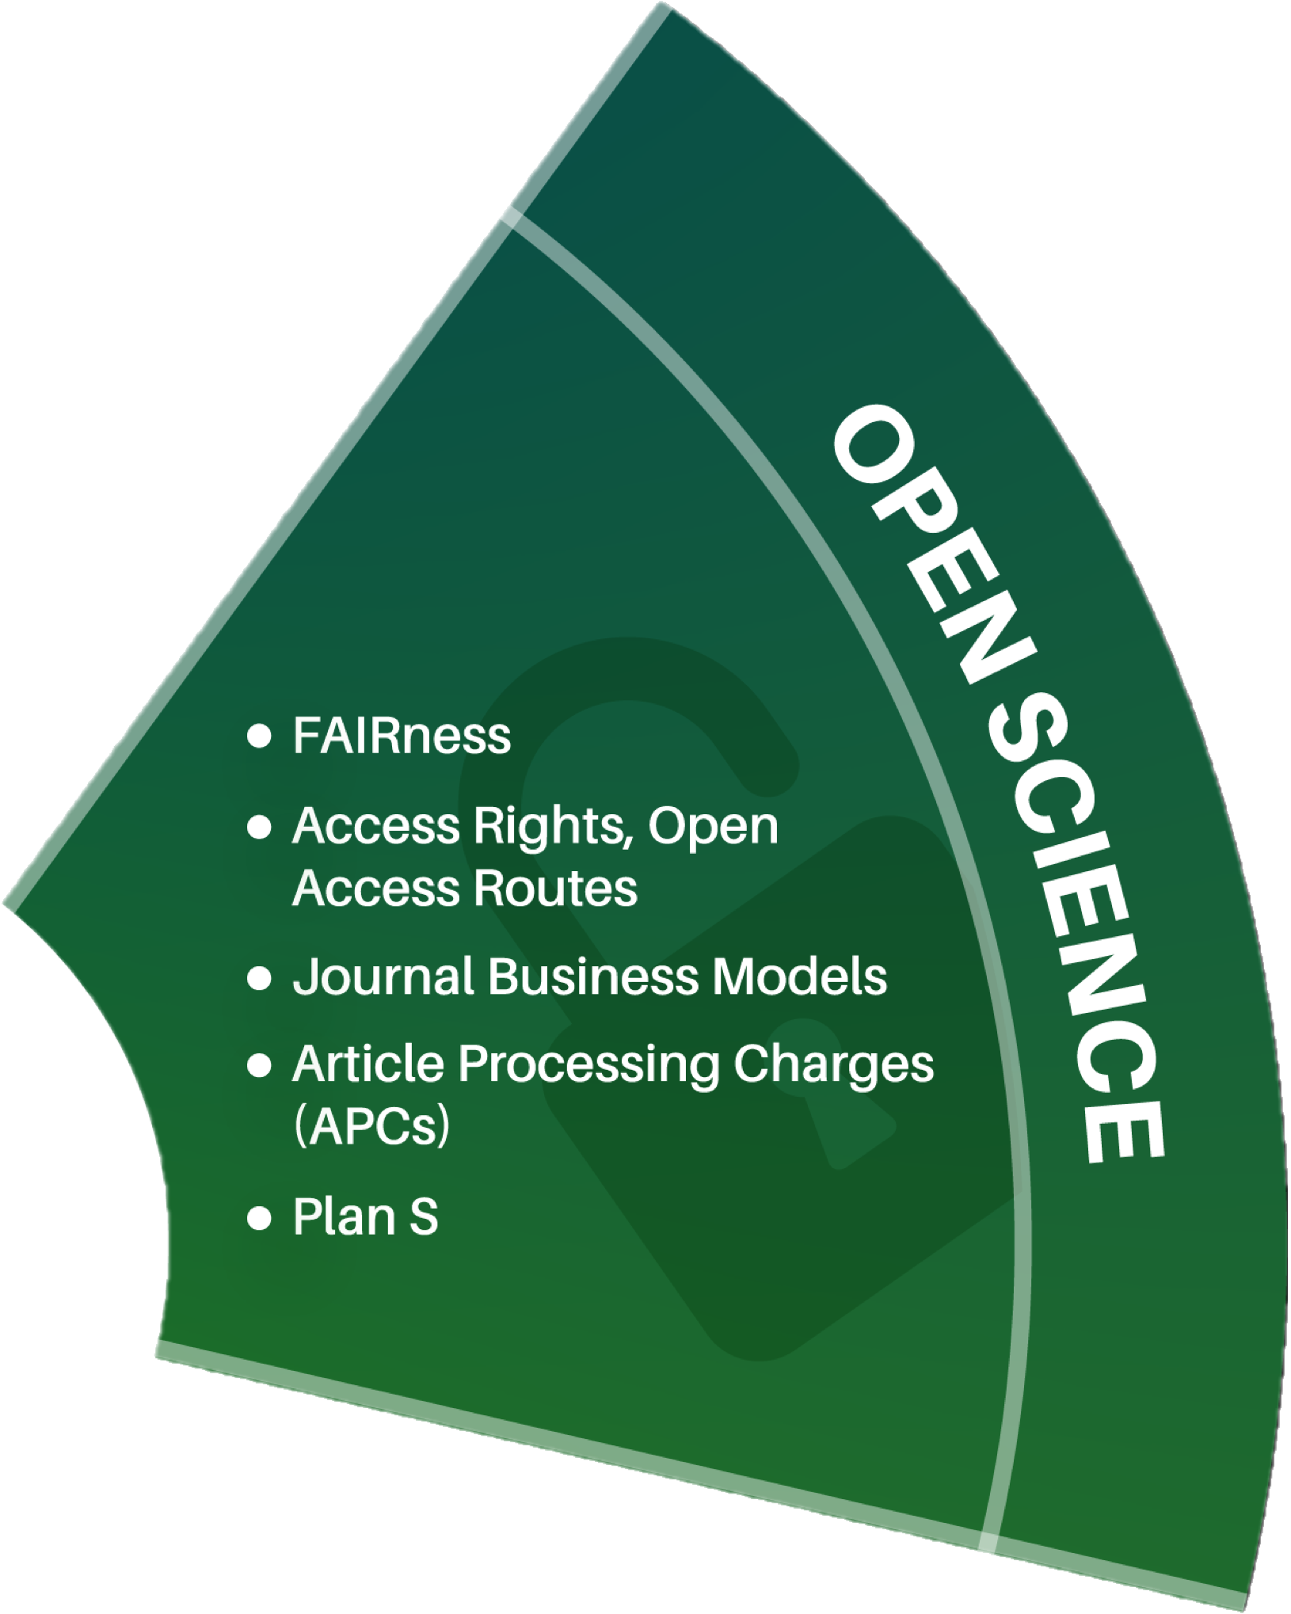
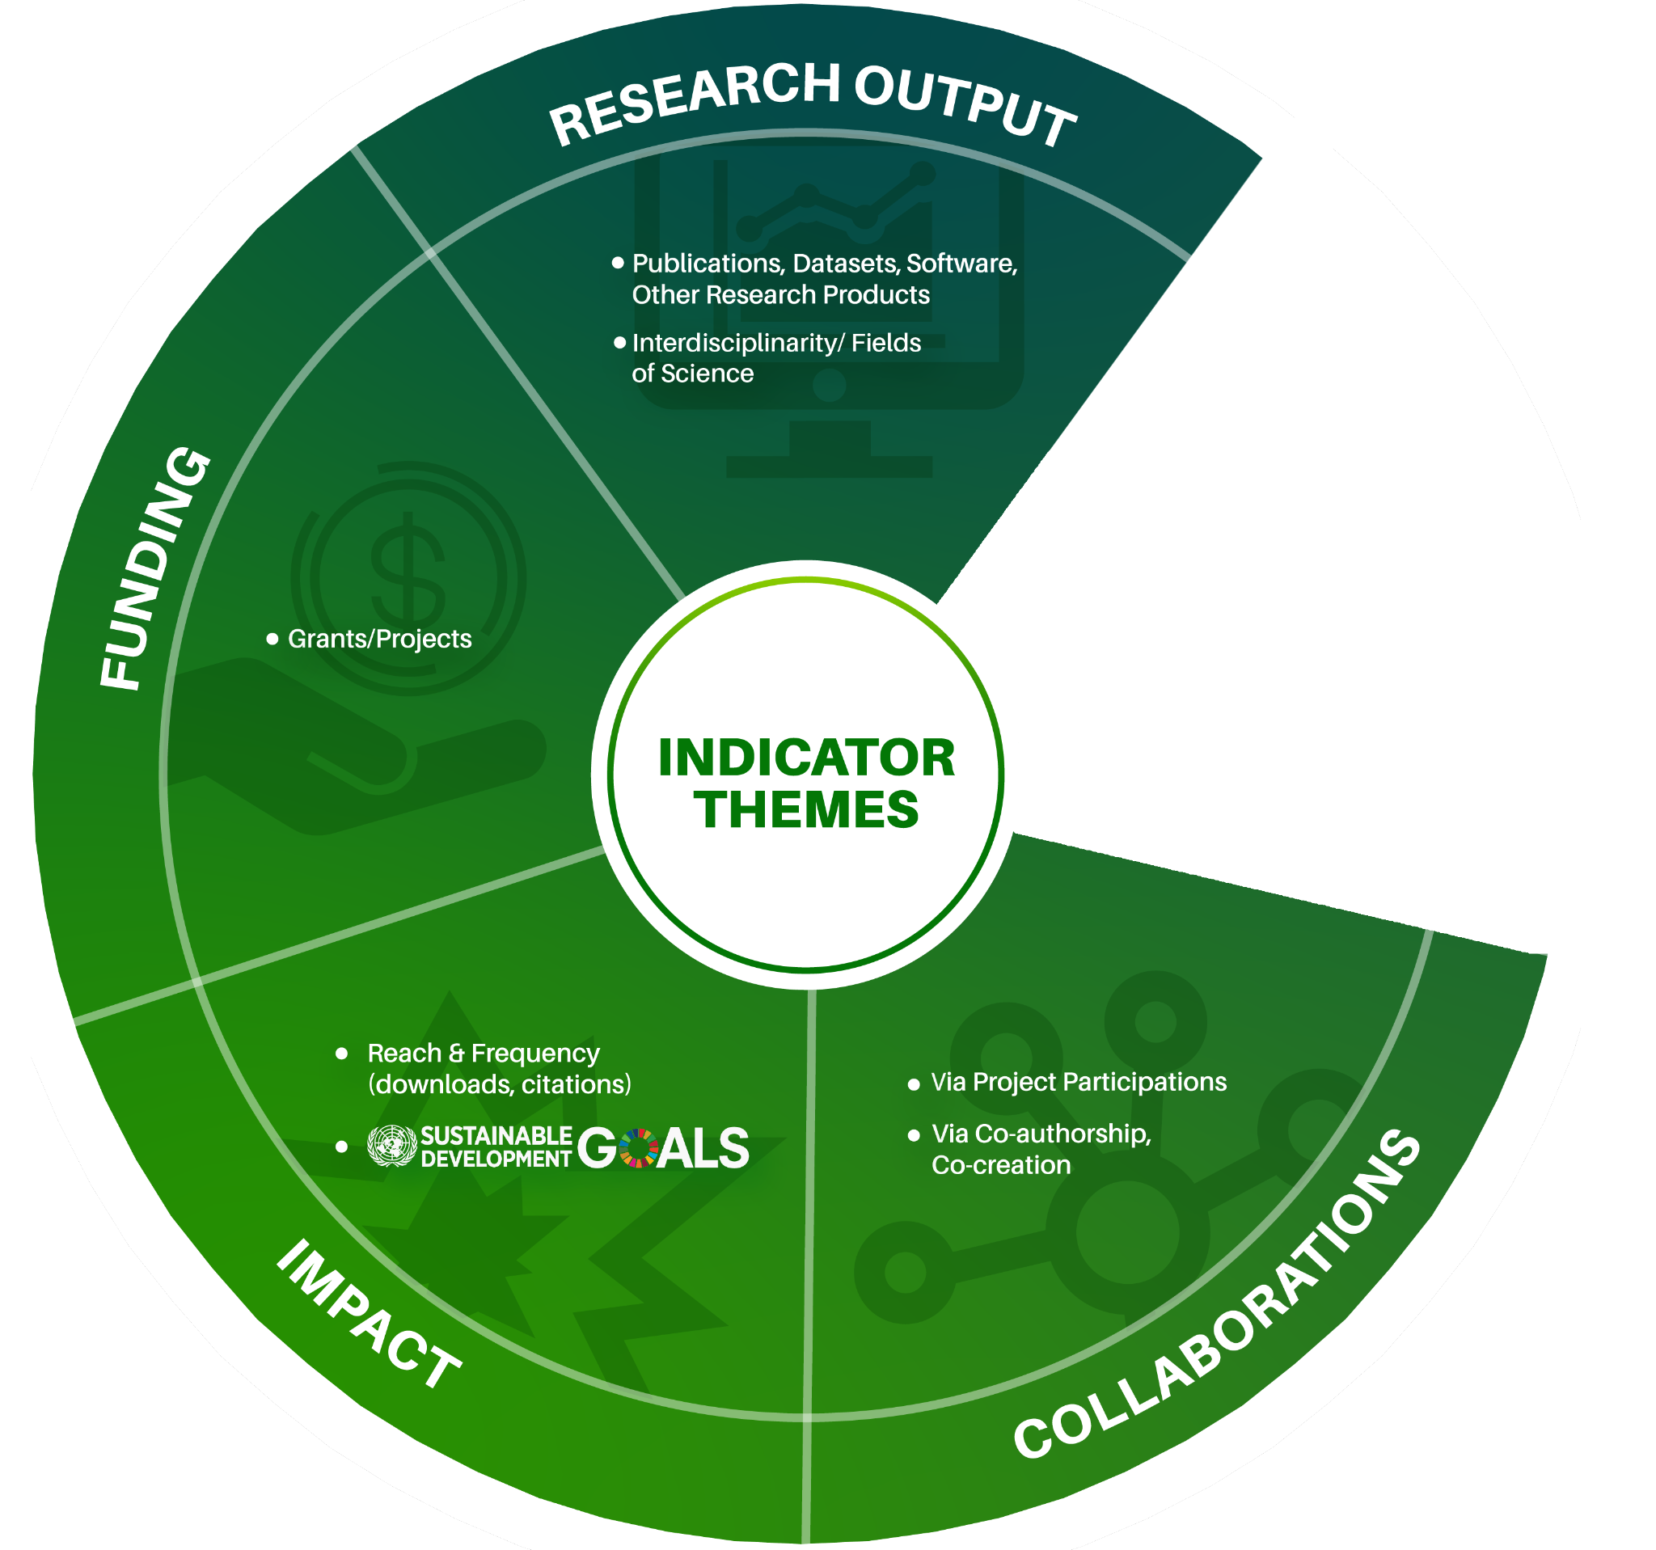
Diverse Monitoring Indicators
Other indicators that support Open Science Monitoring

Slide 8
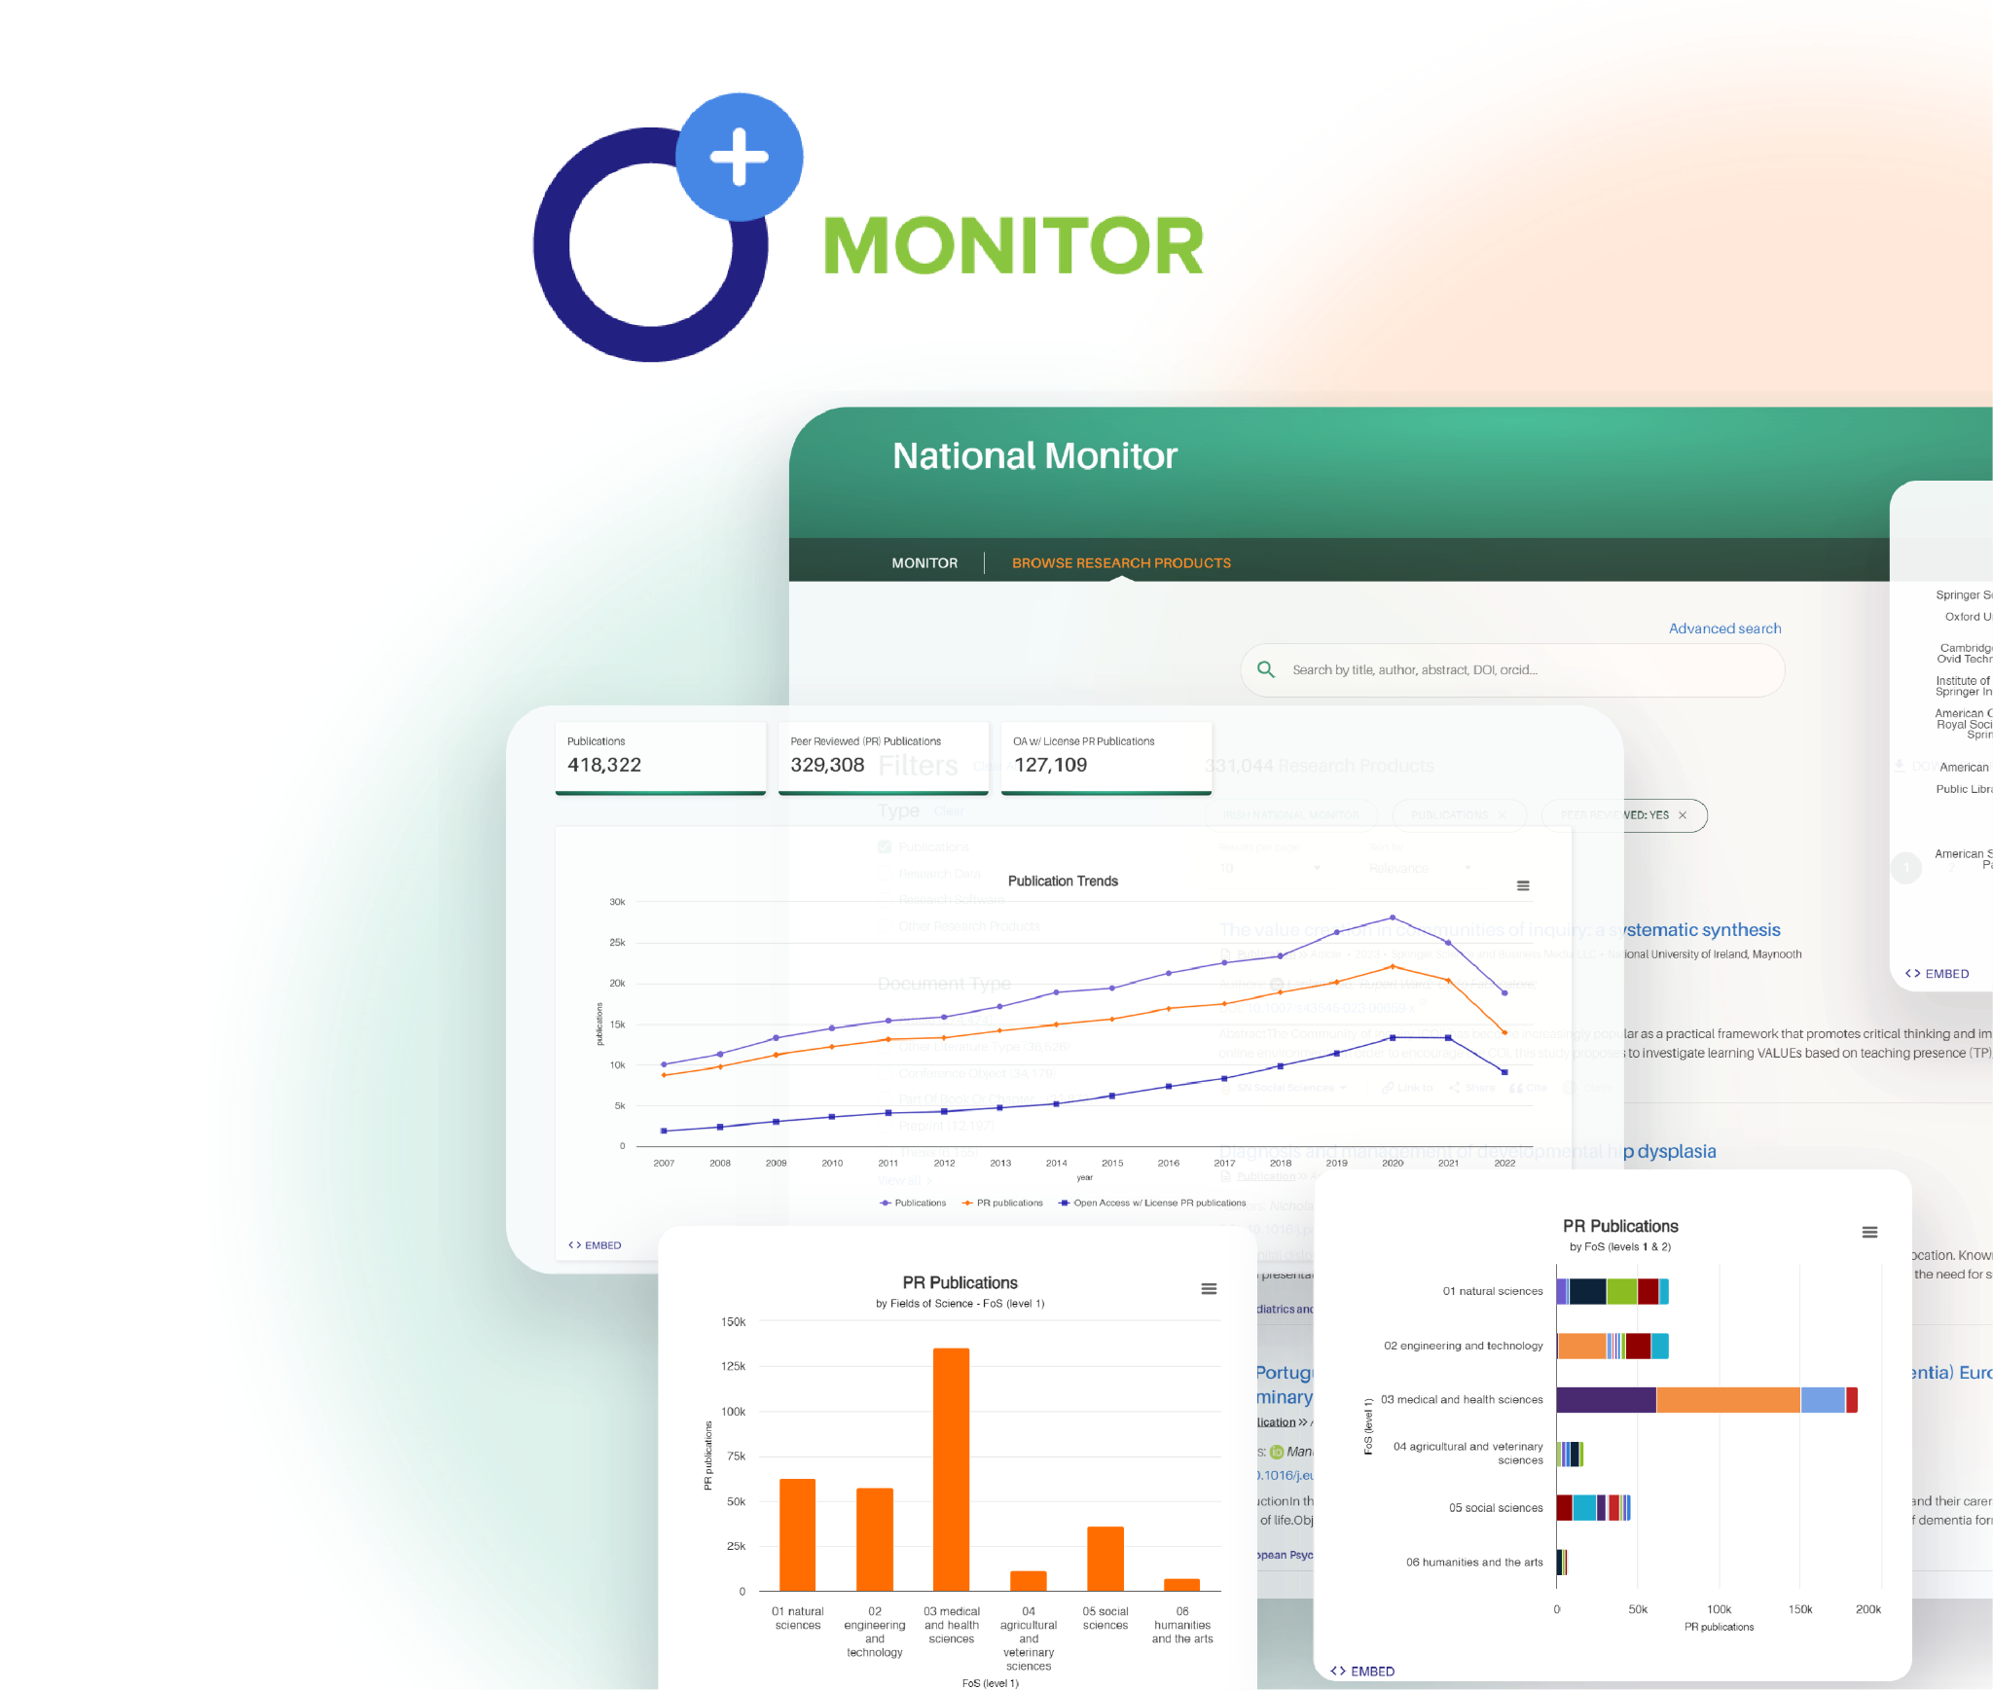
Use OpenAIRE Graph for OS Monitoring
Visualise the Graph’s data on the impact of your
organisation in the research ecosystem
via OpenAIRE MONITOR.
… No technical background or powerful computing infrastructure needed!
The Irish National Open Access Monitor example.
Supporting the nation’s shift towards Irish
scholarly research communication output
transparency and accessibility, aimed at being
100% Open Access.

Slide 9
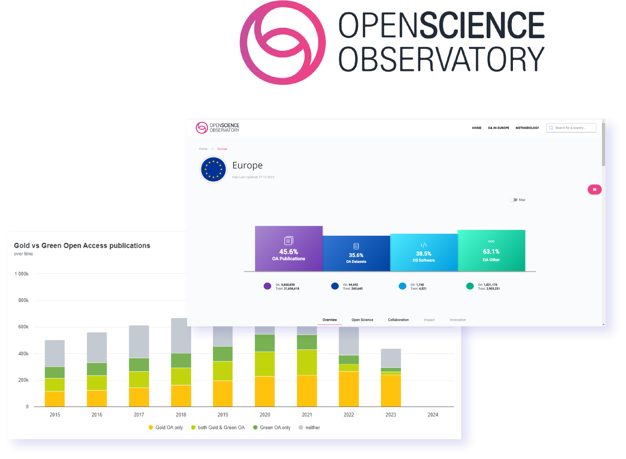
Use OpenAIRE Graph for OS Monitoring
Get a bird’s eye view of the European Open Science
landscape and the uptake of OS in your country.
Identify gaps, trends, collaboration patterns, and
weak spots for better informed decision-making,
all with the Open Science Observatory
… No technical background or powerful computing infrastructure needed!

Slide 10
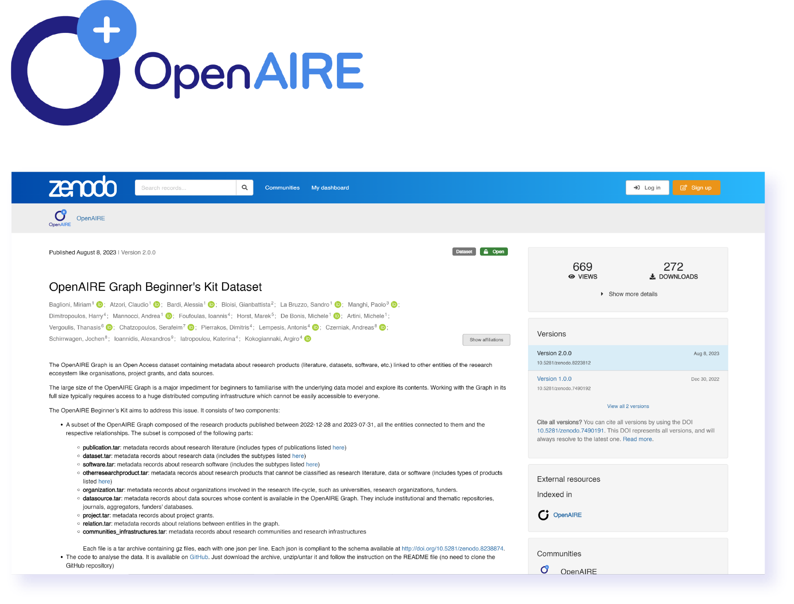
Use OpenAIRE Graph for OS Monitoring
Do you have technical expertise?
Access the OpenAIRE Graph dataset through OpenAIRE API for your bibliometric analysis.
Download the Graph dataset on Zenodo to
explore and process bibliometric data
Note: While the dataset is open and free to all, it requires a significant
amount of processing power to handle the entirety of its data. If you don’t possess such capacities, you can access parts of the Graph via the Beginner Kits.

Slide 11
Stay in touch
Your go-to for personalised technical support and service assistance
Helpdesk
graph.openaire.eu/helpdesk
helpdesk@openaire.eu
A space for Graph users to discuss functionalities, share insights,
ask questions, and learn together
User Forum
openaire.flarum.cloud

