Slide 1
Konstantina Galouni
Service Manager
kgalouni@athenarc.gr
Explore
Improvements and new information available

Slide 2
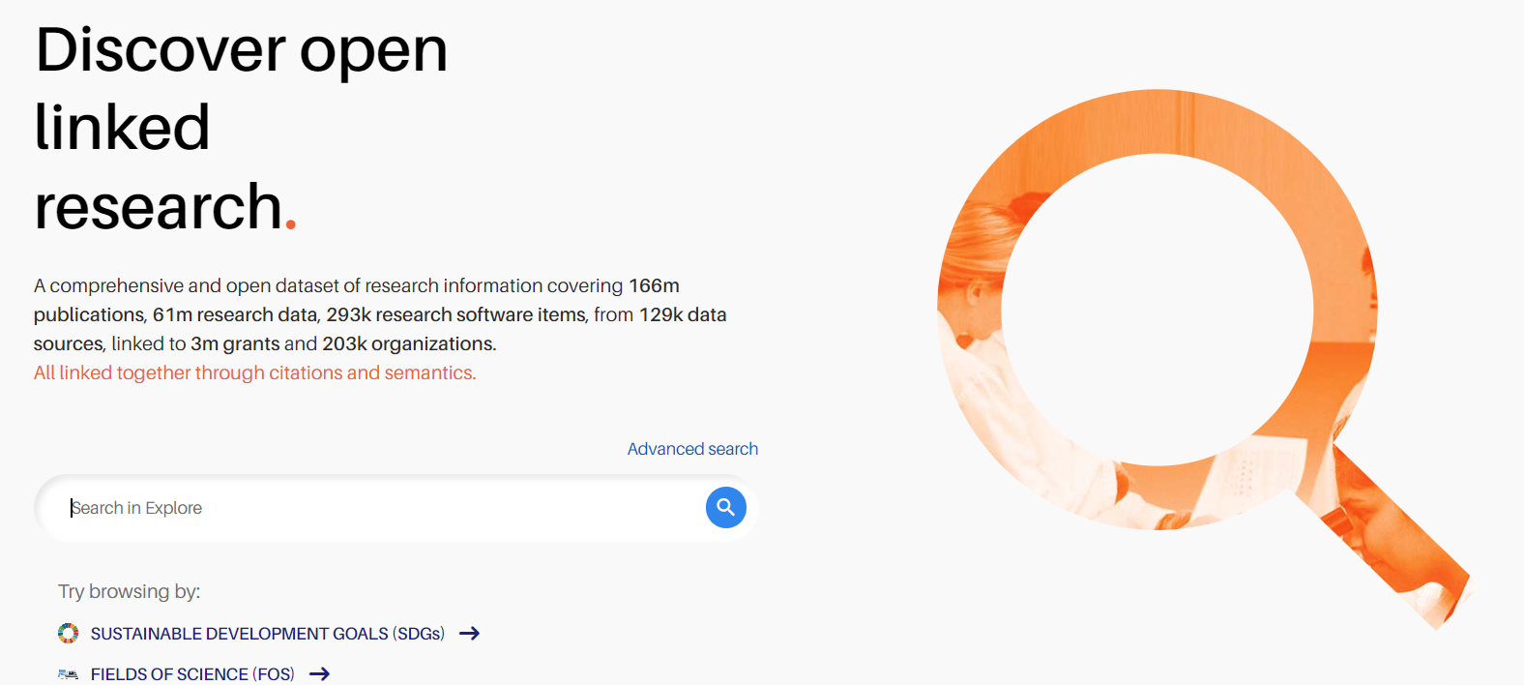
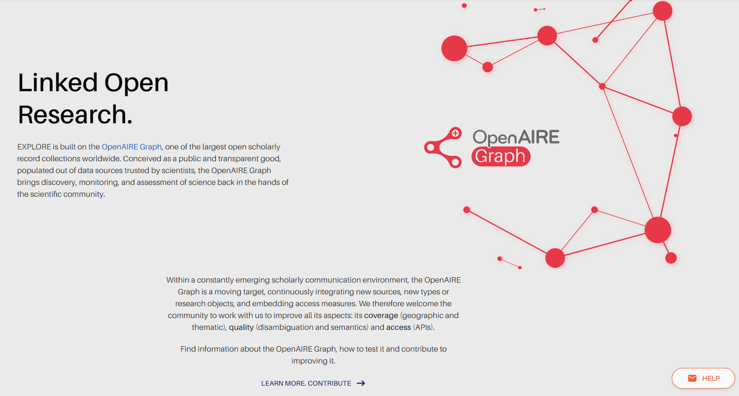
explore.openaire.eu
Access and “explore” the OpenAIRE Graph, its entities and their relationships

Slide 3
Explore basic functionalities
Search
Link
Deposit
Search & filter
Overview of information for each record
Download search results & reports
Statistics & Metrics & impact-based indicators
Link OpenAIRE entities
Link with external results
Enhance the information graph
ORCID Search & Link Wizard
Find repository or journal to deposit your research in Open Access

Slide 4
Improvements and new information
Search pages
Search form
Filters
Search results
[NEW] Actions for each result
[NEW] Usage counts metrics & impact-based indicators
Detailed pages
Redesign
[NEW] Impact-based indicators
New interface to suggest missing Fields of Science & SDGs
Search form on the menu
Linking: Improvements of direct linking flow from the detailed page
[Work in progress] Redesign of search results & detailed pages in mobile screens

Slide 5
Improvements and new information
Search pages
Search form
Filters
Search results
[NEW] Actions for each result
[NEW] Usage counts metrics & impact-based indicators
Detailed pages
Redesign
[NEW] Impact-based indicators
New interface to suggest missing Fields of Science & SDGs
Search form on the menu
Linking: Improvements of direct linking flow from the detailed page
[Work in progress] Redesign of search results & detailed pages in mobile screens
Thoroughly user tested

Slide 6
Usability user tests
Purpose: evaluate the usability of the search and landing pages and gather feedback from users to improve the Explore service.
10 participants.
Researchers and user interface experts, most of them with technological background.
2 Beginner - 4 Intermediate - 4 Advanced experience with research platforms.
Recorded, one-on-one meetings, and a feedback form was used at the end of each test to gather participants’ feedback.
Methodology: The study was conducted using the beta version of the Explore service, which included a new landing page for results and a hybrid version of the search page. Additionally, a mockup version of the new suggested filter structure was presented for comparison. The testing focused on the search and landing pages, with participants asked to perform tasks related to finding and exploring content.

Slide 7
Search

Slide 8
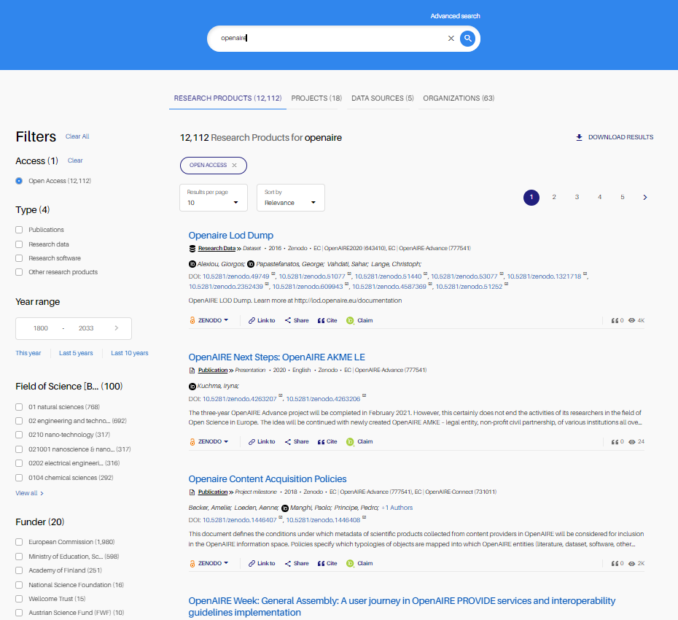
Search - Simplified search form & unification of all the search pages into one
Easy and simple keyword search
Removed the steps from the search form - no need to select entity to search
Fast navigation through the entities
All available entities always on display

Slide 9
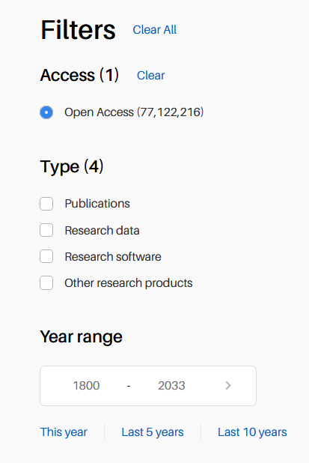
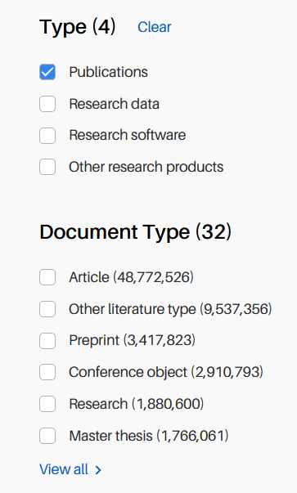
Search - Research product types as filter
Types of research products as filter
Better grouping together with the “Document Type”
Appears only when Type is selected

Slide 10
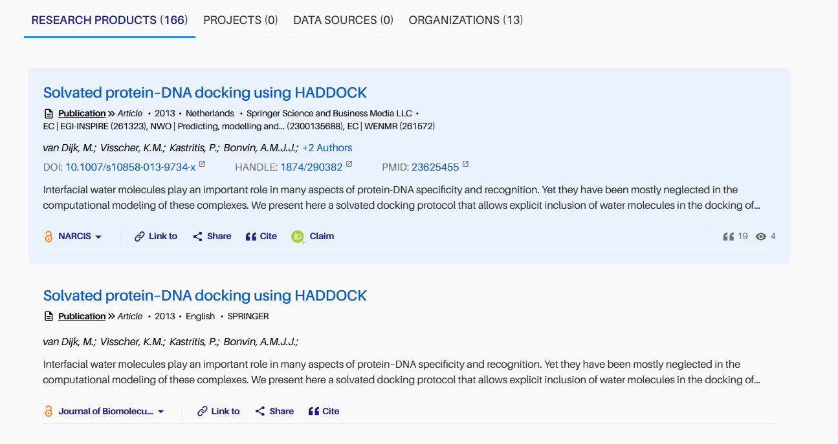
Search - Redesign of the search results
Easy to read
Hovered result gets a light blue background to be highlighted
Compact way of exposing the metadata
Ability to view all authors of a research products from the search page

Slide 11
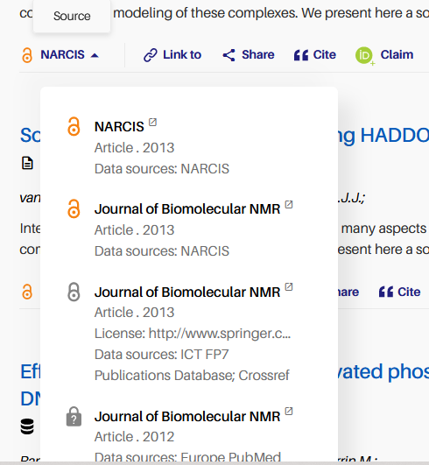
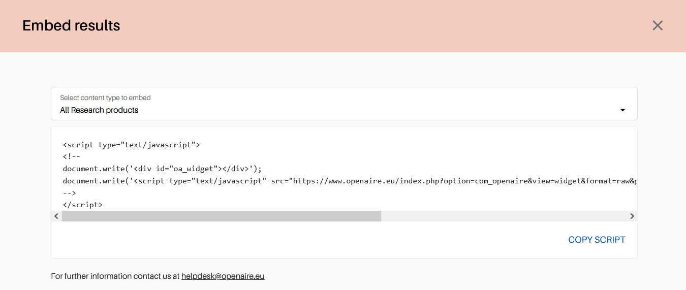
Search - Redesign of the search results - Actions
Research products
Projects

Slide 12
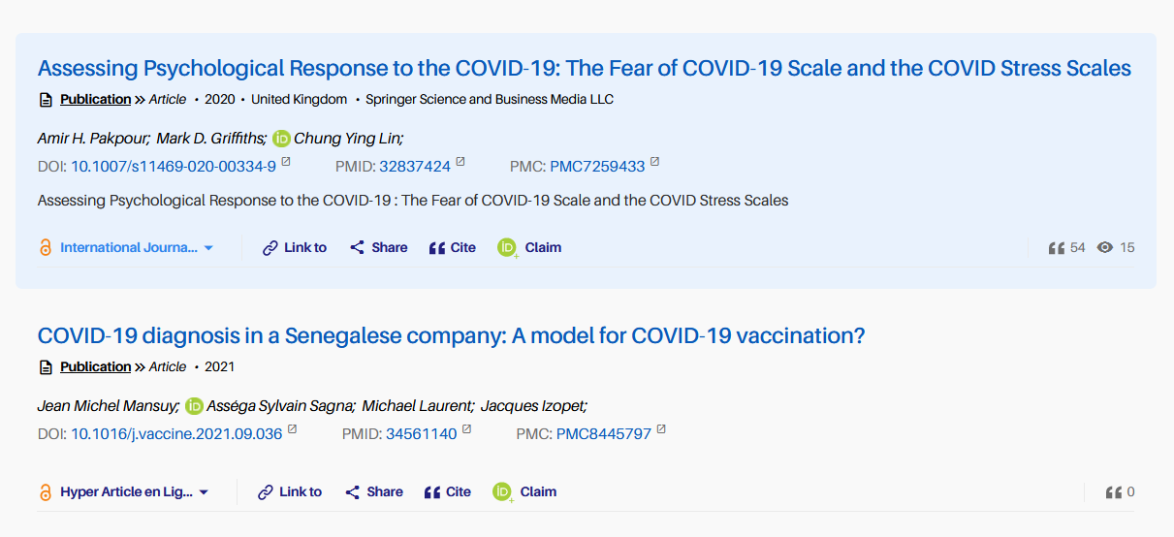
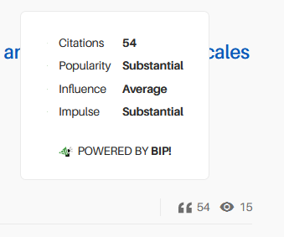
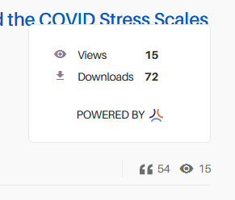
Search - Redesign of the search results - Usage counts metrics & impact-based indicators

Slide 13
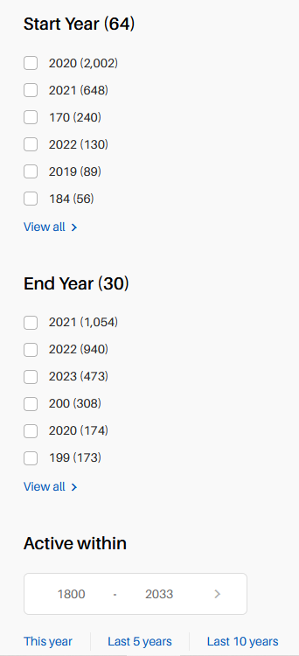
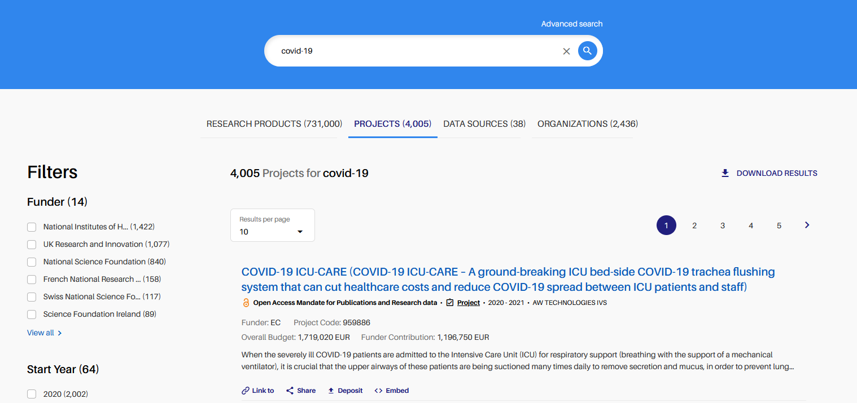
Project search page - Filters grouping
Reorded and grouped together the date-related filters

Slide 14
Detailed page

Slide 15
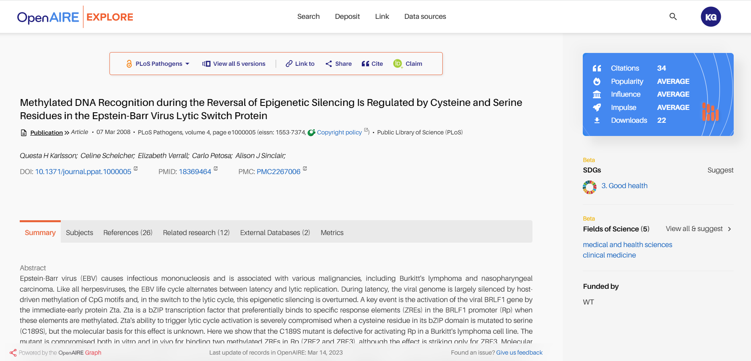
Detailed page - Overview

Slide 16
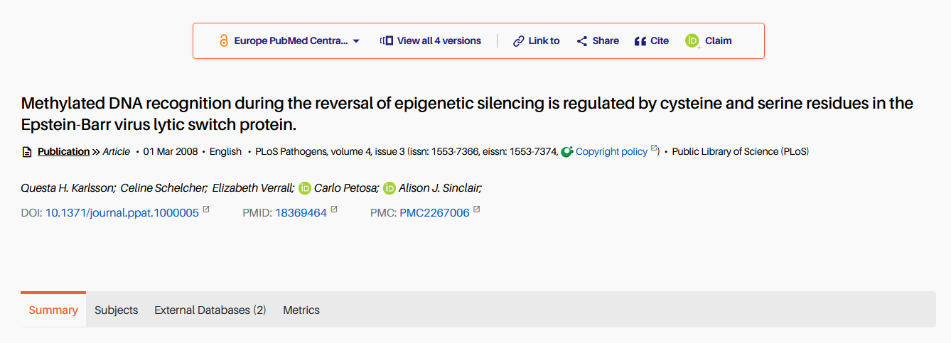
Detailed pages - Redesign
Compact way of exposing the metadata
Actions on top of the page
Subjects as a dedicated tab to emphasize them as important information
Add this publication to your ORCID record

Slide 17
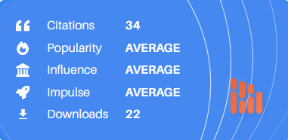
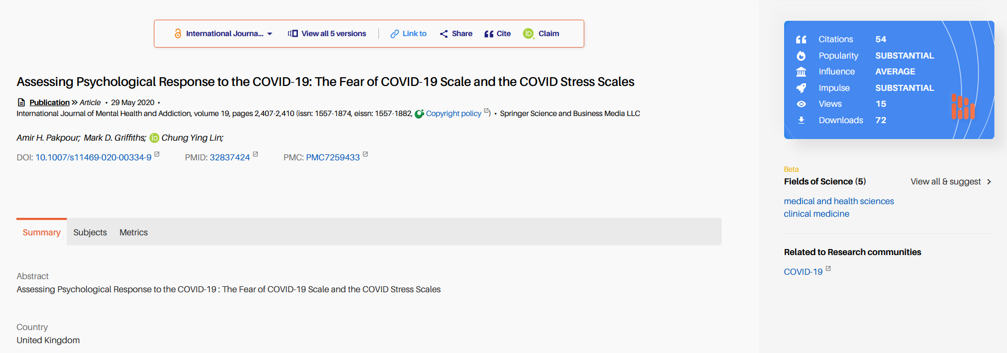
Detailed pages - Usage counts metrics & impact-based indicators
Blue box with metrics and indicators on top right
Metrics as a dedicated tab
More information on click of each metric

Slide 18
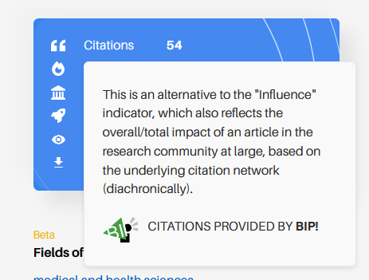
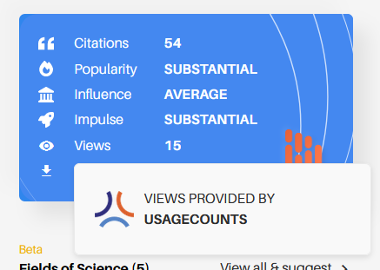
Detailed pages - Usage counts metrics & impact-based indicators
Blue box with metrics and indicators on top right
Metrics as a dedicated tab
More information on click of each metric

Slide 19
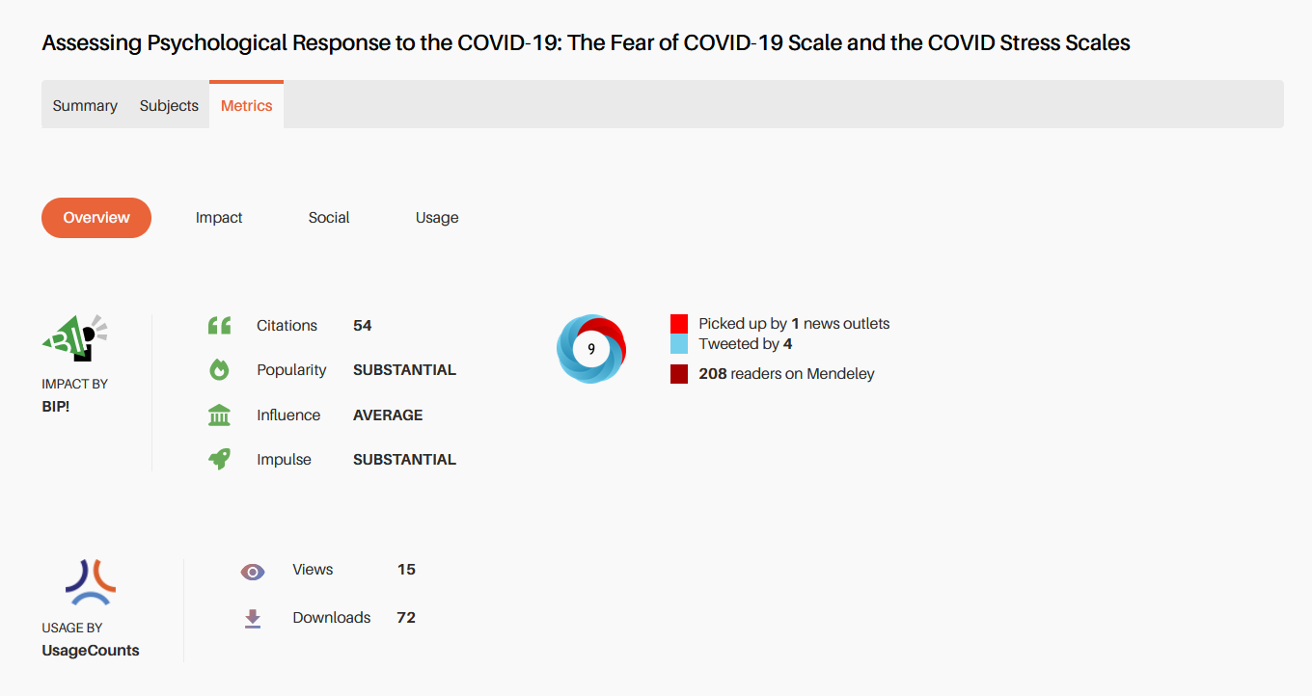
Detailed pages - Usage counts metrics & impact-based indicators

Slide 20
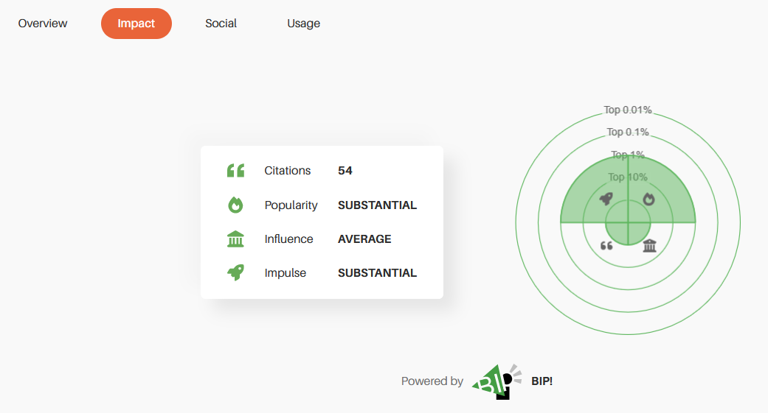
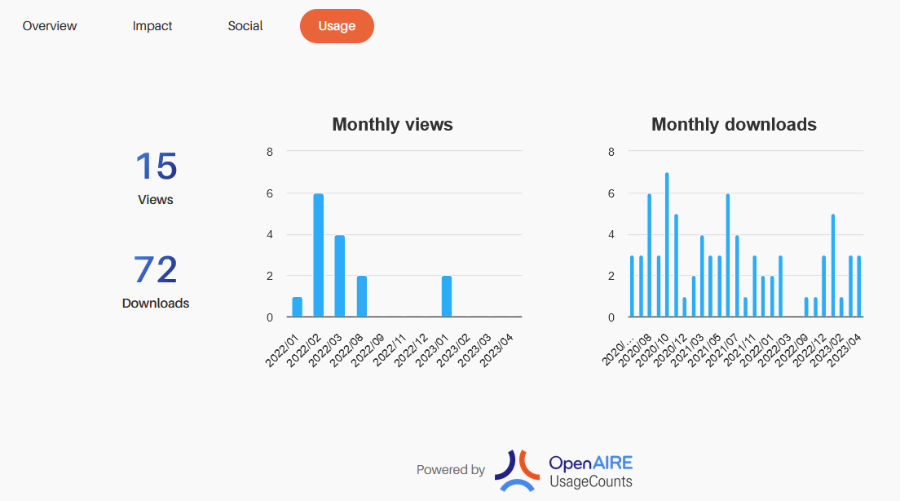
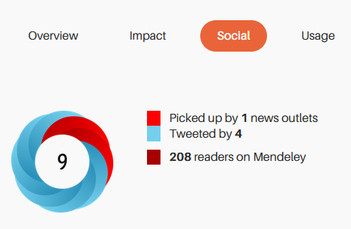
Detailed pages - Usage counts metrics & impact-based indicators

Slide 21
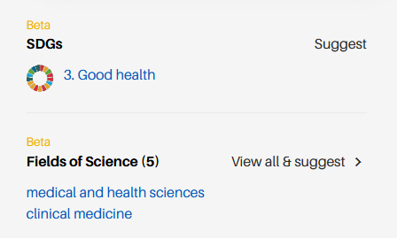
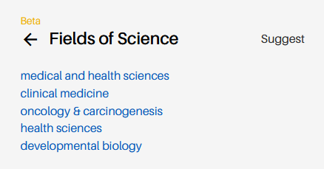
Detailed pages - Fields of Science
Removed numbers from labels of Fields of Science

Slide 22
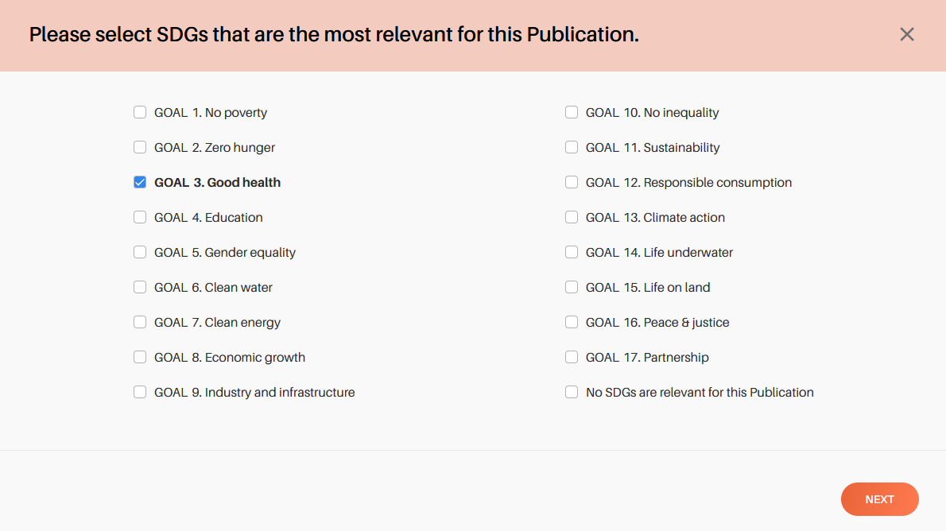
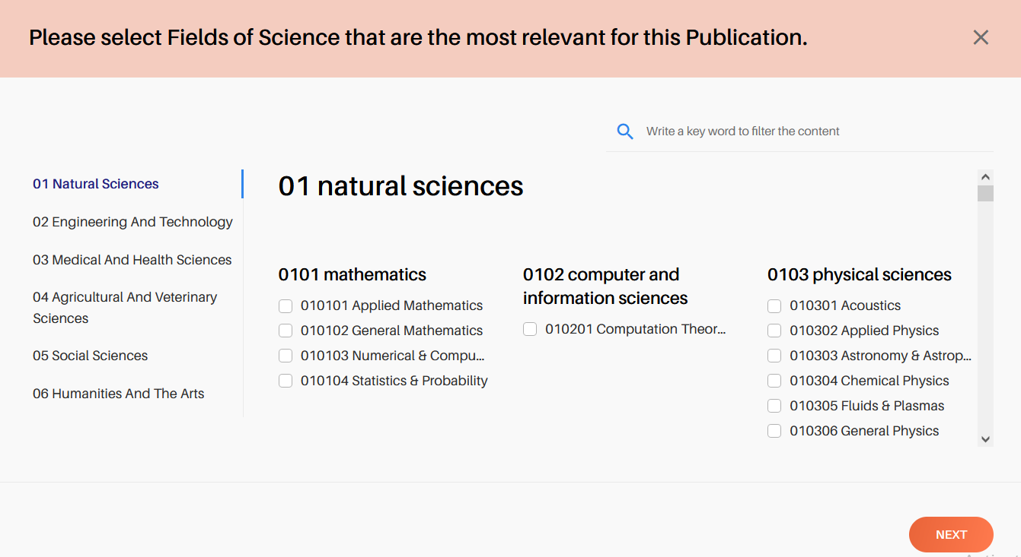
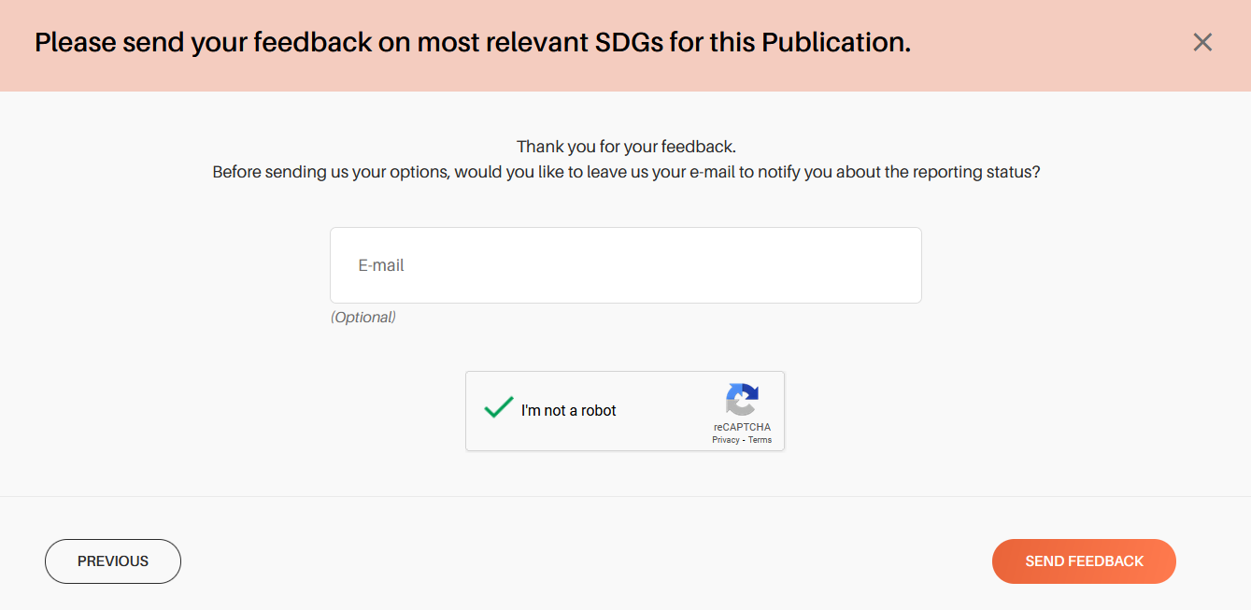
Detailed pages - Fields of Science
New user interface for suggesting FoS and SDGs

Slide 23
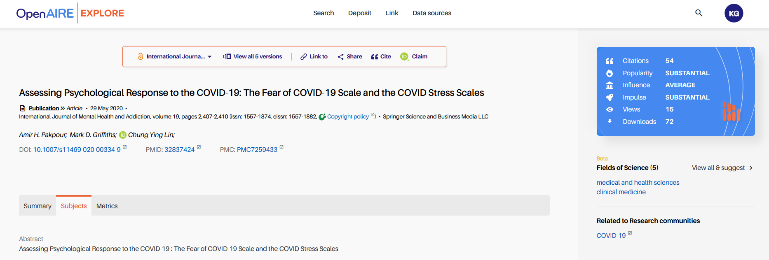
Detailed pages - Search form on the menu
Direct keyword search among all entities of the Graph

Slide 24
Detailed pages - Search form on the menu
Direct keyword search among all entities of the Graph

Slide 25
Link

Slide 26
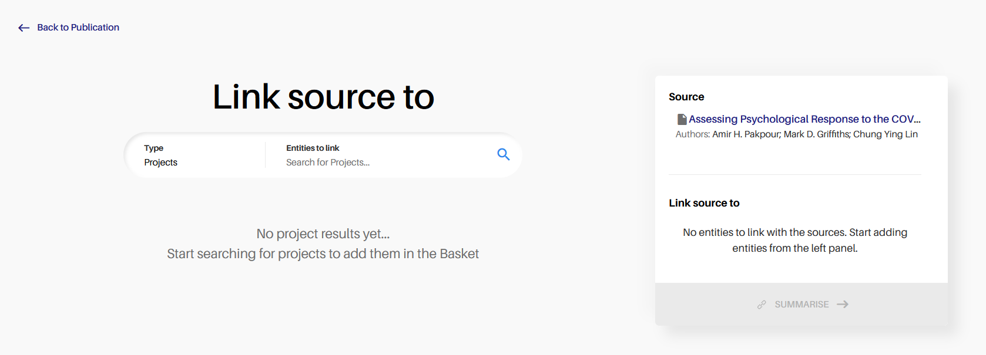
Improvements of direct linking from detailed page
When linking a specific research product:
Removed stepper from the top of the page
Updated display of the basket/ right column

Slide 27
Mobile redesign
Search result & detailed page

Slide 28
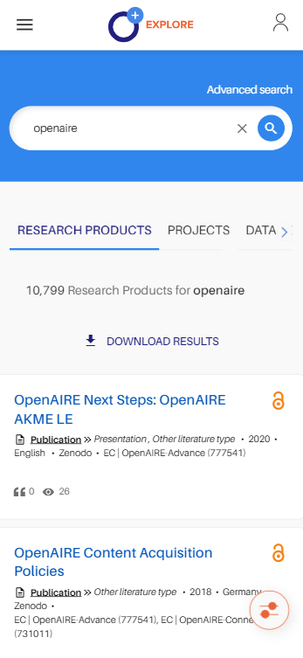
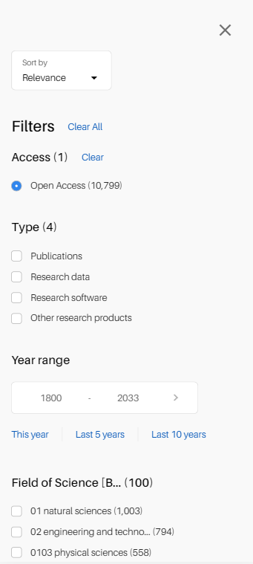
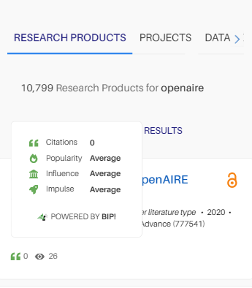
Search page - mobile

Slide 29
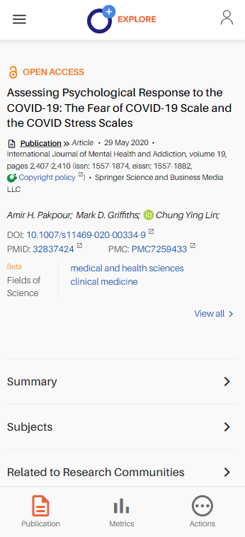
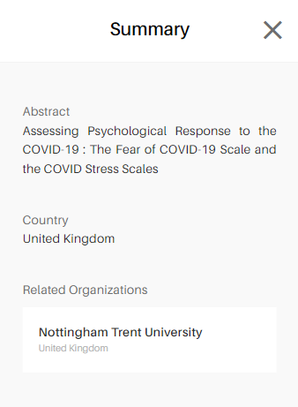
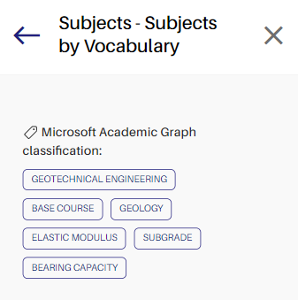
Detailed page - mobile

Slide 30
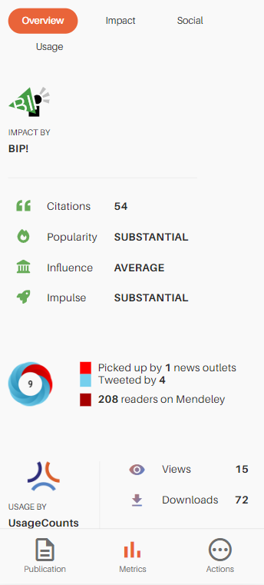
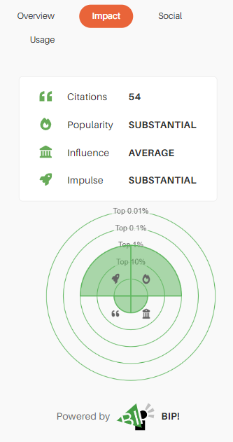
Detailed page - mobile

Slide 31
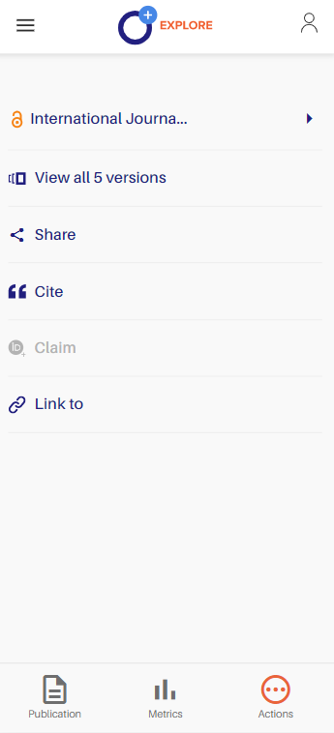
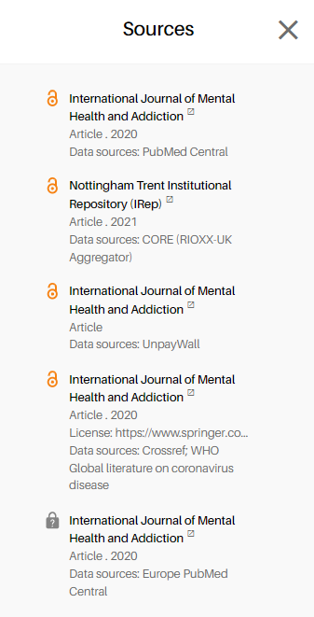
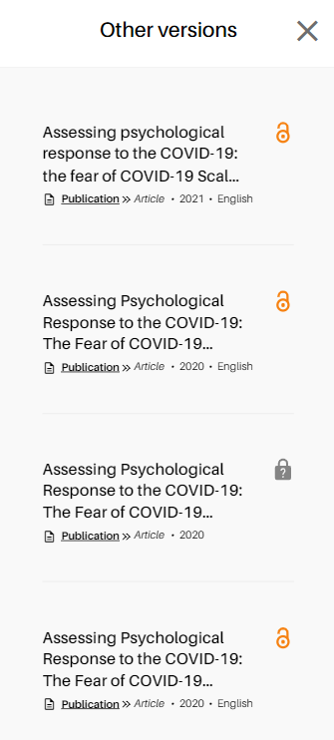
Detailed page - mobile

Slide 32
Next steps

Slide 33
Design of new levels for Fields of Science & SDGs
Direct PDF link in research products
Usage counts metrics and impact-based indicators in search projects
Usage counts metrics in search data sources
More improvements on the redesigned pages
Mobile improvements & redesign of other pages
Organizations: display and search by persistent identifiers

