Slide 1
Giulia Malaguarnera (OpenAIRE)
André Vieira, Pedro Principe (University of Minho)
OpenAIRE PROVIDE dashboard
a service to enable trust and value within the EOSC repositories
EGI Conference 2023

Slide 2
The OpenAIRE Content Provider Dashboard​
One-stop-shop web service​
for​
Content providers (institutional & thematic repositories, data archives, journal, aggregators, CRIS systems) ​
who​
interact with OpenAIRE (share and exchange metadata and content)​
Front-end access to many of OpenAIRE's backend services​
The content gateway to EOSC

Slide 3
PROVIDE dashboard: Added value functionalities
Enrich
Improve your metadata. Get more connections. OA Broker service offers a wealth of information on scholarly communication data. Find out what interests you and subscribe to enrich your records.
Validate
The Validator service assess the metadata quality by measuring your data source compatibility with the the OpenAIRE guidelines to expose your content by using global standards: https://guidelines.openaire.eu/en/latest/
Register
If validation succeeds your data source can be registered for regular aggregation and indexing in OpenAIRE. Additionally, you become part of the EOSC ecosystem and a global interlinked network. Reach a wider audience around the world.
Measure
Share usage data via OpenAIRE's global Metrics Service – UsageCounts. Get the benefit of an aggregated environment.
Collection monitor
Collection monitor provides the aggregation history. Track the aggregation stage, collection mode and the number of records aggregated thus improving your metadata quality.
Notifications
Once registered in OpenAIRE, content providers can use the Provide functionalities and to get notifications & alerts (enrichments, errors, useful info).

Slide 4
Benefits
Extending repository metadata models to Open Science practices
Keeping the collections up-to-date: alerts, enrichments, additions
Fostering notification-based and federated dissemination of knowledge
Added Value, improve:
Repository interoperability, collections and content for enhanced visibility and access
Institution memory & research assessment
Enable the onboarding in EOSC

Slide 5
Role to the EOSC
Interoperability compliance via the OpenAIRE Guidelines. Every data source validated in OpenAIRE is EOSC compliant
Guidelines: v3.0, v4.0, data, CRIS
Integration of the data sources registration workflow within the EOSC Research Product Catalogue
OpenAIRE Graph becomes a key asset for discovery and monitoring within the EOSC: https://graph.openaire.eu/

Slide 6
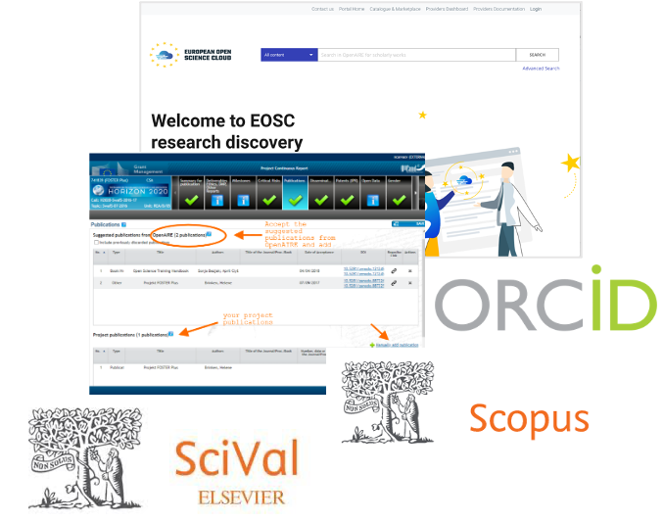
OpenAIRE provide – the content gateway to EOSC
Search, find, identify, compose, and reuse resources!
Share resources!
EOSC users
RIs, clusters, e-infras, long tail, libraries, organizations, funders, companies
Research Products Catalogue
https://search.marketplace.eosc-portal.eu/
Reporting scientific production to funders, Commission, and scholarly communication services
Libraries (e.g. Repositories, Archives, CRIS systems)
Metadata enrichment
(OpenAIRE Broker Service)

Slide 7
Compatibility with the OpenAIRE Guidelines
EOSC: OpenAIRE is your entry/gateway to EOSC.
If you are compliant with the OpenAIRE guidelines
then
You will be onboarding the EOSC Portal Catalogue and Marketplace integrated platform
Improved interoperability to meet latest IT and repository standards
Your content is more:
Contextualised (links and relationships to other types of research outcomes and entities),
Flexible (using different and improved vocabularies)
Embedded in the R&I ecosystem (alignment with Open Science mandates and standards and support for well-established metadata schemas, namespace abbreviations)
This is your road to FAIR“ness”
If you are compliant with the OpenAIRE guidelines
then
you are also FAIR enough

Slide 8
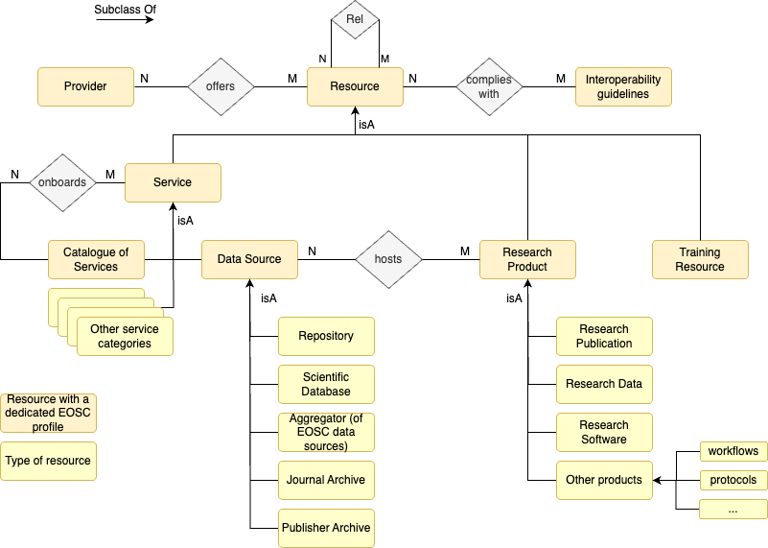
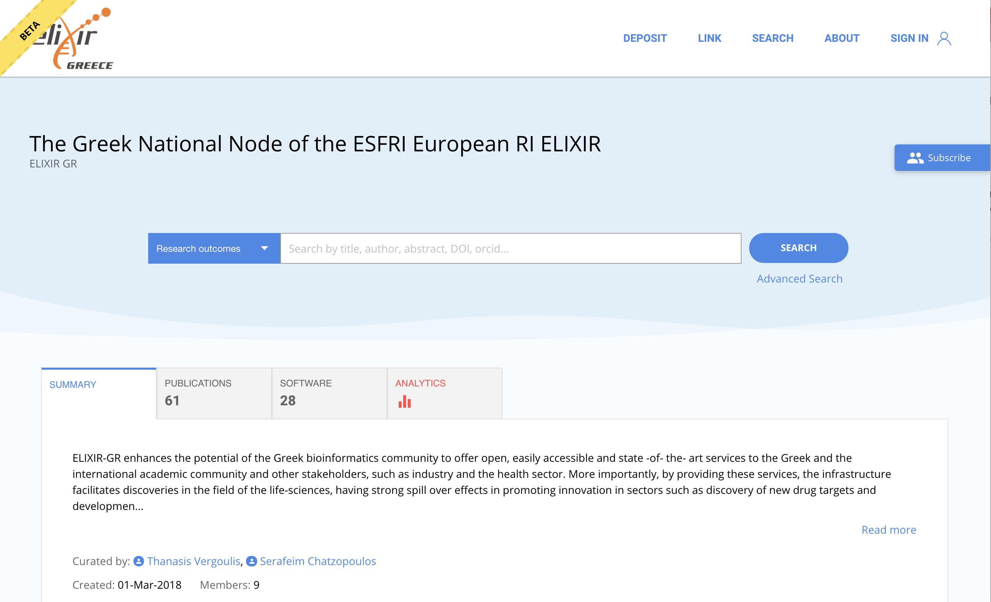
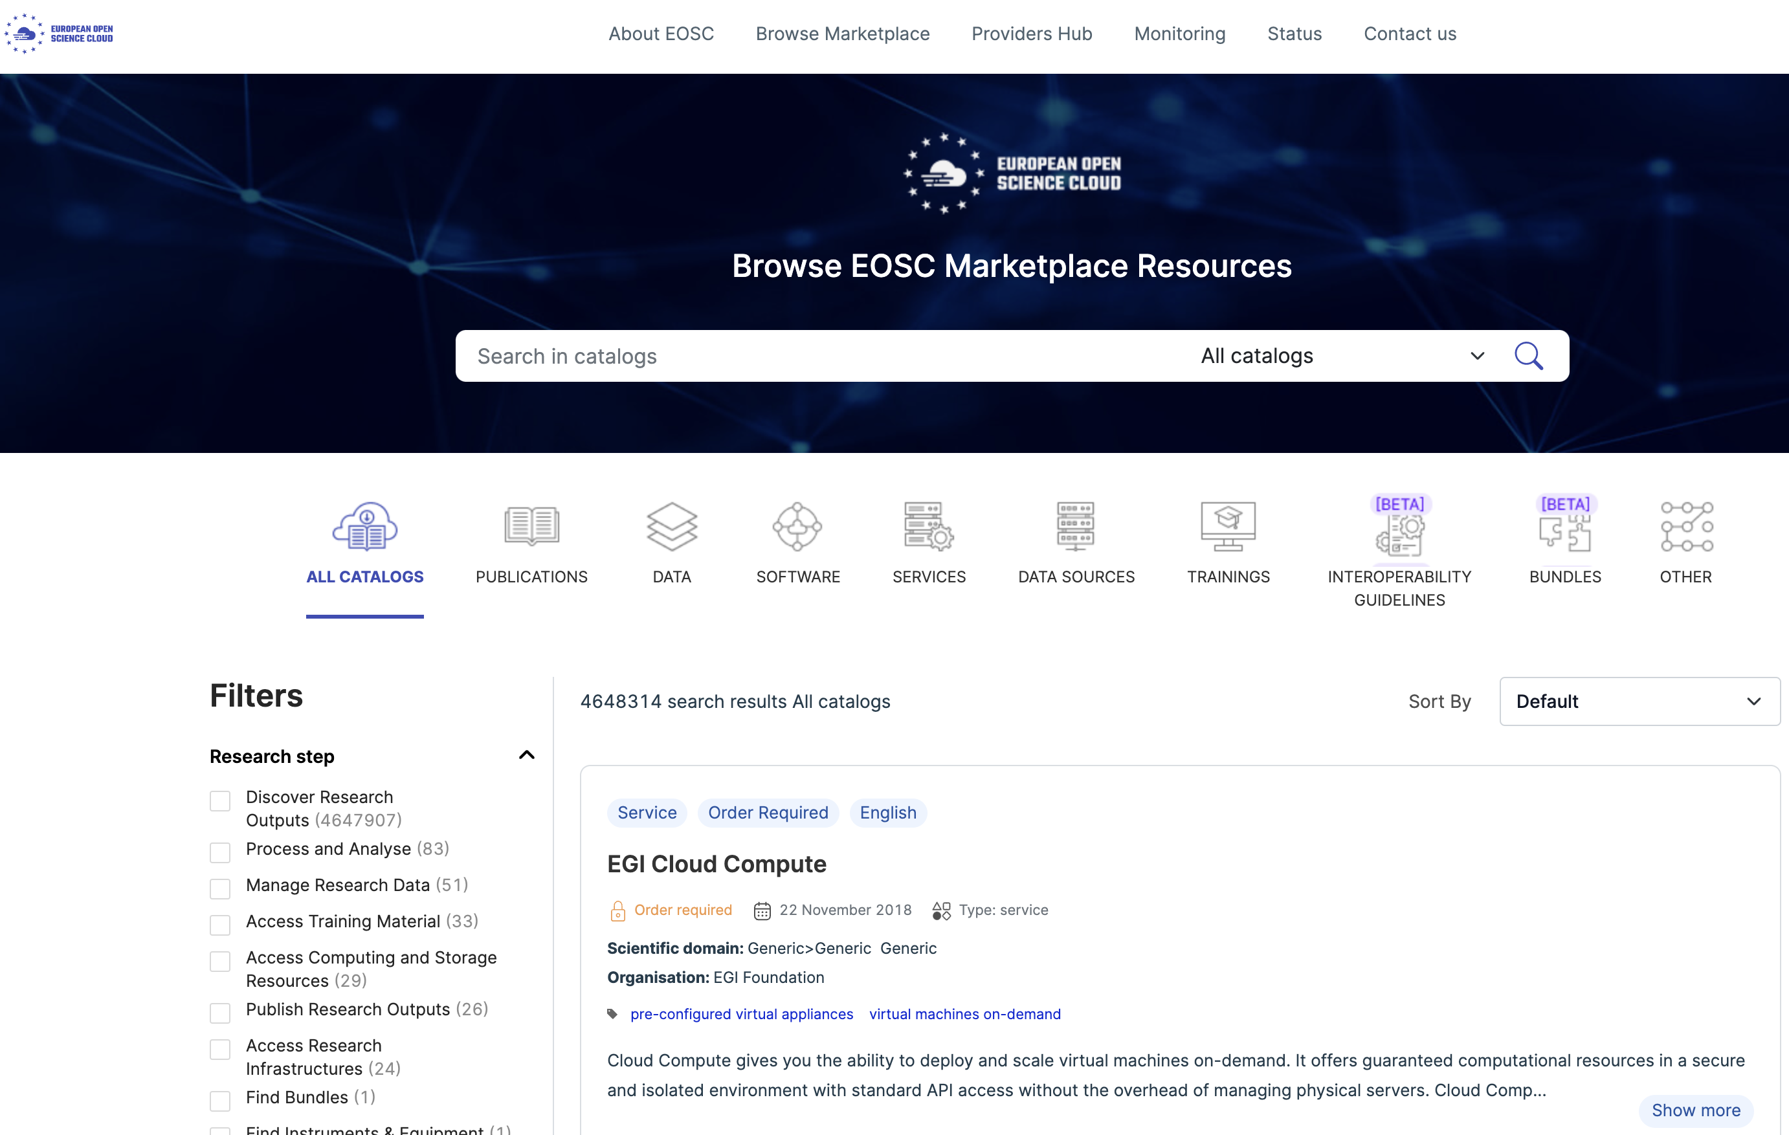
EOSC and OpenAIRE provide and guidelines
Scholarly Community services
OpenAIRE Guidelines
Publication repos
Data Archives
CRIS systems
12345
12345
VALIDATE
REGISTER

Slide 9
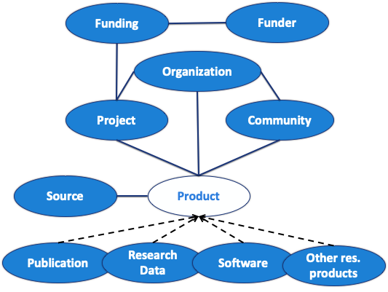
An open metadata research graph of interlinked scientific products, with access rights information, linked to funding information and research communities

Slide 10
Building trust and value
Repositories network
Community-driven service with a strong focus on the end-user needs (user-centered design) based on feedback during the monthly community calls: www.openaire.eu/provide-community-calls

Slide 11
THANKS
Email
helpdesk@openaire.eu
Twitter
@openaire_eu

