Slide 1
Alessia Bardi
Institute of Information Science and Technologies, Italian National Resarch Council
OpenAIRE-CONNECT

Slide 2
CONNECT
OpenAIRE-Nexus has received funding from the pean Union's Horizon 2020 Research and Innovation programme under Grant Agreements No. 101017452
https://connect.openaire.eu/

Slide 3
The realization that many citizens, researchers, organisations are getting lost in the research data trek alerts us.

Slide 4
Approximately 2.725 officially recognised higher-education institutions are in Europe (19.9% global)*.
While alliances of universities emerge.
*https://www.4icu.org/Europe/#:~:text=European%20Universities%20World%20Representation%20How%20many%20Universities%20are,currently%202%2C725%20officially%20recognized%20higher-education%20institutions%20in%20Europe.

Slide 5
Research communities, organisations, universities and their alliances, need tools to discover, assess and outreach their research findings.
When you don’t have a dedicated system to track and monitor your customers, they’ll start to feel underappreciated and unloved.

Slide 6
Create and manage a personalized gateway for your research community to mobilise the discovery, assess and outreach of research products that matter to you and your audiences.

Slide 7
How to collect all scattered research works on common topics for universities, researchers, and help them share that knowledge automatically?

Slide 8
To design, build, set up, run and maintain an infrastructure that aggregates research works of specific interests requires time, resources, R&D, expertise.

Slide 9
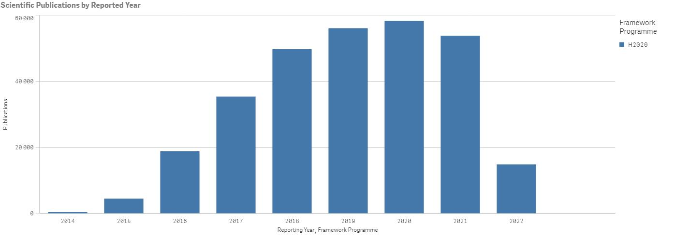
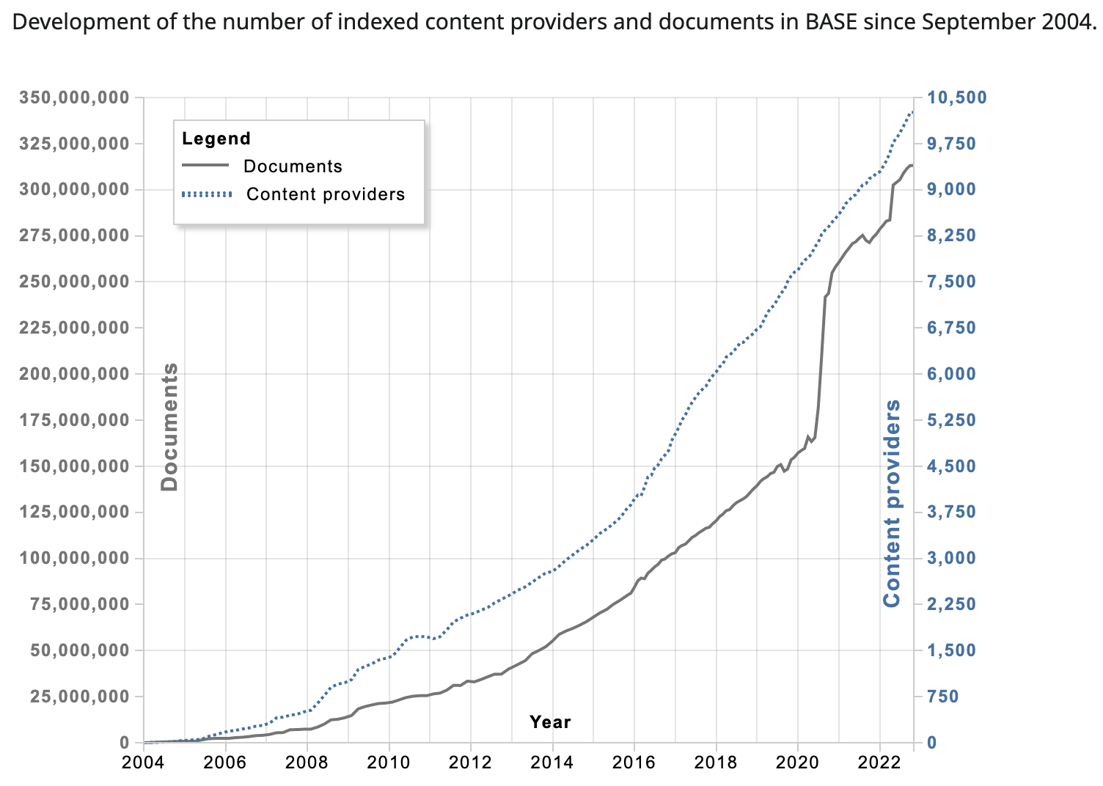
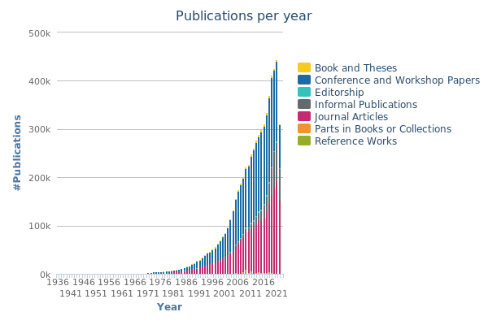
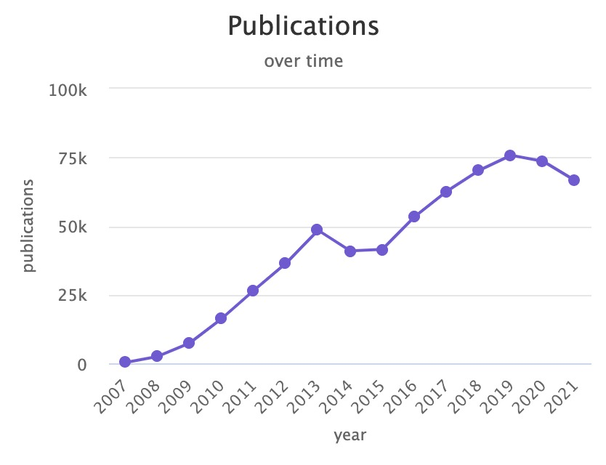
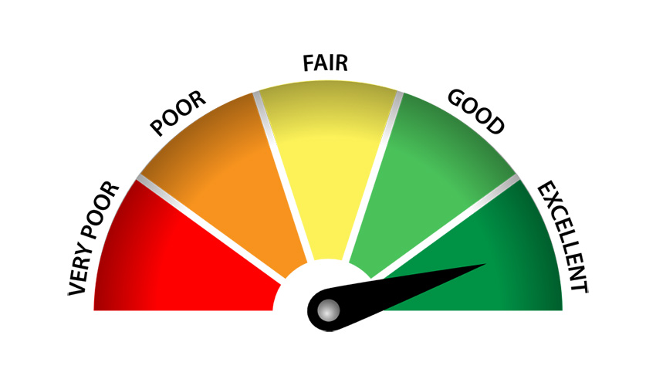
CHALLENGES
Chart from the EC Horizon Dashboard
Heterogeneity
Publication deluge
DBLP statistics
OpenAIRE statistics for EC funded publications
Quality and accuracy
Completeness

Slide 10
OpenAIRE can tackle those challenges for you
Global coverage
+2K trusted sources: institutional repositories, thematic repositories, funder databases, authoritative registries
Enriched metadata: duplicate detection and full-text mining
Select the slice of the OpenAIRE Graph that is relevant for you and build a customised portal on top of it
Integrated with other scholarly services to facilitate Open Science practices: e.g. ORCID, Crossref, UsageCounts
OpenAIRE operates the service: installation, maintaince, uprades, backups and automatic data updates

Slide 11
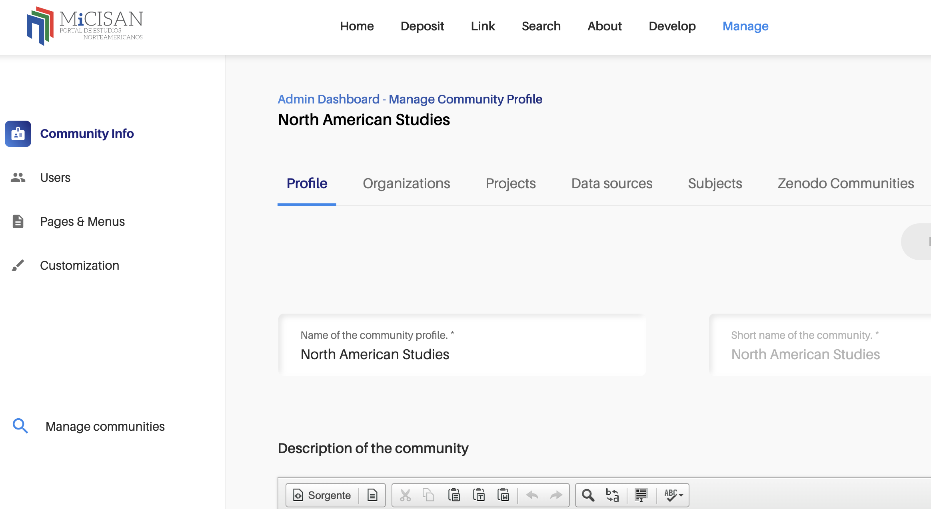
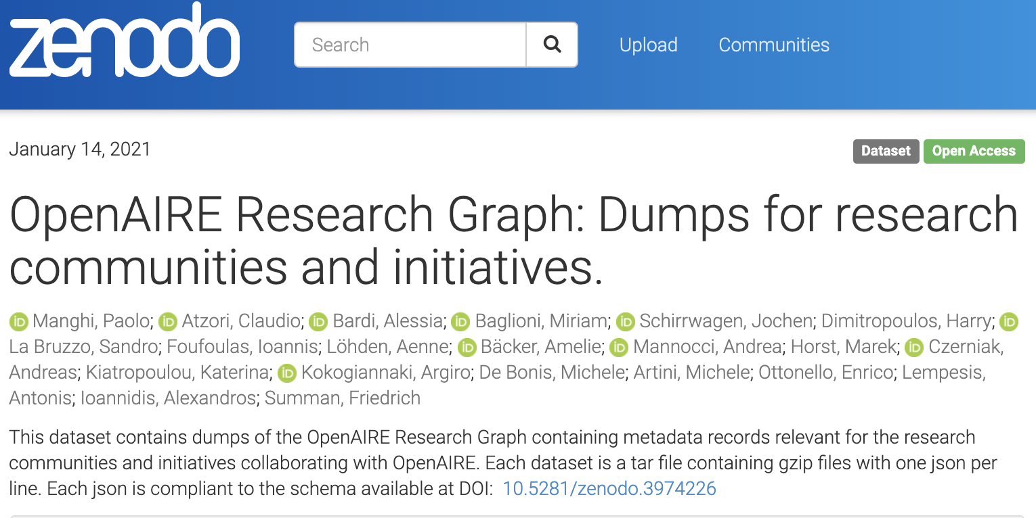
How does CONNECT work?
Community Gateway
Delivery
Gateway configuration
Identify relevant research products
https://doi.org/10.5281/zenodo.3974604
Notes:
How do we do it?
The community managers or community curators, access an administration dashboard of the gateway, through which they can configure the criteria of inclusions.
We apply the configuration on the OpenAIRE Research Graph to identify the products of the community and those are made available via the web portal of the gateway, via the OpenAIRE API, and published as json dumps on Zenodo,

Slide 12
Community Gateway content configuration in more detail
Keywords
Discipline-specific subject terms to be found in the metadata
Projects
From the 25 funders integrated in OpenAIRE
Data sources
E.g. thematic repositories, archives and journals
Gateway curators
Zenodo communities
With research products relevant for the field
Organizations
Organizations in the field: we look for them in the affiliations
Propagation
If a community result is supplemented by another research product, then the latter is also added in the community gateway
Link
Link products in OpenAIRE, Crossref, Datacite, ORCID to the community, also in bulk
Full-text mining
OpenAIRE algorithms
Researchers
Links to projects Affiliations
Document classification
. . .
Notes:
The community managers can specify different criteria of inclusion.
They can give a list of keywords, project grants, thematic repositories and journals, thematic Zenodo communities, and organizations.
However, also the simple users of the gateway can contribute to grow the record of the research output of the community, by adding missing products and links between products.
Finally, we have the OpenAIRE algorithms. One is called the propagation algorithm, which basically propagates the fact that a product is relevant for a community from one product to another. For example, if a publication is relevant because of one of the other criteria and it is supplemented by a dataset, then also the dataset is relevant for the community, and so on.
Then we have the full-text mining algorithms, which looks into the abstract and the full-texts of Open Access publications to identify new information that is not explicitely stated in the metadata like links to projects, affiliations, document classificiations, relevant research infrastructures, related data and much more. This is all information that we can exploit to identify products of the community.

Slide 13
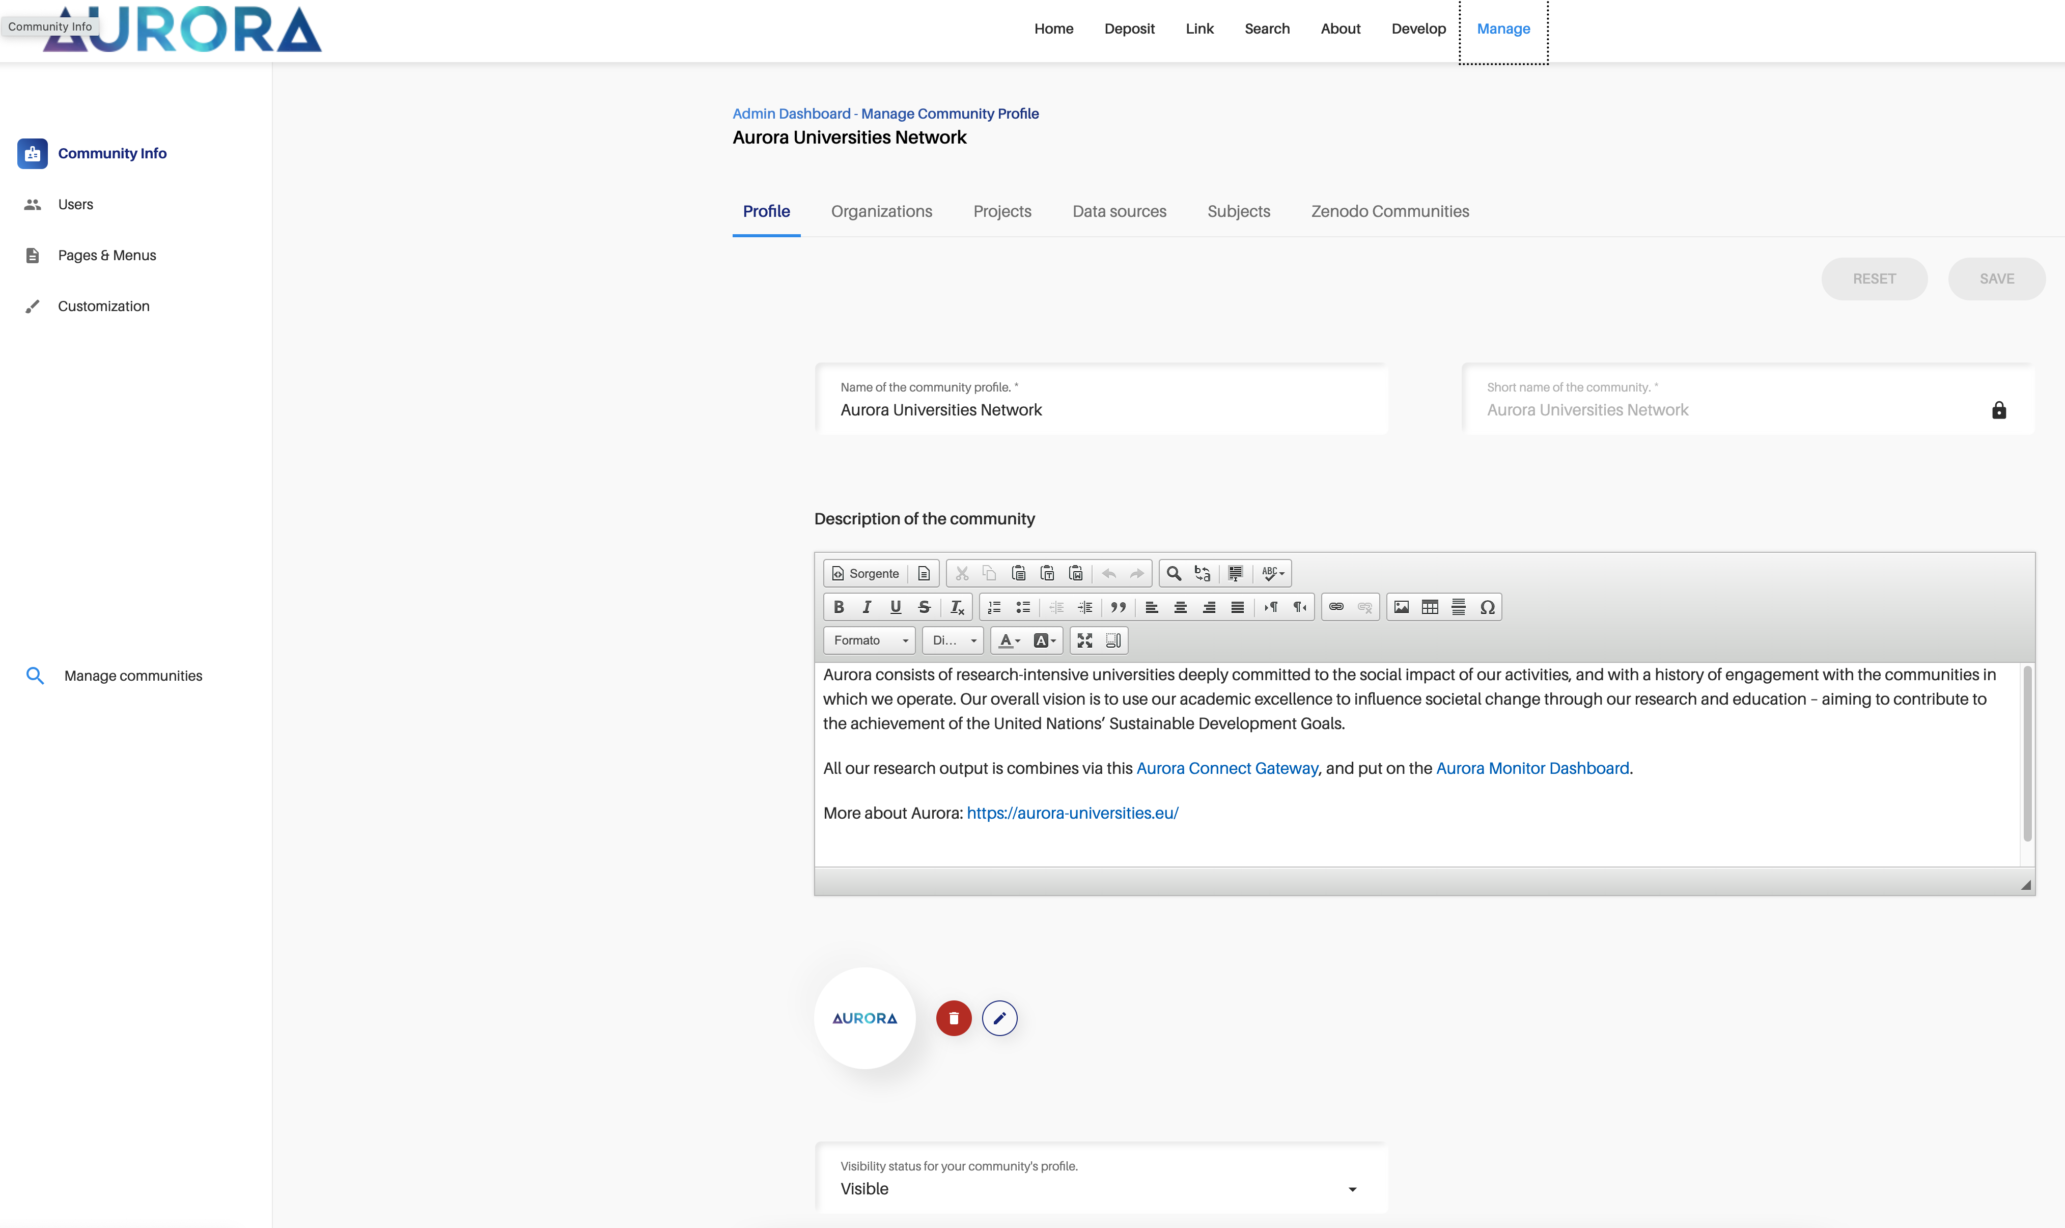
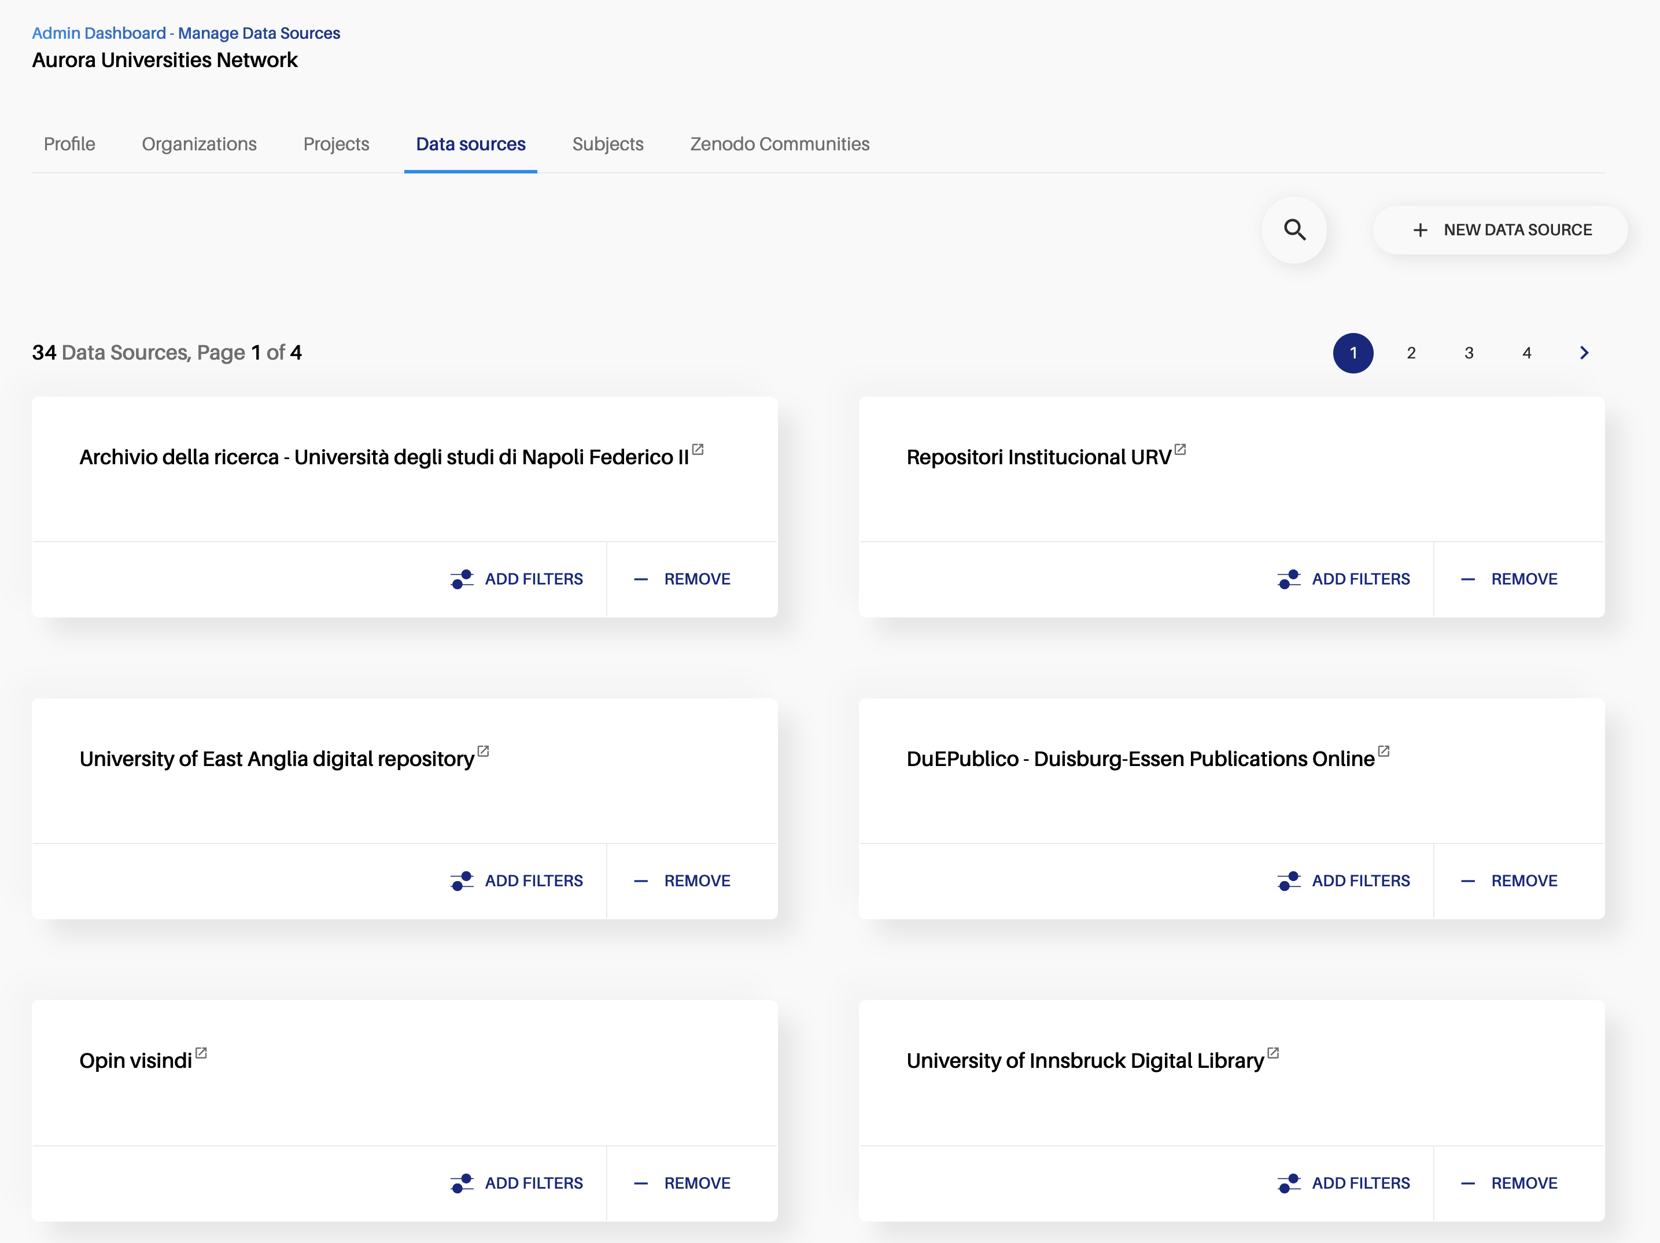
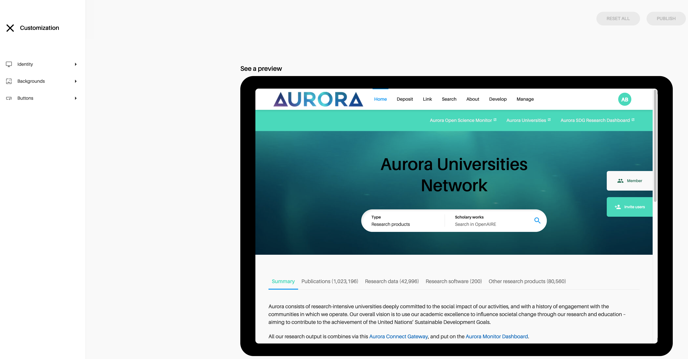
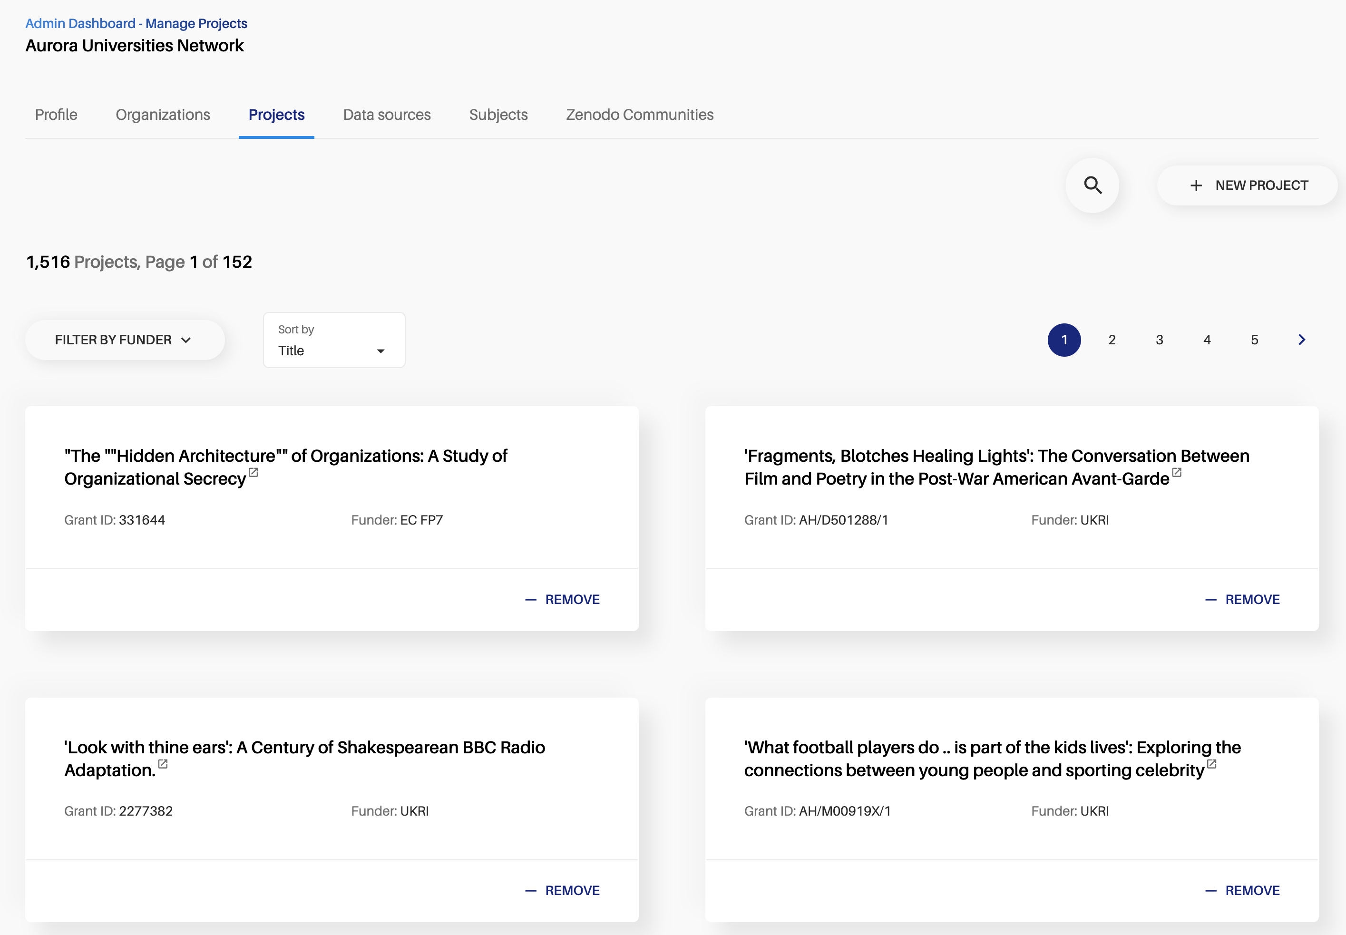
What will you get?
An admin dashboard for the curators to configure the gateway
No code needed!

Slide 14
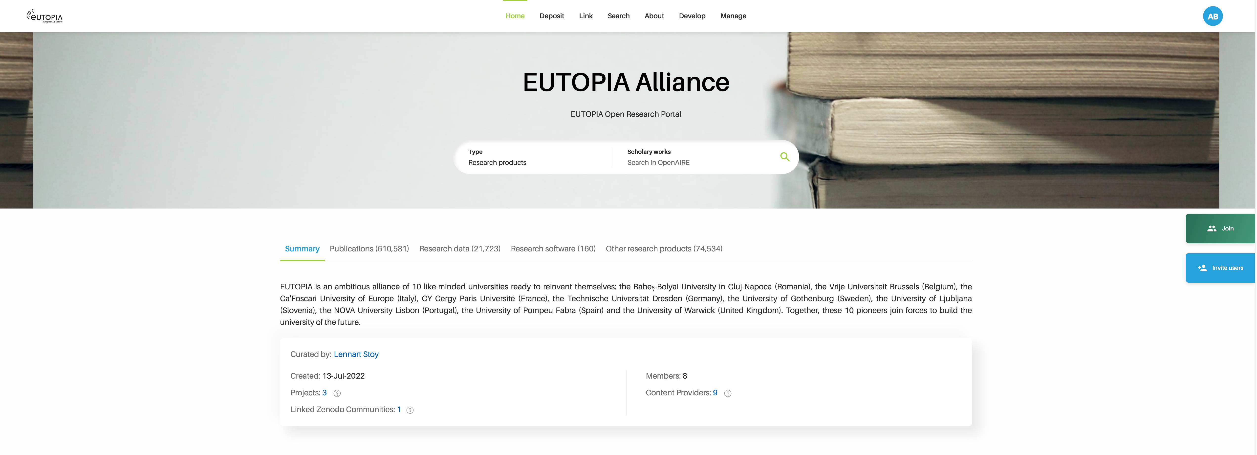
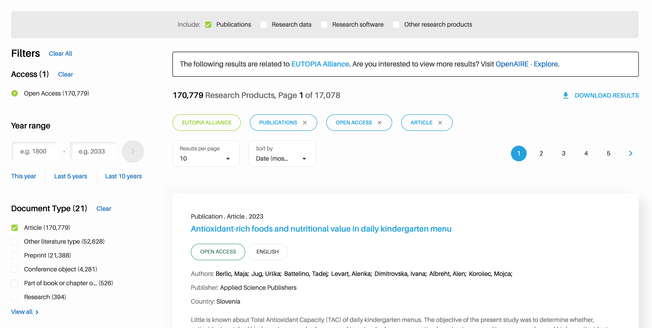
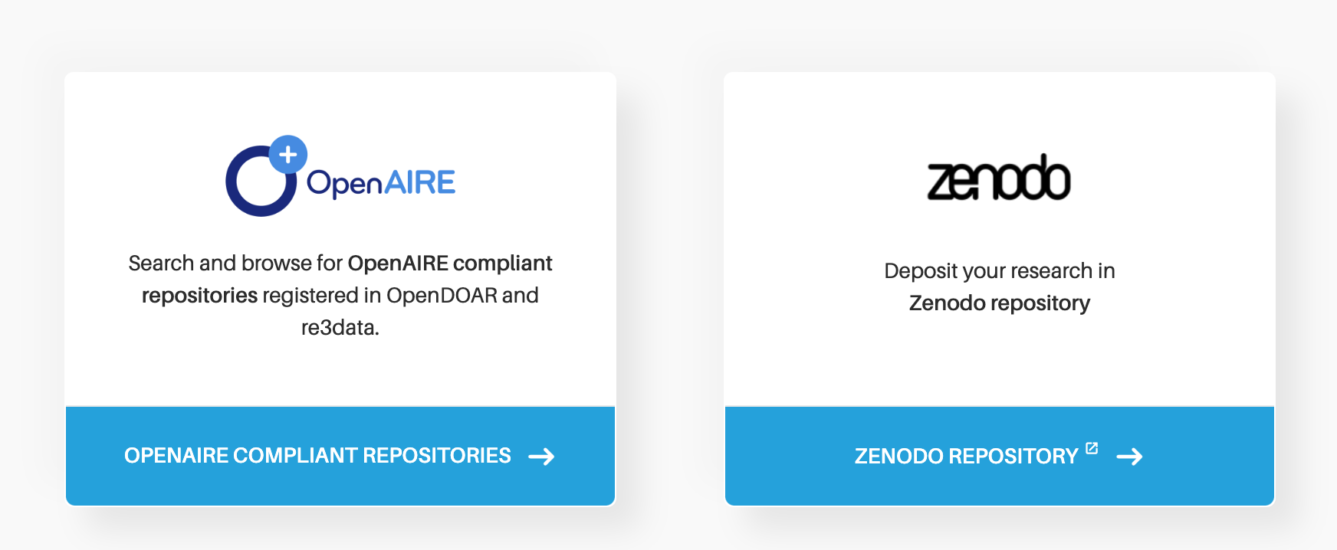
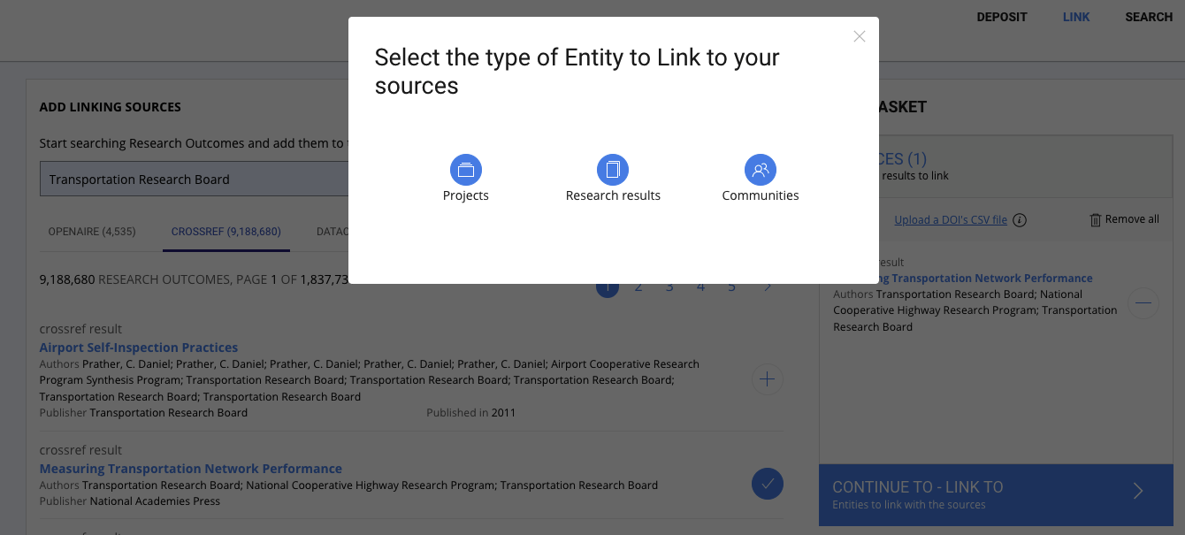
What will you get?
A customised portal for your community where users can ...
SEARCH any type of research works
Check out the UPTAKE of Open Science practices of the community
Find the right place to DEPOSIT
LINK research works among them and with funding projects​

Slide 15
How it works
Step 01
Step 02
Step 03
Express your needs
Configuration
Public Launch
You request a call with a NOAD, and/or the OpenAIRE CONNECT service manager to inform about your needs and the Open Science practices of your community.
We sign a Memorandum of Understanding with the agreed collaboration activities.
OpenAIRE will create a first version of your gateway.
You assign curators that will manage it. OpenAIRE provides millions of research works metadata information. The curators will define the criteria to identify those that are relevant for the community.
OpenAIRE collaborates and supports you to finalise your gateway and amplify dissemination and outreach.

Slide 16
What does the alliance has to do?
Action 01
Action 02
Action 03
Ensure the repositories of your universities are in OpenAIRE
Check the universities are properly represented in OpenAIRE
Appoint gateway curators
Repositories must adhere to the OpenAIRE guidelines, a format for metadata exchange based on standards like Datacite and COAR vocabularies.
Repository managers can us PROVIDE (https://provide.openaire.eu) to test the compliance and use other added-value services.
Search for your university in OpenAIRE EXPLORE (https://explore.openaire.eu). Is it correct? Are there duplicates? Is it correctly linked to its institutional repositories?
OpenAIRE tries to do that automatically, but with your help we can manually curate all details.
You decide who will be the gateway curators. Usually more than one person is preferred.
Gateway curators are responsible for the configuration of the gateway (in terms of content and look&feel) and they can make it publicly available, when ready.

Slide 17
How much does a CONNECT Gateway cost?
When does a personalized portal can be delivered?
Price
Delivery
Personalized support for community curators
Support for gateway users via OpenAIRE helpdesk
helpdesk@openaire.eu
Phase I - 40 days
Phase II – 60 days
Free till June 2023*
2-3 months*
*OpenAIRE CONNECT is funded by EU H2020 OpenAIRE-Nexus until June 2023 (Grant Agreement No. 101017452)

Slide 18
Do you also want statistics and charts about your research products? Ask also for a MONITOR Dashboard
OpenAIRE-Nexus has received funding from the pean Union's Horizon 2020 Research and Innovation programme under Grant Agreements No. 101017452
https://monitor.openaire.eu/

Slide 19
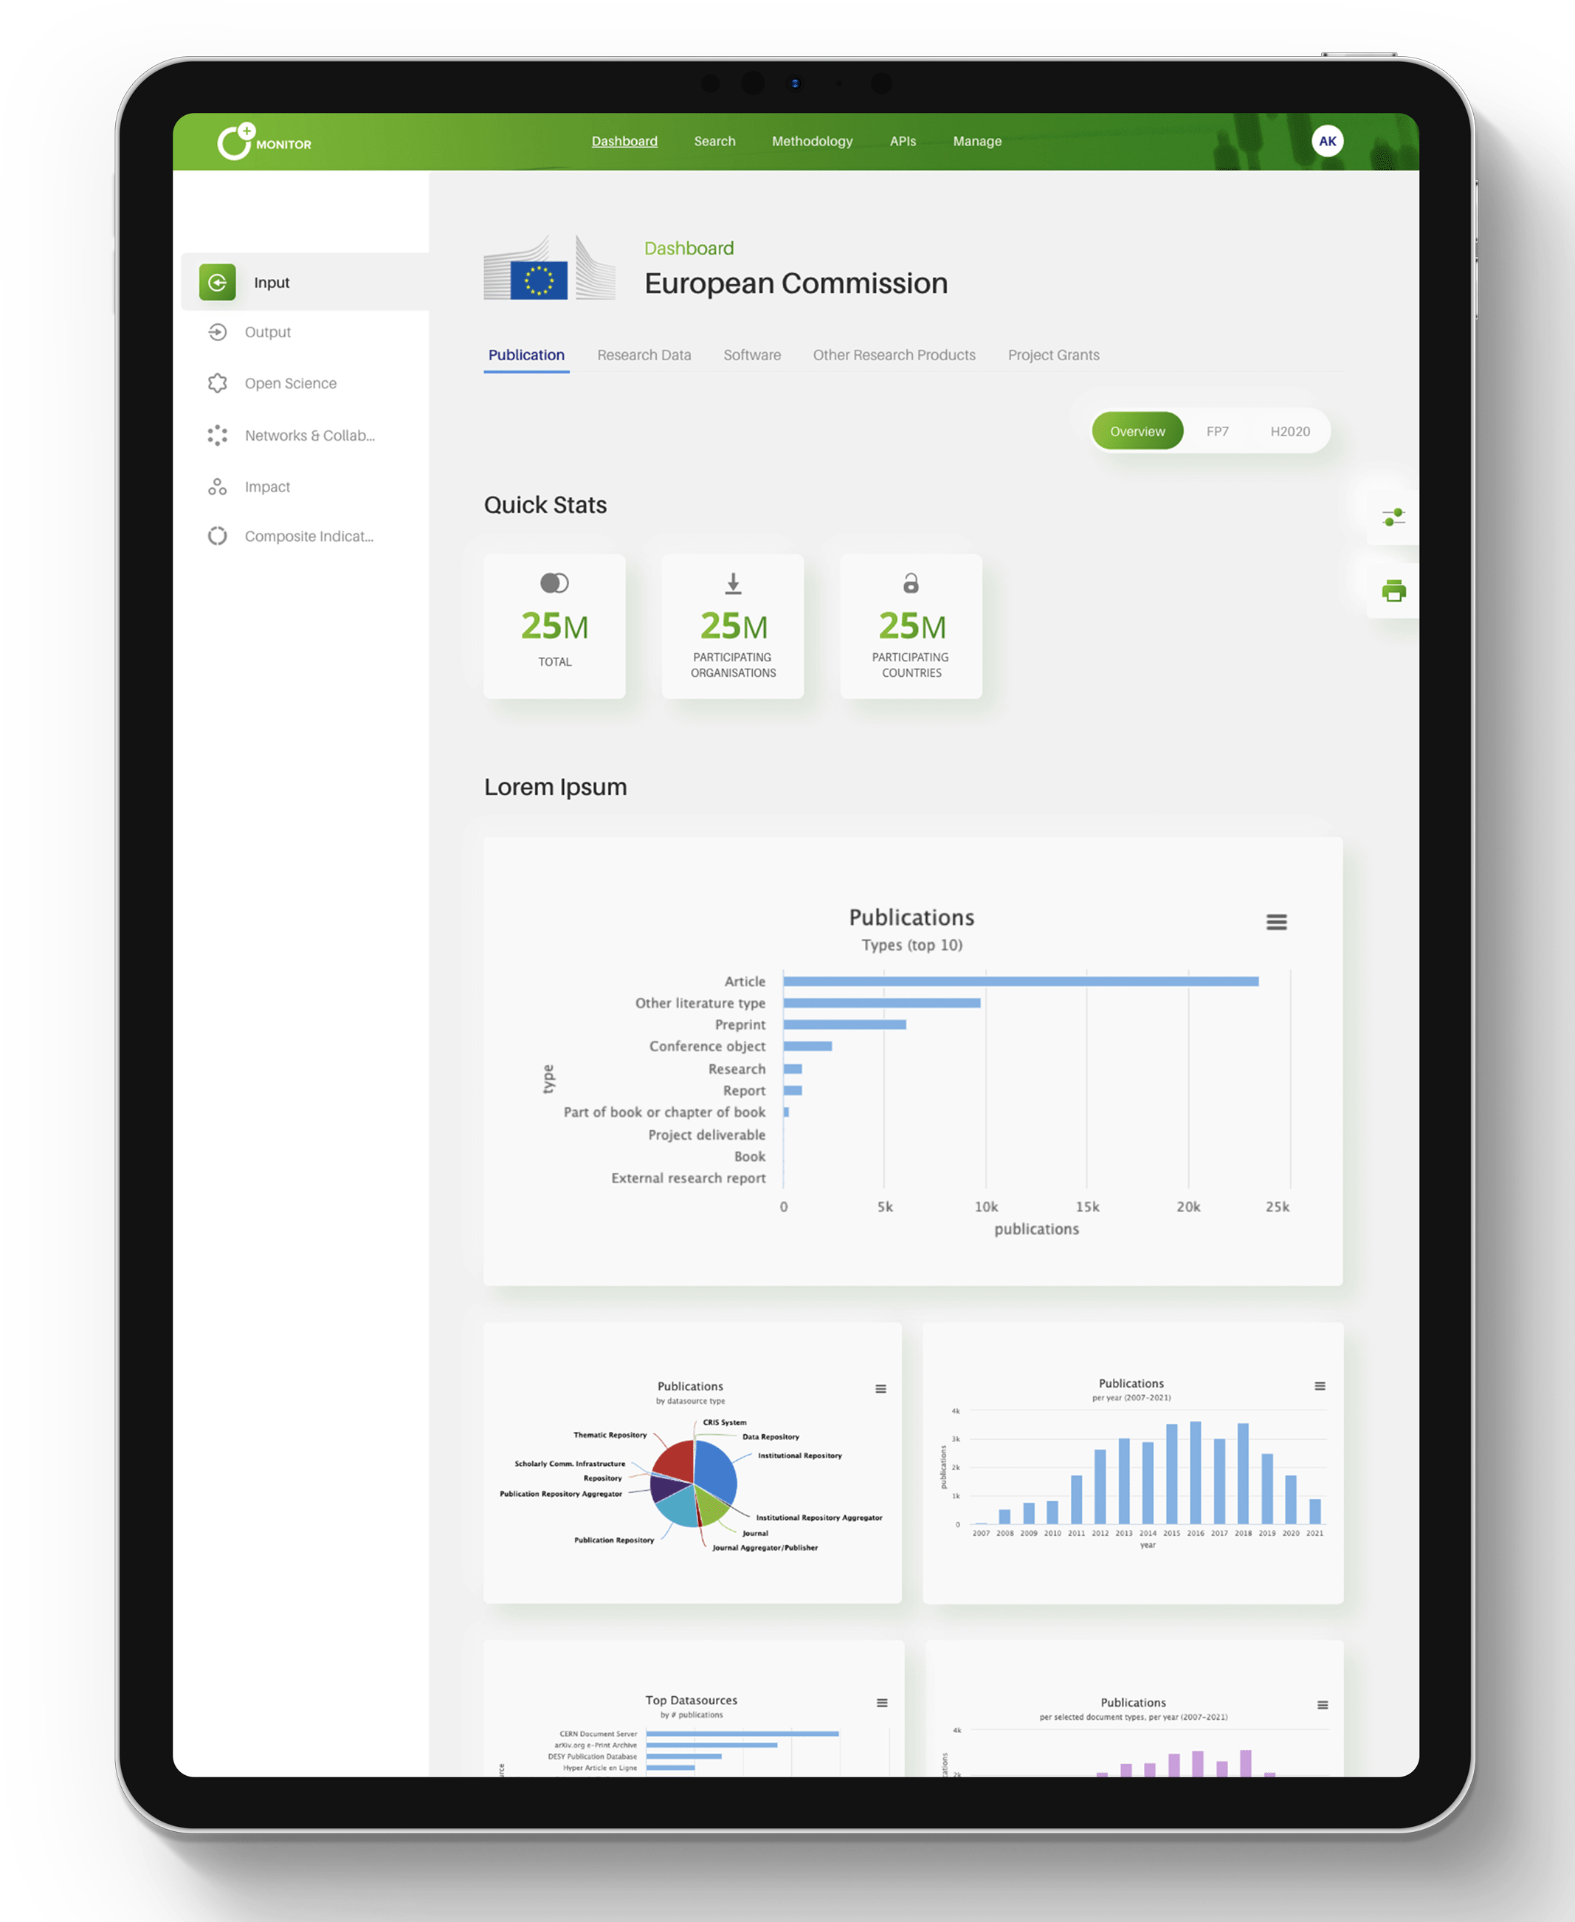
What will you get?
A customizable MONITOR dashboard, with numerous visualisations, by field of interest, research activity, etc. on your data, using research indicators
Public indicators for external stakeholders – Showcasing
Restricted indicators for team-members – Internal Monitoring
Private indicators for “work in progress” - Reviewing

Slide 20
Highlights / Novelties

Slide 21
Soon in your gateway (expecially useful for thematic communities)
SELECTION CRIERIA BASED ON FOS AND SDGS
ADVANCED CRITERIA
Identify relevant research products based on subjects, titles, abstracts, authors and contributors. Also in combination!
e.g. subject=“United States” and subject=“Mexico”
Select terms from the controlled vocabularies
Available on BETA

Slide 22
Use case: the EUT+ alliance
https://eut.openaire.eu/
Yvonne Desmond, Open Research Manager at TU Dublin

Slide 23
Alessia Bardi
alessia.bardi@isti.cnr.it

