Slide 1
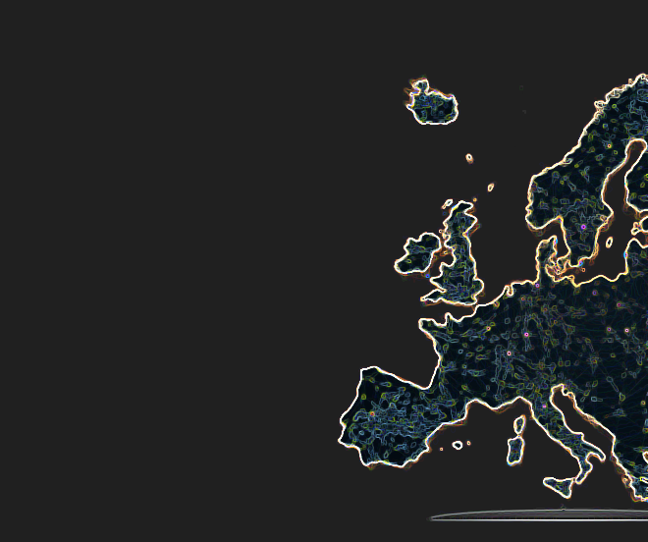
Community Call APR 20, 2023

Slide 2
Agenda
Intro
The World Bank MONITOR Dashboard
The Monitor pipeline: from PROVIDE to MONITOR
Institutional needs, requirements & the MONITOR experience Katie Bannon, The World Bank
New and upcoming MONITOR Indicators
Q&A

Slide 3
Introduction

Slide 4
Why Monitor?
Know Thyself
Understand Thyself
Position Thyself
Open Science Uptake
Resources
Research Output
Collaborations
Visibility
Impact
Pathways
Opportunities
Insights
Decision making
Reporting
Story telling

Slide 5
Why OpenAIRE MONITOR?
Relevance for the community
Co-develop indicators that make sense to all
It’s all about open science and open data
Inclusiveness, transparency and replicability
Coverage
Beyond publications: Research Data, Software, Other Research Products
Linked science
Fully embedded in EOSC infrastructure
Starting from content providers to included metrics
‘Not everything that can be counted counts, and not everything that counts can be counted’
(attributed to
Albert Einstein)

Slide 6
How? Methodological Approach
Tracking and evaluating research activities and open science uptake must be
data-driven & relevant – use key aspects of big data available
comprehensive & granular – 360º view across multiple facets of research activities & their links, down to a fine level
automated & timely
sustainable – tracking long-term & repeatedly
open, transparent & replicable → trustworthy

Slide 7
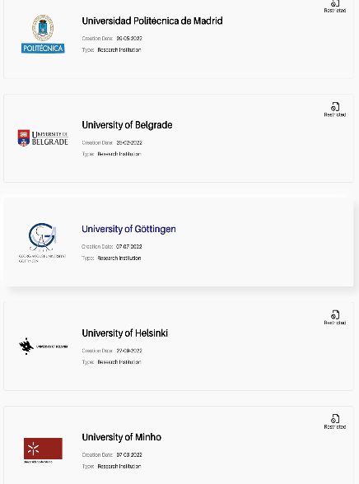
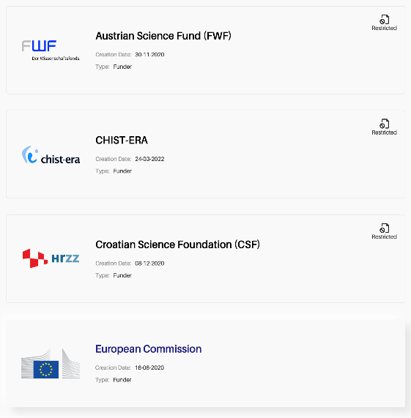
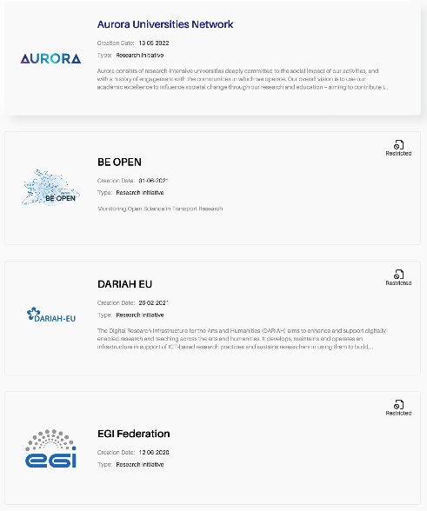
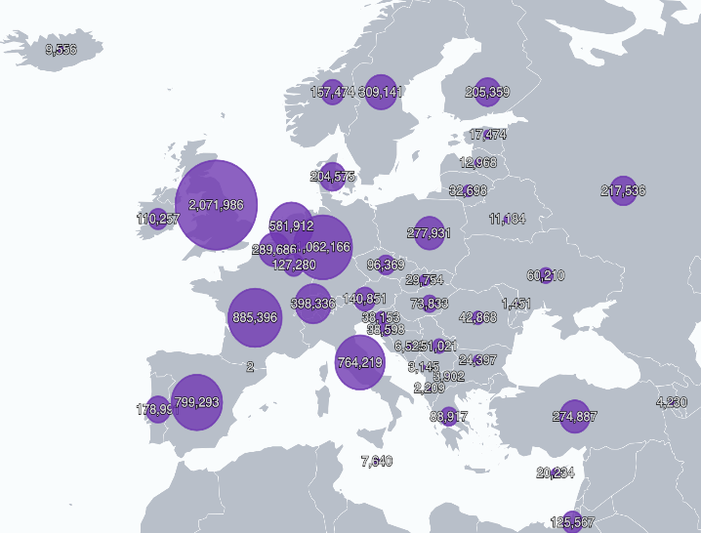
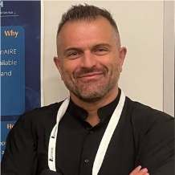
What? Dashboards on Demand
Institutions
Funders
Research Initiatives
Countries
Your OpenAIRE expert
Leonidas Pispiringas
Your OpenAIRE expert
Harry Dimitropoulos
Your OpenAIRE expert
Alessia Bardi
Your OpenAIRE expert
Ioanna Grypari
https://monitor.openaire.eu/
https://osobservatory.openaire.eu/
OpenAIRE MONITOR Community Call | April 20, 2023 | monitor.openaire.eu

Slide 8
Monitor Dashboard
From PROVIDE to MONITOR
Leonidas Pispiringas
Institutional Dashboard Manager | OpenAIRE

Slide 9
Iteration - Collaboration
MONITOR Dashboard
World Bank
OpenAIRE
OpenAIRE MONITOR Community Call | April 20, 2023 | monitor.openaire.eu

Slide 10
The Big Picture
team sharing
Your Dashboard
yours truly
DASHBOARD
community-led
dashboards of indicators
Collaboration
Publication Production
Institutional Openness
SDG Contribution
metrics data
OpenAIRE experts in data science, statistics and data mining
common global asset
Organization
OpenAIRE MONITOR Community Call | April 20, 2023 | monitor.openaire.eu

Slide 11
What is OpenAIRE Graph?
A collection of metadata describing:
Objects in the research lifecycle
Relationships among them
Collected from ~70.000 trusted sources
Further enriched with metadata and links provided by:
End-users providing links from scientific products to projects, funders, communities, or other products
Full-text mining algorithms over ~10Mi Open Access article full-texts
Research infrastructure scholarly services, bridged to the graph via OpenAIRE
Open
De-duplicated
Transparent
Participatory
Trusted
Complete
Decentralized
OpenAIRE MONITOR Community Call | April 20, 2023 | monitor.openaire.eu

Slide 12
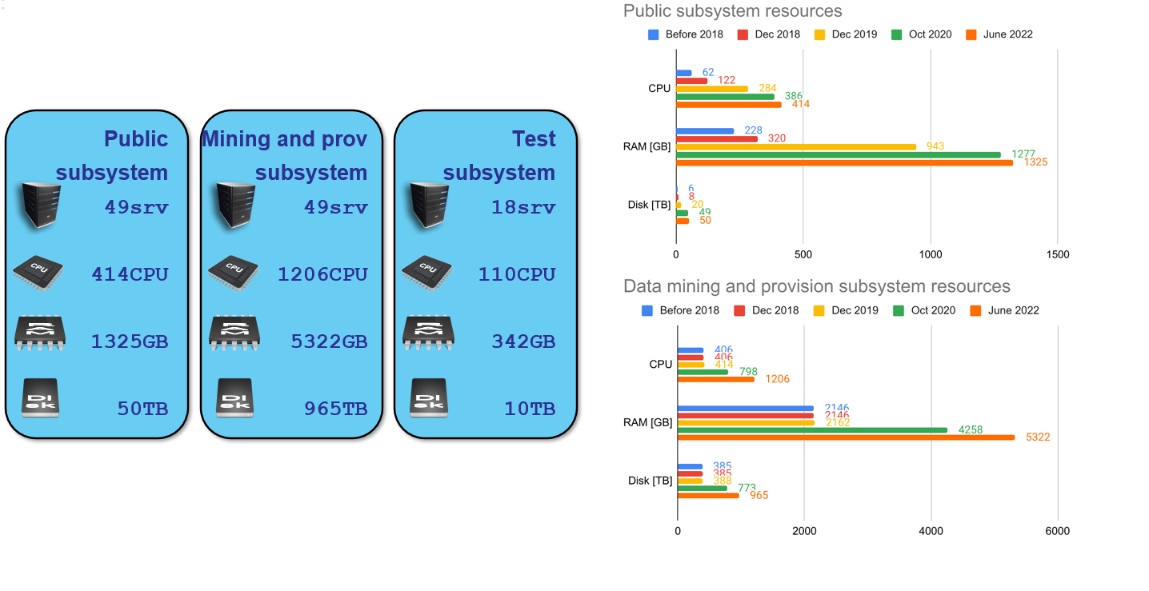
System Infrastructure
OpenAIRE MONITOR Community Call | April 20, 2023 | monitor.openaire.eu
OpenAIRE MONITOR Community Call| April 20th, 2022

Slide 13
Data quality. What can go wrong? (1)
Identified usually in MONITOR in a few cases
Relatively small numbers of research products
Disambiguation of the institutions’ different names
Issue with the repository’s metadata records during the aggregation (e.g. missing mandatory metadata field of the research product type)
Registration of the institution’s repository(ies) sets, validates and enriches the affiliation information
Datasets affiliation comes from the institution’s data sources
OpenAIRE MONITOR Community Call | April 20, 2023 | monitor.openaire.eu

Slide 14
Data quality. What can go wrong? (2)
Identified usually in MONITOR in a few cases
No funding information (Projects, EC projects)
Funders must interact with OpenAIRE and provide information for their funded projects: https://monitor.openaire.eu/about/how-it-works
Disambiguation issue in OpenOrgs
OpenAIRE MONITOR Community Call | April 20, 2023 | monitor.openaire.eu

Slide 15
Data quality. How to improve?
Data sources before entering OpenAIRE Graph
PROVIDE Dashboard
Validation & Registration of your data sources
Compatibility with the OpenAIRE Guidelines
Data sources that are part of the OpenAIRE graph
OpenOrgs Disambiguation
Improve the compatibility level with the OpenAIRE Guidelines
OpenAIRE MONITOR Community Call | April 20, 2023 | monitor.openaire.eu

Slide 16
What are my Data Sources?
Institutional Repositories
Literature
Data
Software
CRIS (Current Research Information Systems)
Journals
OpenAIRE MONITOR Community Call | April 20, 2023 | monitor.openaire.eu

Slide 17
How can I register my data sources?
Through the PROVIDE Dashboard service
Prerequisites:
Metadata records:
Exposed via the OAI-PMH protocol
Compatible with the OpenAIRE Guidelines
OpenAIRE MONITOR Community Call | April 20, 2023 | monitor.openaire.eu

Slide 18
Why should I register my data sources?
EOSC: OpenAIRE is your entry/gateway
If you are compliant with the OpenAIRE guidelines
then
You will be onboarding the EOSC Portal Catalogue and Marketplace integrated platform
Improved interoperability to meet latest IT and repository standards
Your content is more:
Contextualised (links and relationships to other types of research outcomes and entities)
Flexible (use of different and improved vocabularies)
Embedded in the R&I ecosystem (align with Open Science mandates and standards and support for well-established metadata schemas)
This is your road to FAIRness
If you are compliant with the OpenAIRE guidelines
then
you are also FAIR enough
Accurate and qualitative metrics
OpenAIRE MONITOR Community Call | April 20, 2023 | monitor.openaire.eu

Slide 19
OpenAIRE Guidelines
https://guidelines.openaire.eu/
A common metadata framework for exchanging minimum metadata information
Provide orientation to define and implement your local data management policies according to the requirements of OpenAIRE
Expose publications, datasets and CRIS metadata via the OAI-PMH protocol in order to integrate with OpenAIRE infrastructure
OpenAIRE MONITOR Community Call | April 20, 2023 | monitor.openaire.eu

Slide 20
OpenOrgs
Information ambiguity
Information about the organizations is distributed in numerous data sources
Organizations may appear with different names (legal names, acronyms, short names, alternatives...)
The organization’s structure may not be so clear: faculties, departments, branches, detachments etc.
Information disambiguation
de-duplicate organizations
identify parent-child relationship
OpenAIRE MONITOR Community Call | April 20, 2023 | monitor.openaire.eu

Slide 21
OpenOrgs activity pillars
Automatic suggestion of duplicates
periodically produce new suggestions for the curators when a new source of organization objects is registered in OpenAIRE
Metadata curation
Curators can enrich the metadata description of the organization entities thus improving the discoverability / completeness
Management of duplicates
Task that only humans can carry out precisely. Curators manage the ambiguities in the data lack of the organization mentions aggregated by OpenAIRE
OpenAIRE MONITOR Community Call | April 20, 2023 | monitor.openaire.eu

Slide 22
We are here to assist you!
PROVIDE Dashboard Validation & Registration quide:
https://www.openaire.eu/validator-registration-guide
Support
helpdesk@openaire.eu
Dedicated calls with our experts
OpenAIRE MONITOR Community Call | April 20, 2023 | monitor.openaire.eu

Slide 23
Monitor Indicators
New & Upcoming
Ioanna Grypari
Indicators Lead | ATHENA Research Center

Slide 24
Behind the indicators.. Why Monitor?
Know Thyself
Understand Thyself
Position Thyself
Resources
Research Output
Open Science Uptake
Collaborations
Visibility
Impact
Pathways
Insights
Opportunities
Decision making
Reporting
Story telling

Slide 25
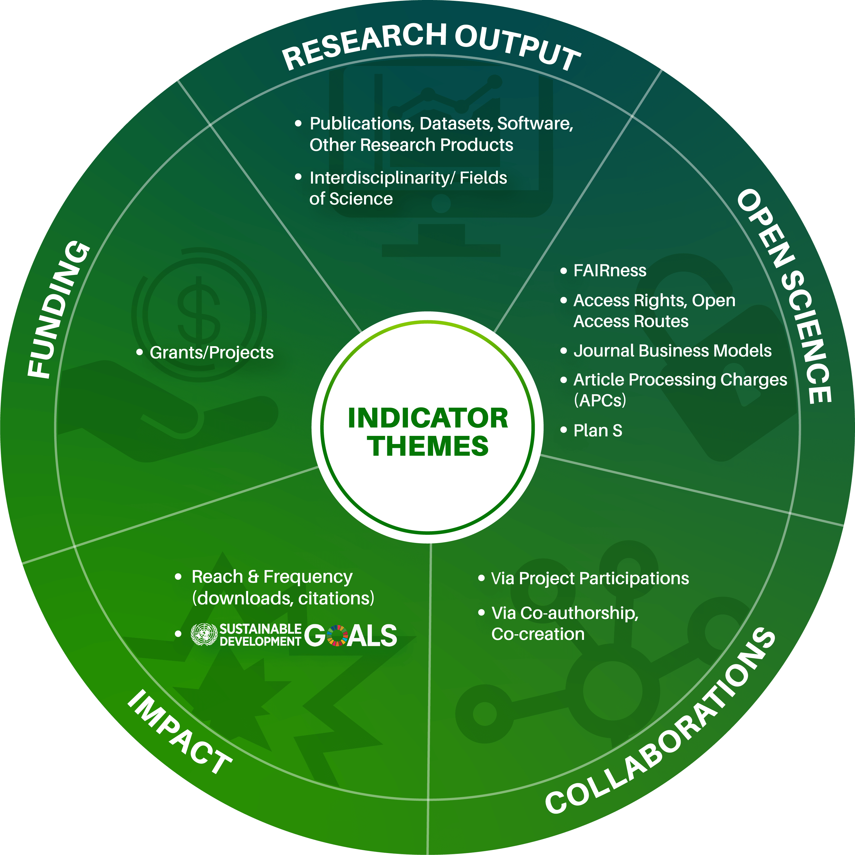
Indicators bird’s-eye view

Slide 26
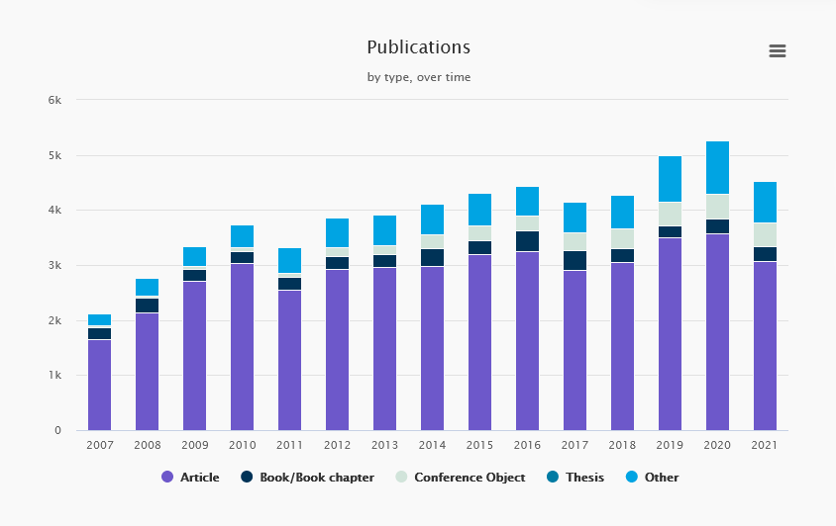
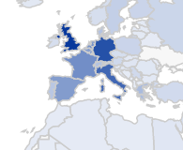
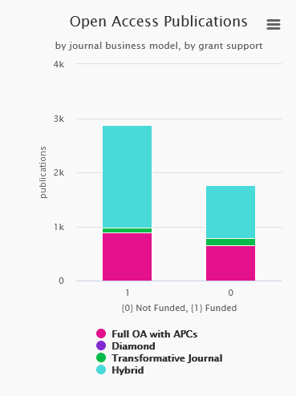
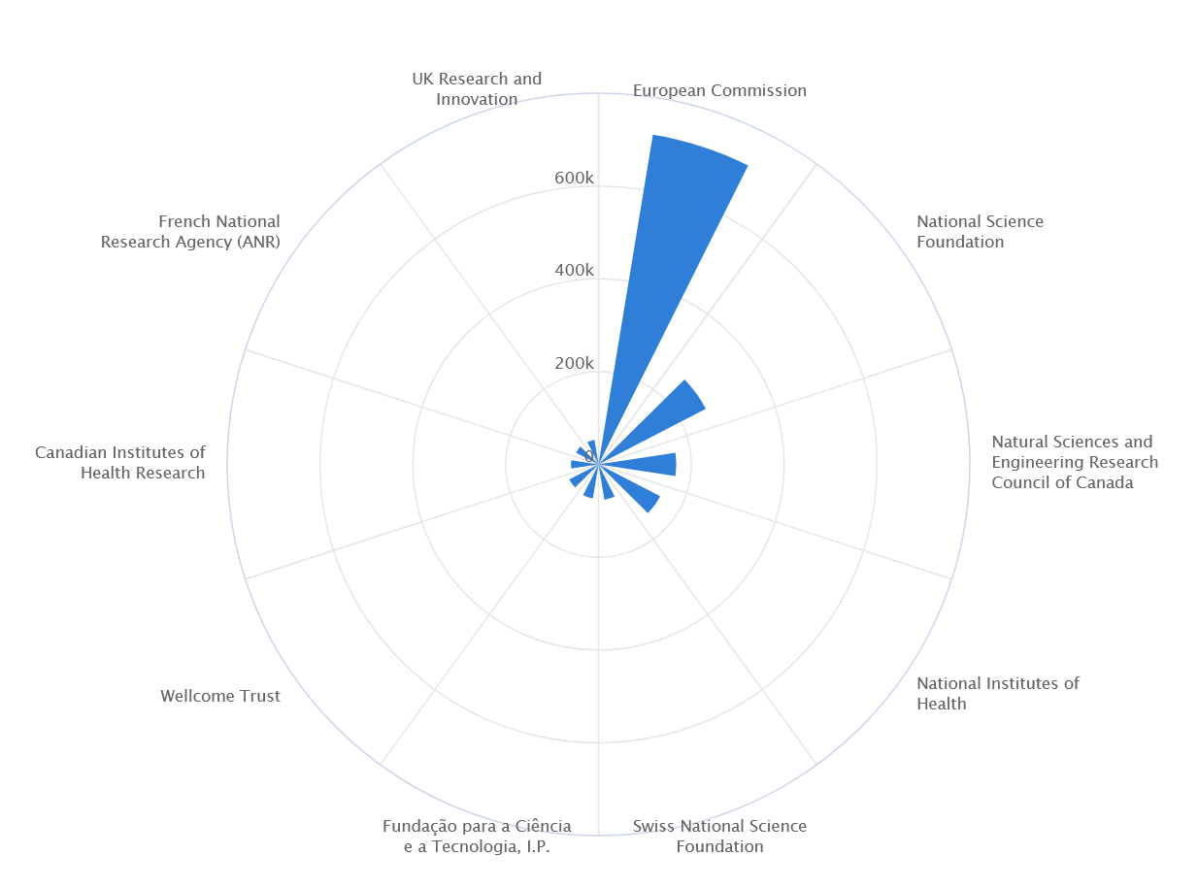
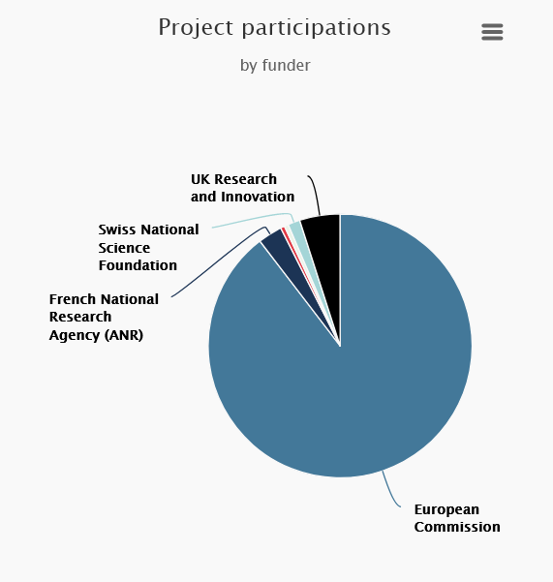
Indicators Breakdown
By fields of interest
research product type
time
countries
data sources
funders
…

Slide 27
New Indicators OS Composites
Open Science composite indicators for organizations

Slide 28
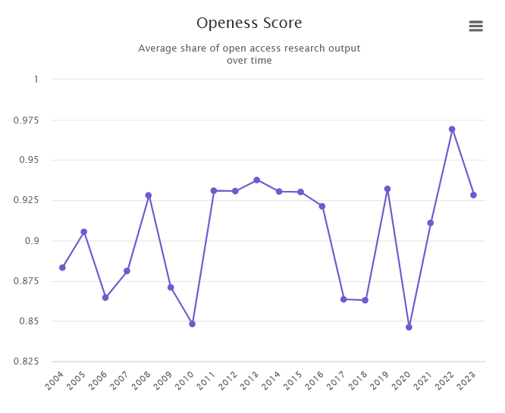
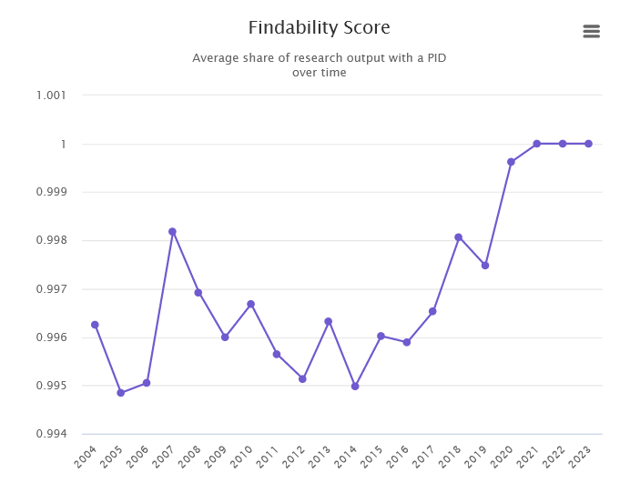
New Indicators OS Composites
Open Science composite indicators for organizations

Slide 29
New Indicators UN SDGs
We have developed a classification scheme for UN Sustainable Development Goals, to view contributions of research towards complex challenges for humanity such as climate change, biodiversity loss, pollution and poverty reduction.
https://explore.openaire.eu/sdgs

Slide 30
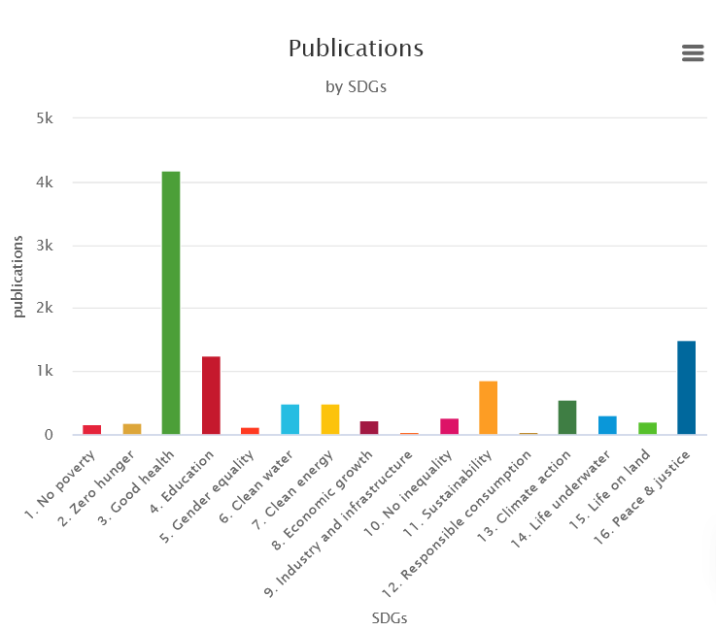
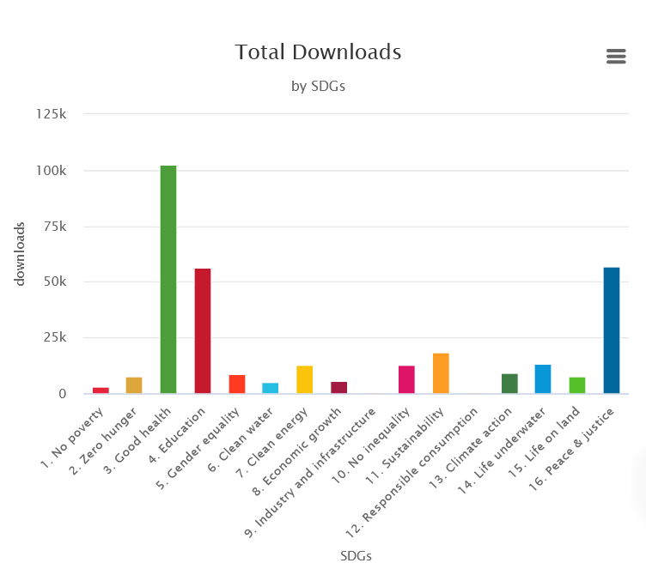
New Indicators UN SDGs

Slide 31
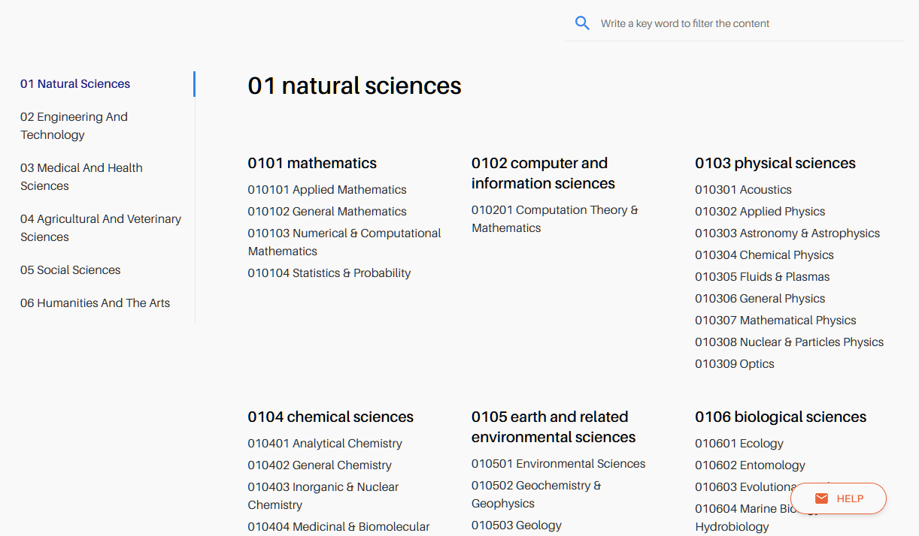
Additional Dimension of Analysis
Fields of Science (FoS) Classification Levels 1, 2, 3
https://explore.openaire.eu/fields-of-science

Slide 32
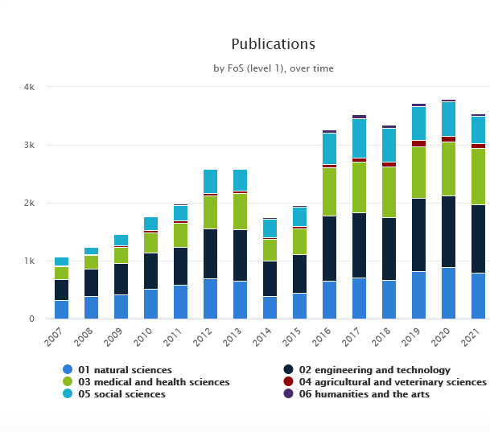
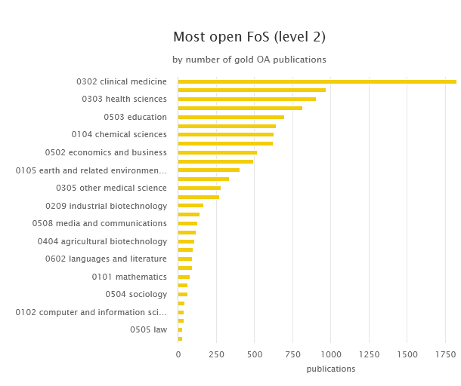
Indicators Breakdown by FoS

Slide 33
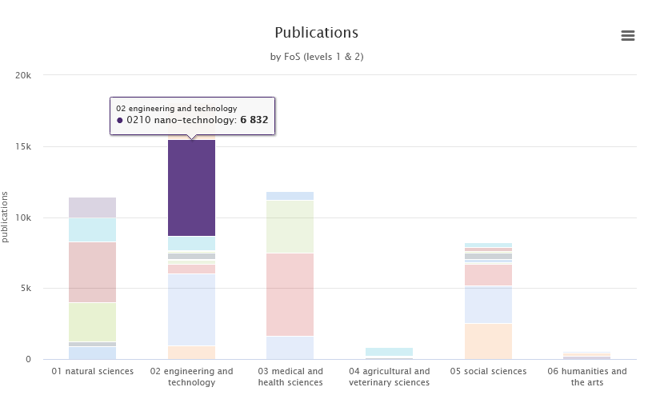
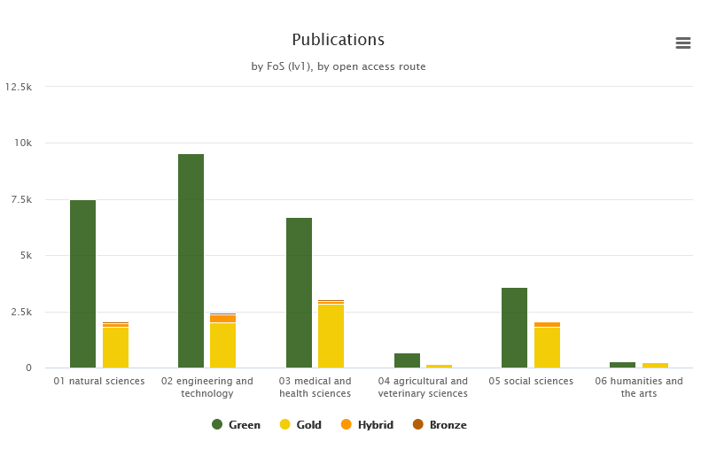
Indicators Breakdown by FoS

Slide 34
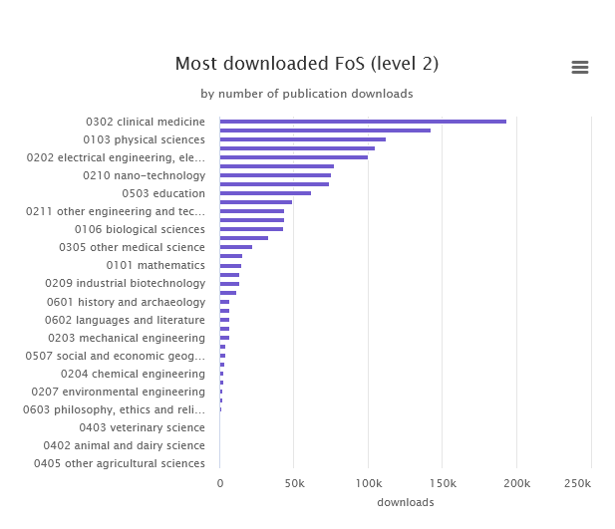
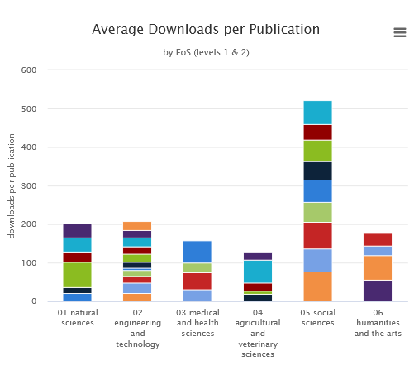
Indicators Breakdown by FoS

Slide 35
Upcoming Indicators
Citations
Citation count, “incubation” citation count, RAM, page rank (https://graph.openaire.eu/docs/graph-production-workflow/indicators-ingestion/impact-indicators)
Article Processing Charges
OpenAPC
Horizon Europe projects indicators
Plan S Compliance
PlanS funder grant-supported output
Transformative agreements
Analysis/Breakdown by
Multi-disciplinarity

Slide 36
Great! When can I see these on my dashboard?
New: May 2023
Upcoming: September 2023
How do I get started with a new dashboard?
Here: monitor.openaire.eu/get-started

Slide 37
THANKS
Email
igrypari@athenarc.gr
leonidas.pispiringas@openaire.eu
Twitter
@openaire_eu
OpenAIRE MONITOR Community Call | April 20, 2023 | monitor.openaire.eu

