Slide 1
Presenter: Pedro Principe, University of Minho
Leonidas Pispiringas, Natalia Manola, OpenAIRE
Ioanna Grypari, Harry Dimitropoulos, Antonis Lempesis and Dimitris Pierrakos, Athena Research Center
Alessia Bardi, CNR-ISTI
From scholarly output to knowledge database to insights on scientific content and its impact.
OR2023| OpenAIRE MONITOR | monitor.openaire.eu

Slide 2
This Talk
OpenAIRE MONITOR – An on-demand service for tracking research activities and impacts. Our goal: unlocking insights, help with informed decisions, and maximizing societal impact.
Harnessing the power of the OpenAIRE Graph and leveraging machine learning algorithms to transform scholarly output into a comprehensive knowledge graph database
In Focus: linking content to FoS and SDGs in OpenAIRE
The crucial role of repositories in the MONITOR pipeline; tracking and evaluating research activities, enhancing discoverability, and driving research excellence.

Slide 3
Introduction

Slide 4
Why Monitor?
Know Thyself
Understand Thyself
Position Thyself
Open Science Uptake
Resources
Research Output
Collaborations
Visibility
Impact
Pathways
Opportunities
Insights
Decision making
Reporting
Story telling

Slide 5
Why OpenAIRE MONITOR?
monitor.openaire.eu
‘Not everything that can be counted counts, and not everything that counts can be counted’
(attributed to
Albert Einstein)
Relevance for the community
Co-develop indicators that make sense to all
It’s all about open science and open data
Inclusiveness, transparency and replicability
Coverage
Beyond publications: Research Data, Software, Other Research Products
Linked science
Fully embedded in EOSC infrastructure
Starting from content providers to included metrics

Slide 6
How? Methodological Approach
Data-Driven and Relevant: Leveraging big data to understand key trends in research activities and open science.
Comprehensive & Granular: Providing a 360° view across various facets of research, with detailed insights.
Automated & Timely: Ensuring real-time tracking and evaluation of research activities.
Sustainable: Enabling long-term tracking for consistent monitoring.
Open & Transparent: Fostering trust with a replicable approach.

Slide 7
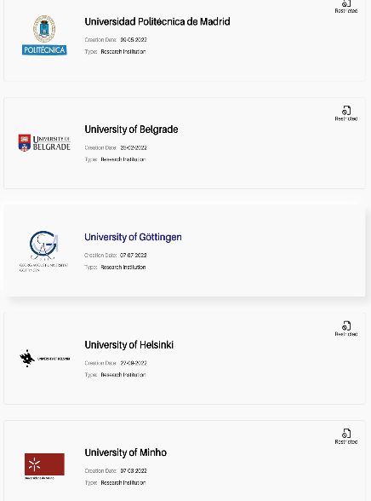
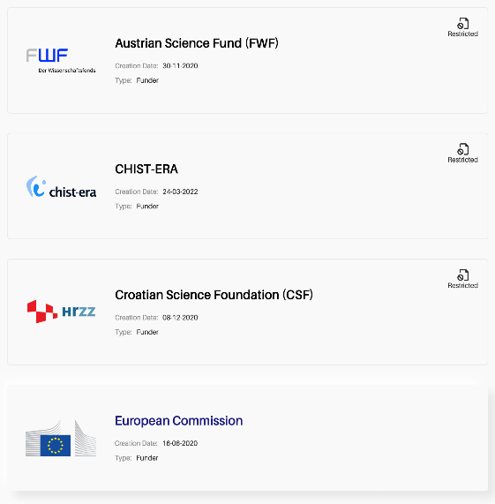
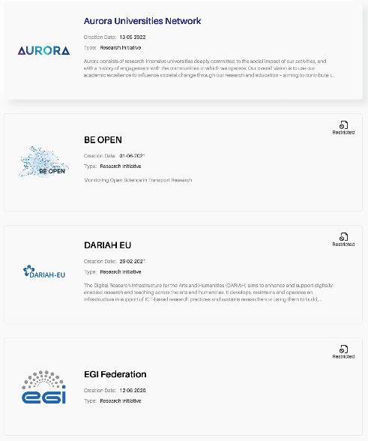
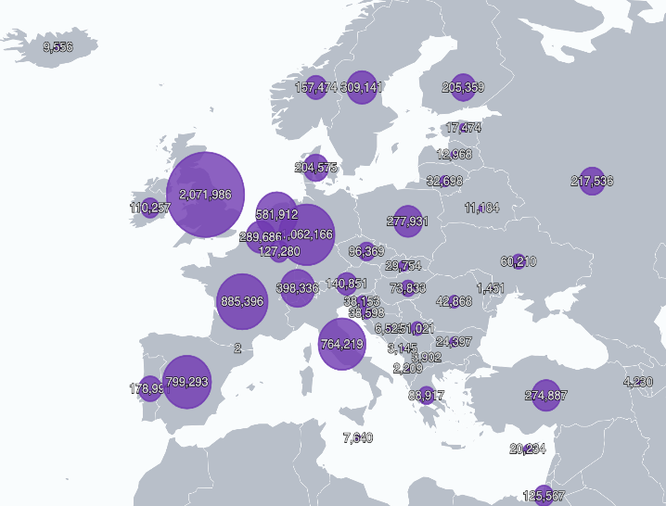
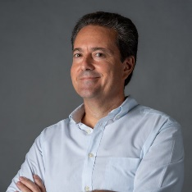
What? Dashboards on Demand
Institutions
Funders
Research Initiatives
Countries
OpenAIRE expert
Leonidas Pispiringas
OpenAIRE expert
Harry Dimitropoulos
OpenAIRE expert
Alessia Bardi
OpenAIRE expert
Ioanna Grypari
https://monitor.openaire.eu/
https://osobservatory.openaire.eu/

Slide 8
OpenAIRE Graph

Slide 9
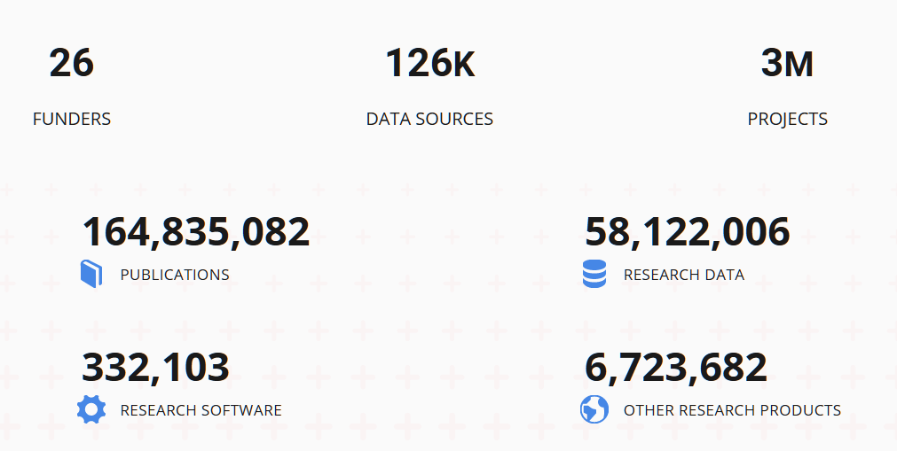
What is the OpenAIRE Graph?
Open
De-duplicated
Transparent
Participatory
Trusted
Complete
Decentralized
graph.openaire.eu
A collection of metadata describing:
Objects in the research lifecycle
Relationships among them
Collected from ~70.000 trusted sources
Further enriched with metadata and links provided by:
End-users providing links from scientific products to projects, funders, communities, or other products
Full-text mining algorithms over ~10Mi Open Access article full-texts
Research infrastructure scholarly services, bridged to the graph via OpenAIRE
Last OpenAIRE Graph Update (06/23)
OR2023| OpenAIRE MONITOR | monitor.openaire.eu

Slide 10
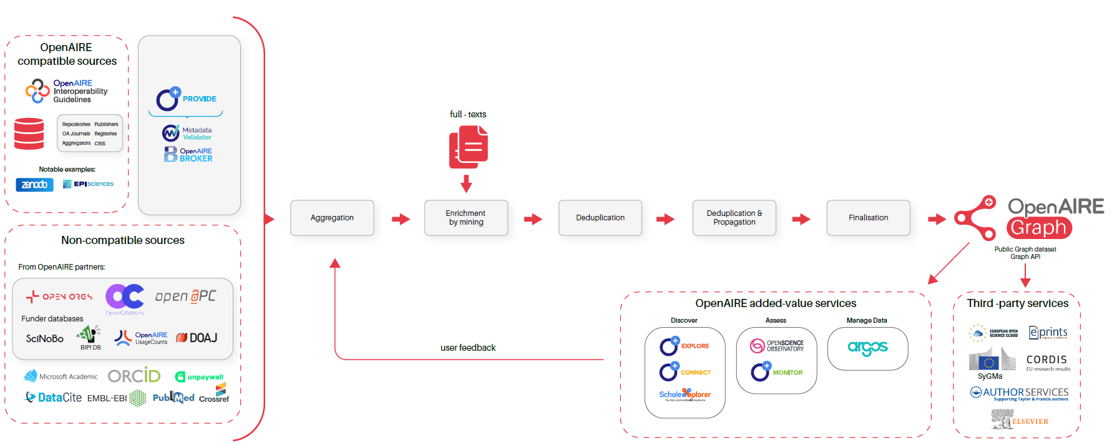
The OpenAIRE Graph Pipeline
graph.openaire.eu
Repositories
FoS & SDGs
Knowledge Graph
Insights
OR2023| OpenAIRE MONITOR | monitor.openaire.eu

Slide 11
The Monitor Dashboard
team sharing
Customized Dashboard
customization
DASHBOARD
community-led
dashboards of indicators
Collaborations
Citations & Downloads
Institutional Openness
SDG Contribution
metrics data
OpenAIRE experts in data science, statistics and data mining
common global asset
Organization Data
OR2023| OpenAIRE MONITOR | monitor.openaire.eu

Slide 12
FoS & SDG
Classification in OpenAIRE

Slide 13
Fields of Science (FoS) Classification System
FoS in OpenAIRE
https://explore.openaire.eu/fields-of-science
Categorize scholarly research into specific scientific disciplines.
Standardized framework for understanding the disciplinary focus of research outcomes
Insights into the disciplines where their scholarly output has the most impact.
Benefits of FoS Classification:
Enhanced Discoverability: FoS classification enables users to easily identify and explore research in their specific areas of interest.
Research Assessment: By associating research outcomes with FoS, institutions can evaluate the disciplinary strengths and contributions of their scholarly output.
Interdisciplinary Insights: FoS classification also reveals interdisciplinary areas where research impact is being generated.
SCINOBO: Kotitsas, S., Pappas, D., Manola, N., & Papageorgiou, H. (2023). SCINOBO: a novel system classifying scholarly communication in a dynamically constructed hierarchical Field-of-Science taxonomy. Frontiers in Research Metrics and Analytics, 8, 23. https://doi.org/10.3389/frma.2023.1149834
OR2023| OpenAIRE MONITOR | monitor.openaire.eu

Slide 14
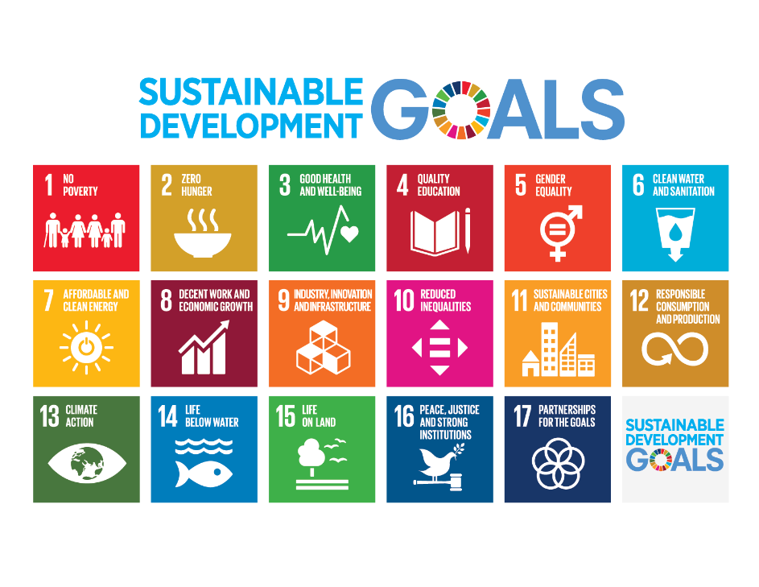
UN SDGs Classification System
SDGs in OpenAIRE https://explore.openaire.eu/sdgs
Importance:
Policy Alignment: Track research aligned with societal priorities
Impact Evaluation: Assess research's contribution to/interest in SDGs
Evidence-Based Policy: Support policy-making with data-driven insights
Global Development Agenda: Contribute to global goals and collaboration
Classifying publications according to SDGs is the first KEY step
towards an SDG-contribution evaluation system
STEP 1: Classify publications according to SDGs
STEP 2: Extract which way research is trying to reach SDG (claim)
STEP 3: Assess if they accomplished it (evidence)
OR2023| OpenAIRE MONITOR | monitor.openaire.eu

Slide 15
Insights and Impact
Through OpenAIRE MONITOR

Slide 16
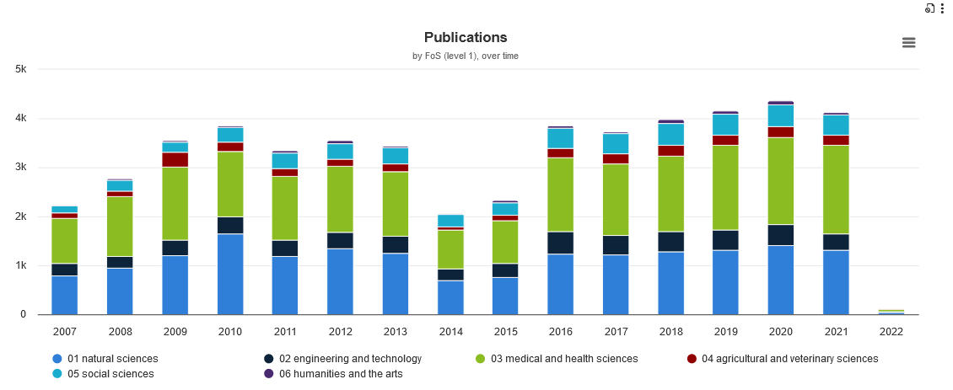
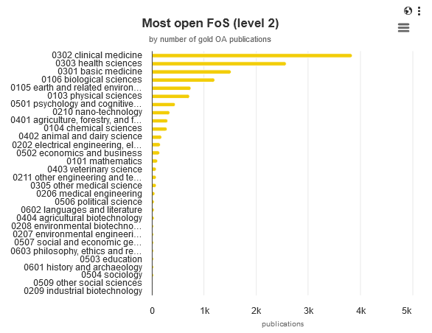
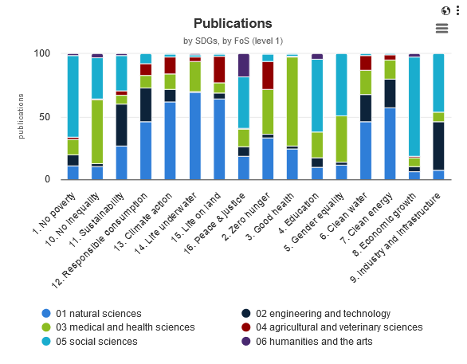
Key Insights Enabled by FoS in OpenAIRE MONITOR Example Questions
How is research distributed across different fields of science?
How extensively is Open Science adopted within the institution across disciplines?
What is the percentage of Open Access publications in each discipline (green, gold, hybrid, bronze)?
How collaborative is research within and between different scientific domains?
What is the citation impact of research in various fields of science?
How do download rates vary across scientific disciplines?
How does the institution's research align with SDGs in different fields of science?
How is research funding distributed across scientific fields?
Currently in Beta, expected in production by Fall 2023

Slide 17
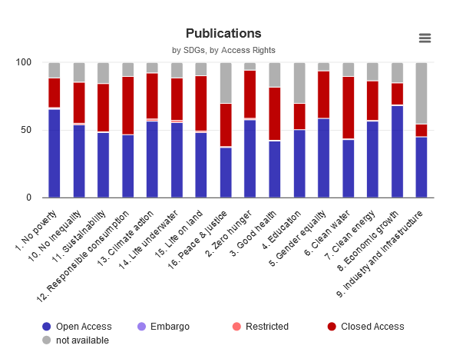
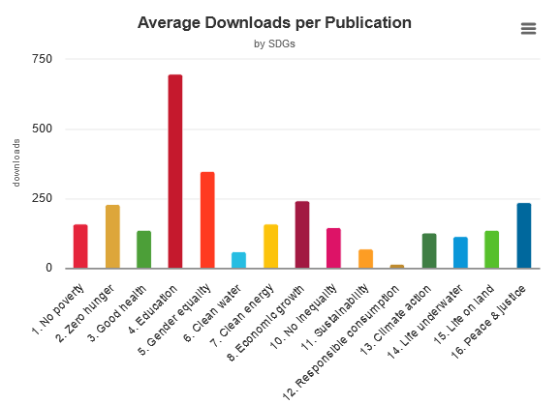
Key Insights Enabled by SDGs in OpenAIRE MONITOR Example Questions
What are the trends in research output related to specific SDGs over time?
What is the open science uptake (OA colors, journal business models, FAIR indicators) in research output related to specific SDGs?
How is research output distributed across different data sources for specific SDGs?
Are there notable differences in the research impact (citations, downloads) between different SDGs?
Which scientific disciplines have the highest societal impact in relation to SDGs?
How is funding aligned with SDGs?
Among my institution's research outputs, which SDGs show the highest degree of collaboration, and which countries and organizations are involved in these collaborations?
OR2023| OpenAIRE MONITOR | monitor.openaire.eu
Currently in Beta, expected in production by Fall 2023

Slide 18
CONCLUSION

Slide 19
Conclusion
Leveraging Interconnected Ecosystem:
OpenAIRE MONITOR taps into the network of repositories and data sources.
Creation of Knowledge Database:
Aggregates data for comprehensive insights into impact pathways of research activities.
Use of Machine Learning Algorithms:
Classifies publications and datasets according to their contribution to scientific domains and Sustainable Development Goals (SDGs).
Assessment of Reach, Visibility and Societal Impact:
Evaluates scholarly output's breadth, visibility, and influence on society.
Connection to Open Infrastructures and Open Science Uptake:
Analyzes how open infrastructures and the embrace of open science affect the scholarly output's impact.

Slide 20
THANKS
Email
pedro.principe@usdb.uminho.pt
igrypari@athenarc.gr
Twitter
@openaire_eu
OR2023| OpenAIRE MONITOR | monitor.openaire.eu

