Slide 1
From COUNTER CoP Release 4 to Release 5
Updates in the new usage statistics reports and metrics
Dimitris Pierrakos
OpenAIRE

Slide 2
UsageCounts Service Features
The Usage Statistics Service of OpenAIRE Research Graph
Tracking of usage with specialized server-side software (PUSH)
Collecting COUNTER reports (R4 and R5) (Pull)
Anonymization of IPs
Metadata de-duplication enables accumulation of usage for same research outputs
COUNTER Code of Practice compatibility to provide standards based usage statistics.
Indicators that complements other (traditional and alternative) bibliometric indicators to provide a comprehensive and recent view of the impact of academic resources.

Slide 3
COUNTER CoP Timeline
Before COUNTER
Not Consistent, not comparable usage statistics, i.e. not standard
Release 1 (2003)
Journals and Databases
Release 2 (2005)
Platform-wide use
SUSHI (2006)
automate harvesting of reports
Release 3 (2009)
Book reports, journal archive and YOP
Release 4 (2013)
24 Reports including multimedia reports, book chapter reports
Release 5 (2019)
4 Master reports
New CoP
New concepts, metrics, filters, etc

Slide 4
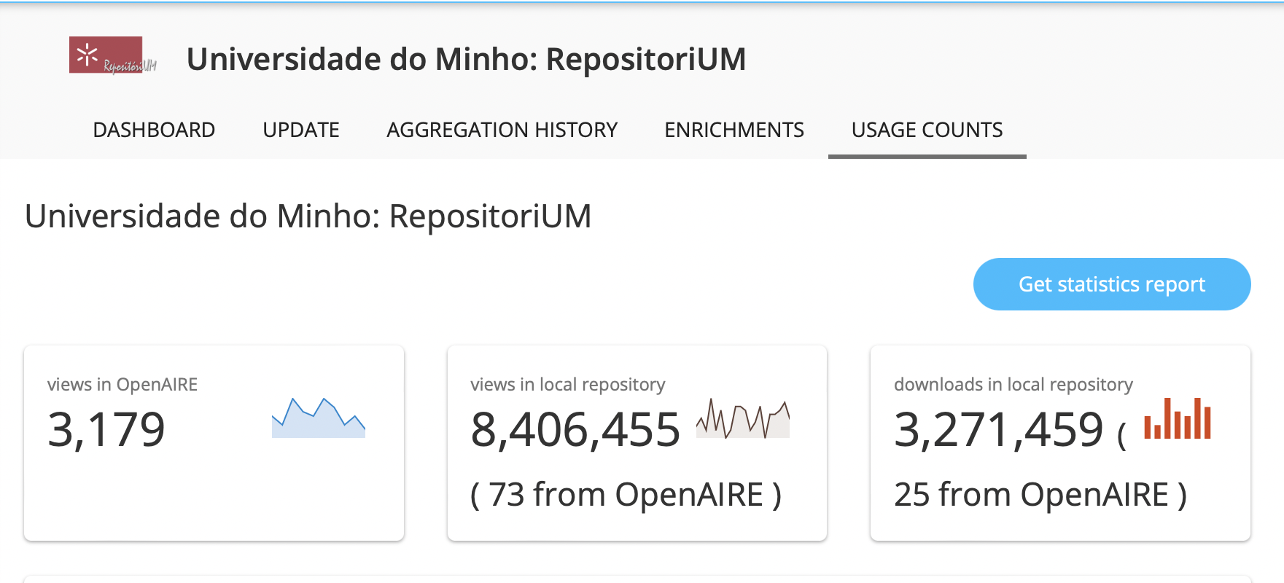
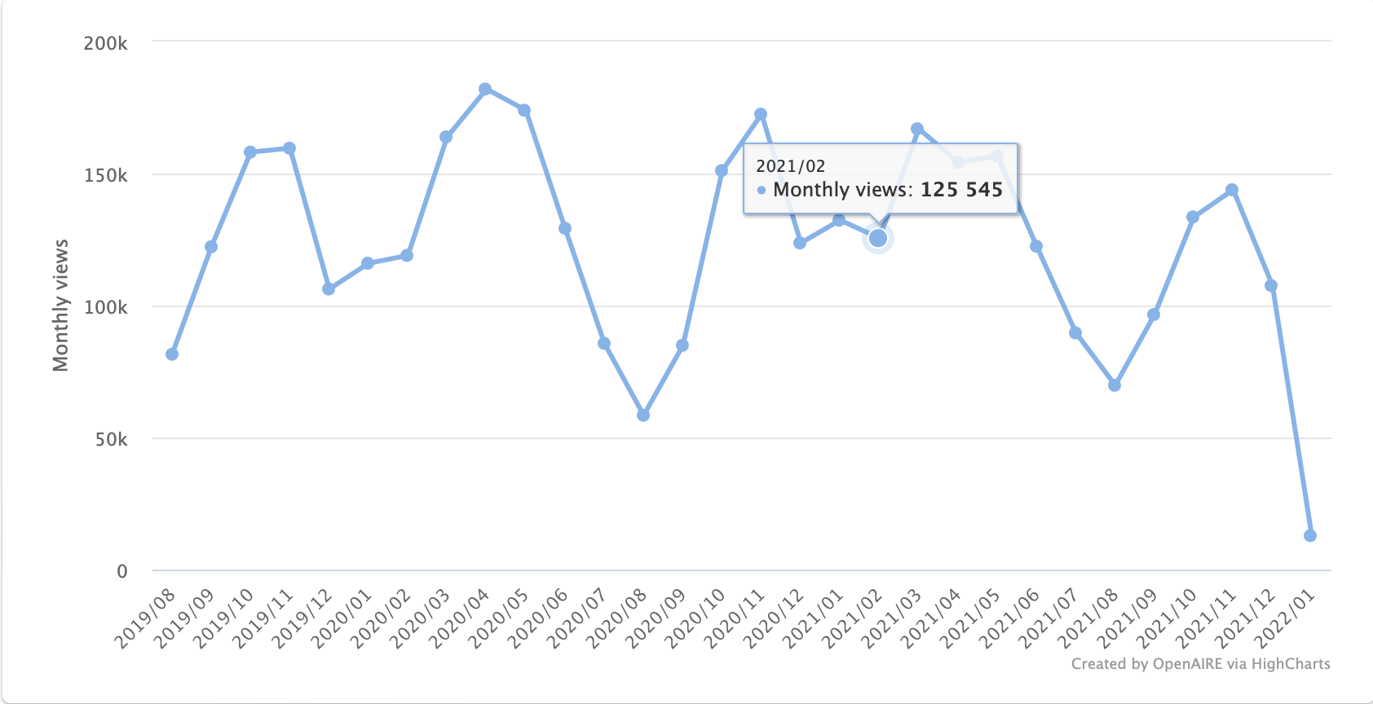
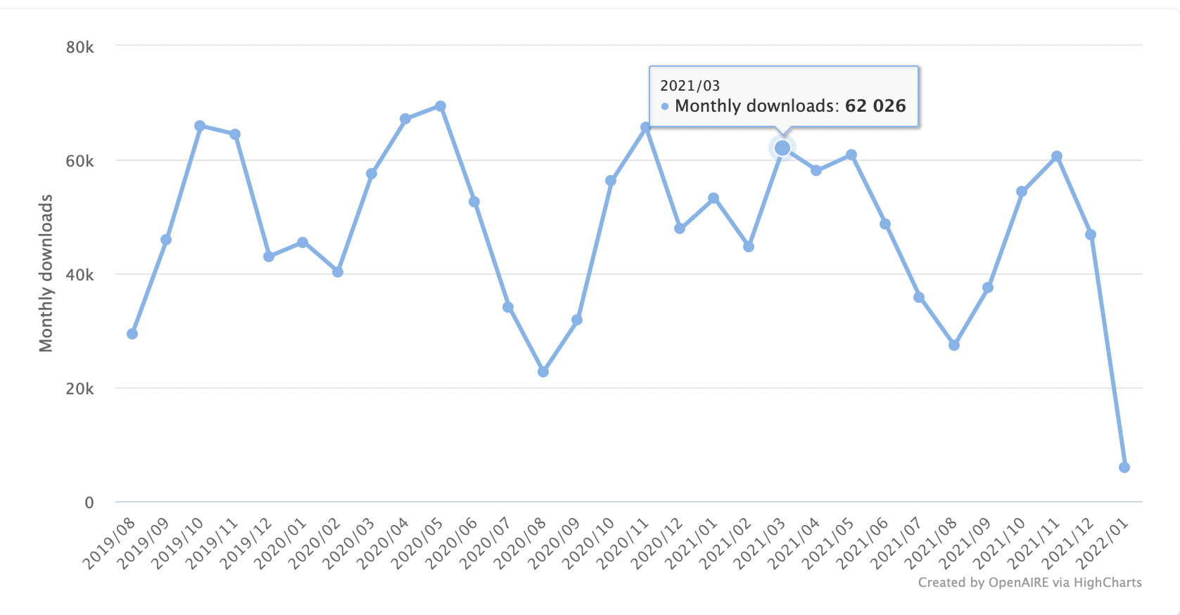
Current Status: COUNTER CoP R4 Metrics
Views
Downloads

Slide 5
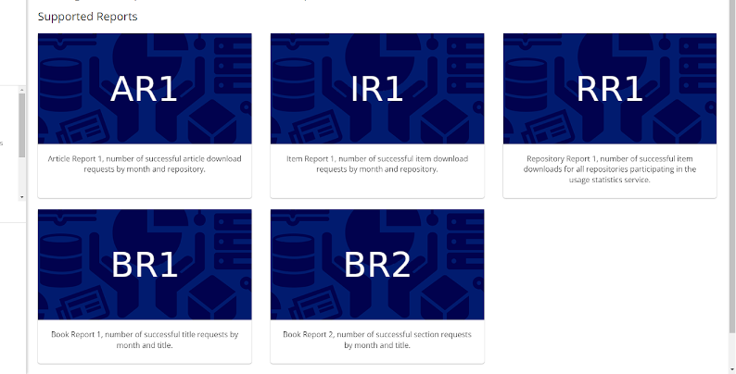
Current Status: COUNTER CoP R4 Reports

Slide 6
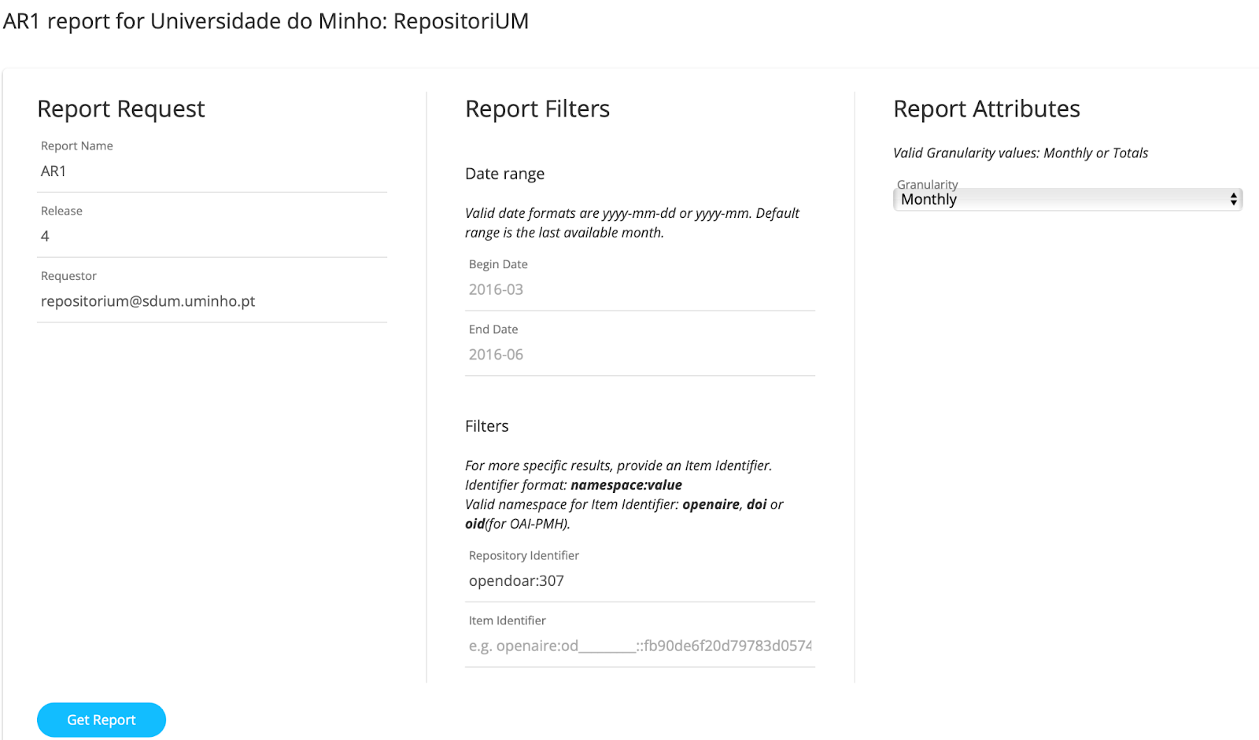
COUNTER CoP R4

Slide 7
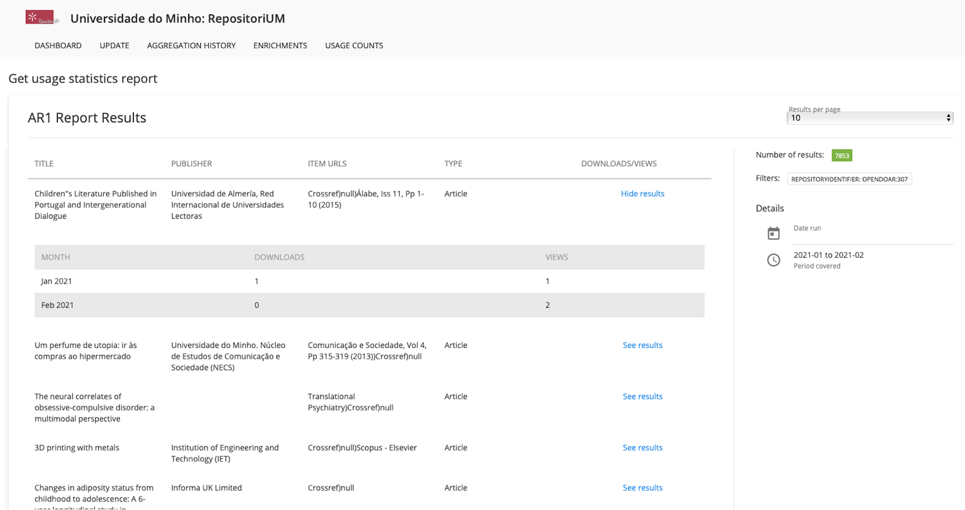
COUNTER CoP R4

Slide 8
UsageCounts: Upcoming Updates
COUNTER Code of Practice R5
Metric Types
Other Concepts
Reports

Slide 9
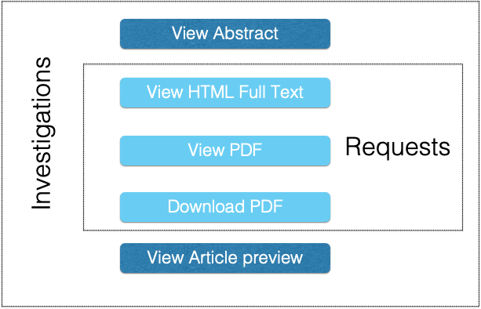
COUNTER CoP R5 Metric_Types
An investigation is tracked when a user performs any action in relation to a content item or title
A request is specifically related to viewing or downloading the full content item
COUNTER R4: Views/Downloads

Slide 10
COUNTER CoP R5 Updates: Metric Types
Unique_Item_Investigations: Counts unique article investigations and requests in a user‐session.
Total_Item_Investigations: Counts total number of times information related to an article viewed (including all article full‐content views).
Total_Item_Requests: Counts all article full‐content views across all formats like HTML and PDF. This is equivalent to the Release 4 usage count.
Unique_Item_Requests: Counts unique article full‐content views in a given session regardless of format. If a user views an article PDF and HTML in the same session this would only count as 1.

Slide 11
COUNTER CoP R5: Example Scenario
Susan is researching the history of Porto in UMINHO repository. From a list of search results, she opens three article abstracts. The counts are:
total_item_investigations: 3
unique_item_investigations: 3
After reading the abstracts, Susan downloads the PDFs for two of the articles. The counts change to:
total_item_investigations: 5 (3 as "views" + 2 as "downloads")
unique_item_investigations: 3 (3 unique "views")
total_item_requests: 2
unique_item_requests: 2

Slide 12
R4 Downloads vs R5 Total_Item_Requests

Slide 13
R4 Views vs R5 Total_Item_Investigations

Slide 14
CoP R5 Metric Types Features
Total Item Requests
Important for providers that have full-text content
Reports the number of full-text downloads or views
Total Item Investigations
Provides a big picture perspective of the total number of investigations
Unique Investigations and Requests
Powerful metrics for identifying activities with unique items and titles
Most accurate for cost per use analysis

Slide 15
R5 Data_Types (R4 Items)
Data_Type
Article Book Book Segment Collection Database Dataset Journal Multimedia Platform Repository Item
Data_Type identifies the general type of content being accessed or for which usage is being reported.

Slide 16
CoP R5 Access_Type
Access_Type describes the nature of access control that was in place when the content item was accessed.
This attribute appears in Journal Title Report 1 and allows usage of open access content to be separated from content that requires a license.
Data_Type
Controlled OA_Delayed OA_Gold_APC OA_Gold_Non_APC Other_Free_to_Read

Slide 17
CoP R5 Access_Method
Access_Method is an attribute indicating whether the usage related to investigations and requests was generated by a human user browsing and searching a website (“regular”) or by Text and Data Mining processes (TDM).
This attribute appears as an optional parameter in the Expanded Title Report.
TDM usage is excluded from the standard Journal and Book reports.
Access_Method
Regular TDM

Slide 18
CoP R5 Year of Publication
YOP is the year of publication for the content item accessed. If content is available in print and online format and the publication dates of these two formats differ, the year of publication of the print will be used.
This attribute appears as an attribute in Journal Title Report 2 as well as both Book Reports and as an optional parameter in the Expanded Title Report.
Access_Method
yyyy 0001 (unknown) 9999 (articles in press)

Slide 19
COUNTER CoP R5 Reports
Reduced number of reports (4 Master, 16 Total vs 24).
Many of the special-purpose reports that are seldom used are replaced with a small number of flexible generic reports.
All COUNTER R4 reports have either been renamed or eliminated in favour of other COUNTER R5 report options.
Filter to show selected:
Dates
Content/Data types
Metric types
Year of Publication
License types
and more in various combinations

Slide 20
COUNTER CoP R5 Reports
Report_ID | Report_Name
PR | Platform Master Report
PR_P1 | Platform Usage
DR | Database Master Report
DR_D1 | Database Search and Item Usage
DR_D2 | Database Access Denied
TR | Title Master Report
TR_B1 | Book Requests (Excluding OA_Gold)
TR_B2 | Book Access Denied
TR_B3 | Book Usage by Access Type
TR_J1 | Journal Requests (Excluding OA_Gold)
TR_J2 | Journal Access Denied
TR_J3 | Journal Usage by Access Type
TR_J4 | Journal Request by YOP (Excluding OA_Gold)
IR | Item Master Report
IR_A1 | Journal Article Requests
IR_M1 | Multimedia Item Requests

Slide 21
COUNTER CoP R5 Reports
Report Name | Short Description | Description
PR | Platform Master Report | A report summarizing usage activity for the repository by month, metric type and item type
PR_1 | Platform Usage Report | A report summarizing usage activity for the repository by month, broken down by metric type
IR | Platform Master Item Report | A report for items requests by month metric_type, item type and repository
DSR | Datasets Report | A report for datasets requests by month metric_type and repository

Slide 22
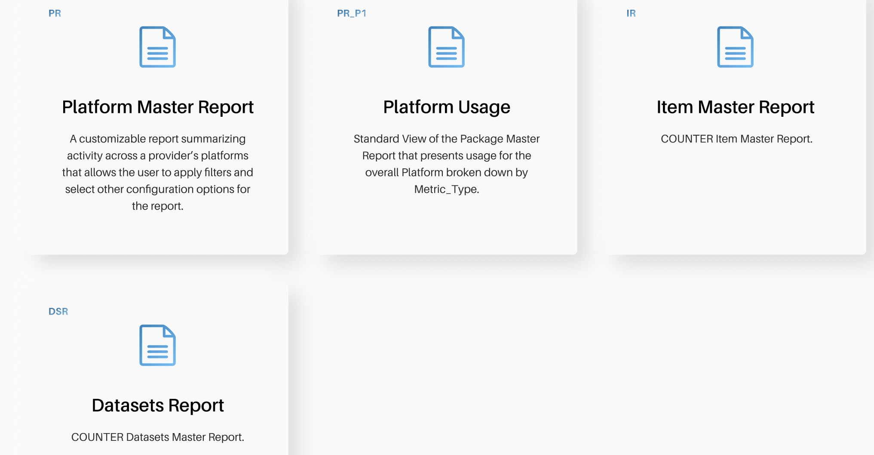
COUNTER CoP R5 Reports

Slide 23
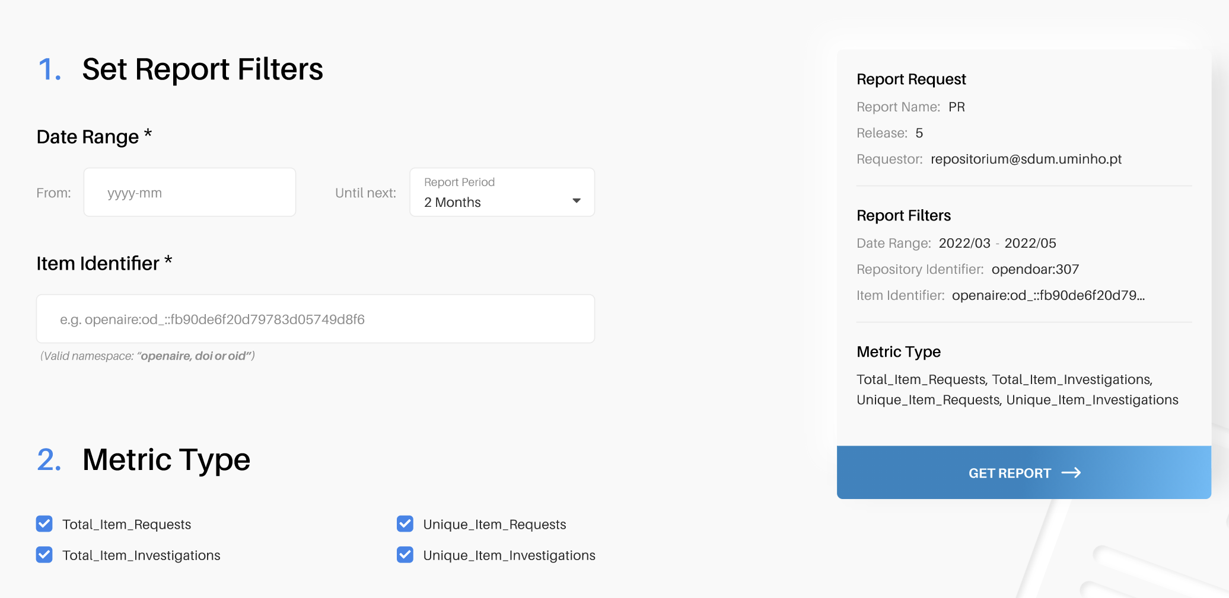
COUNTER CoP R5 Reports: PR Master

Slide 24
COUNTER CoP R5: PR Report
Platform | Data_Type | Access_Method | Metric_Type | Reporting_Period_Total
Universidade do Minho: RepositoriUM | Article | Regular | Total_Item_ Investigations | 10
Universidade do Minho: RepositoriUM | Article | Regular | Unique_Item_Investigations | 6
Universidade do Minho: RepositoriUM | Book | Regular | Unique_Item_ Requests | 3
Universidade do Minho: RepositoriUM | Book | Regular | Total_Item_Requests | 2
Universidade do Minho: RepositoriUM | Book | Regular | Total_Item_Investigations | 5
Universidade do Minho: RepositoriUM | Book | Regular | Unique_Item_Investigations | 3

Slide 25
COUNTER CoP R5 Reports Attributes
PR | Platform | Data_Type | Access_Method | Metric_Type | Reporting _ Period_Total
IR | Item | Publisher | Publisher_ID | Platform | Authors | Publication_Date | Article_Version | DOI | Proprietary_ID | ISBN | Print_ISSN | Online_ISSN | URI | Parent_Title | Parent_Data_Type | Parent_DOI | Parent_Pr oprietary_I D | Parent_ISBN | Parent_Print_ISSN
 | Parent_Online_ISSN | Parent_URI | Componen t_Title | Componen t_Title | Component_Data_Type | Component_DOI | Component_Proprietary_ID | Component_ISBN | Component_Print_ISSN | Component_Online_ISSN | Component_URI | Data_Type | Section_Type | YOP | Access_Type | Access_Method | Metric_Type | Reporting_Period_Total | Monthly_Usage_Details

Slide 26
Dimitris Pierrakos
dpierrakos@athenarc.gr

