Slide 1



Amnesia
Data anonymization
Manolis Terrovitis
mter@athenarc.gr

Slide 2

GDPR limits the usage of personal data
  according to law and contracts
  Consent
  Can be used for research
Using Personal data
  Consent might not be given or withdrawn
  Difficult to manage
  Usage for research purposes requires strict internal processes
  Cannot share with third parties

Slide 3

Unlock the information
Research and studies need statistical information and properties
Personal identification is not necessary in most fields
Low reduction in data quality is tolerable
  Or can be mitigated by using larger amounts of data

Slide 4

Anonymization unlocks the valuable information in data
  The anonymized data are different from the original data
  Anonymization is a one-way transformation of data
  Original data cannot be retrieved
Pseudonymization is not Anonymization
  In Pseudonymized data there is a way to retrieve the original data
  Pseudonymized data are still personal data

Slide 5
Why Anonymize?
Anonymized data are outside the scope of GDPR
Anonymization provides a statistical guaranty about the risk of information leakage
It is the most suitable way to give information to third parties, without revealing personal data

Slide 6
Limitations of Anonymization
Anonymized data have lost some information
The key idea of a good anonymization algorithm is to minimize this loss and limit it in the least important information
There are gray boundaries between anonymized and pseudonymized data
Formal privacy guaranties provide a statistical guaranty for the anonymized data
This is only an interpretation of the notion of “privacy”
It cannot easily be fully automated
User input is needed

Slide 7
When to anonymize
When you are a practitioner, and you want to share data with researchers and third parties without compromising the privacy of the user
  After the data is anonymized, you do not need consent
When you want to give data to recipients you do not fully trust
  Encryption will reduce the risks of data leaks to unauthorized third parties, it will do nothing for untrusted recipients
When you want to openly publish data and you are not fully aware of the audience
When reduction in information quality is acceptable

Slide 8
Why Amnesia
User friendly
Works locally, no data transfer risk
Allows users to customize the solution
The only tool to offer anonymization for set-valued data
The only tool to support k^{m}-anonymity
Easy to incorporate to third party information systems

Slide 9

Statistics
110k visitors
415k page views
7.3k downloads
https://amnesia.openaire.eu

Slide 10





Status
K-anonymity
Km-anonymity
Object relational datasets
Disk based algorithm
API
ReST and command line API exist to help programmers
Bugs have diminished
Queries in helpdesk are less about bugs these days

Slide 11
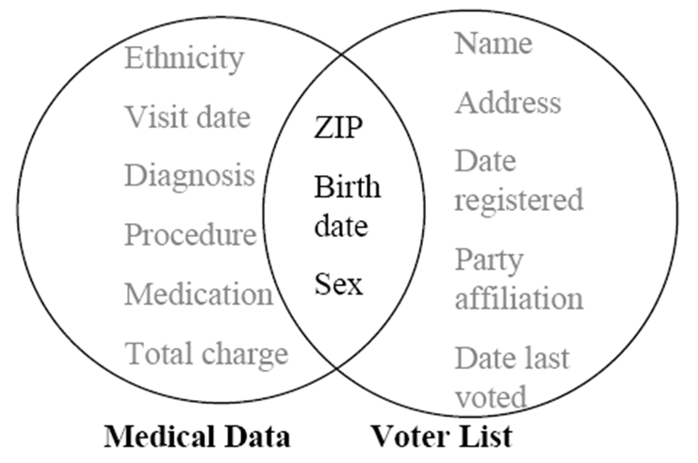
Pseudonymization - Link attacks

Slide 12
k-anonymity
Each entry becomes indistinguishable from other k-1 entries
id | Zipcode | Age | National. | Disease
1 | 13053 | 28 | Russian | Heart Disease
2 | 13068 | 29 | American | Heart Disease
3 | 13068 | 21 | Japanese | Viral Infection
4 | 13053 | 23 | American | Viral Infection
5 | 14853 | 50 | Indian | Cancer
6 | 14853 | 55 | Russian | Heart Disease
7 | 14850 | 47 | American | Viral Infection
8 | 14850 | 49 | American | Viral Infection
9 | 13053 | 31 | American | Cancer
10 | 13053 | 37 | Indian | Cancer
11 | 13068 | 36 | Japanese | Cancer
12 | 13068 | 35 | American | Cancer
id | Zipcode | Age | National. | Disease
1 | 130** | <30 | ∗ | Heart Disease
2 | 130** | <30 | ∗ | Heart Disease
3 | 130** | <30 | ∗ | Viral Infection
4 | 130** | <30 | ∗ | Viral Infection
5 | 1485* | ≥40 | ∗ | Cancer
6 | 1485* | ≥40 | ∗ | Heart Disease
7 | 1485* | ≥40 | ∗ | Viral Infection
8 | 1485* | ≥40 | ∗ | Viral Infection
9 | 130** | 3∗ | ∗ | Cancer
10 | 130** | 3∗ | ∗ | Cancer
11 | 130** | 3∗ | ∗ | Cancer
12 | 130** | 3∗ | ∗ | Cancer

Slide 13
Data transformation – Full domain generalization

Slide 14
Full domain
Age | Place
28 | Greece
33 | Italy
21 | Greece
24 | Greece
37 | Germany
36 | Holland
35 | Germany
Age | Place
[25-35] | South Europe
[25-35] | South Europe
[20-25] | South Europe
[20-25] | South Europe
[35-40] | North Europe
[35-40] | North Europe
[35-40] | North Europe

Slide 15
Local Recoding
Original values are not globally generalized but only some of subsets of them
Age | Place
28 | Greece
33 | Italy
21 | Greece
24 | Greece
37 | Germany
36 | Holland
35 | Germany
Age | Place
[25-35] | South Europe
[25-35] | South Europe
[20-25] | Greece
[20-25] | Greece
[35-40] | North Europe
[35-40] | North Europe
[35-40] | North Europe

Slide 16
k^{m}-anonymity
 | Fruits | Meat | Vegetables | Fish
Vassilis | Χ | Χ
Manolis | Χ | Χ | Χ
Eleni |  |  | Χ
Maria |  | Χ | Χ
Kostas | Χ |  |  | Χ
 | Fruits | Meat | Other food
Vassilis | Χ | Χ
Manolis | X | Χ | X
Eleni |  |  | X
Maria |  | Χ | X
Kostas | Χ |  | X
2²-anonymous
Any combination of m items will not appear less than k times

Slide 17
Method Description
Data Generalization Hierarchy
*
c₃= {A,b₁,b₂,b₃}
A
B
a₁
a₂
a₃
b₁
b₂
b₃

Slide 18
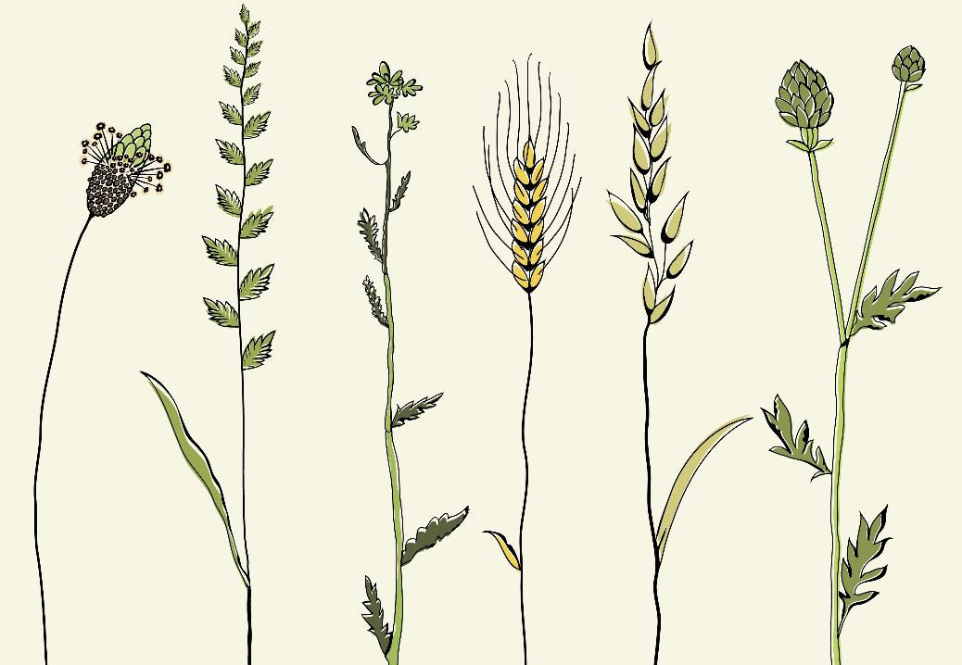
Amnesia Limitations
Users are not familiar with anonymization techniques
The process is novel and requires effort from the user’s part
Amnesia cannot decide on privacy parameters
K-anonymity does not protect from every type of attack

Slide 19






Thank You
Manolis Terrovitis
mter@athenarc.gr
https://amnesia.openaire.eu

