Slide 1
TRAINING .SESSION.
IVANA KONČIĆ
Ruđer Bošković Institute Croatia ikoncic@irb.hr
BOJAN MACAN
Ruđer Bošković Institute Croatia
bmacan@irb.hr
MARTINA ŽUGAJ
Ruđer Bošković Institute Croatia
mzugaj@irb.hr

Slide 2
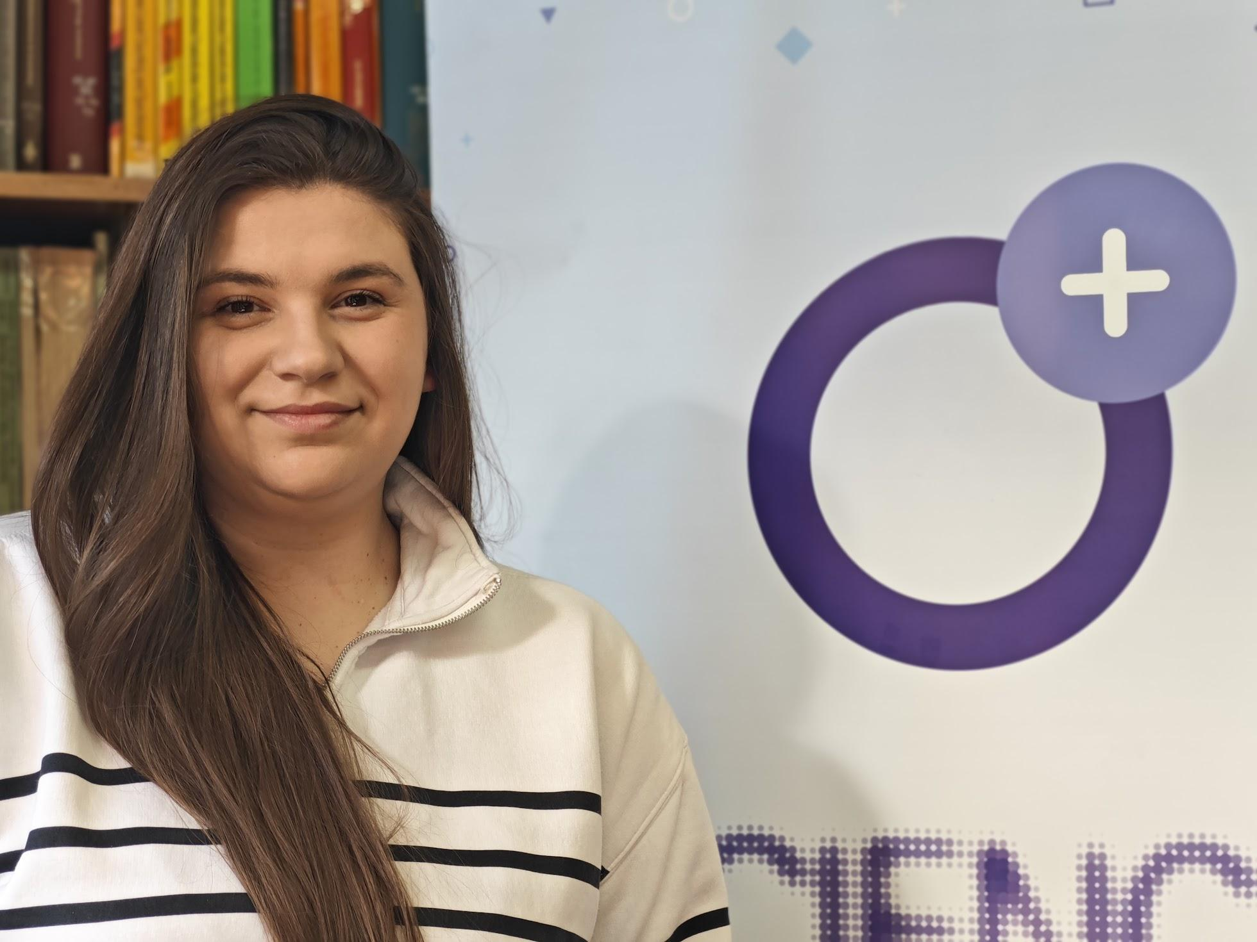
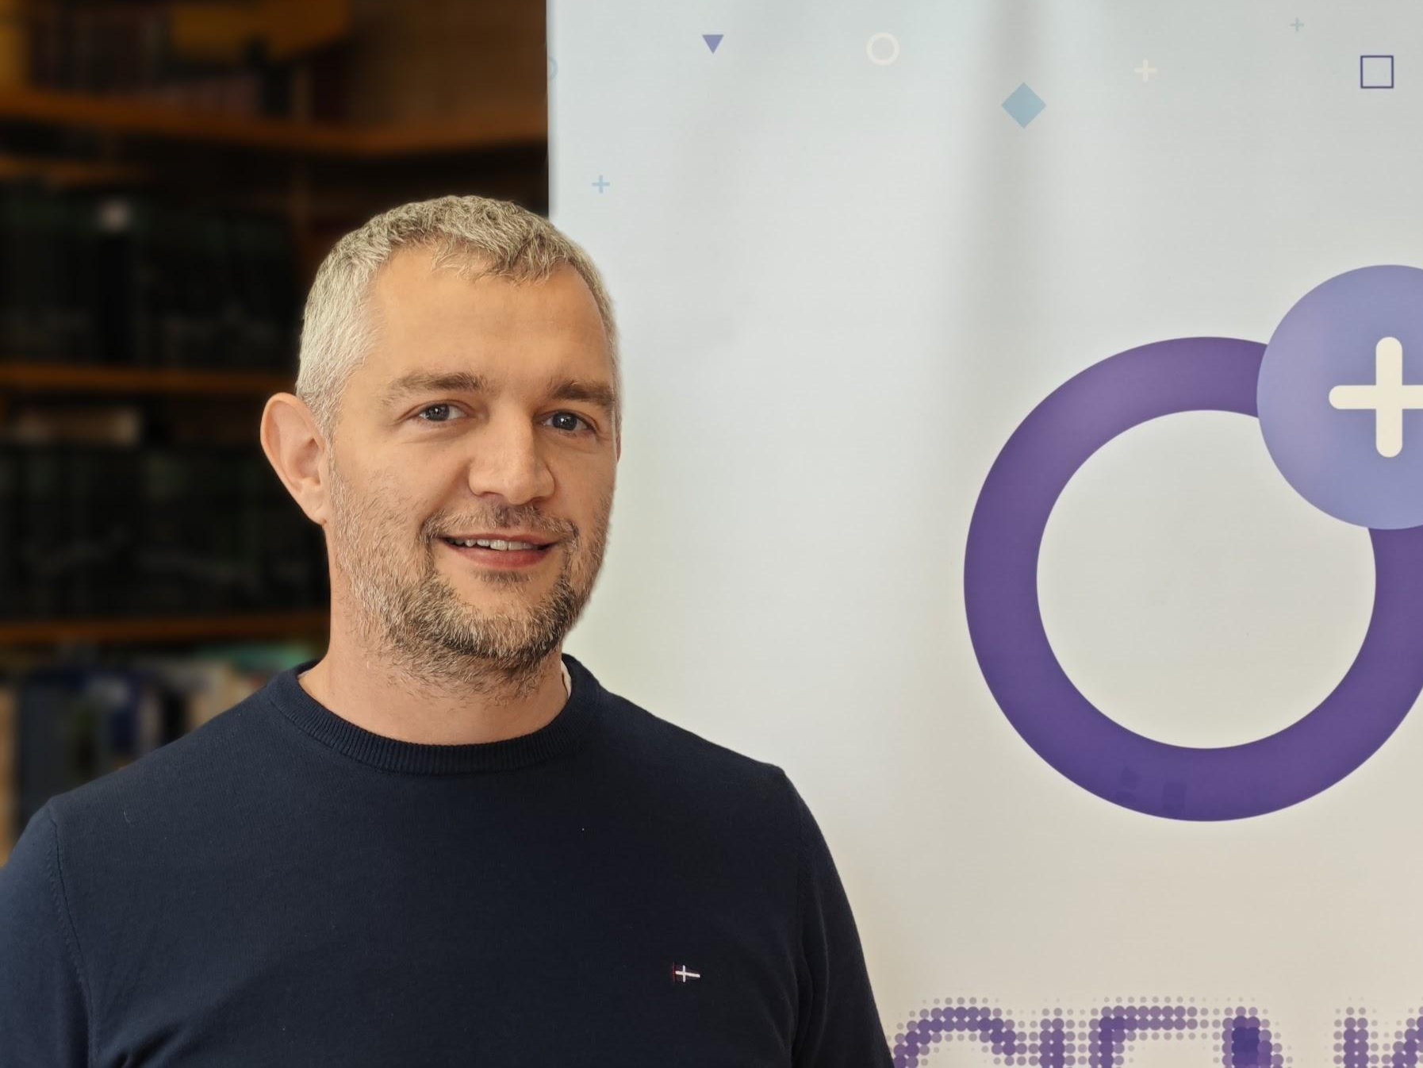
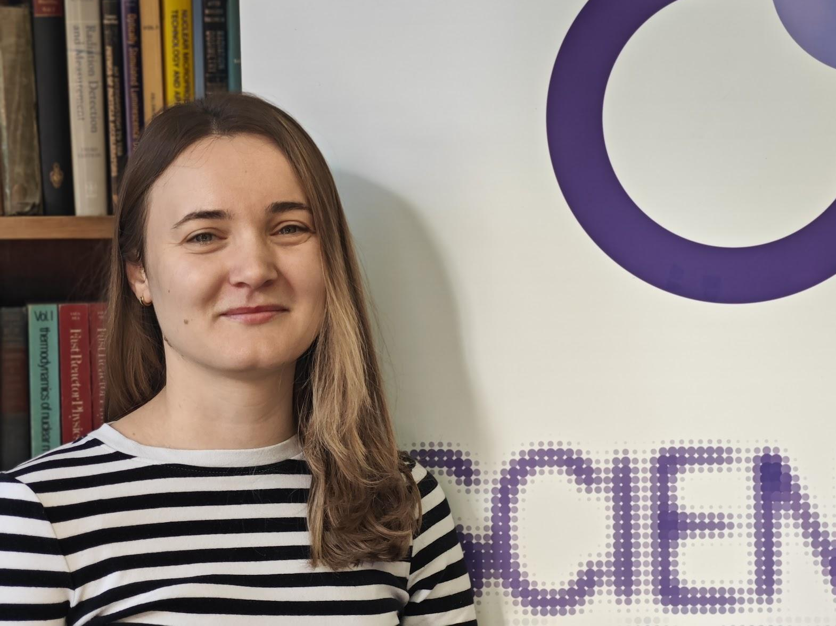
Meet the .Trainers.
.Ivana Končić.
.Bojan Macan.
.Martina Žugaj.
Head of the Department for Maintenance and Development of CroRIS
Ruđer Bošković Institute
Croatia
Head of the Centre for Scientific Information
Ruđer Bošković Institute
Croatia
Graduate Librarian at the Centre for Scientific Information
Ruđer Bošković Institute
Croatia

Slide 3
TODAY'S .AGENDA.
Registration
Why OpenOrgs: rationale behind OpenOrgs and why the tool is important for the quality of data
Functionalities and Workflow: how the tool works and how to proceed with the curation tasks
Short Q&A session
Hands-on Session: live demo followed by participant-driven activities
Final remarks and next steps

Slide 4
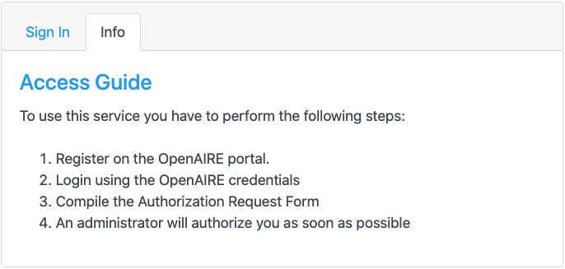
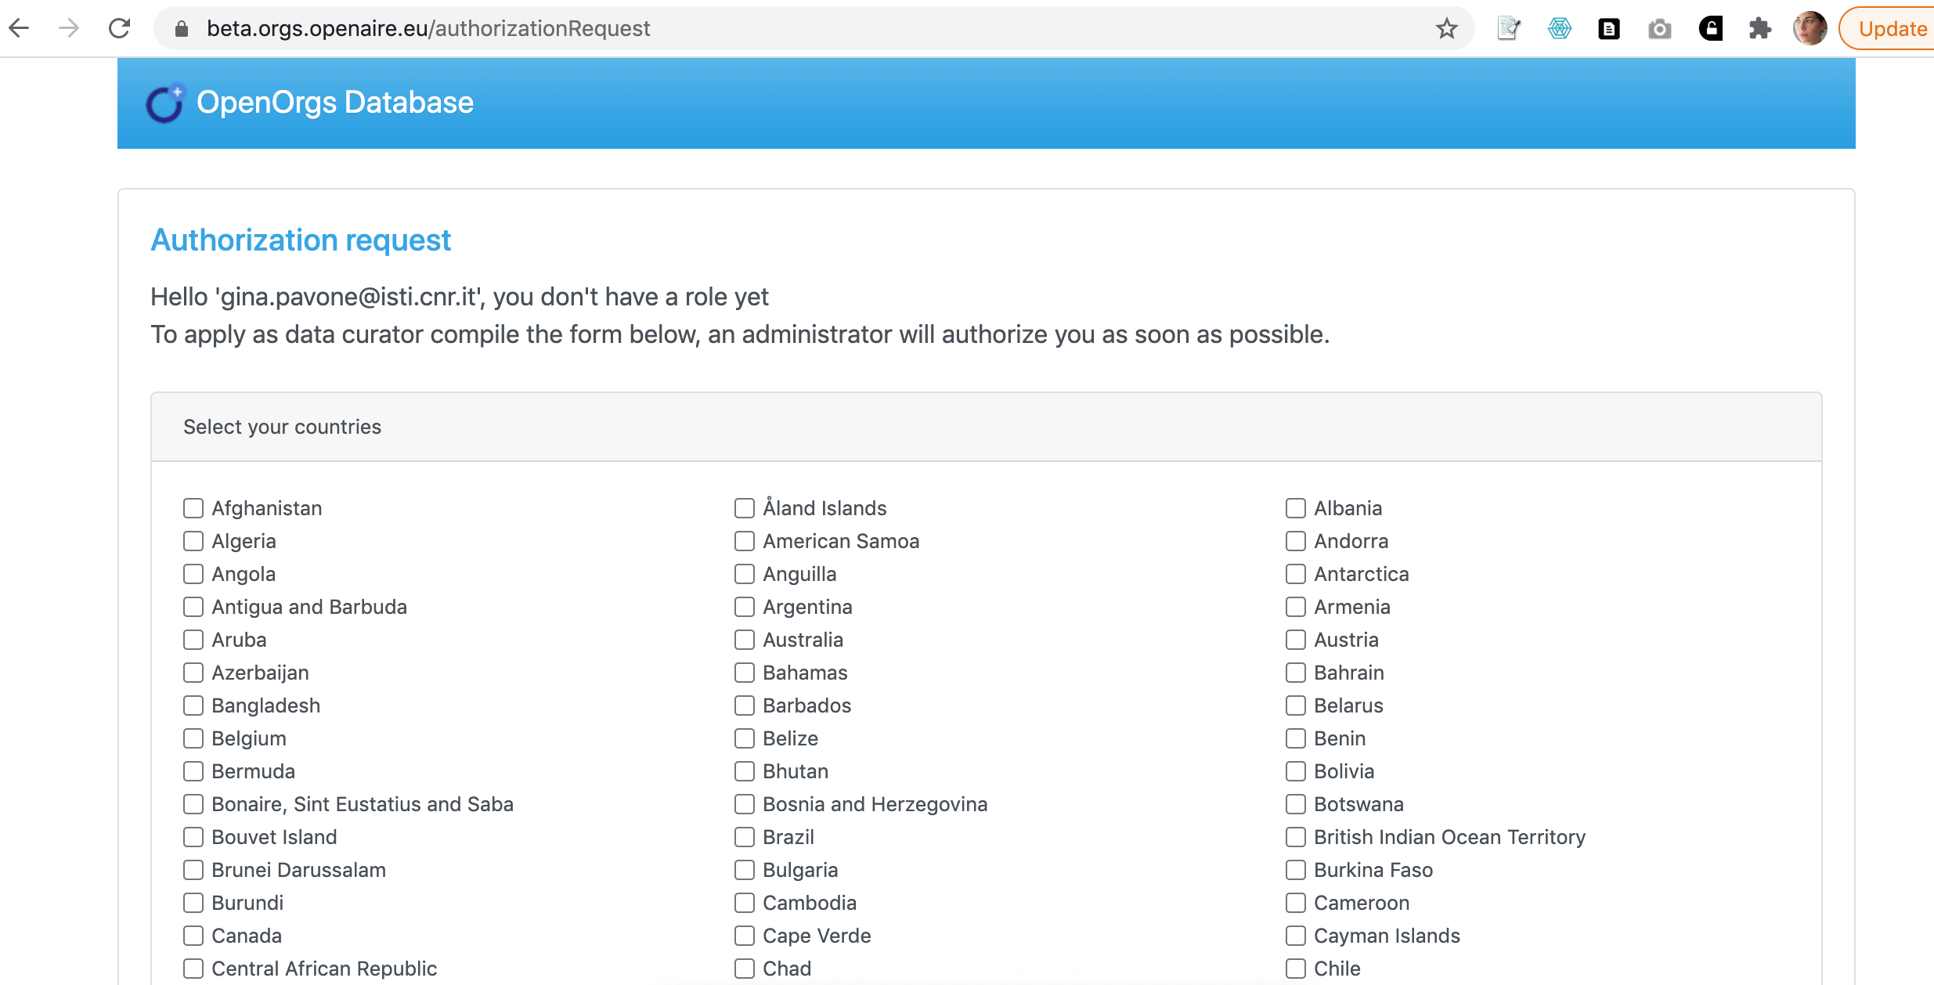
Register as a curator.
Create an OpenAIRE account by following this link: https://services.openaire.eu/uoa-user-management/register.jsp. You can use your institutional email.
Sign in to the OpenOrgs platform at https://orgs.openaire.eu using the account you created in step 1, and request access. You may choose different countries that you want to curate.
Administrators will grant you access to the platform (openorgs-admin@openaire.eu)

Slide 5
Information ambiguity.
Diverse Sources
Different Names
Organisational Architecture
Metadata about organisations can be found scattered through many different sources.
Organisations may present themselves under various identifiers, including legal names, acronyms, short names, and alternative designations.
The organisation's structure, with its faculties, departments, branches, and detachments, might not always be straightforward.
Key to Success
To ensure an efficient scholarly communication system, clarifying and disambiguating information is essential.

Slide 6
This ambiguity affects the whole scholarly communication system.

Slide 7
Who needs .unambiguous. information?
Open Science services
Search & Discovery
Aggregation & showcase
Monitoring services
Researchers
RPOs
RFOs
All stakeholders
To facilitate the findability of digital objects
To consistently showcase the overall scientific production
To have consistent information on the impact of resources
To have functional and up-to-date services

Slide 8
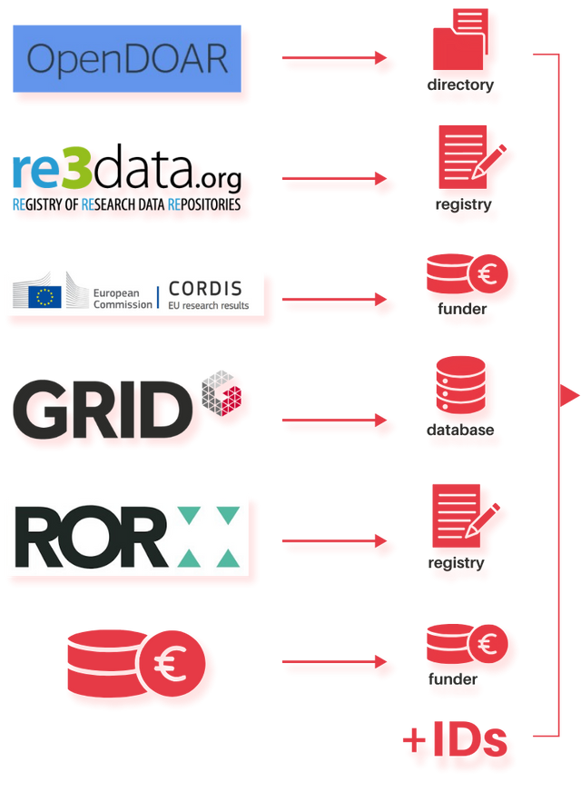
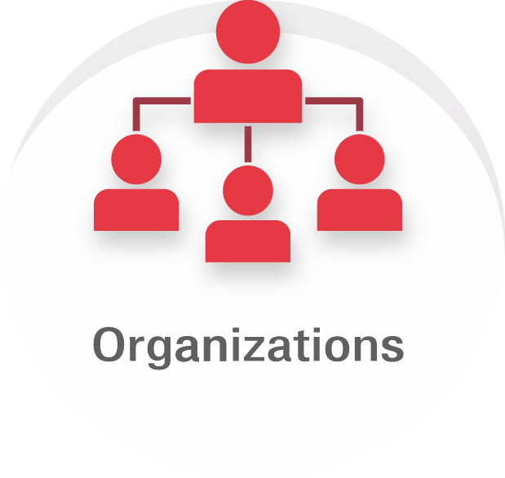
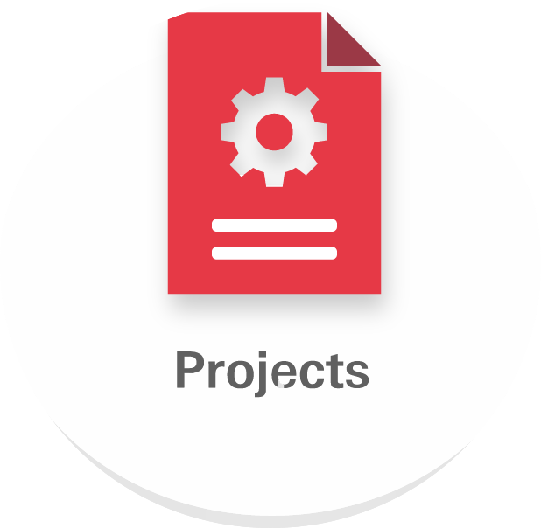
Problem statement
.import phase.
operates
Beneficiary of
Has author affiliated with
Collected from
Hosted by
Is produced by

Slide 9
Problem statement
.import phase.
Organisations (affiliations/mentions)
Responsible body for the management of a data provider
Project participant
Extracted from the article full-text as paper affiliation
Lack of common identifiers!

Slide 10
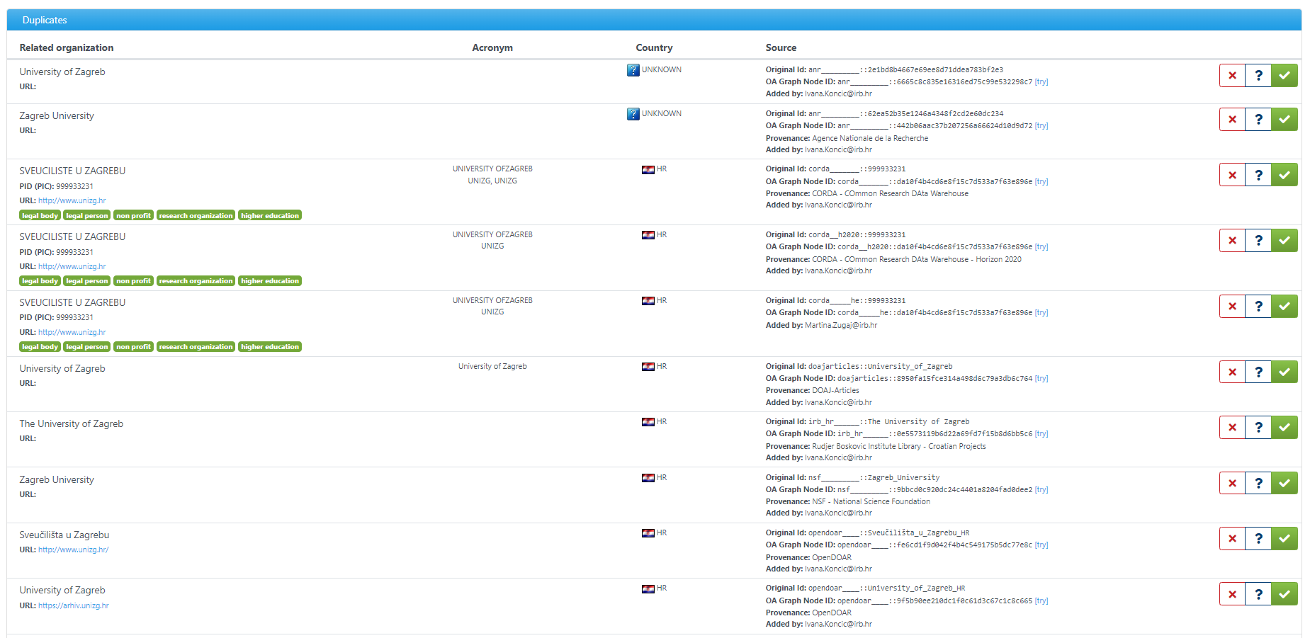

Slide 11
Problem statement
.disambiguation.

Slide 12
Problem statement
.quality / completeness.
organization field completeness
field | missing | % missing
legalname | 254 | 0.1%
legalshortname | 156,923 | 43.2%
alternativenames | 319,825 | 88.0%
country | 82,002 | 22.6%
website url | 142,047 | 39.1%
pid | 184,536 | 50.8%

Slide 13
Limitations of a fully .automated approach
False positives
Inaccurate statistics (e.g. for institutional and country monitors)
Inaccurate search results (e.g. finding only the US Concordia University and not the Canadian one)
False negatives
One instance is linked to the papers, one to the project… but it is the same organization!

Slide 14
Data provision .pipeline.

Slide 15
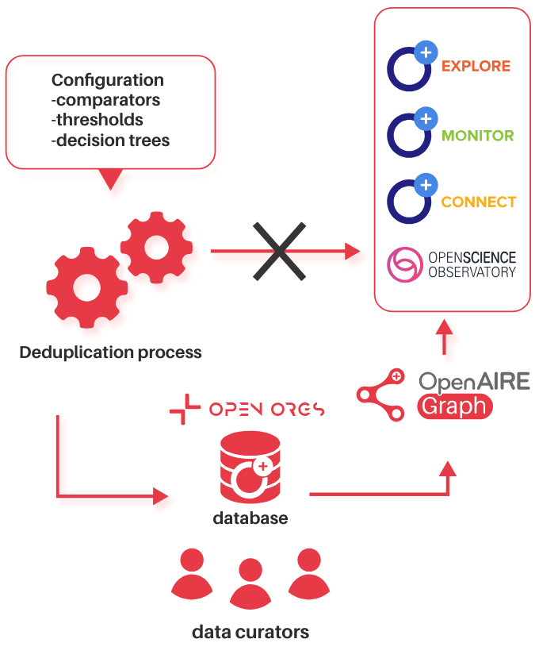
Data provision .pipeline.

Slide 16
OpenAIRE services benefiting from organisation disambiguation
Provides access to millions of interlinked scholarly works, their citations and contextual information such as organisations, grants.
Enables institutions, universities, or lead teams on a scientific domain, to easily create, configure and manage, their own customised web portal that collects and shares research outcomes of their interest to their audiences.
Produces well-documented, timely and accurate monitoring indicators of research activities for funders, research initiatives and organisations, by creating personalised and on-demand online configurable dashboards.
Facilitates access to the Open Science indicators for policy makers, funders, organisations, by combining and visualising information from all over Europe.

Slide 17
OpenOrgs activity pillars
Metadata curation
In OpenOrgs data curators can enrich the metadata description of the organization entities, compensating the lack of information available from the sources and improving the discoverability / completeness of the organization records.
03
Automatic suggestion of duplicates
The process for the automatic identification of possible duplicates will periodically produce new suggestions for the data curators.
Manual management of duplicates
Deciding whether two or more digital representations are duplicates of the same object can be a task that only humans can carry out precisely. The OpenOrgs tool allows data curator to manage the ambiguities in the data lack of the organization mentions aggregated by OpenAIRE.
01
02

Slide 18
Check out the new website!
openorgs .openaire.eu

Slide 19
OpenOrgs curation tasks

Slide 20
Curating and enriching metadata for organisations.
Identifying and resolving duplicates.
Adding parent-child relations (if any).
Approving organisations and providing them with stable OpenOrgs IDs.
Adding new organisations to the OpenOrgs database.
Documenting insights in the notes section.
Resolving conflicts; merging and distinguishing.

Slide 22
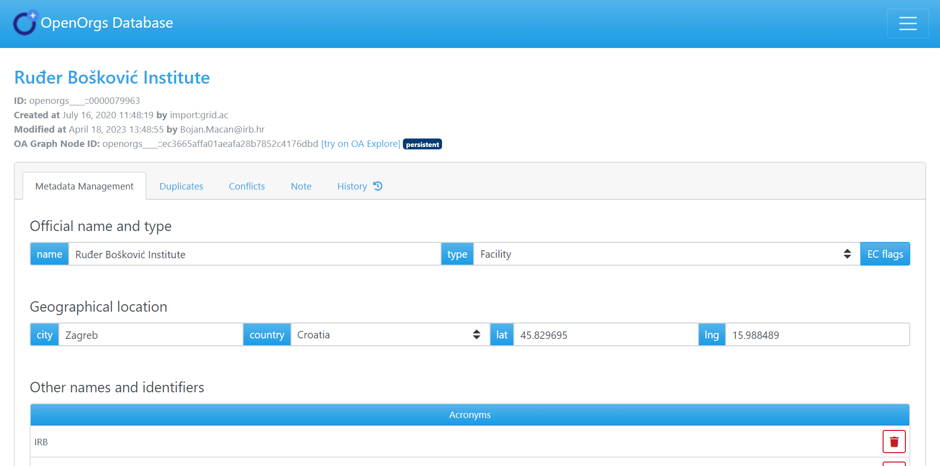

Slide 23
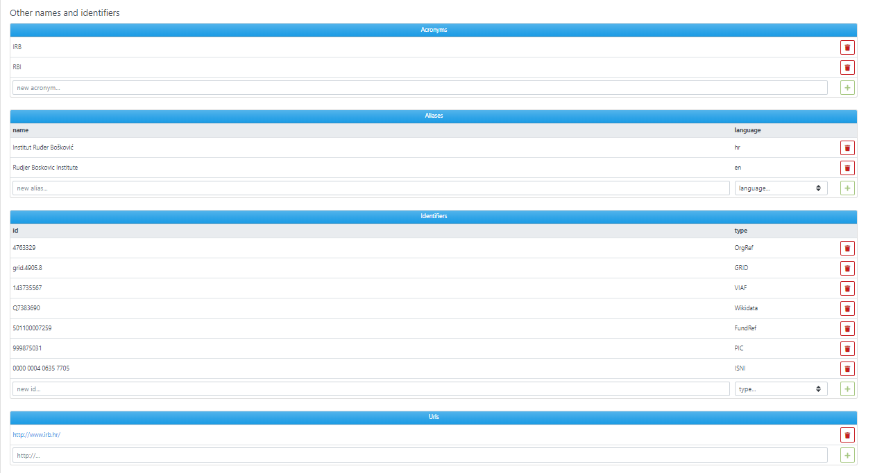

Slide 24
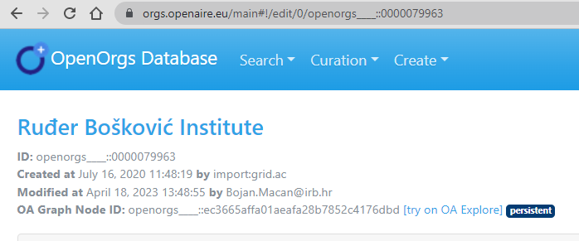
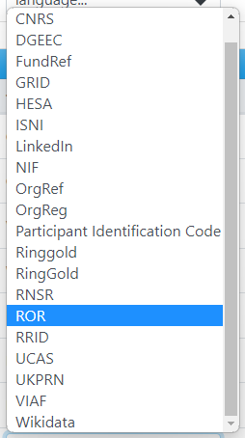
OpenOrgs ID
Where to find org’s IDs?
orgs official websites, documents, etc.
other databases
ISNI https://isni.org/page/search-database/
ROR https://ror.org/
PIC https://bit.ly/41kE71Y
VIAF https://viaf.org/

Slide 25
Establishing relationships between organisations
Only parent-child relationships ('is parent of' or 'is child of').
Child production is included in parent production.
Important for monitoring production, particularly between universities, departments, and institutes.
To link departments or institutes within an org, they must first be approved as an organisation and then linked as a child to the main org.
Consider naming children orgs with a specific rule (e.g. University of Zagreb, Faculty of Law).
One org can have more than one parent (for "hybrid" cases).

Slide 26
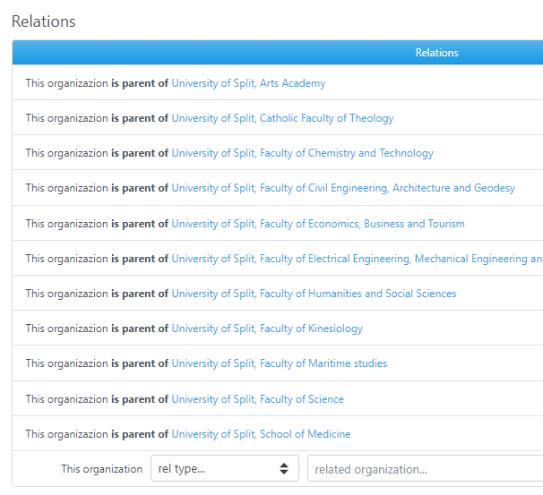
deduced affiliation
UNIV. XYZ
isParentOf
DEPT. A
DEPT. B
DEPT. C
affiliation

Slide 27
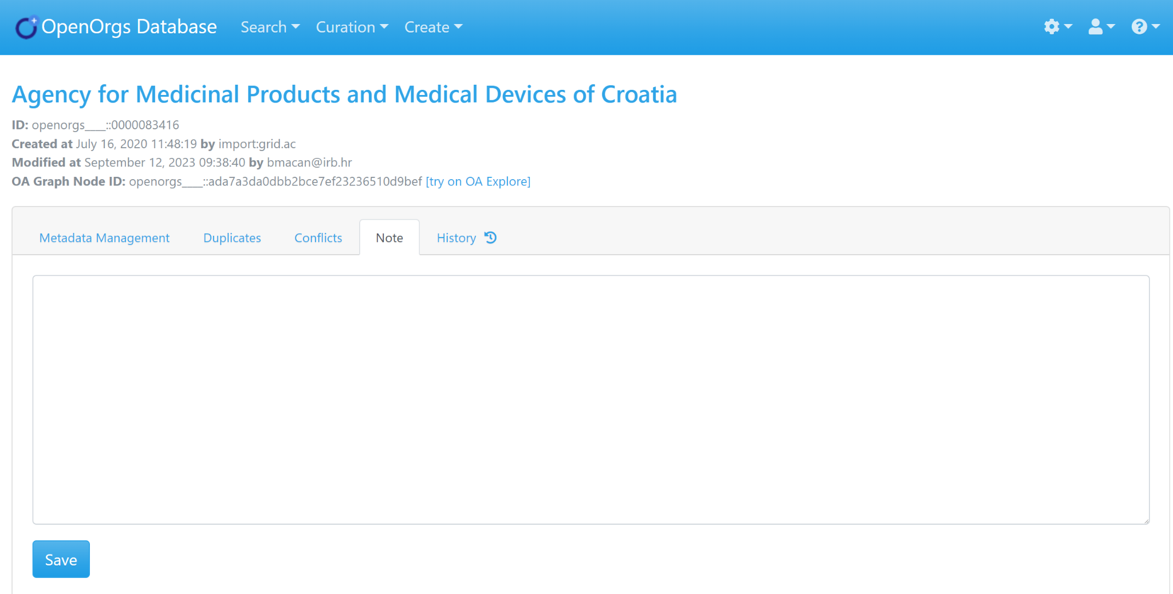
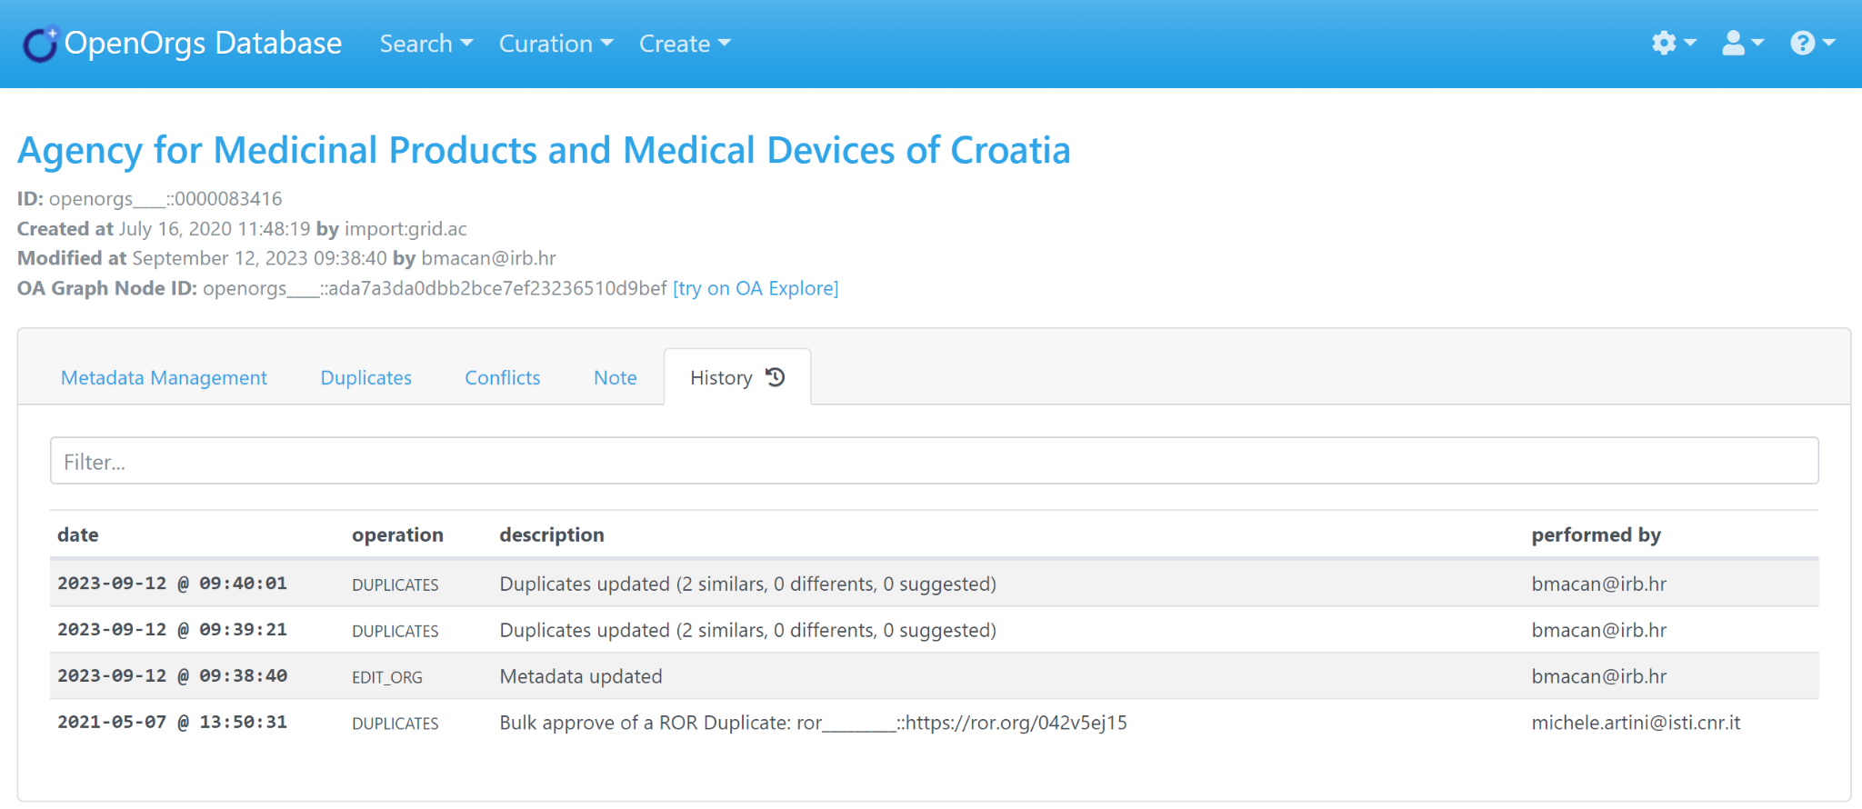

Slide 28
Adding new orgs (if it is not present already)
Add it by clicking on create → a new org.
There are three mandatory metadata: name, country and type.
Recommendations:
For the org's name, it is recommended to use the English version as the main name and include the name in the national language as an alias.
Always try to include the organization's URL or check that it is correct and use UTF-8 encoding.
Tips:
To determine the organization's type, check the EC flags.
Notes can be added within an orgs page to keep track of choices made.

Slide 29
Approval of new orgs
Main concepts:
Suggested org: is an organization to be approved by a data curator; the approval produces an OpenOrgs ID.
Approved org: is an organization that was confirmed by a curator. It is persisted with a stable identifier (OpenOrgs ID) and its metadata fields can be enriched/curated.

Slide 31
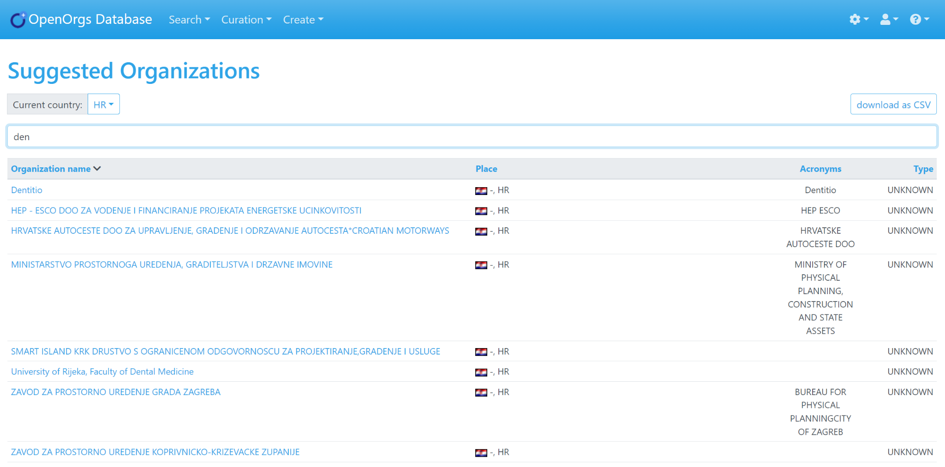
In this case also a relation must be established!

Slide 32
Beware !
The same org must not have more than one OpenOrgs ID!
Only approve the organization after checking that it does not already exist with the OpenOrg ID.
Multiple OpenOrg IDs for the same organization will result in a conflict.

Slide 33
Duplicates curation
Duplicates can occur between approved and raw organisations.
Raw organisations are external organizations without an OpenOrgs ID, sourced from platforms such as Corda, Re3data, and ROR.
The deduplication algorithm may suggest duplicates, or users may add them manually within an organization's page.

Slide 34
Duplicates curation
Complete the automated part
Duplicates section → lists organisations suggested by an algorithm to be duplicates.
It is an automated process that requires confirmation or rejection by the data curator.
Manual entry
Duplicates addition in the single org page → The data curator manually adds duplicates in the main org page.

Slide 35
Potential new duplicates section
Curation menu → Organizations with new duplicates

Slide 36
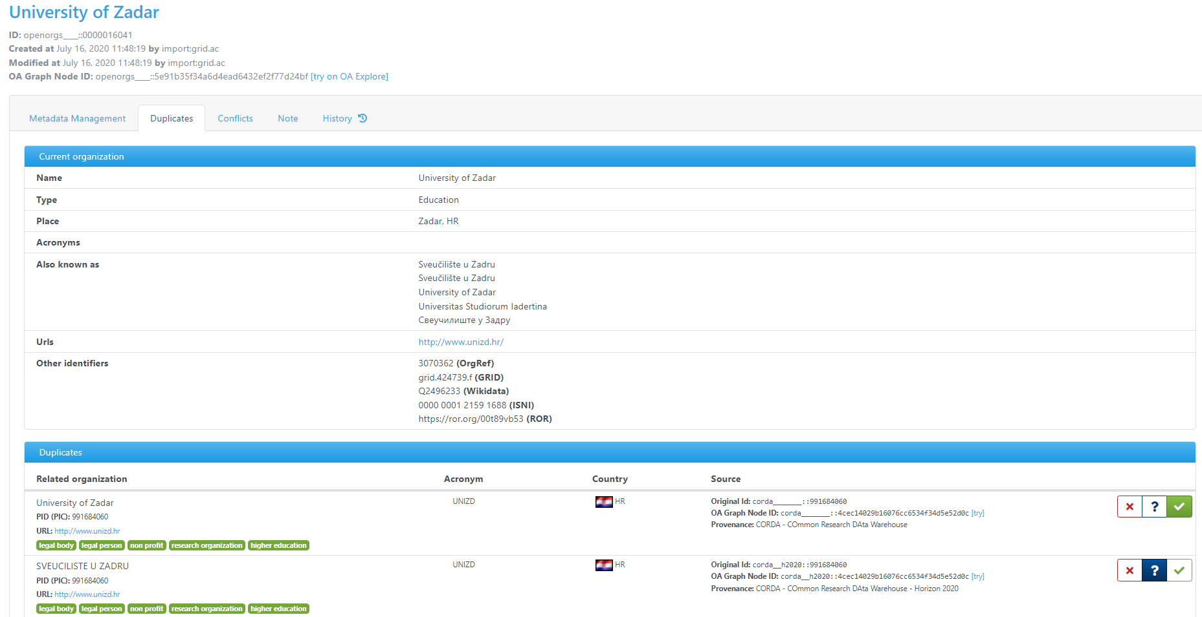

Slide 37
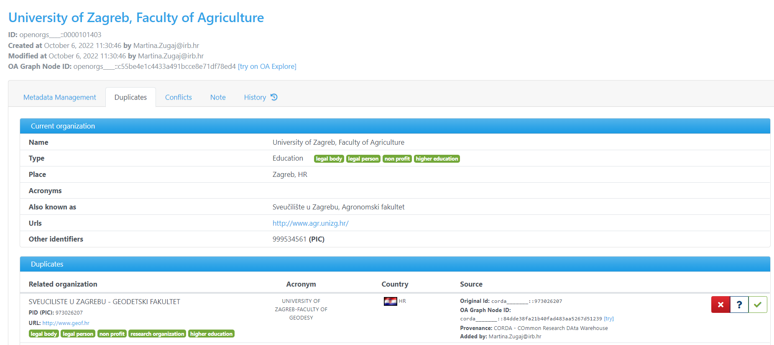
An org with wrong suggested duplicates

Slide 38
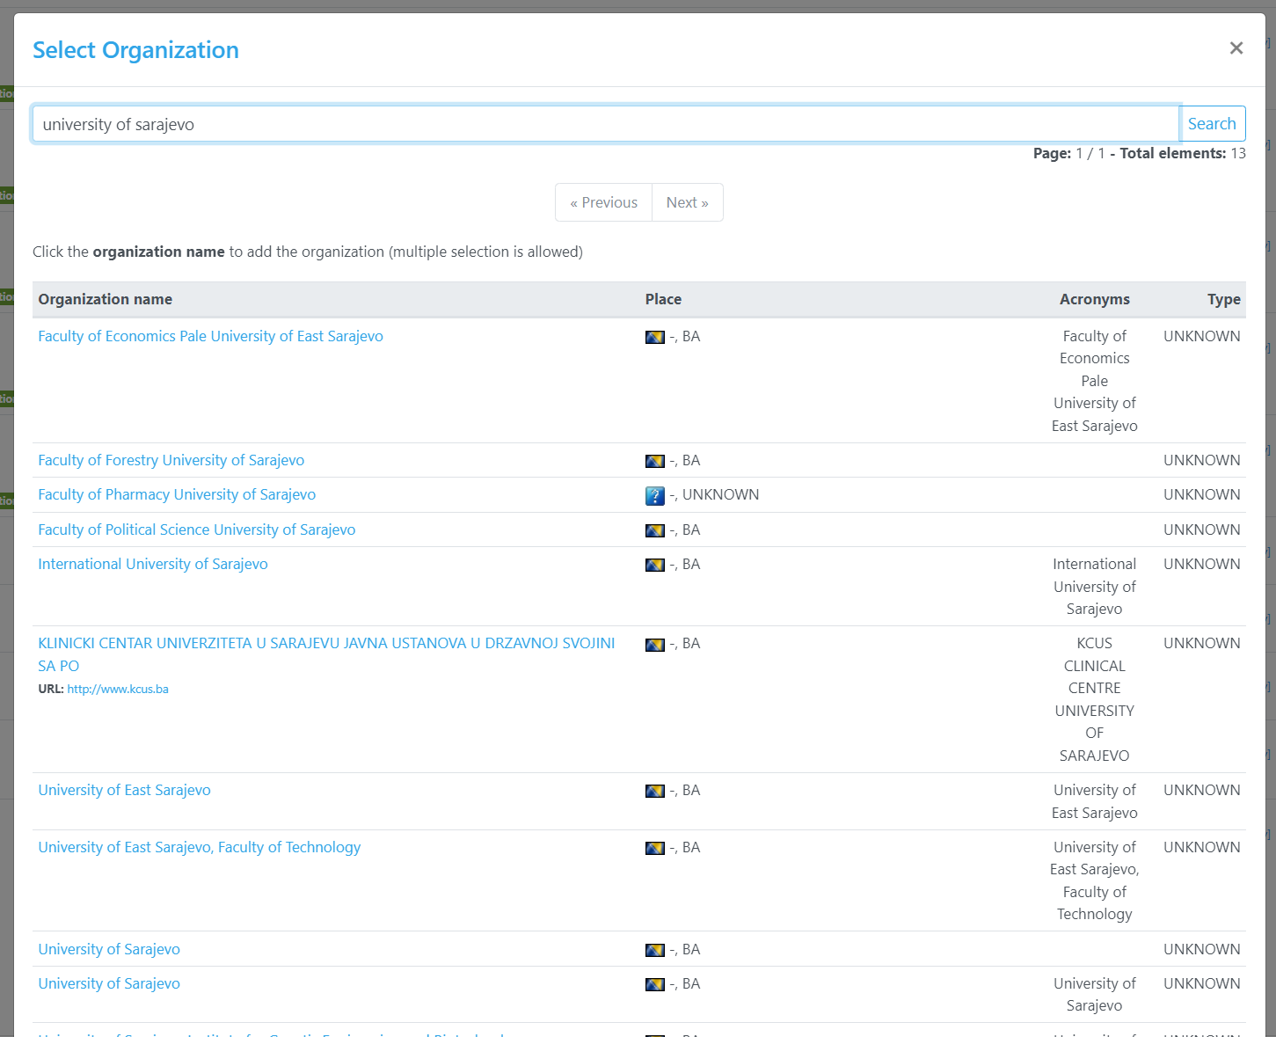
Manual entry of duplicates
Single org page → Duplicates tab → Add button (bottom of the page) → type the search

Slide 39
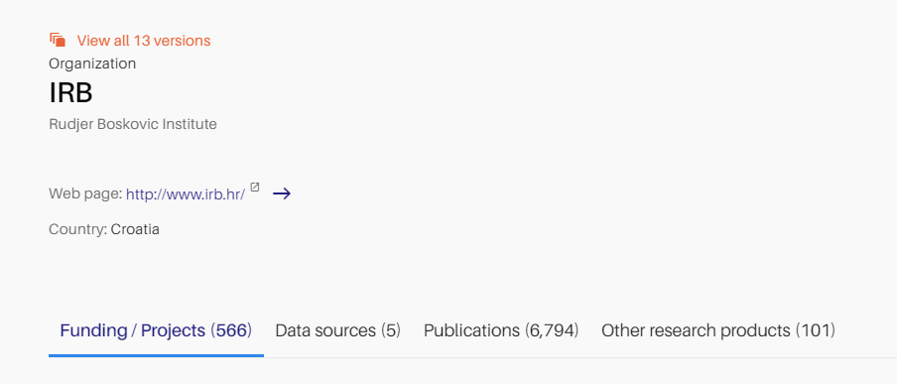
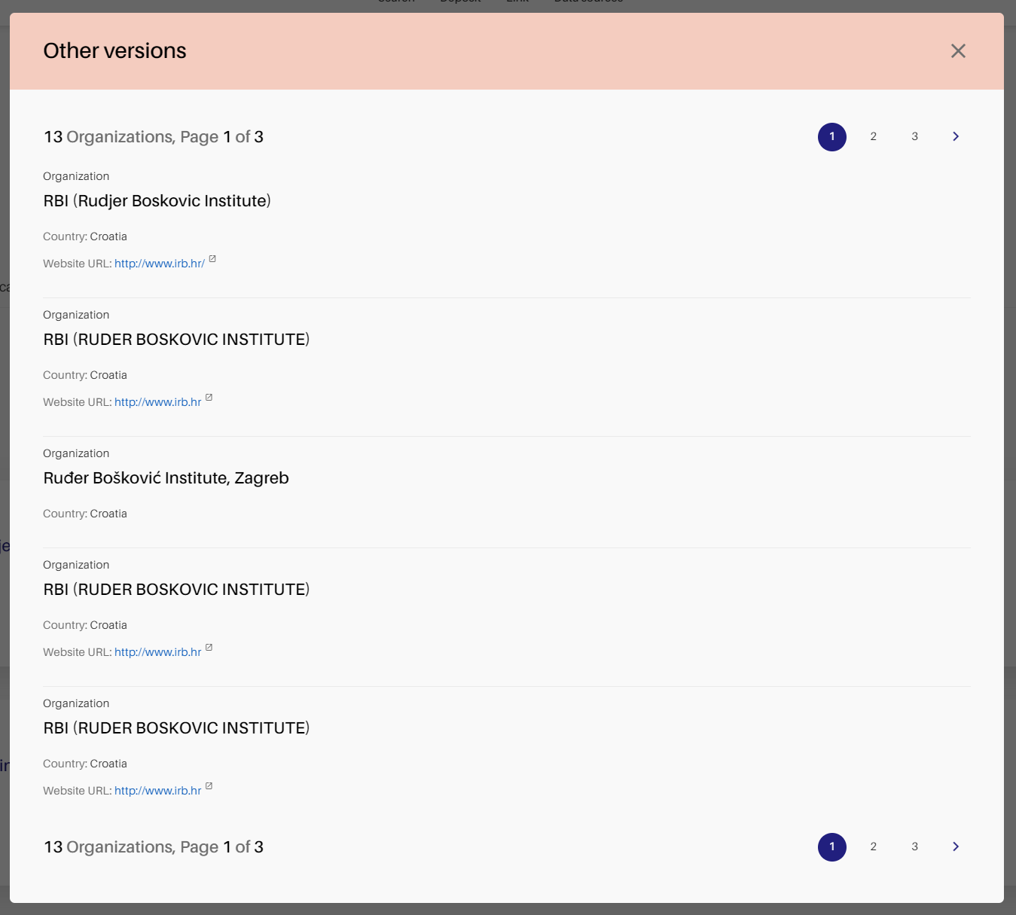
Duplicates on Openaire Explore

Slide 40
Resolution of conflicts.
A conflict is created when the same organization is approved more than once, thus giving to the same org different OpenOrgs IDs.
The deduplication algorithm suggests potential conflicts, which require confirmation from the curator.
To add a conflict, curators can select the main organization and add the conflicting org through the conflicts tab on the org page.
Resolving potential conflicts hides the conflicting orgs (‘hidden’) and creates a new OpenOrg ID.

Slide 41
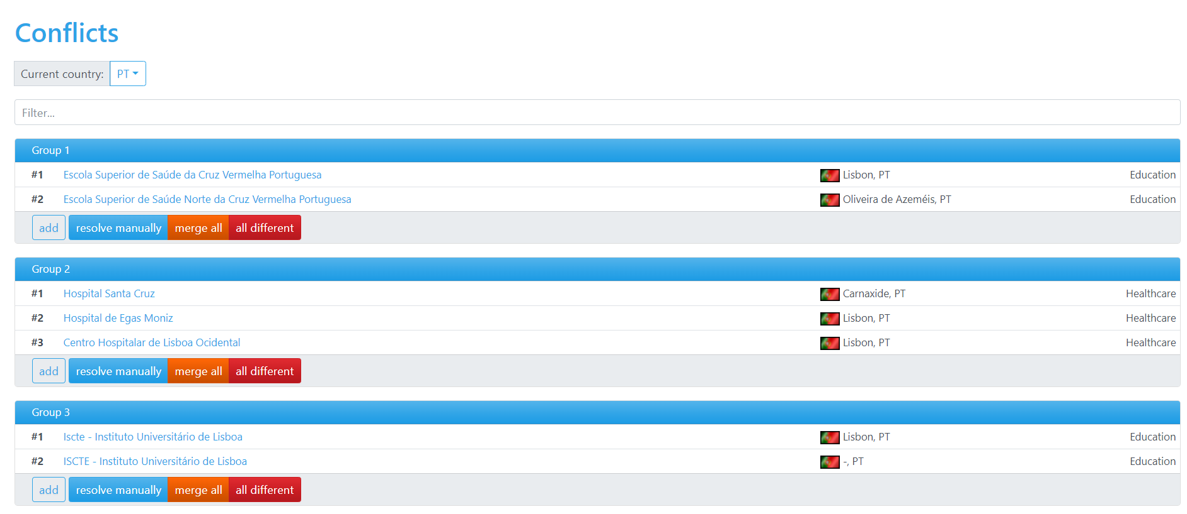

Slide 42
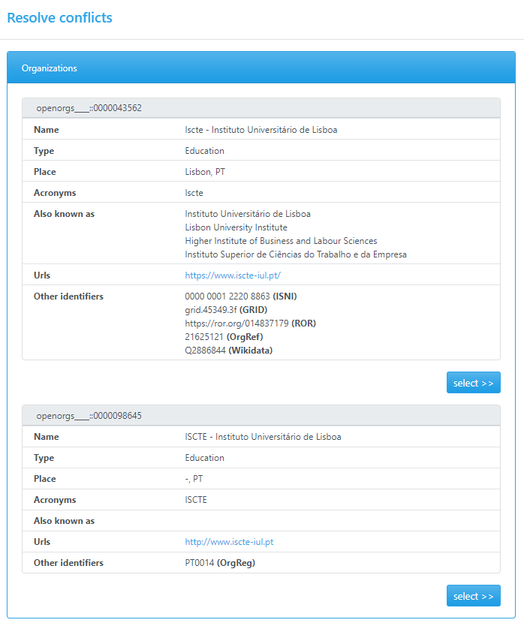
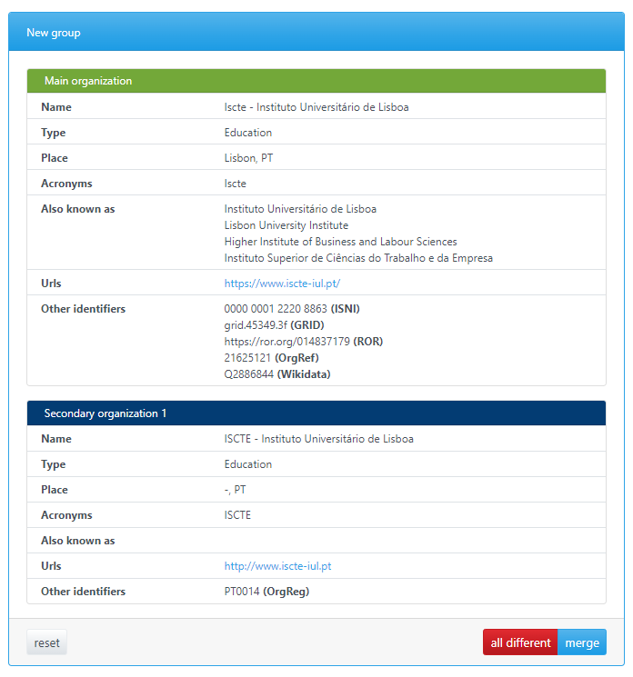

Slide 43
Recap: Main concepts.
Approved org: is an organization that was confirmed by a curator. It is persisted with a stable identifier (OpenOrgs ID) and its metadata fields can be enriched/curated;
Pending or suggested org: is an organization to be approved by the national admin; the approval produces an OpenOrgs ID.
Duplicate: possible duplication of the same organization, to be resolved by the user. It is created between an approved org and a raw org (an external org with no OpenOrg ID, ie coming from Corda, Re3data, ROR...).
Duplicates can be suggested by the dedup algorithm or added by the user inside an org page.
Raw org: the organization with the original registry id. It will never change its ID (those changing ID with the approval are the pending or suggested orgs), it identifies the org as it comes from the original source; it can be added as duplicate.
Hidden org: is an organization not shown in the OpenAIRE public portals. It is the result of a resolution of a conflict. A conflict can be created for example when the same organization is approved by mistake more than once inside OpenOrgs (thus giving different stable OpenOrgs IDs to the same organization). If the curator resolves this conflict by merging two organizations with different OpenOrgs IDs, a new org is created and the previous ones are set as hidden.

Slide 44
.Q&A. time!

Slide 45
Hands-on session
1. Choose an organisation to curate (e.g. your organisation) from the approved list. (Search → Browse by country → #approved)
a. Check and edit (eventually enrich) the metadata.
b. Set parent/child relations (if any)
c. Go to the duplicate section and approve/reject duplicates.
d. Manually add duplicates.
e. Are there any conflicts? If yes, resolve them.
2. Choose an organisation from the suggested list to approve. (Curation → Suggested organisations)
a. Check that it hasn’t already been approved:
i. If yes, add it as a duplicate (Search → Browse by country → #approved → single org page → duplicates → add)
ii. If no, check, edit and approve.
3. Go to the duplicates list (Curation → Organizations with new duplicates) and resolve at least one duplicated organisation.
4. Go to the potential conflicts list (Curation → Potential conflicts) and resolve at least one conflict (if any).
5. Create a parent-child relation. Go to an approved organisation you know has a parent-child relation and create it (if it hasn’t been already).

Slide 46
Thank you!
.get in touch:.
ikoncic@irb.hr mzugaj@irb.hr bmacan@irb.hr openorgs-admin@openaire.eu

