Slide 1
CURATING RESEARCH PERFORMING ORGANISATION .AFFILIATIONS.
IVANA KONČIĆ
Ruđer Bošković Institute Croatia ikoncic@irb.hr
MARTINA ŽUGAJ
Ruđer Bošković Institute Croatia
mzugaj@irb.hr

Slide 2
TODAY'S .AGENDA.
Challenges with Organisation Affiliations
Solving Problems Using OpenOrgs
Overview of the Services
OpenOrgs Website Tour
How You Can Help
The Importance of Community Expertise
Invitation to the OpenOrgs Training
Q&A and Conclusion

Slide 3
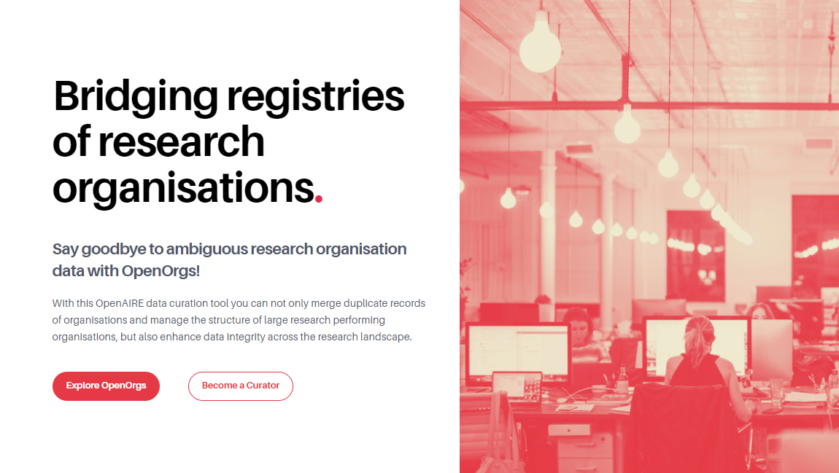

Slide 4
Information ambiguity.
Diverse Sources
Different Names
Organisational Architecture
Metadata about organisations can be found scattered through many different sources.
Organisations may present themselves under various identifiers, including legal names, acronyms, short names, and alternative designations.
The organisation's structure, with its faculties, departments, branches, and detachments, might not always be straightforward.
Key to Success
To ensure an efficient scholarly communication system, clarifying and disambiguating information is essential.

Slide 5
This ambiguity affects the whole scholarly communication system.

Slide 6
Who needs .unambiguous. information?
Open Science services
Search & Discovery
Aggregation & showcase
Monitoring services
Researchers
RPOs
RFOs
All stakeholders
To facilitate the findability of digital objects
To consistently showcase the overall scientific production
To have consistent information on the impact of resources
To have functional and up-to-date services

Slide 7
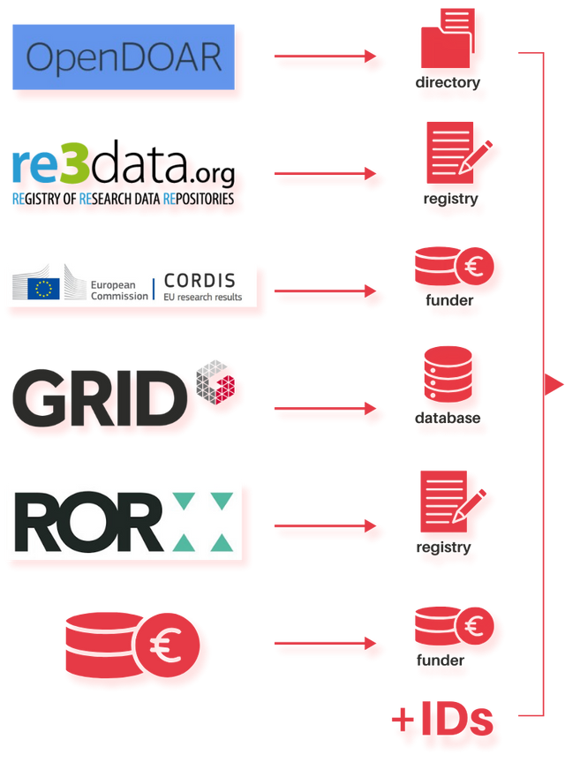
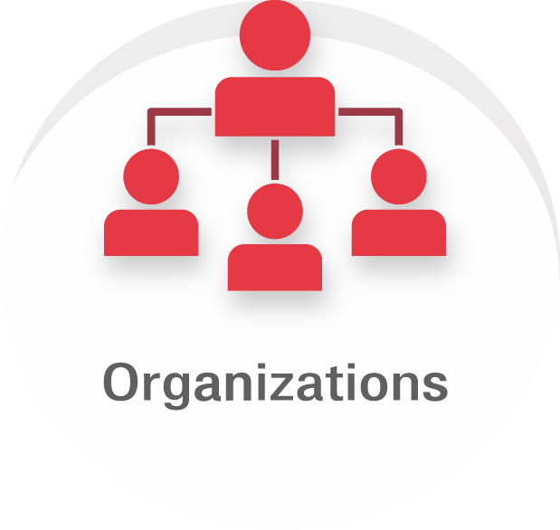
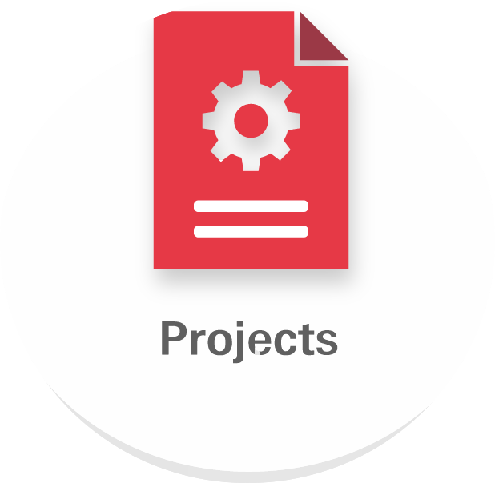
Problem statement
.import phase.
operates
Beneficiary of
Has author affiliated with
Collected from
Hosted by
Is produced by

Slide 8
Problem statement
.import phase.
Organisations (affiliations/mentions)
Responsible body for the management of a data provider
Project participant
Extracted from the article full-text as paper affiliation
Lack of common identifiers!

Slide 9
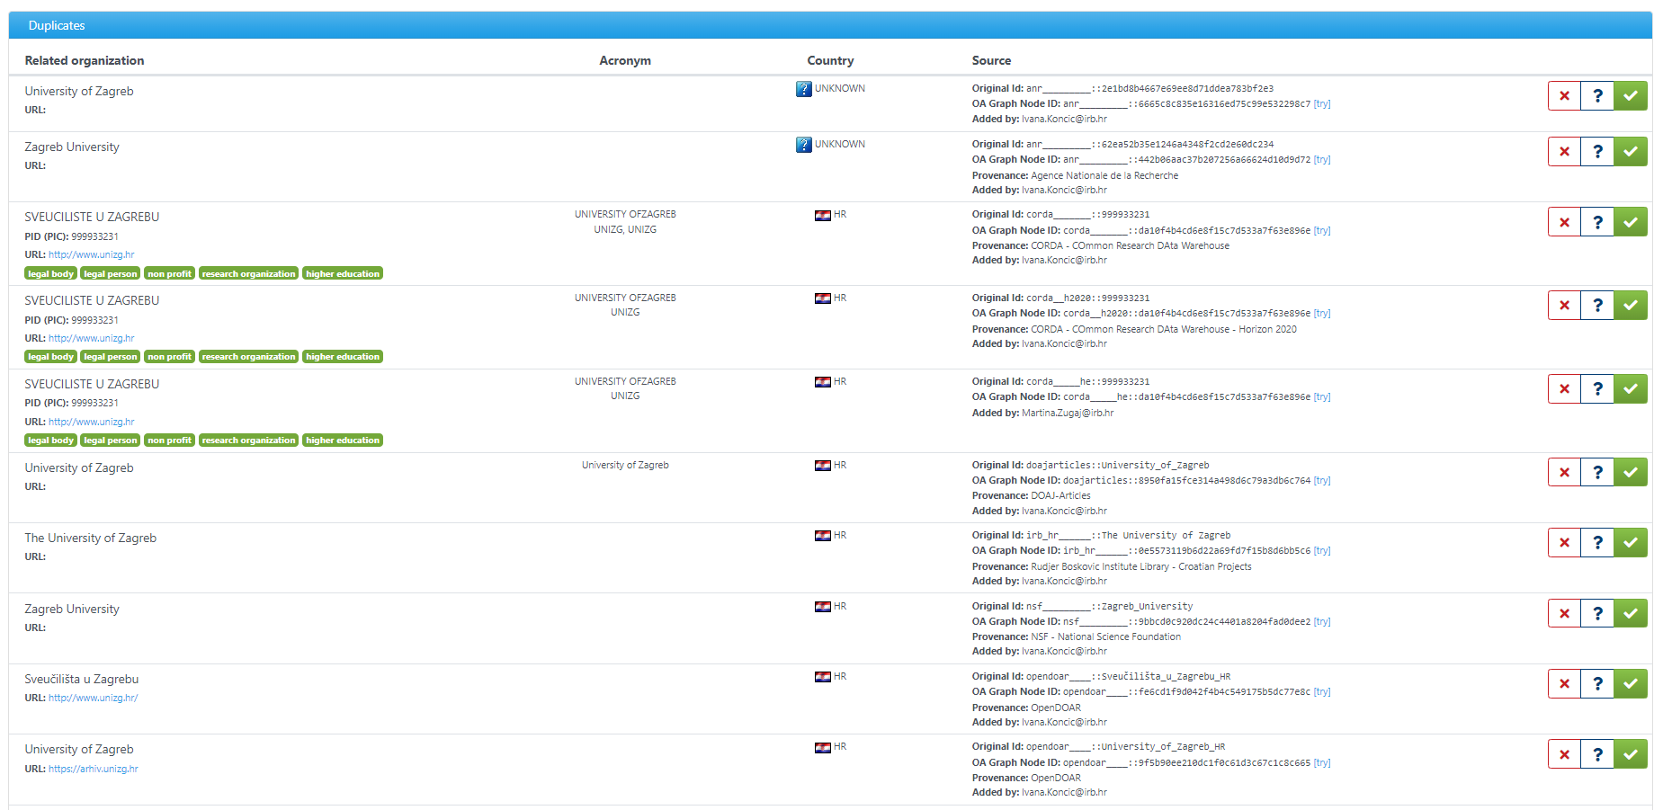

Slide 10
Problem statement
.disambiguation.

Slide 11
Problem statement
.quality / completeness.
organization field completeness
field | missing | % missing
legalname | 254 | 0.1%
legalshortname | 156,923 | 43.2%
alternativenames | 319,825 | 88.0%
country | 82,002 | 22.6%
website url | 142,047 | 39.1%
pid | 184,536 | 50.8%

Slide 12
Limitations of a fully .automated approach
False positives
Inaccurate statistics (e.g. for institutional and country monitors)
Inaccurate search results (e.g. finding only the US Concordia University and not the Canadian one)
False negatives
One instance is linked to the papers, one to the project… but it is the same organization!

Slide 13
Data provision .pipeline.

Slide 14
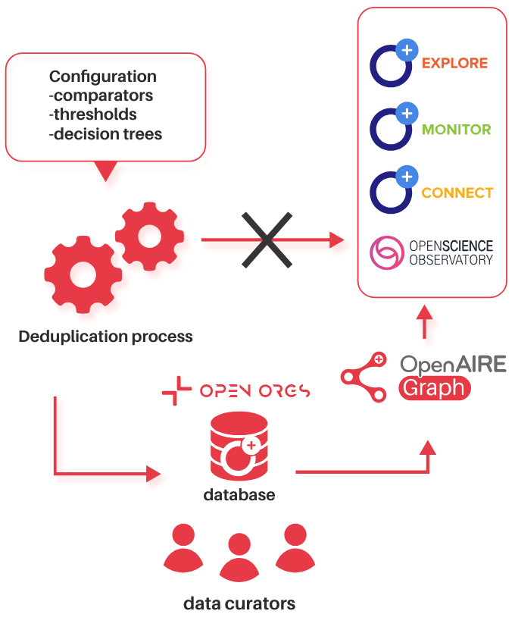
Data provision .pipeline.

Slide 15
OpenAIRE services benefiting from organisation disambiguation
Provides access to millions of interlinked scholarly works, their citations and contextual information such as organisations, grants.
Enables institutions, universities, or lead teams on a scientific domain, to easily create, configure and manage, their own customised web portal that collects and shares research outcomes of their interest to their audiences.
Produces well-documented, timely and accurate monitoring indicators of research activities for funders, research initiatives and organisations, by creating personalised and on-demand online configurable dashboards.
Facilitates access to the Open Science indicators for policy makers, funders, organisations, by combining and visualising information from all over Europe.

Slide 16
OpenOrgs activity pillars
Metadata curation
In OpenOrgs data curators can enrich the metadata description of the organization entities, compensating the lack of information available from the sources and improving the discoverability / completeness of the organization records.
03
Automatic suggestion of duplicates
The process for the automatic identification of possible duplicates will periodically produce new suggestions for the data curators.
Manual management of duplicates
Deciding whether two or more digital representations are duplicates of the same object can be a task that only humans can carry out precisely. The OpenOrgs tool allows data curator to manage the ambiguities in the data lack of the organization mentions aggregated by OpenAIRE.
01
02

Slide 17
Check out the new website!
openorgs .openaire.eu

Slide 18
HOW CAN YOU HELP?

Slide 19
Curating and enriching metadata for organisations
Identifying and resolving duplicates.
Adding parent-child relations (if any).
Approving organisations and providing them with stable OpenOrgs IDs.
Adding new organisations to the OpenOrgs database.
Documenting insights in the notes section.
Resolving conflicts; merging and distinguishing.

Slide 20
Curator ROLES.
USER
Scope of data curation is limited to a set of countries.
Editing and enriching the metadata of organisations.
Approval of suggestions from the automated duplicate identification.
Creation of a new Organisation (requires national admin approval).
NATIONAL ADMIN
Scope of data curation is limited to a set of countries.
Editing and enriching the metadata of organisations.
Giving final approval to new organisations, granting them official OpenOrgs IDs.
Managing user access and permissions within their nation.
Resolving any conflicts that occur.
Making decisions on suggested organisations to finalize their approval status.

Slide 21
Why we need YOU. ?
Knowledge of the country's research landscape.
Enhancing the OpenAIRE platforms.
Maintain up-to-date and precise information.
Increase the visibility of research outputs, projects, and datasets.
Simplify adherence to open access regulations, promoting greater transparency and accessibility in research.

Slide 22
Skills. of a Data Curator
Specialized skills:
Expertise in research organisations within their chosen country
Knowledge of major research institutions and universities
Awareness of the research structure and organisation in their country
Familiarity with national or regional research information systems
General skills:
Attention to detail
Strong data management skills
Analytical abilities
Technical proficiency
Problem-solving skills

Slide 23
Skills. of a Data Curator
Specialized skills:
Expertise in research organisations within their chosen country
Knowledge of major research institutions and universities
Awareness of the research structure and organisation in their country
Familiarity with national or regional research information systems
General skills:
Attention to detail
Strong data management skills
Analytical abilities
Technical proficiency
Problem-solving skills
This sounds like you?
Join our team as a data curator!

Slide 24
How to become. a Data Curator?

Slide 25
Join us for an engaging .training session on OpenOrgs!
Date: 15th April
Time: 14:30 - 16:30 CET
You will learn how OpenOrgs simplifies research organization identification, ensuring data integrity and accessibility, and participate in hands-on activities for practical learning.
SCAN THE QR & REGISTER!

Slide 26
.Q&A. time!

Slide 27
Thank you!
.get in touch:.
ikoncic@irb.hr mzugaj@irb.hr openorgs-admin@openaire.eu

