Slide 1
Connecting overlay journals with open repositories
and other open science infrastructures
18th International Open Repositories Conference
(OR 2023) Stellenbosch, South Africa
24x7: People and Process
2023-06-13
Raphaël Tournoy
Centre pour la Communication Scientifique Directe
Episciences has received funding from the European Union's under grant agreement OpenAIRE Nexus - OpenAIRE-Nexus Scholarly Communication Services for EOSC users (1010174

Slide 3
Overview of motivations and functionalities
Episciences
Quick overview
A platform for publishing open access scientific journals
Diamond open access (free to both authors and readers)
Any disciplines
New or flipping journals
Academic-led and funded
Initiated by researchers for researchers
Cost efficient, relies on existing infrastructures
Publishing toolkit for Scientific communities
Free software GPLv3 licence

Slide 4
Overlay Model
An overlay journal model
Supported
Operating on top of OA repositories e.g., arXiv, HAL, Zenodo, … (exchange metadata)
Peer-review of preprints, datasets, softwares
Peer-review : single-blind and open peer-review
Preprints and published articles are hosted only on open repositories
Ongoing development
Operating on top of OA repositories e.g., arXiv, HAL, Zenodo, …
Peer-review preprints, datasets, softwares
single-blind review
open peer-review
Preprints and published articles are hosted only on open repositories

Slide 5
Two challenges
Two challenges of the overlay model
Preprint submission metadata
Overlay and Open Repository communications

Slide 6
Limited metadata obtained
Preprint submission from repository to journal
Historical approach
Advantages:
easy protocol
DC lingua franca
OAI-PMH- Dublin Core
OAI-PMH- Dublin Core
Drawbacks:
simple metadata
one way communication
OAI-PMH - Dublin Core

Slide 7
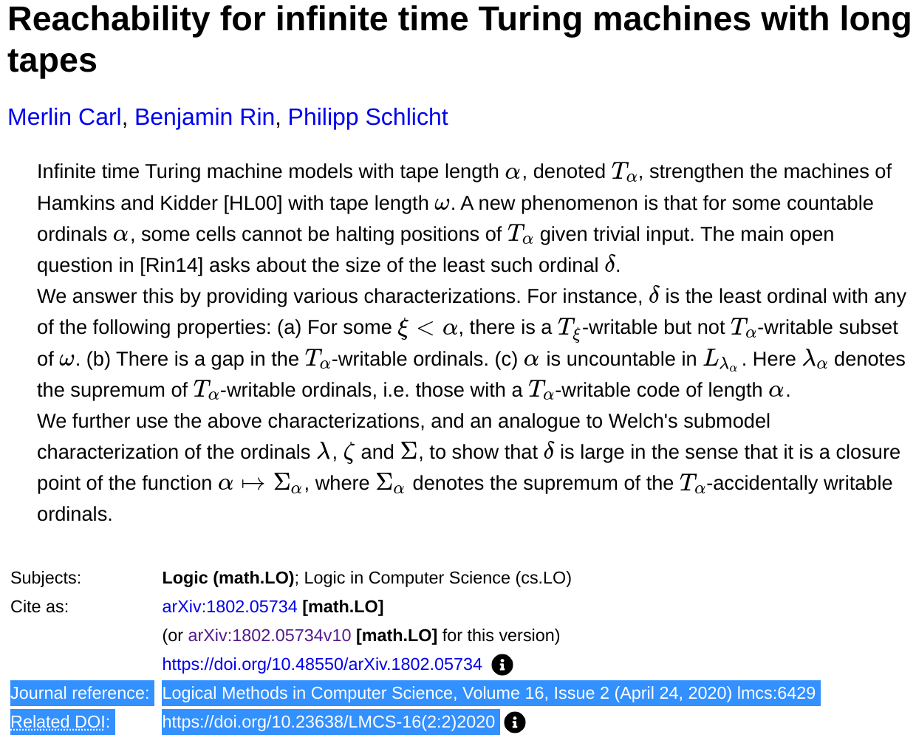
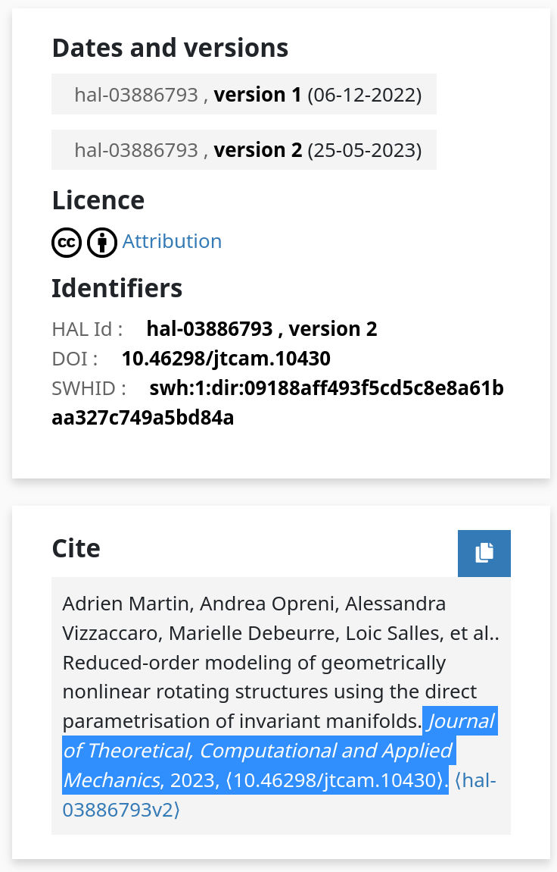
Many different APIs
Notification of publication to open repository
Historical approach
XML feed arXiv API
Manual by users
Specific API

Slide 8
Solutions
Two Solutions to overcome overlay journal challenges
Enrichment of metadata
COAR Notify

Slide 9
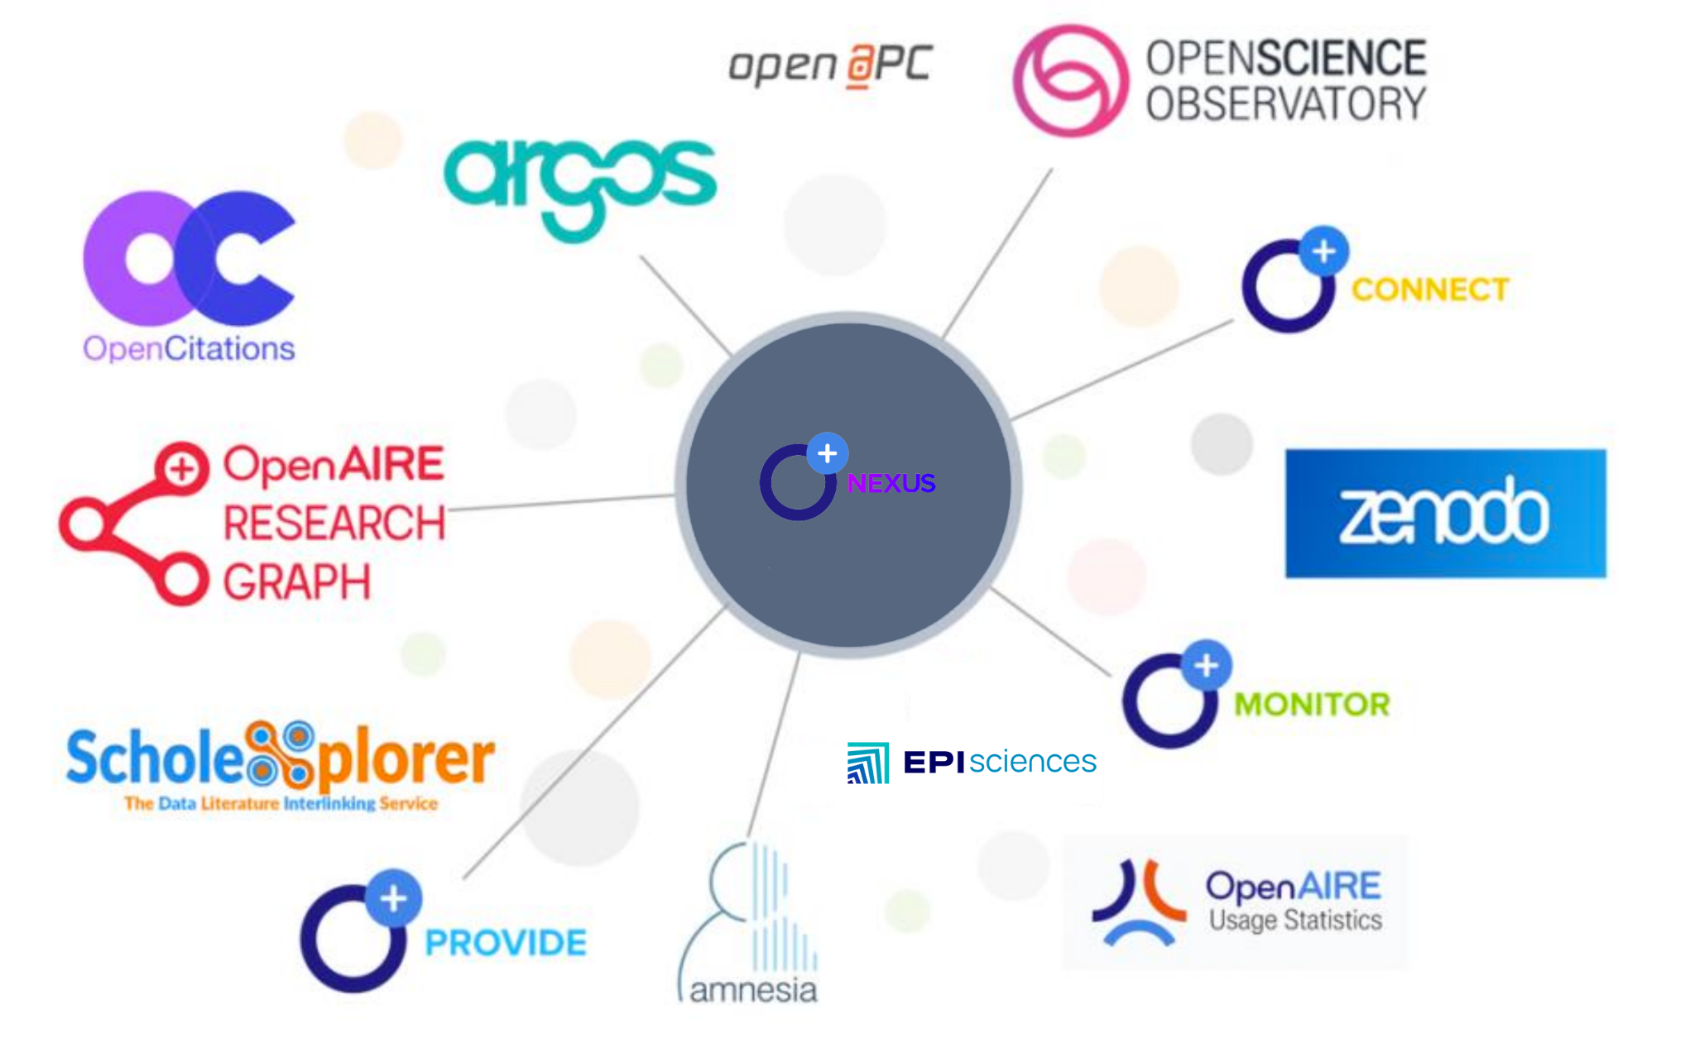
Titre de la page
Overcoming the problems of incomplete metadata
Post publication enrichment of metadata
Episciences has received funding from the European Union's under grant agreement OpenAIRE Nexus - OpenAIRE-Nexus Scholarly Communication Services for EOSC users (1010174

Slide 10
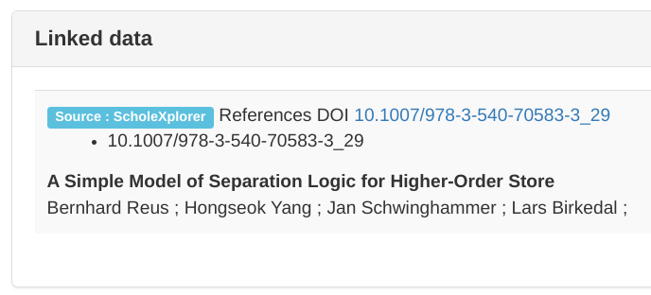
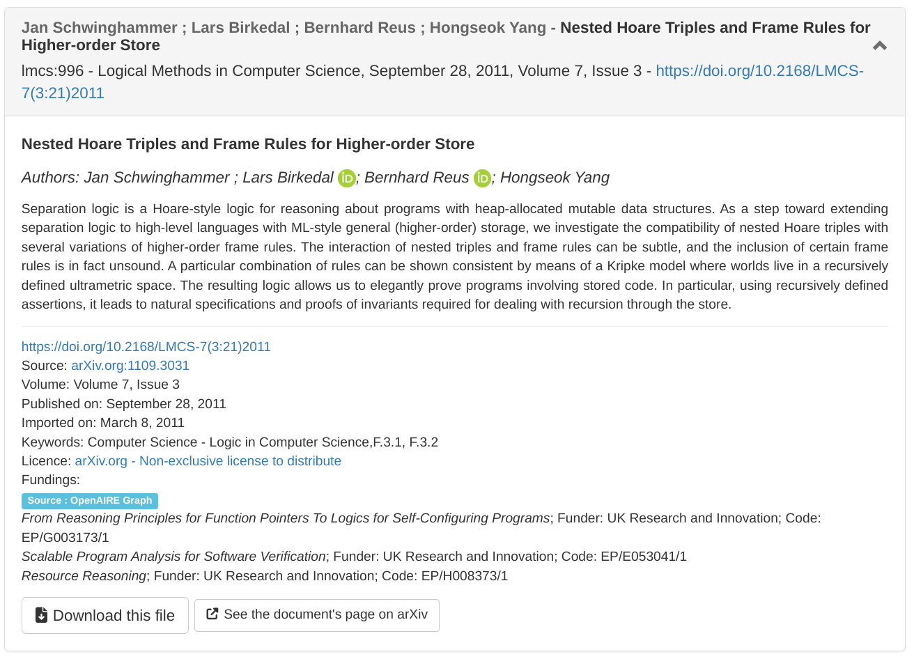
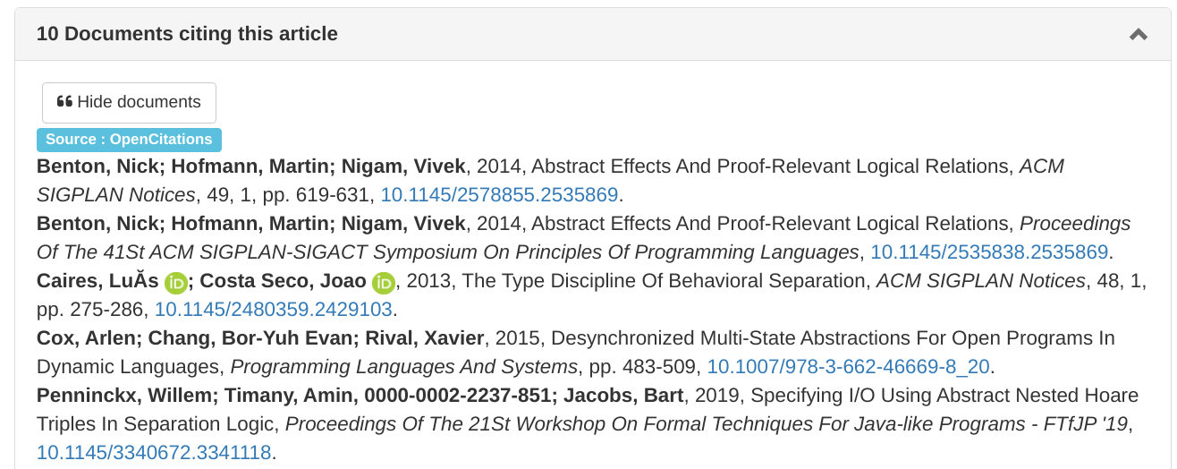
Metadata enrichment outcomes
Overcoming the problems of incomplete metadata
Metadata enrichment outcomes

Slide 11
Metadata enrichment outcomes
Episciences numbers
26 publishing journals
> 11 000 submissions
> 5600 published articles
> 11 800 users
> 6 700 peer-review reports
> 2000 ORCID
> 8200 affiliations
> 900 ROR affiliations
> 1700 cited-by references
> 900 Linked publication and datasets
> 1300 projects/funders
> 3700 licences
All published articles have a DOI since 2021

Slide 12
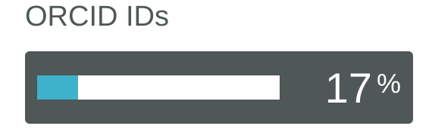
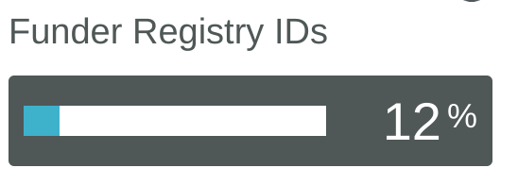
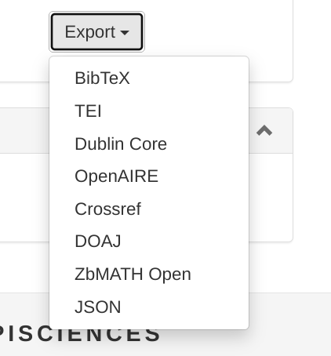
An iterative process
Giving back
Distributing to other services
OAI-PMH harvesting OpenAIRE Guidelines
DOI metadata updates
DOAJ export format
https://www.crossref.org/members/prep/25203

Slide 13
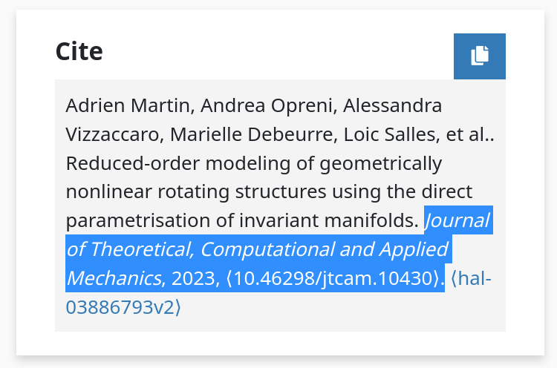
From Overlay Journal to Open Repository
Communication with repositories
Use Case - 1 -
Since December 2022
> 90 notifications processed
Implementing COAR Notify protocol
the overlay journal notifies the repository of its publication/endorsement
Article is published
HAL inbox
Notification Pattern Announce Endorsement
JSON Metadata Format
Metadata is retrieved from the article’s page
HAL updates its metadata (Journal references, document type, DOI, etc.)

Slide 14
From Open Repository to Overlay Journal
Communication with repositories
Use Case - 2 -
Roadmap
Before end of 2023
Implementing COAR Notify protocol
Author submits preprint
+
selects a journal for submission
Episciences
Inbox receives submission
Notification Pattern Request Review
HAL notifies the journal of a new submission/review request
Journal initiates submission and peer-review
Project HALOWIN funded with support from the French National Fund for Open Science

Slide 15
The next steps we hope to see
What to expect?
The more metadata we give, the more we discover
More repositories implementing COAR notify
Real time notifications between open science infrastructures
More repositories implementing Signposting for the scholarly web
The next steps
A virtuous circle of metadata enrichment
Easily connecting open repositories with overlay journals
A data repository is notified when a preprint/software uses a dataset ; another notification is issued if the preprint is published
An automated system is able to easily discover relevant metadata for its purpose

Slide 16
Thank you
Raphaël Tournoy
raphael.tournoy@ccsd.cnrs.fr
More information on https://www.episciences.org/

