Slide 1
Raphaël Tournoy
CCSD/CNRS
Episciences
Overlay journal platform

Slide 2
Motivations and functionalities
A platform for publishing open access scientific journals
Any disciplines
New or flipping journals
Publishing toolkit for Scientific communities
Diamond open access (free to both authors and readers)
Free software GPLv3 licence
Academic-led and funded
Metadata available with API

Slide 3
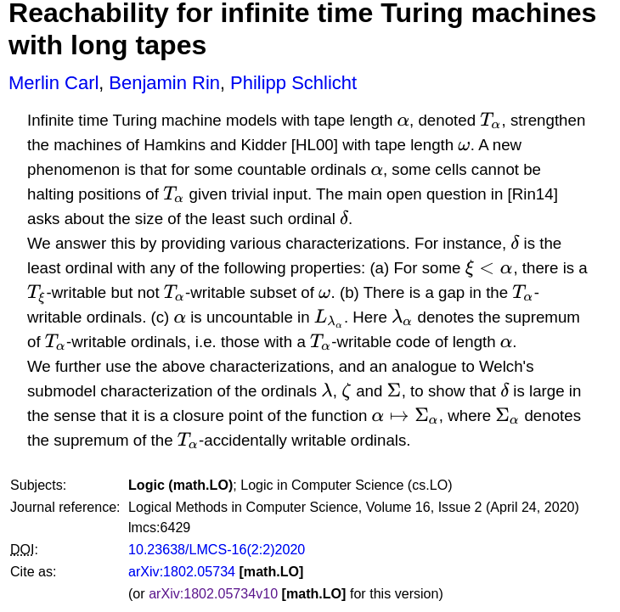
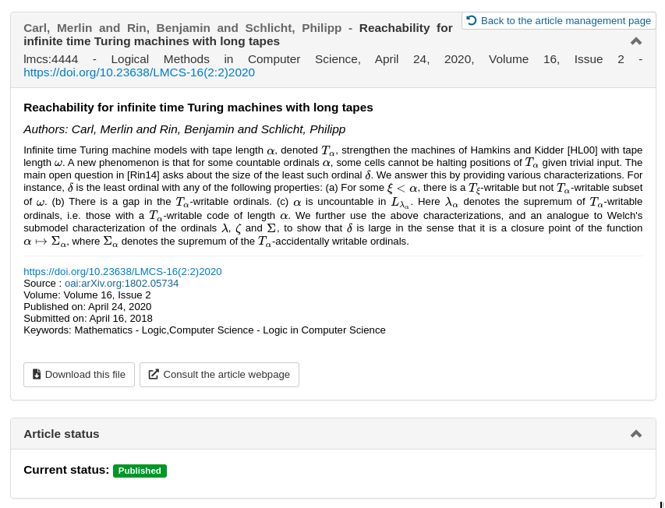
Article hosted on arXiv
Article published on LMCS, an Episciences journal
An overlay journal model
Operating on top of OA repositories e.g., arXiv, HAL, Zenodo, …
Peer-review preprints, datasets, softwares
single-blind review
open peer-review
Preprints and published articles are hosted only on open repositories

Slide 4
Episciences for the scientific communities
Saves time for readers, researchers and editorial teams
End-to-end compatible with FAIR principles
Operated by researchers and their scientific communities
Cost efficient, independant from the publishers
Hosted in Europe on public infrastructure

Slide 5
Compatible repositories
Supported
Ongoing development

Slide 6
Episciences for the scientific communities
Reducing costs
Adding value to AO
Reduce time to access publications
No subscriptions, no APC, free hosting and support
Publish at a reasonable cost (shared infrastructure, hosting and preservation by repositories)
Reinvesting public money (HR) in a public service for scientific dissemination
Validation/certification of preprints
Preprints are immediately available
Stay online, even if refused

Slide 7
Episciences for the scientific communities
Traceability
Open by design
Allow authors to retain their rights
Track the evolution of document versions, even after publication
Consider publications as a conversation flow, beyond a simple published version
Compliant with open access mandates
CC licences, non-exclusive distribution rights to journals

Slide 8
Episciences for the scientific communities
Long term access
Scientific independence
FAIR & Bibliodiversity
Maintain control over access to publications/ evaluations
Maintain access to content even if the journal ceased publication
Allow scientific communities to own their journals and the data created by their activity
To have a scientific publication policy independent of a commercial logic
Meets FAIR principles
More bibliodiversity

Slide 9
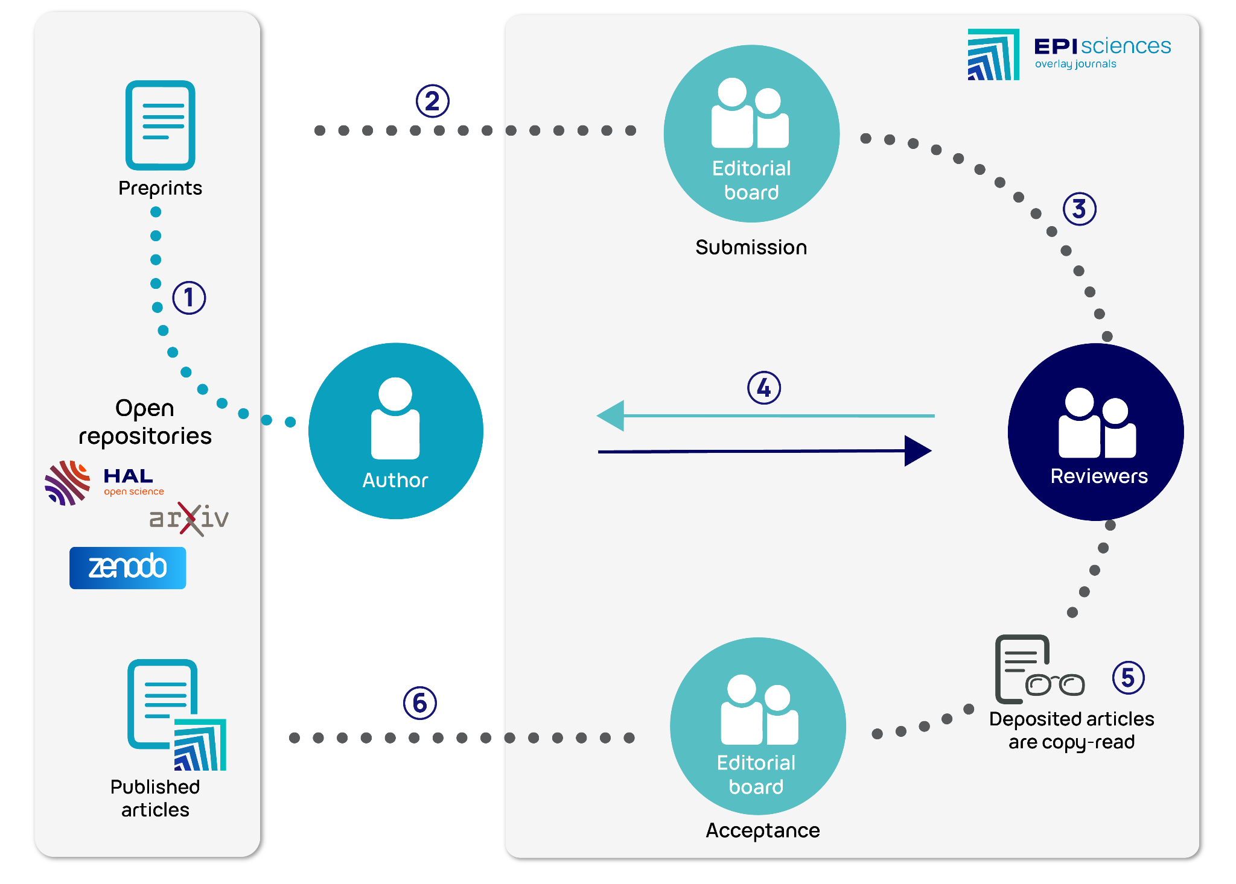
Workflow

Slide 10
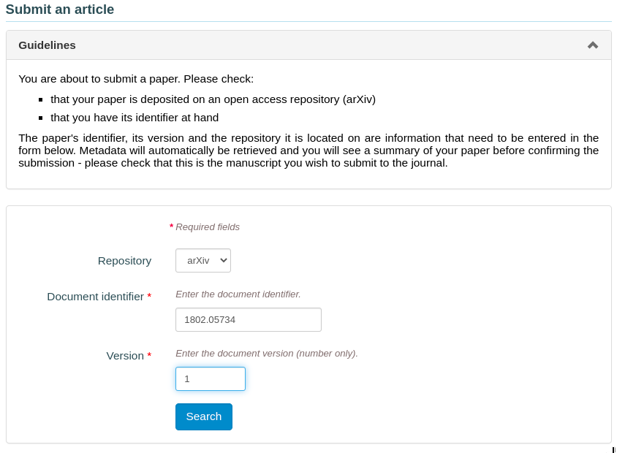
Import your preprint on a journal
with your preprint ID:
1802.05734v1

Slide 11
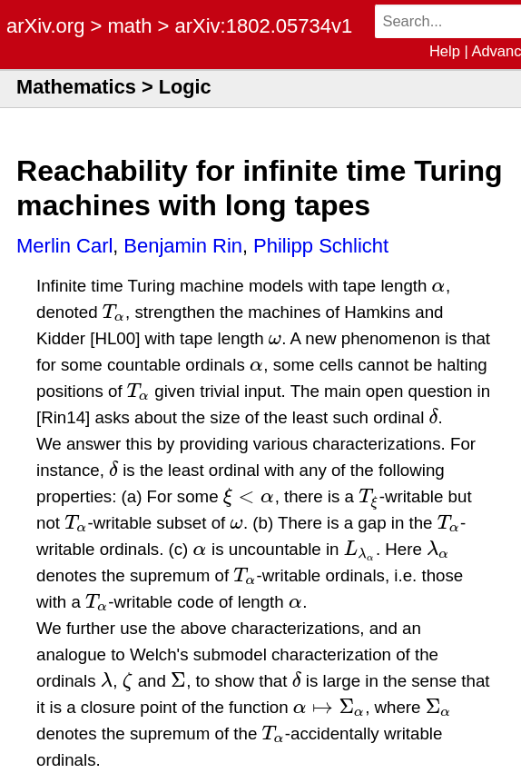
Metadata retrieved with arXiv’s APIs
API

Slide 12
Publication: one Version Of Record

Slide 13
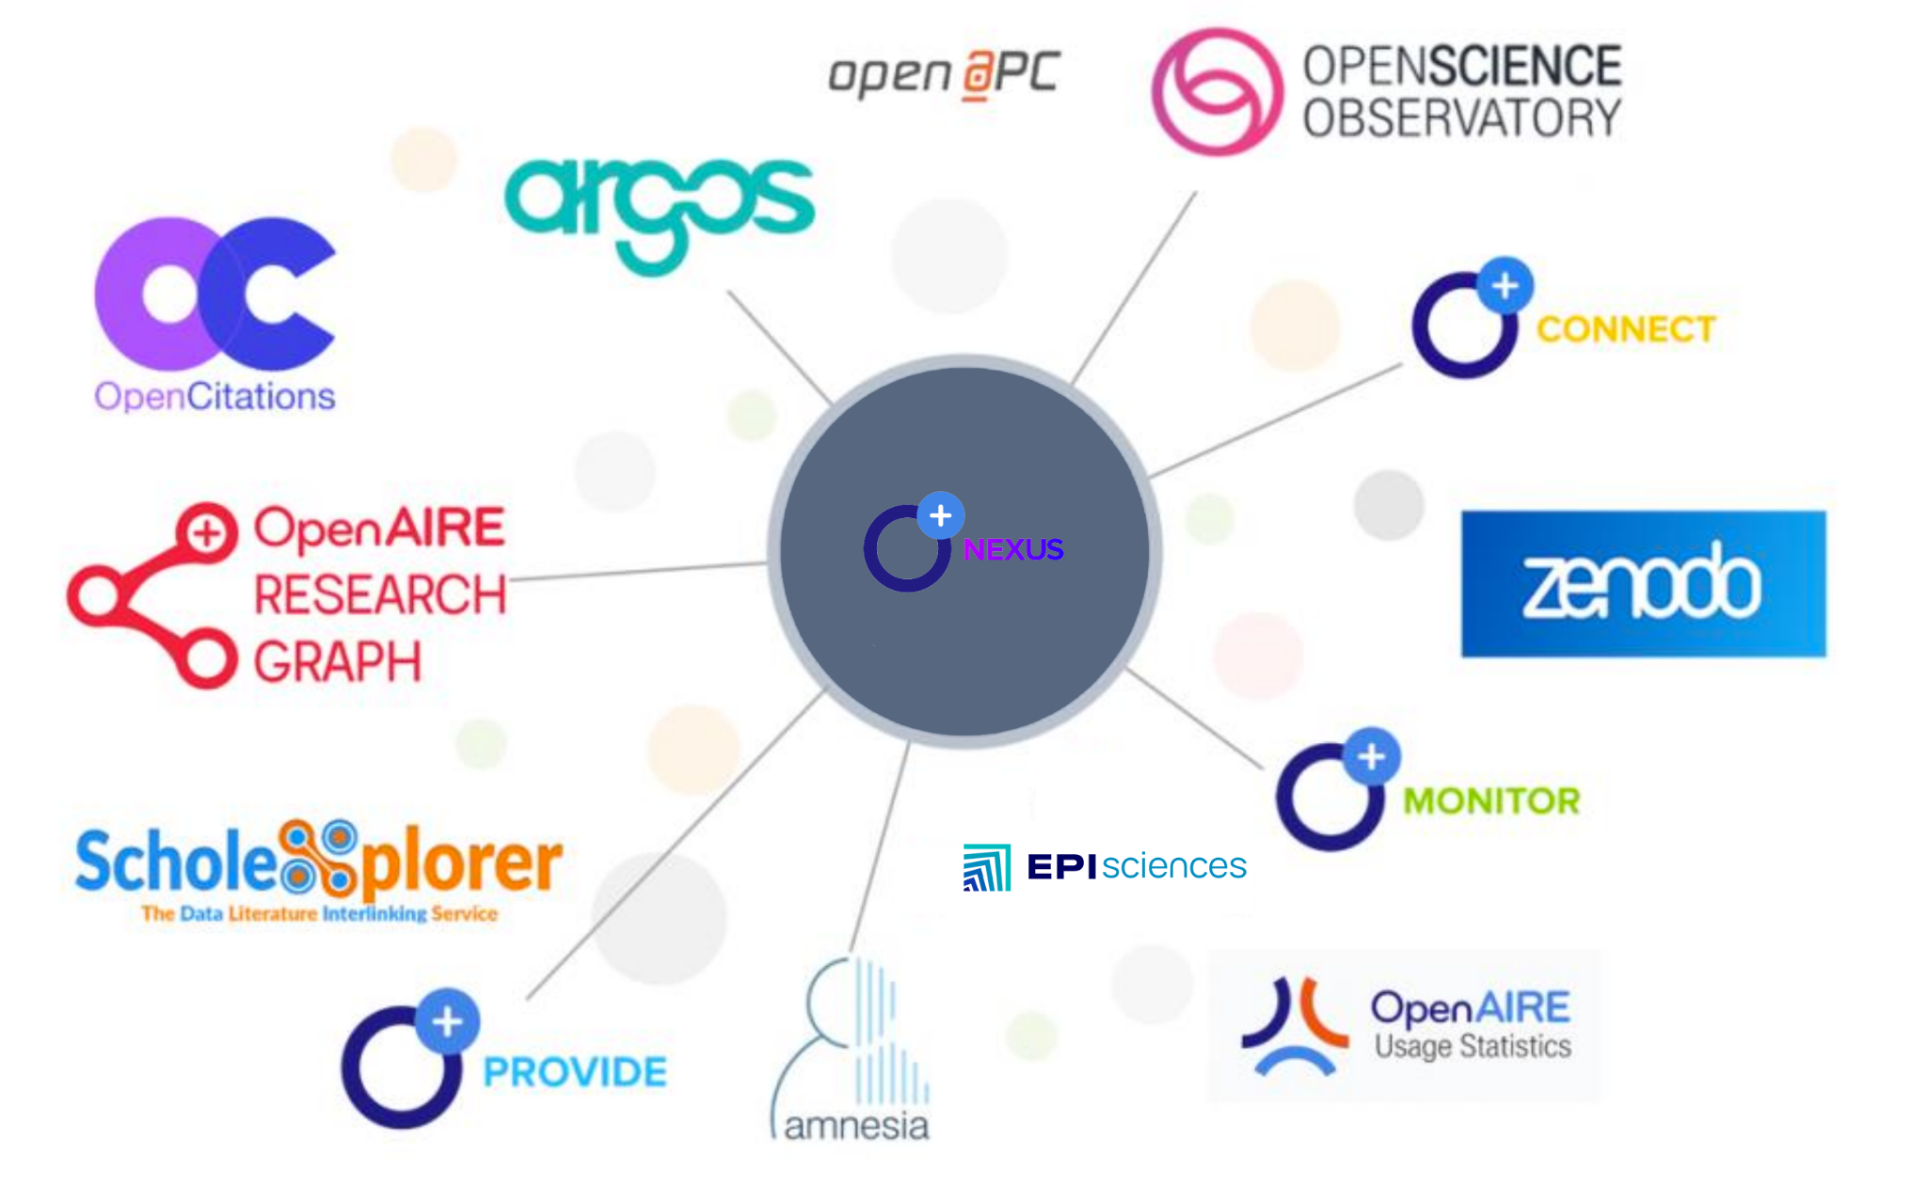
Integration with OpenAIRE services

Slide 14
Integration with research-related services

Slide 15
Raphaël Tournoy
raphael.tournoy@ccsd.cnrs.fr
info@openaire.eu

