Slide 1
OpenCitations
an infrastructure for open bibliographical metadata
Ivan Heibi
University of Bologna

Slide 2
Outline
OpenCitations
Overview
Citations
OpenCitations Indexes
Integration with Nexus services
Recent releases
DOCI and POCI
META
Indexed resources in OC
Querying and usage
SPARQL endpoints
REST APIs
OpenCitations access token
Dumps

Slide 3
OpenCitations https://opencitations.net/

Slide 4
Overview
OpenCitations (http://opencitations.net) is an independent infrastructure organization ​
dedicated to open scholarship and the publication of open bibliographic and citation data by the use of Semantic Web technologies​
engaged in advocacy for open citations and open bibliographic metadata​, particularly via I4OC (https://i4oc.org) and I4OA (https://i4oa.org)
It provides:​
a data model: the OpenCitations Data Model (based on the SPAR Ontologies)​
bibliographic and citation data (CC0)
software: in our GitHub repository, released with open source licenses​
online services: REST APIs, SPARQL endpoints, dumps and interfaces​

Slide 5
Citations in OpenCitations
Citation data should be structured, separable, and open. In OpenCitations citations are hosted as Linked Open Data, defined using the OpenCitations Data Model (OCDM) as first-data entities
Advantages:
all the information regarding each citation is available in one place.
citations become easier to describe, distinguish, count and process.
Citations are identified with the Open Citation Identifier (OCI), a globally unique persistent identifier (PID) for the identification of open bibliographic citations stored in a specific database or in other kinds of storages.
has citing article
Citation
has cited article
creation
timespan
author self citation ?
journal self citation ?

Slide 6
OpenCitations Indexes
COCI, the OpenCitations Index of Crossref open DOI-to-DOI citations –
an RDF dataset containing data of all the citations that are specified by the open references to DOI-identified works present in Crossref
CROCI, the Crowdsourced Open Citations Index – individuals (identified by ORCiD) may deposit citation information that they have a legal right to submit, and within which these submitted citation data will be published under a CC0 public domain waiver
At the end of November 2022 OpenCitations had:
1,363,718,366 citation links​
75,030,924 bibliographic resources

Slide 7
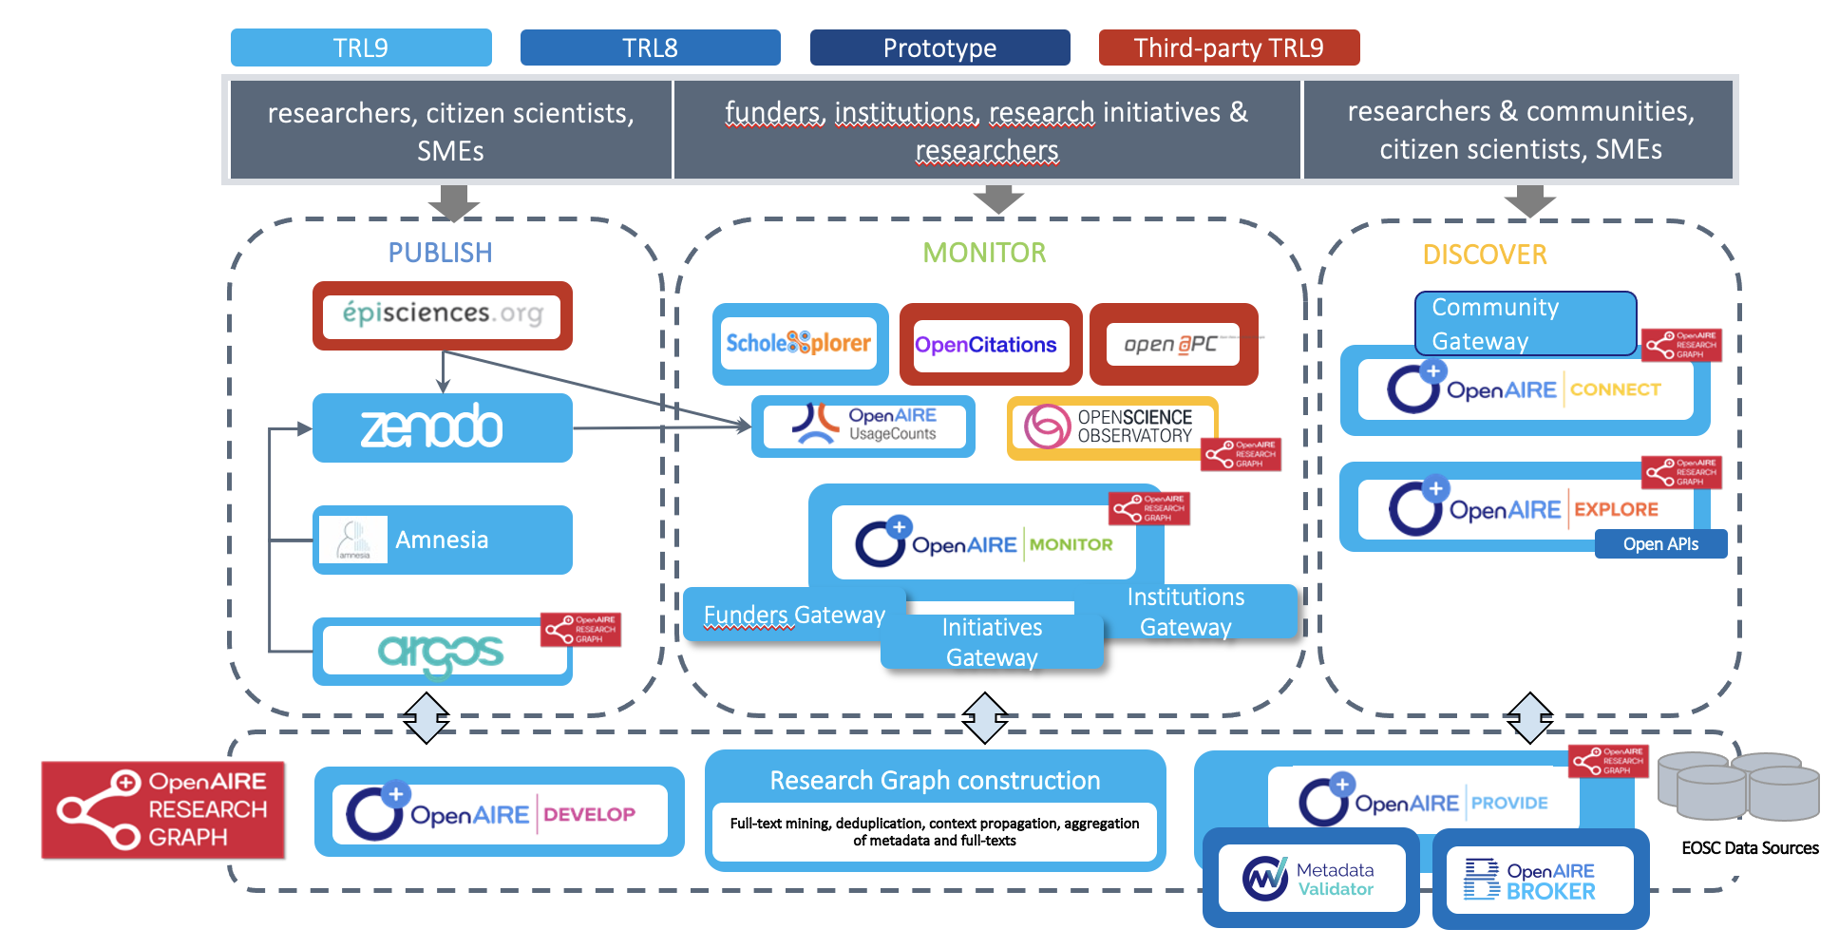
Integration with Nexus services
Research Graph
ingestion of OpenCitations data (bibliographic and citation data) to the Research Graph
software developed for enabling ingestion to/from OpenCitations

Slide 8
Recent releases Data and Services released on December 2022

Slide 9
https://opencitations.net/index/doci
169,822,752
CITATIONS
1,753,858
BIBLIOGRAPHIC RESOURCES

Slide 10
https://opencitations.net/index/poci
717,654,703
CITATIONS
29,005,551
BIBLIOGRAPHIC RESOURCES

Slide 11
https://opencitations.net/meta
87,321,593
BIBLIOGRAPHIC RESOURCES
277,750,235 AUTHORS
710,226 VENUES
2,359,301 EDITORS
17,268 PUBLISHERS

Slide 12
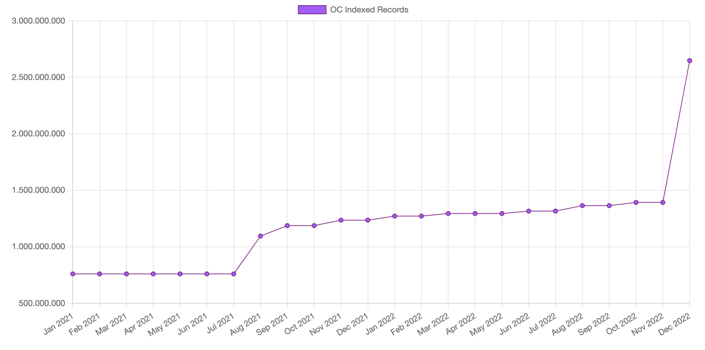
Indexed resources in OpenCitations
2,647,672,913
COCI & CROCI
+ DOCI; POCI; META

Slide 13
Querying Data https://opencitations.net/querying

Slide 14
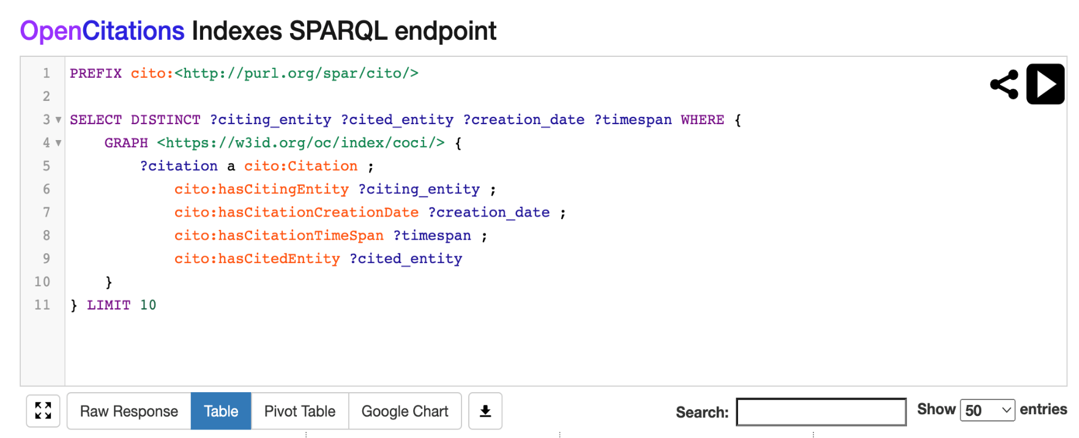
SPARQL endpoints
OpenCitations mantains a SPARQL endpoint for all its datasets. When such a SPARQL endpoint is accessed with a browser, it shows an editor GUI generated with YASGUI
Requires technical background on semantic web technologies and SPARQL language

Slide 15
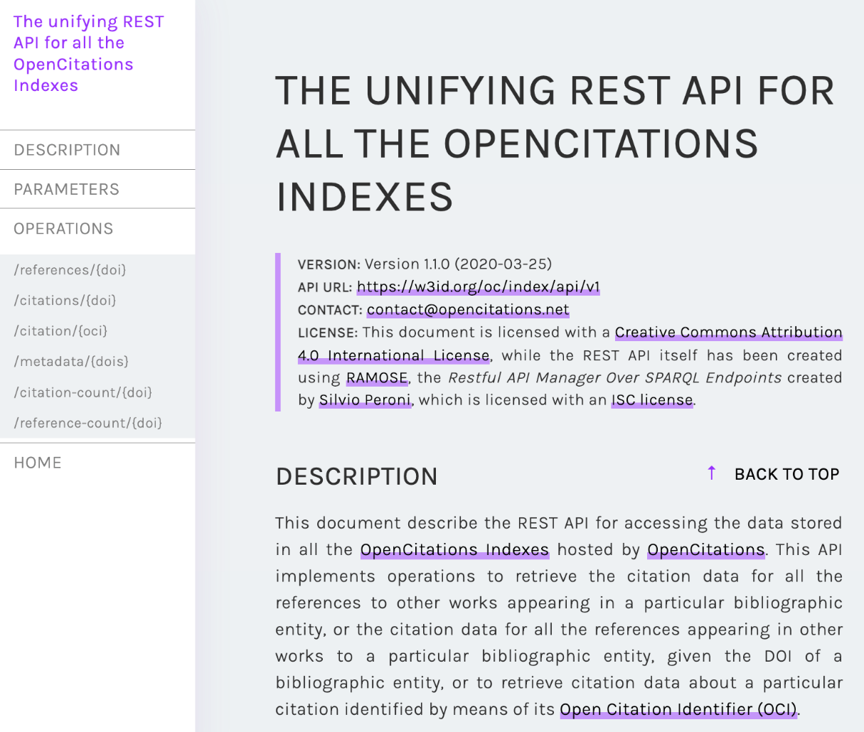
REST APIs
Data in any of the OpenCitations datasets can be retrieved by using an HTTP REST API. This solution represents a convenient access to the data included in the OpenCitations datasets for Web developers and users who are not necessarily experts in Semantic Web technologies.
Implemented by means of RAMOSE, the Restful API Manager Over SPARQL Endpoints
(https://github.com/opencitations/ramose)

Slide 16
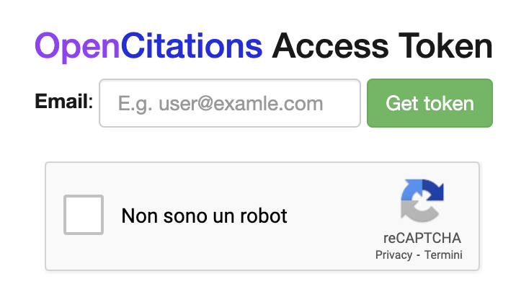
OpenCitations access token
Before accessing our services, we encourage getting the OpenCitations Access Token.
An opaque string that anonymously identifies a unique user of the OpenCitations’ APIs.
Its usage is not compulsory; however, it will help OpenCitations incredibly, by enabling us to monitor the number of the unique users accessing our data and services.
https://opencitations.net/accesstoken

Slide 17
Dumps
Data dumps of the OpenCitations Indexes – COCI, CROCI, DOCI, POCI, and META. Dumps are available on Figshare (https://figshare.com/) in CSV, N-Triples and Scholix formats.
https://opencitations.net/download
This option is highly recommended for massive and large data analysis on the resources of OpenCitations

Slide 18
THANKS
Email
Ivan.heibi2@unibo.it
Twitter
@ivanhb

