Slide 1
OpenCitations
an infrastructure for open bibliographical metadata
Ivan Heibi
University of Bologna

Slide 2
Outline
OpenCitations
Overview
Citations
OpenCitation Indexes
Citation coverage and Statistics
Integration with other services
Integration with Nexus services
Integration with research-related services
OpenCitations in EOSC
Usage KPIs
Future steps
OpenCitations Meta
COCI, NOCI, and DOCI
OpenCitations badge
Querying data
SPARQL endpoints
Search interfaces
REST APIs
OpenCitations access token

Slide 3
OpenCitations https://opencitations.net/

Slide 4
Overview
OpenCitations (http://opencitations.net) is an independent infrastructure organization ​
dedicated to open scholarship and the publication of open bibliographic and citation data by the use of Semantic Web technologies​
engaged in advocacy for open citations and open bibliographic metadata​, particularly via I4OC (https://i4oc.org) and I4OA (https://i4oa.org)
It provides:​
a data model: the OpenCitations Data Model (based on the SPAR Ontologies, recently included in FAIRSharing.org)​
bibliographic and citation data (CC0): OpenCitations Indexes
software: in our GitHub repository, released with open source licenses​
online services: REST APIs, SPARQL endpoints, dumps and interfaces​

Slide 5
Citations
Citation: conceptual directional link from a citing entity to a cited entity​
data of a particular citation must include: (1) the representation of such a conceptual directional link; (2) basic metadata of the citing entity and the cited entity
citation data should be structured, separable, and open
citations in OpenCitations are hosted as Linked Open Data, defined using the OpenCitations Data Model (OCDM)
Citing Article
Cited Article
cites

Slide 6
Citations in OpenCitations
Citations are defined as First-Class Data Entities (following OCDM)
Advantages:
all the information regarding each citation is available in one place.
citations become easier to describe, distinguish, count and process.
Citations are identified with the Open Citation Identifier (OCI), a globally unique persistent identifier (PID) for the identification of open bibliographic citations stored in a specific database or in other kinds of storages.
has citing article
has cited article
Citation
creation
timespan
author self citation ?
journal self citation ?

Slide 7
OpenCitations Indexes
OpenCitations Indexes have crossed the significant threshold of one billion citations and the last release (August 2022) contains ​
1,363,718,366 citation links​
75,030,924 bibliographic resources
OpenCitations provides citation data via: REST APIs, SPARQL endpoints, dumps and interfaces​

Slide 8
COCI and CROCI
COCI, the OpenCitations Index of Crossref open DOI-to-DOI citations
an RDF dataset containing data of all the citations that are specified by the open references to DOI-identified works present in Crossref.
CROCI, the Crowdsourced Open Citations Index
individuals (identified by ORCiD) may deposit citation information that they have a legal right to submit, and within which these submitted citation data will be published under a CC0 public domain waiver

Slide 9
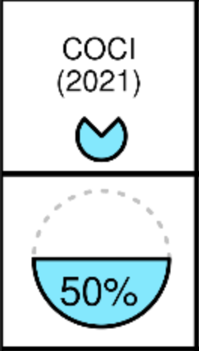
Citation coverage
A recent independent comparison has shown that the coverage of COCI is approaching parity with those of the expensive subscription citations indexes Web of Science and Scopus
https://opencitations.hypotheses.org/1420

Slide 10
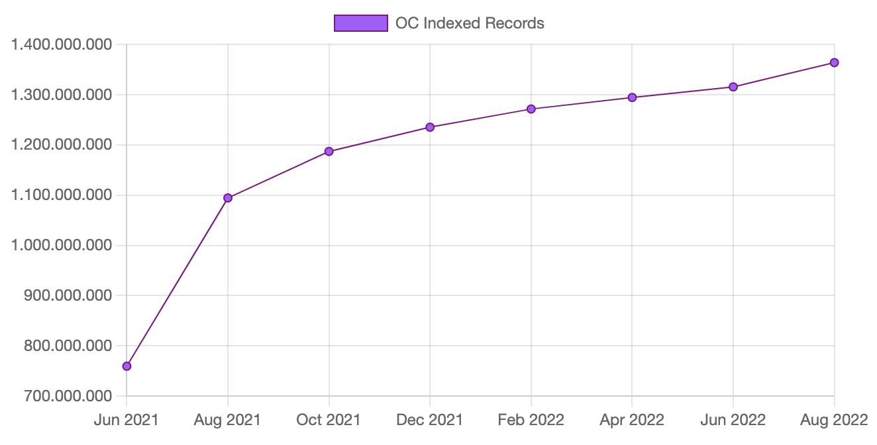
Statistics regarding the indexed citations
The number of records (citations) indexed in the COCI dataset of OpenCitations throughout the time

Slide 11
Integration with Other Services

Slide 12
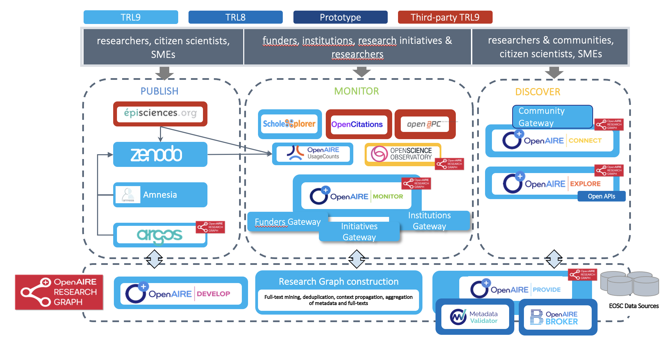
Integration with Nexus services
Research Graph
Ingestion of OpenCitations data (bibliographic and citation data) to the Research Graph
Software developed for enabling ingestion to/from OpenCitations (integration with EpiSciences is still in progress)

Slide 13
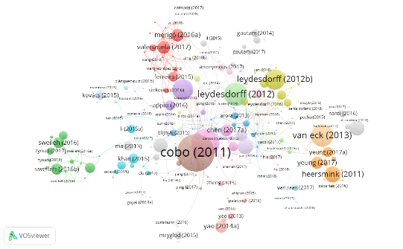
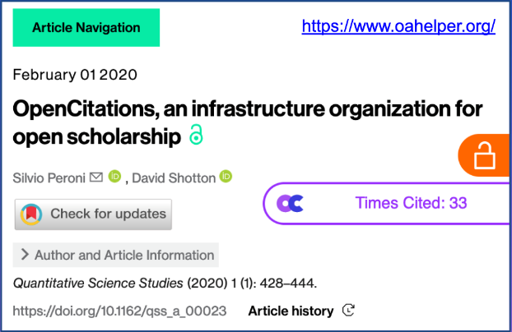
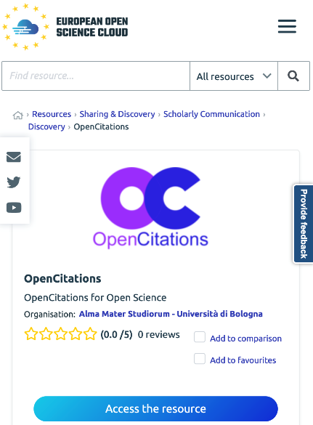
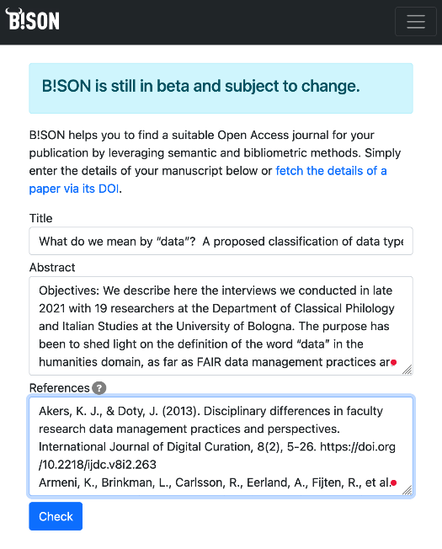
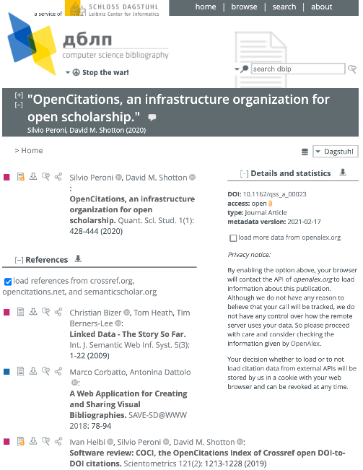
Integration with research-related services
Exposed in the EOSC Marketplace
Other users: DBLP, OpenAccess Helper, Lens.org, VOSviewer, Inciteful, Citation Gecko, VisualBib, CiteCorp, Scipedia, scanR, Spark, Pure Suggest, B!SON, BIP! Finder, …

Slide 14
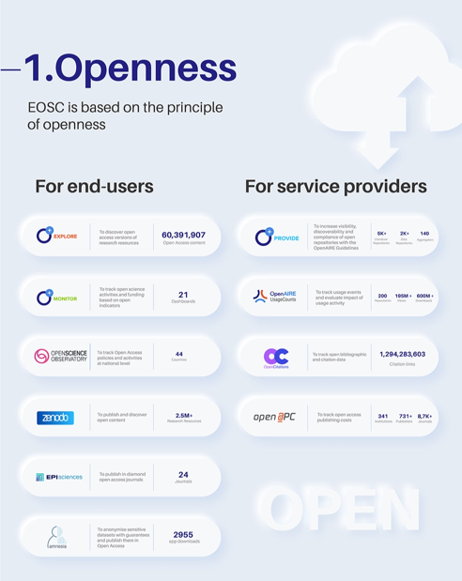
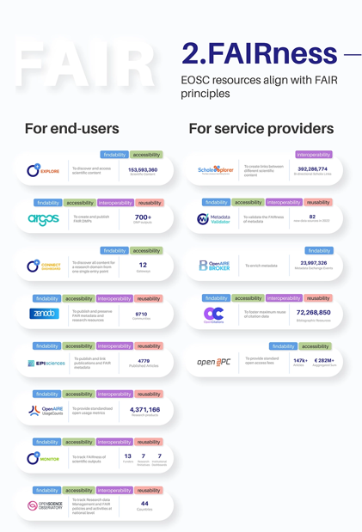
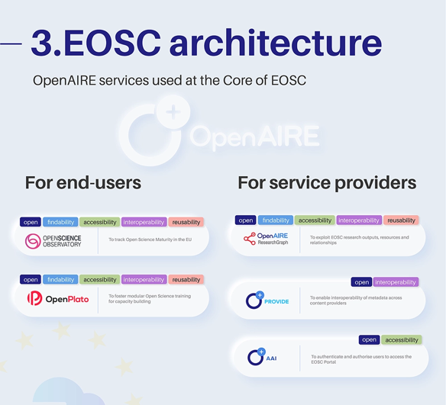
OpenCitations in EOSC

Slide 15
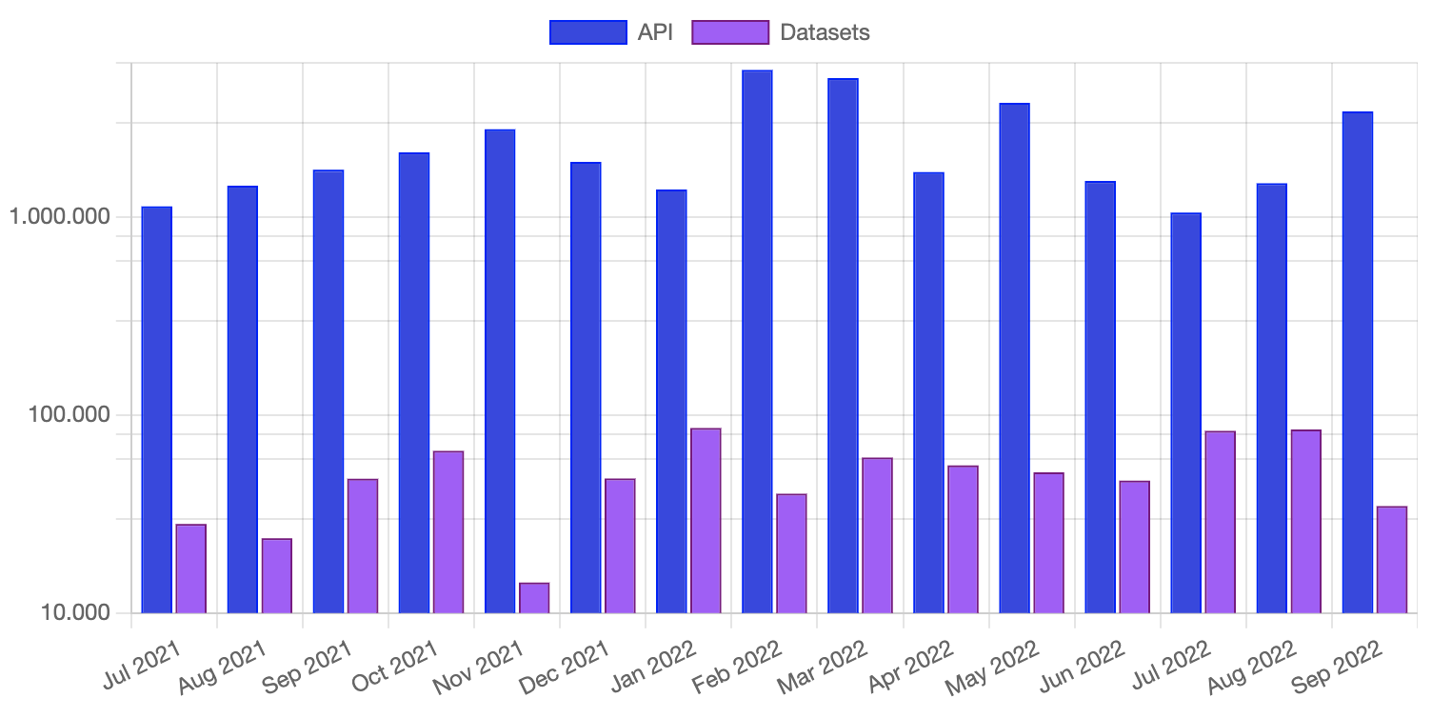
Usage KPIs
On September 2022, 12 different Tokens made API requests – with an average of 1414 calls per token
Currently we have registered 36 different tokens

Slide 16
Future Steps Learn more about current/future activities of OpenCitations on its public roadmap at https://opencitations.hypotheses.org/1519

Slide 17
OpenCitations Meta
Enables to store in house bibliographic metadata for the citing and cited publications involved in all our indexed citations
Advantages:
Index citations involving entities lacking DOIs
Improving the performance of some API operations
Enables text search (e.g. in titles)
Expected by the end of 2022

Slide 18
COCI, NOCI and DOCI
A new release of COCI based on the October dump of Crossref
A coverage expansion with the integration of new citation indexes of open citations, based on the holdings of DataCite (DOCI) and the NIH Open Citation Collection (NOCI)
TODO – SOME NUMBERS FROM ARIANNA
Expected by the end of 2022

Slide 19
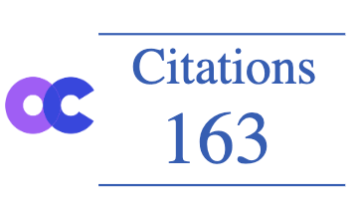
OpenCitations badge
A badge widget to be integrated in any webpage by simply adding a precise HTML tag. The hosting service can decide what kind of information to display (mainly number of citations)
Expected by the end of 2022

Slide 20
Querying Data https://opencitations.net/querying

Slide 21
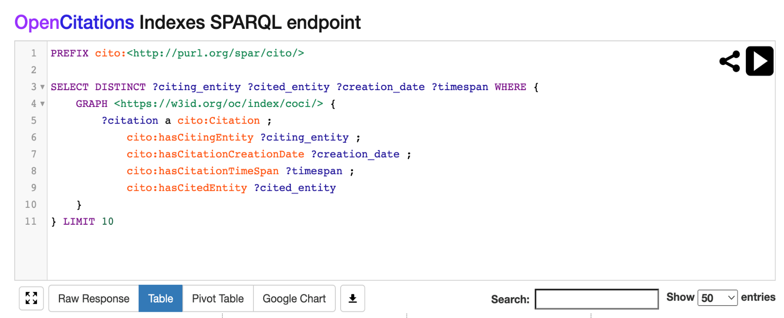
SPARQL endpoints
OpenCitations mantains a SPARQL endpoint for all its datasets. When such a SPARQL endpoint is accessed with a browser, it shows an editor GUI generated with YASGUI
Requires technical background on semantic web technologies and SPARQL language

Slide 22
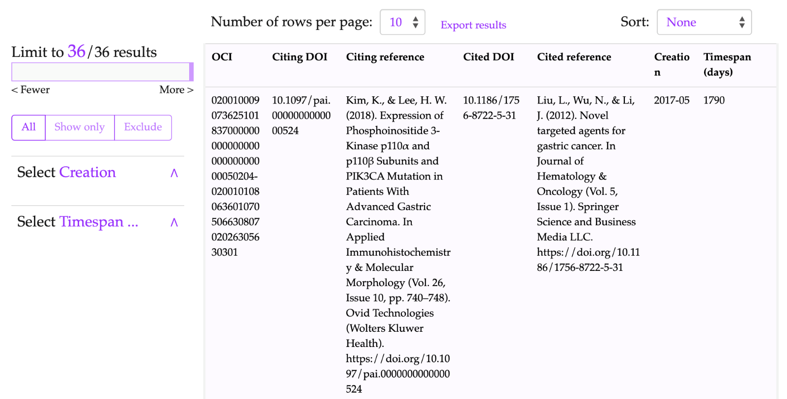
Search Interfaces
User-friendly text search interfaces that can be used to search data in all the OpenCitations datasets and filter the outcoming results.
Developed using OSCAR, The OpenCitations RDF Search Application
(https://github.com/opencitations/oscar)

Slide 23
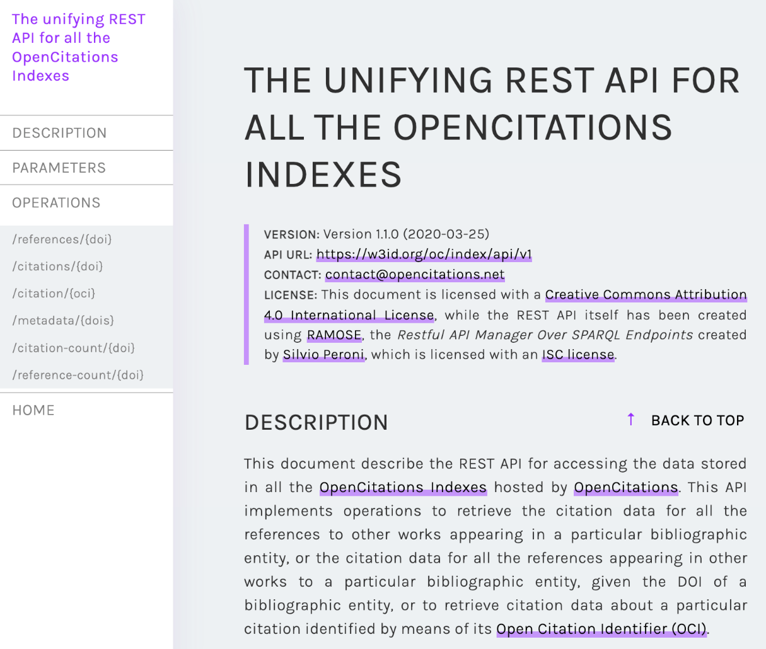
REST APIs
Data in any of the OpenCitations datasets can be retrieved by using an HTTP REST API. This solution represents a convenient access to the data included in the OpenCitations datasets for Web developers and users who are not necessarily experts in Semantic Web technologies.
Implemented by means of RAMOSE, the Restful API Manager Over SPARQL Endpoints
(https://github.com/opencitations/ramose)

Slide 24
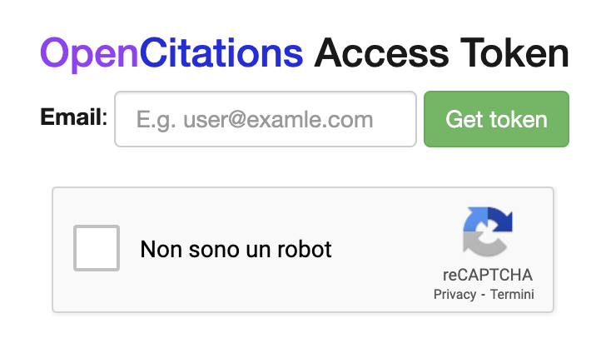
OpenCitations access token
Before accessing our services, we encourage getting the OpenCitations Access Token.
An opaque string that anonymously identifies a unique user of the OpenCitations’ APIs.
Its usage is not compulsory; however, it will help OpenCitations incredibly, by enabling us to monitor the number of the unique users accessing our data and services.
https://opencitations.net/accesstoken

Slide 25
THANKS
Email
Ivan.heibi2@unibo.it
Twitter
@ivanhb

