Slide 1
How to make training materials FAIR
Iryna Kuchma, Open Access Programme Manager
Attribution 4.0 International

Slide 2
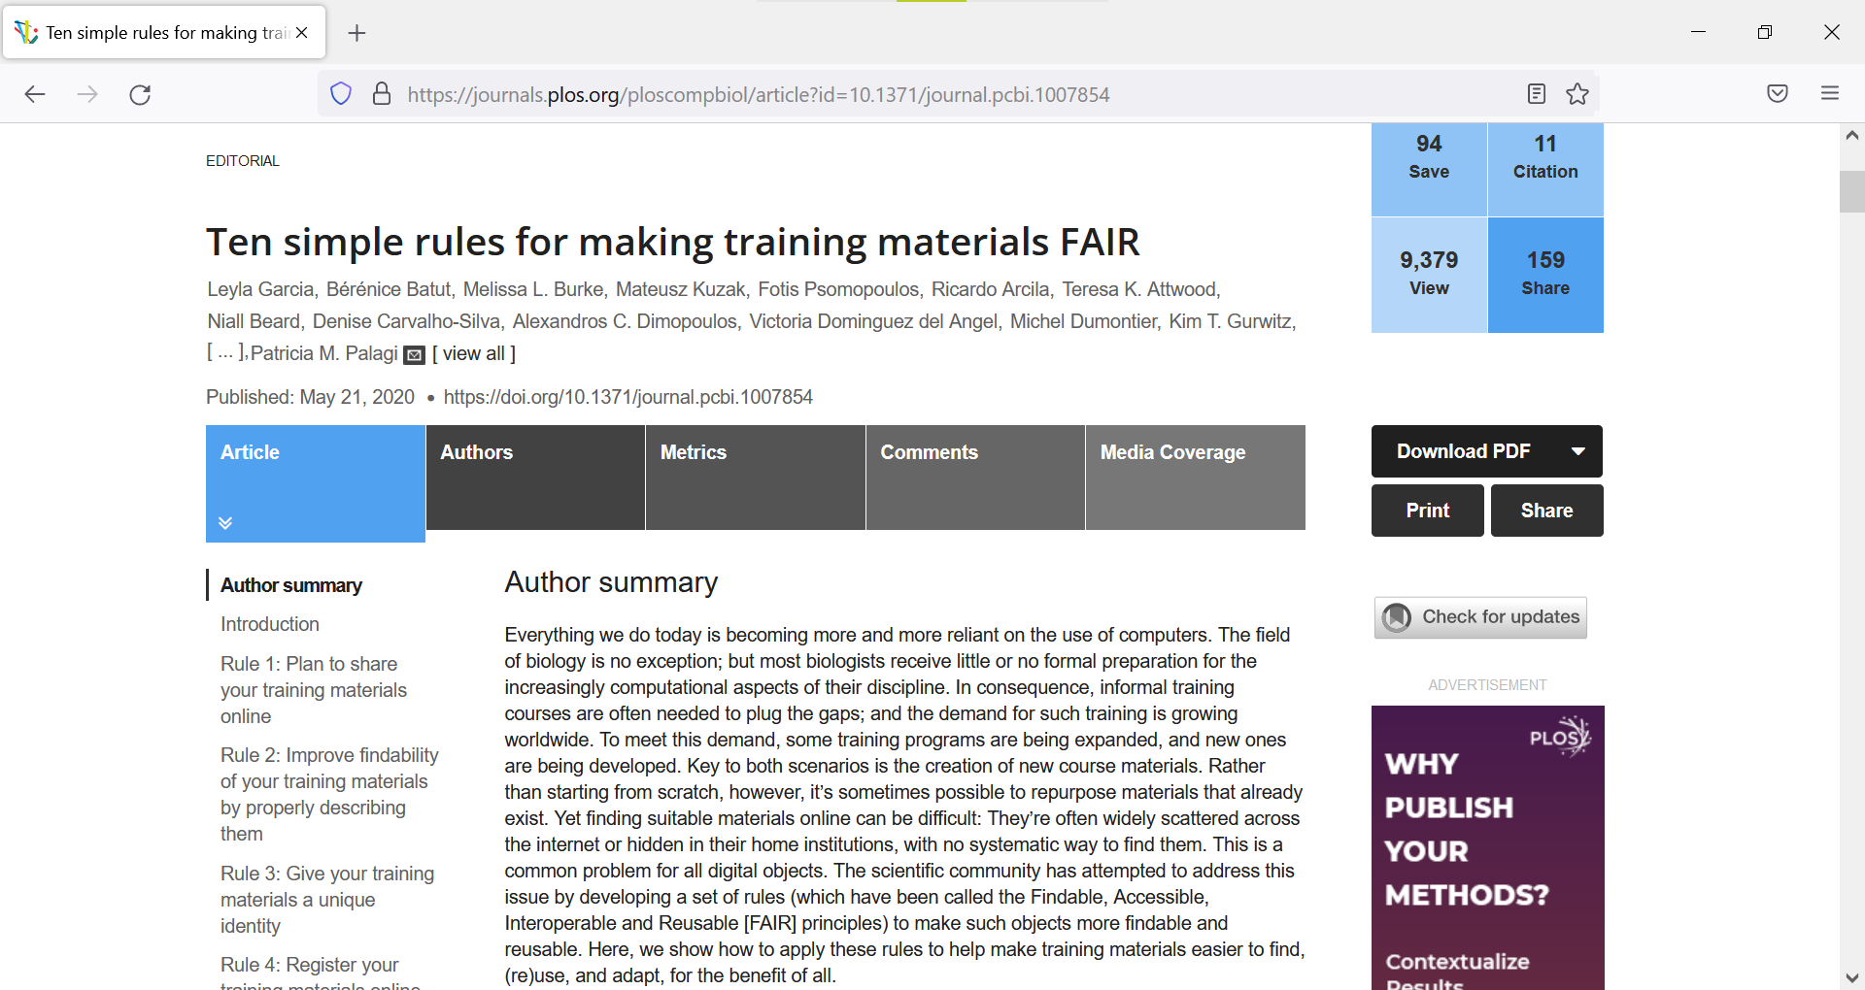
https://doi.org/10.1371/journal.pcbi.1007854

Slide 3
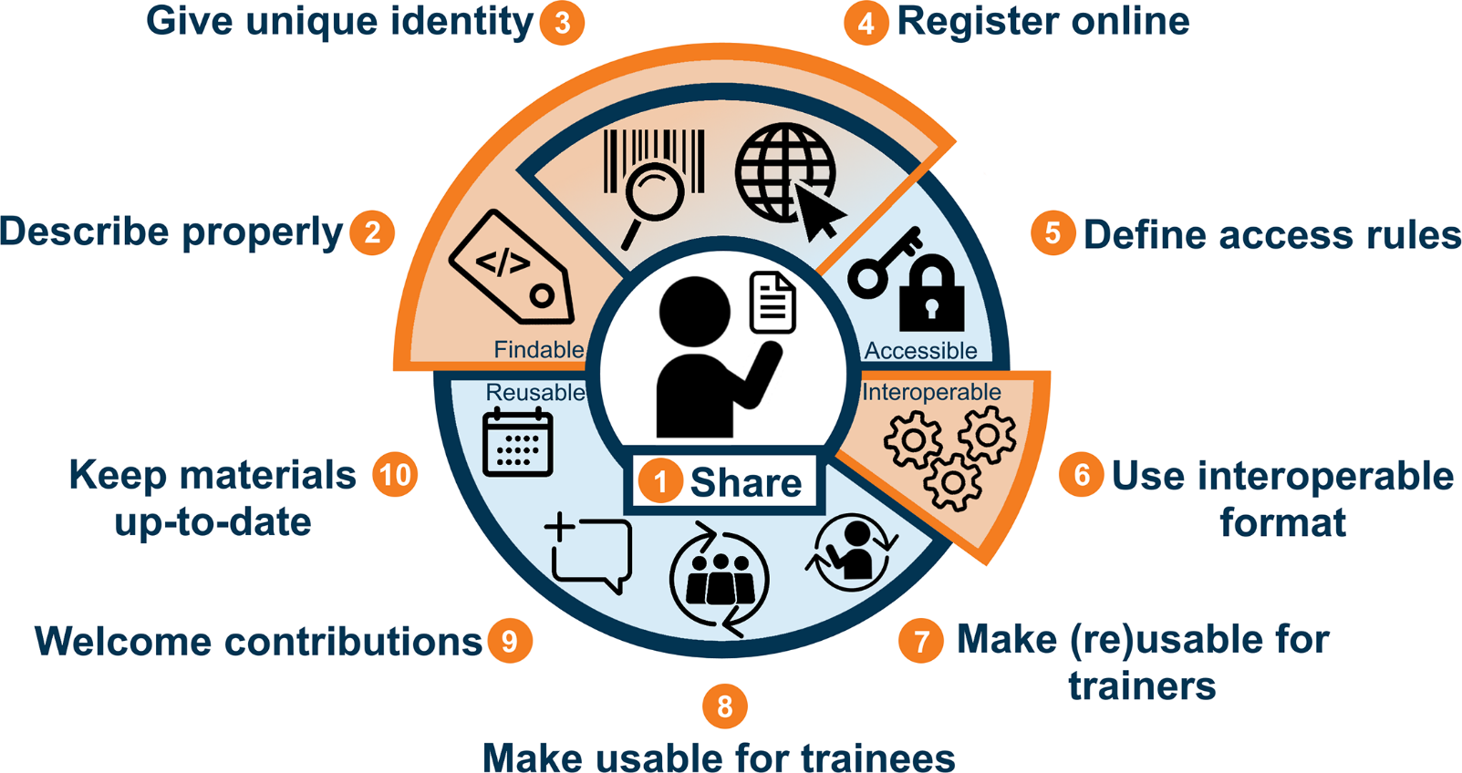
Figure 1: Ten rules for making training materials FAIR. Taken from Garcia et al 2020 https://doi.org/10.1371/journal.pcbi.1007854

Slide 4
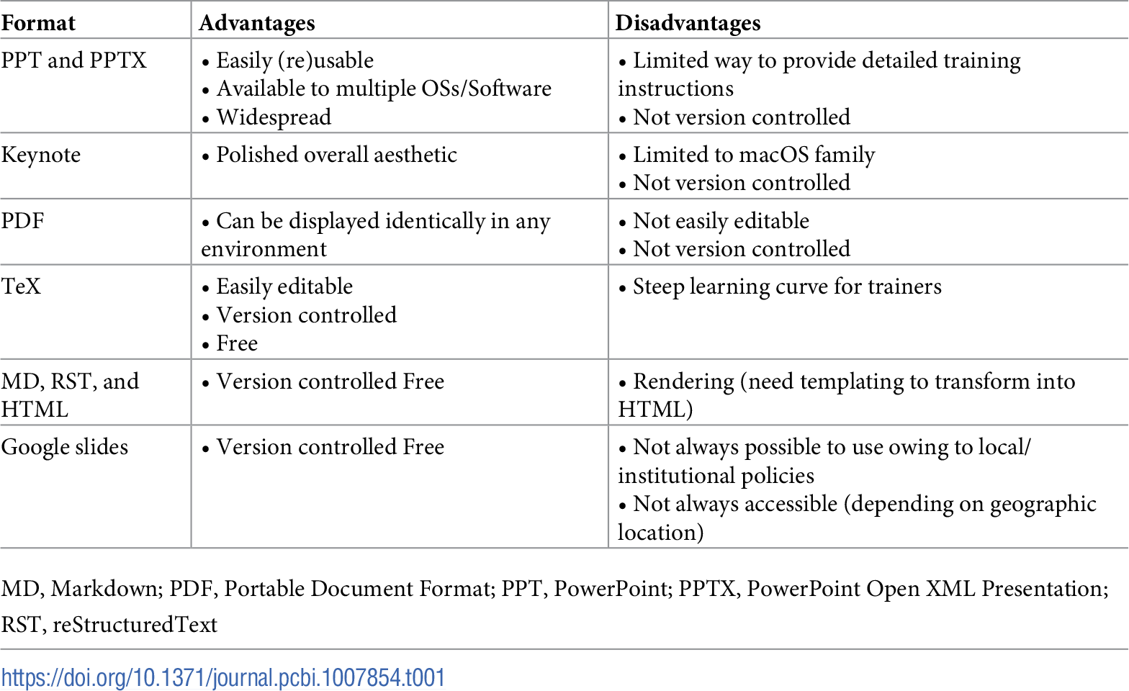
Table 1: Ten rules for making training materials FAIR. Taken from Garcia et al 2020 https://doi.org/10.1371/journal.pcbi.1007854

Slide 5
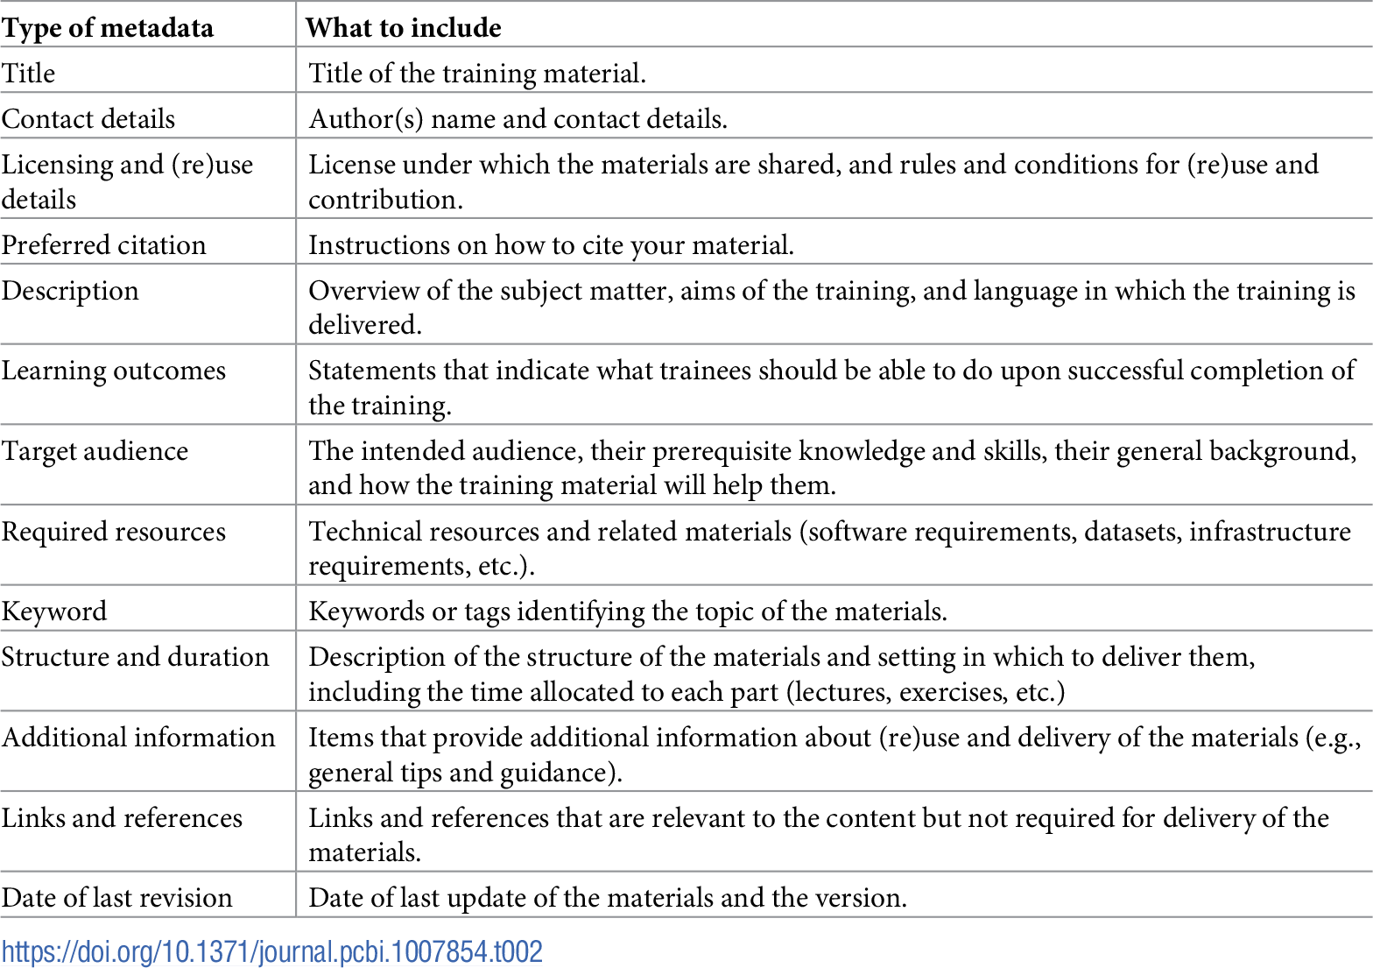
Table 2: Ten rules for making training materials FAIR. Taken from Garcia et al 2020 https://doi.org/10.1371/journal.pcbi.1007854

Slide 6
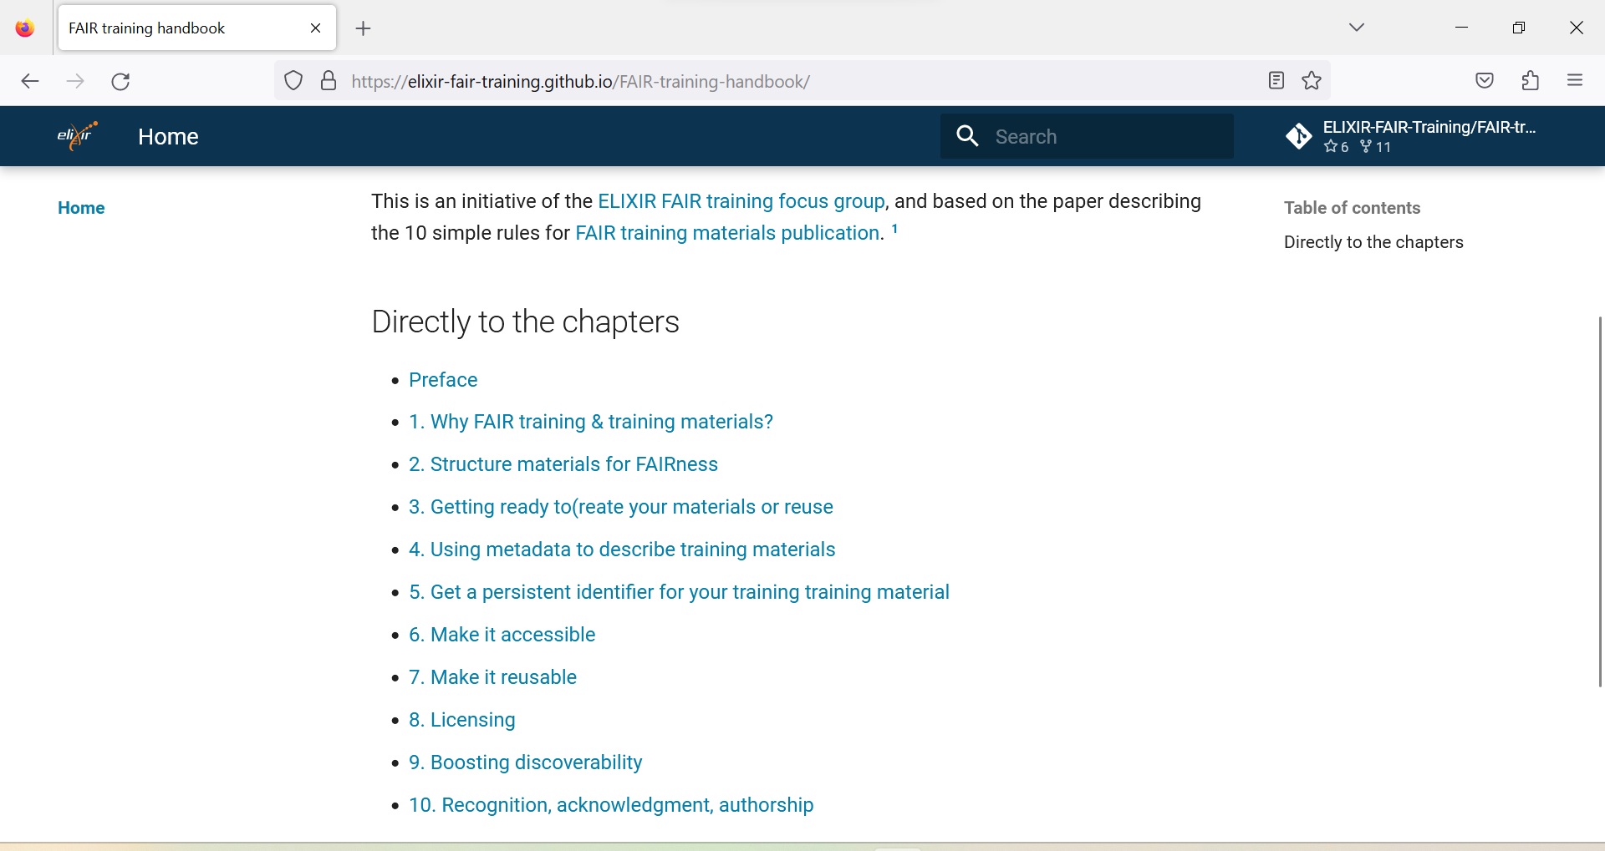
https://elixir-fair-training.github.io/FAIR-training-handbook/

Slide 7
https://docs.google.com/document/d/1Bv2Tg2GlN7OW4LB_maimxoTtmNujwuX-/edit

Slide 8
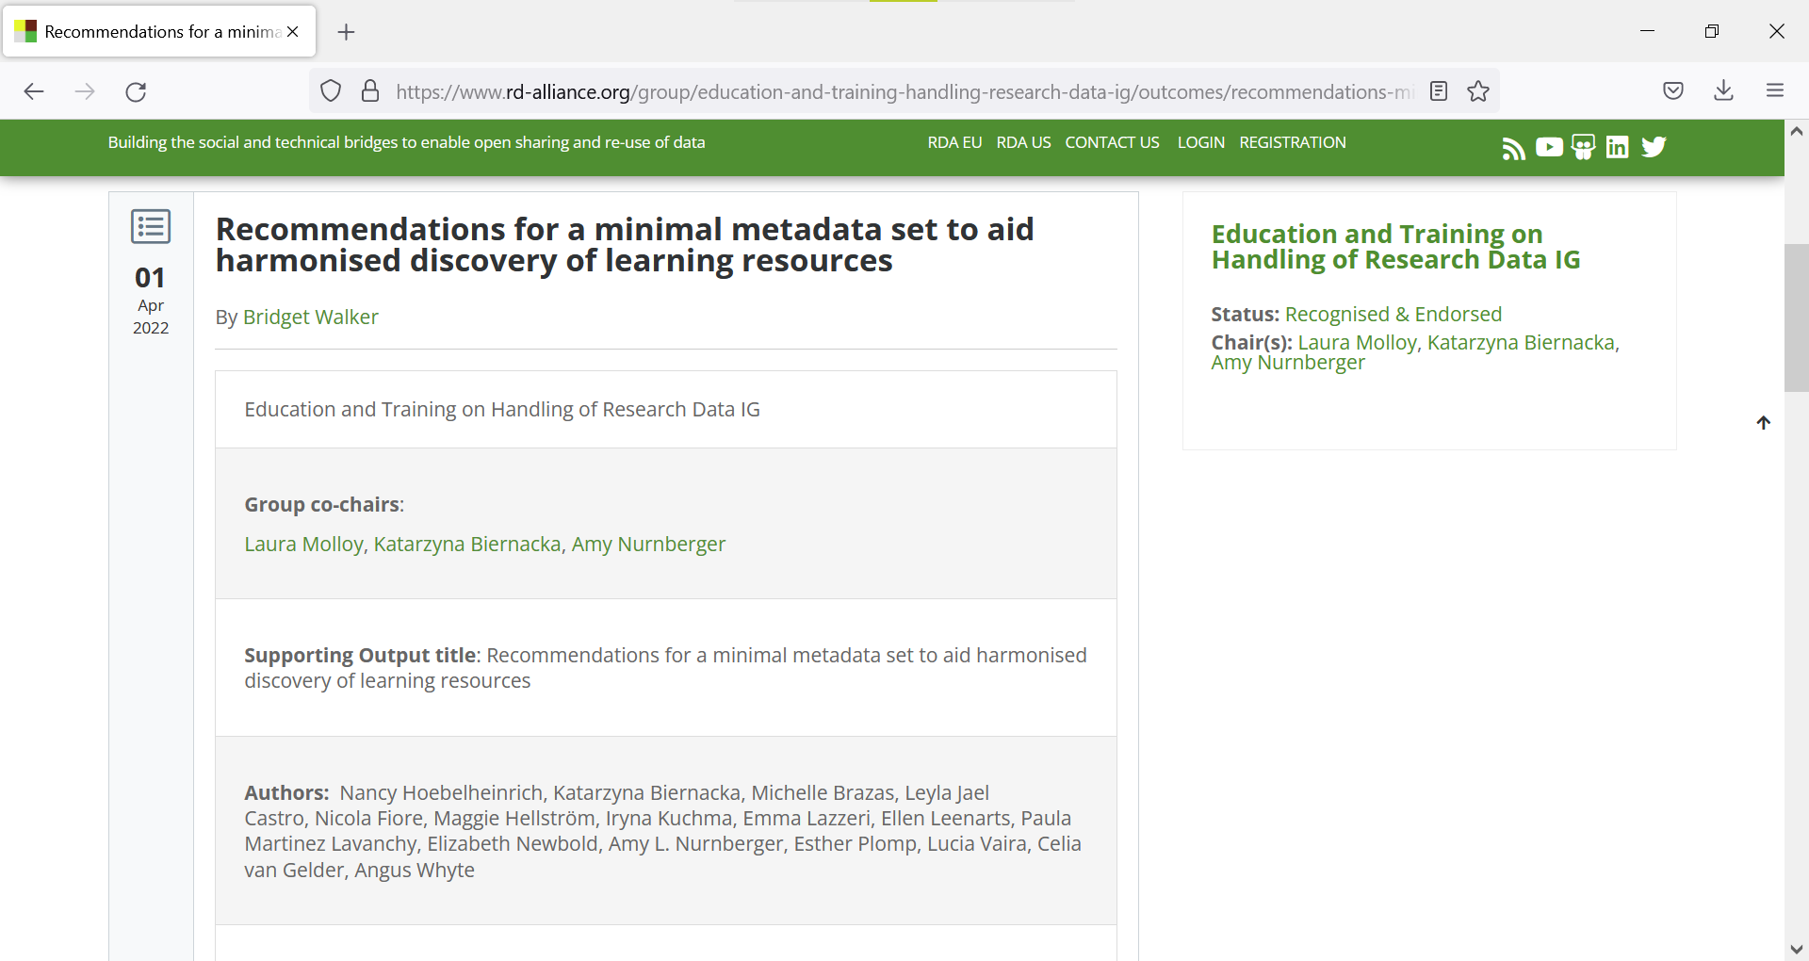
https://www.rd-alliance.org/group/education-and-training-handling-research-data-ig/outcomes/recommendations-minimal-metadata-set

Slide 9
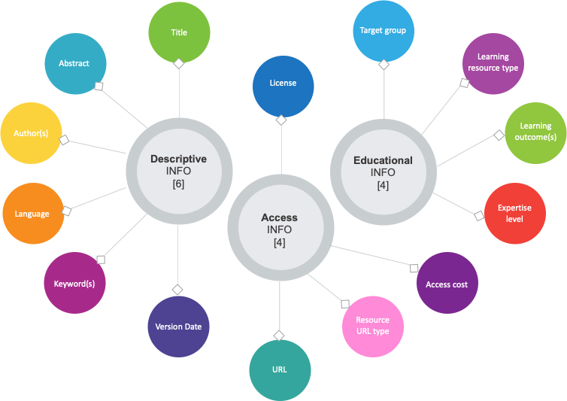
Figure 1: Minimum set of metadata for learning resources
10.15497/RDA00073

Slide 10
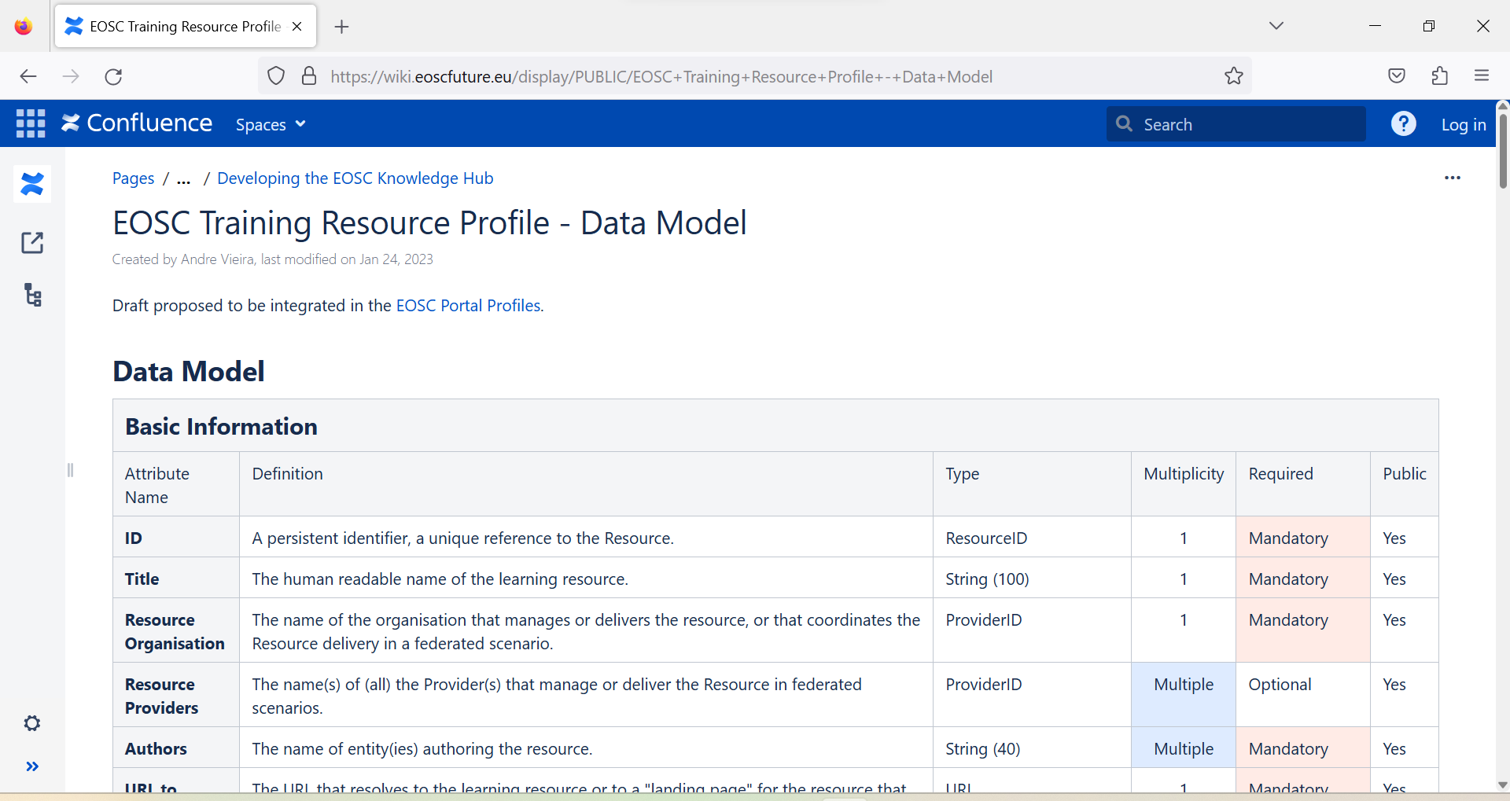
https://wiki.eoscfuture.eu/display/PUBLIC/EOSC+Training+Resource+Profile+-+Data+Model

Slide 11
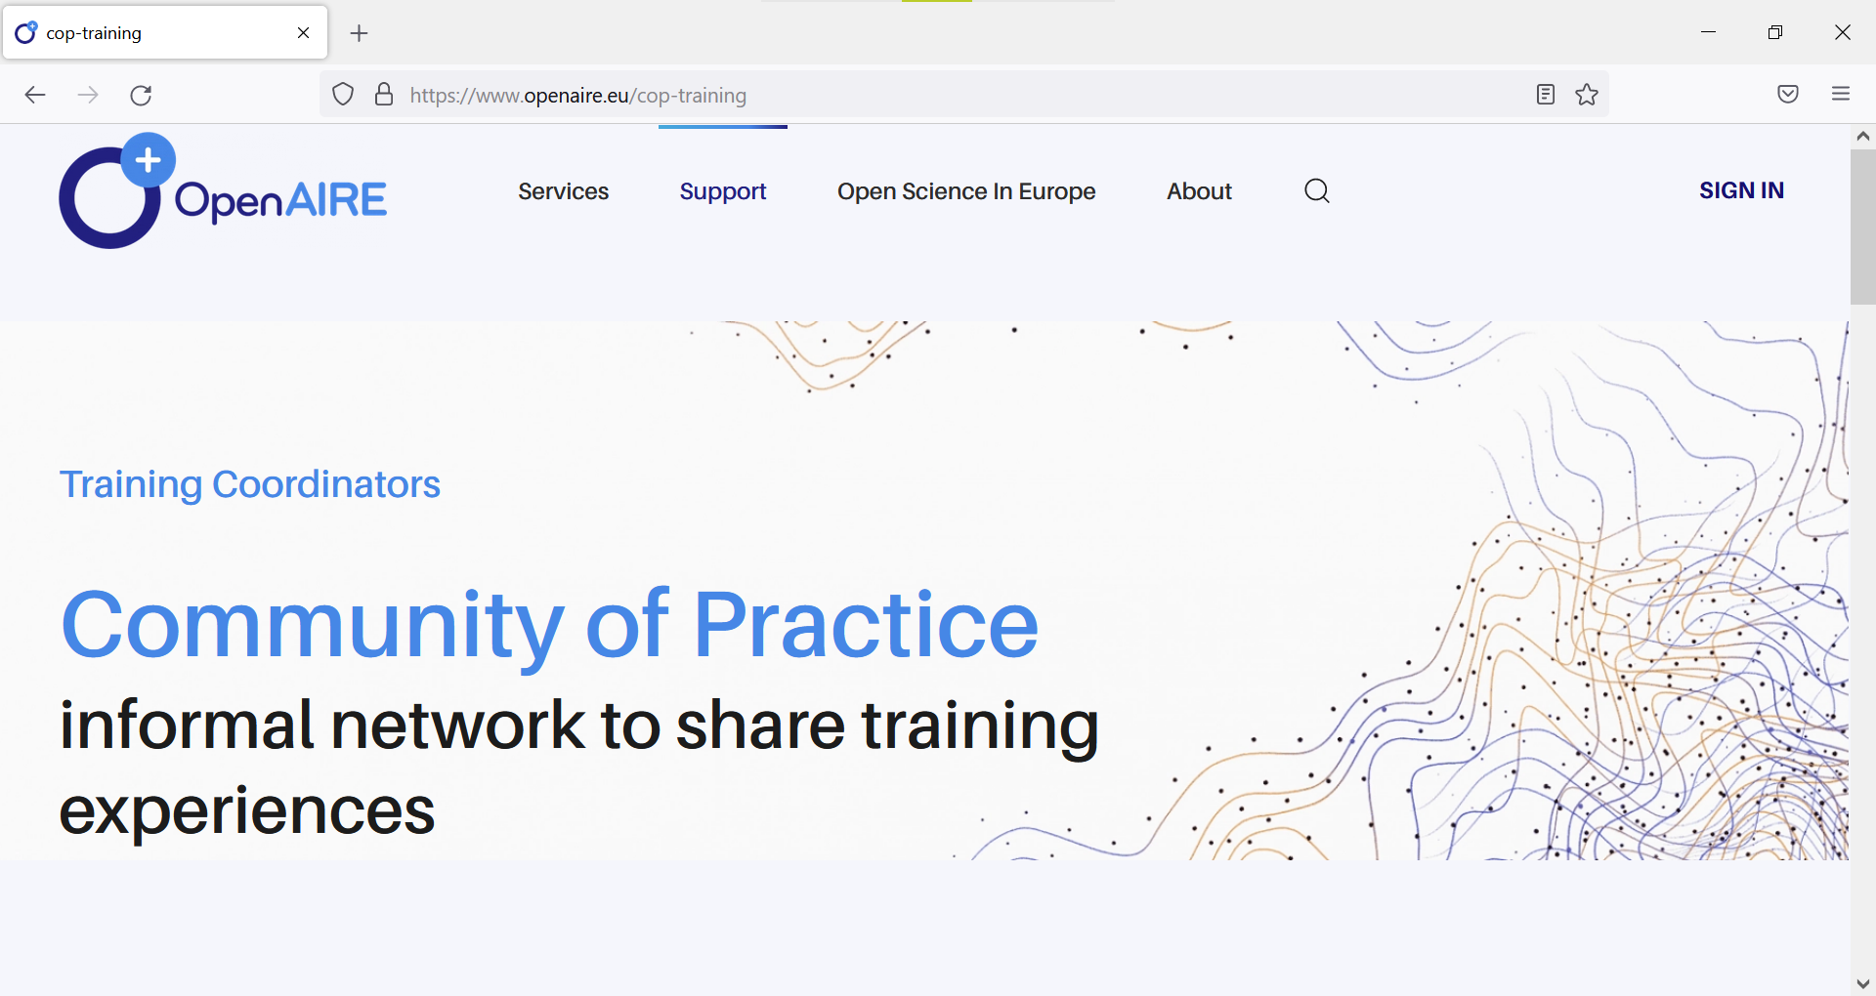
https://www.openaire.eu/cop-training

Slide 12
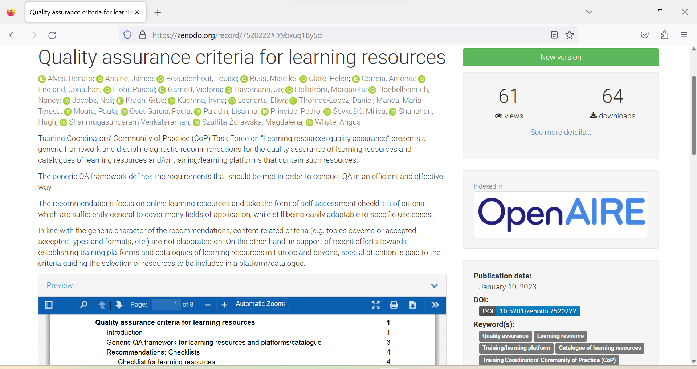
https://doi.org/10.5281/zenodo.7520222

Slide 13
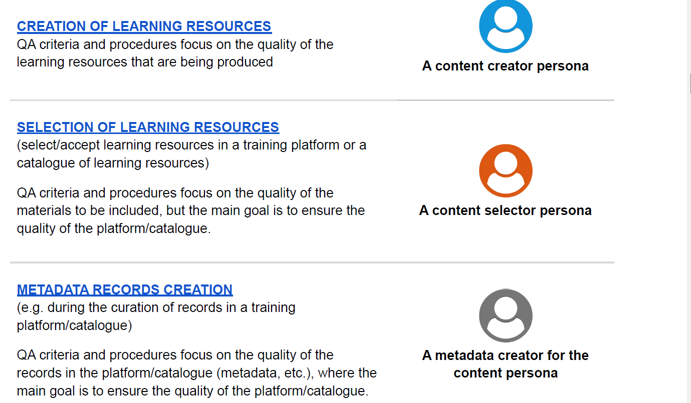
https://doi.org/10.5281/zenodo.7520222

Slide 14
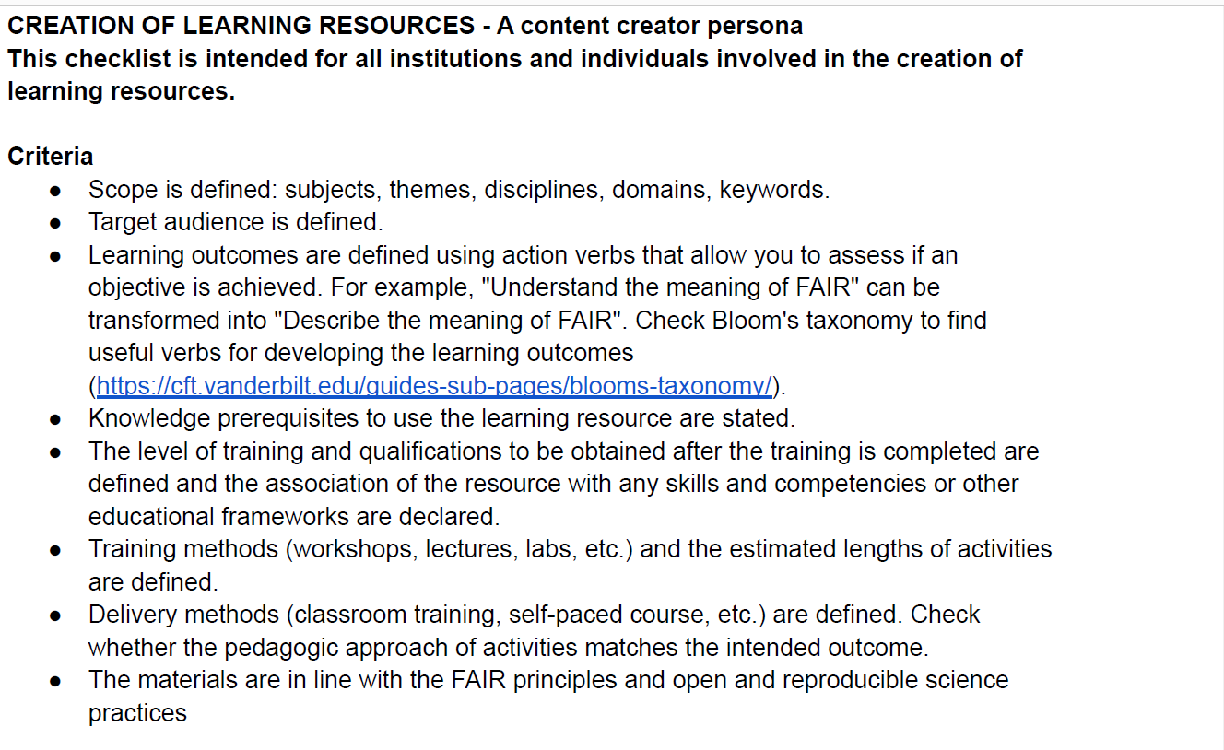
https://doi.org/10.5281/zenodo.7520222
https://doi.org/10.5281/zenodo.7520222

Slide 15
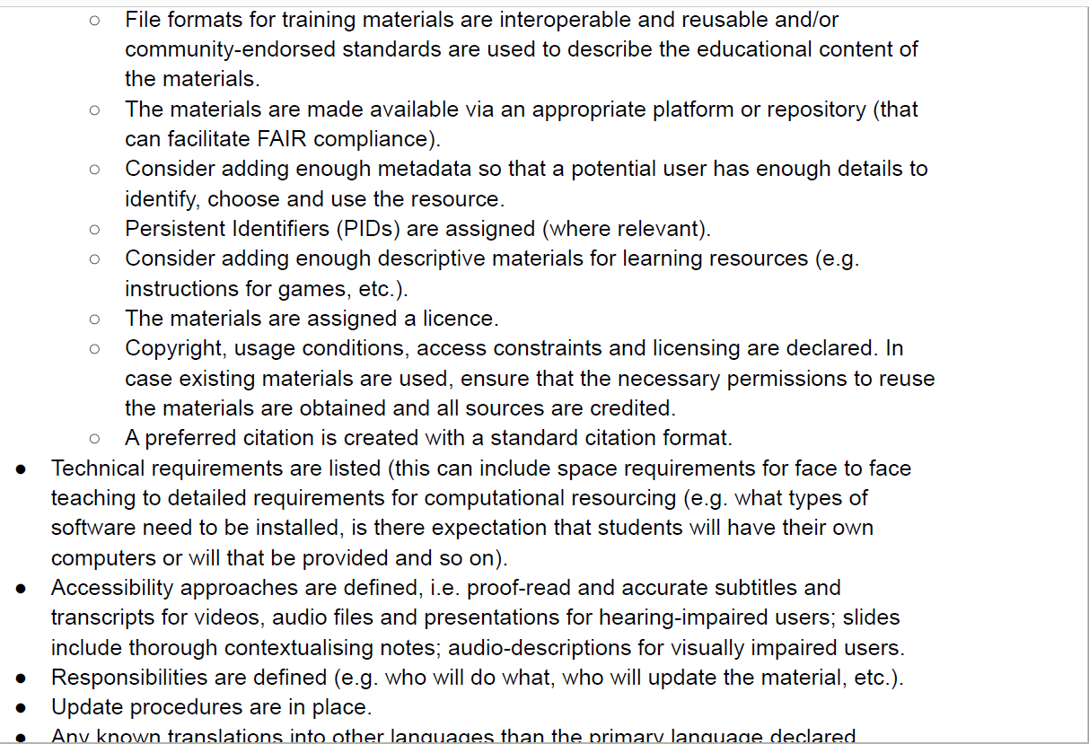
https://doi.org/10.5281/zenodo.7520222

Slide 16
Thank you! Questions? Your thoughts?
Contact: iryna.kuchma@eifl.net
@irynakuchma
@irynakuchma@mstdn.social
www.eifl.net

