Slide 1
www.openaire.eu
1st OpenAIRE Open Science Train the Trainer Bootcamp
June 6-10, 2022
How to make your training materials FAIR
Iryna Kuchma, EIFL, OpenAIRE Training & Support Standing Committee
Attribution 4.0 International
#OpenAIRE_OSBootcamp

Slide 2
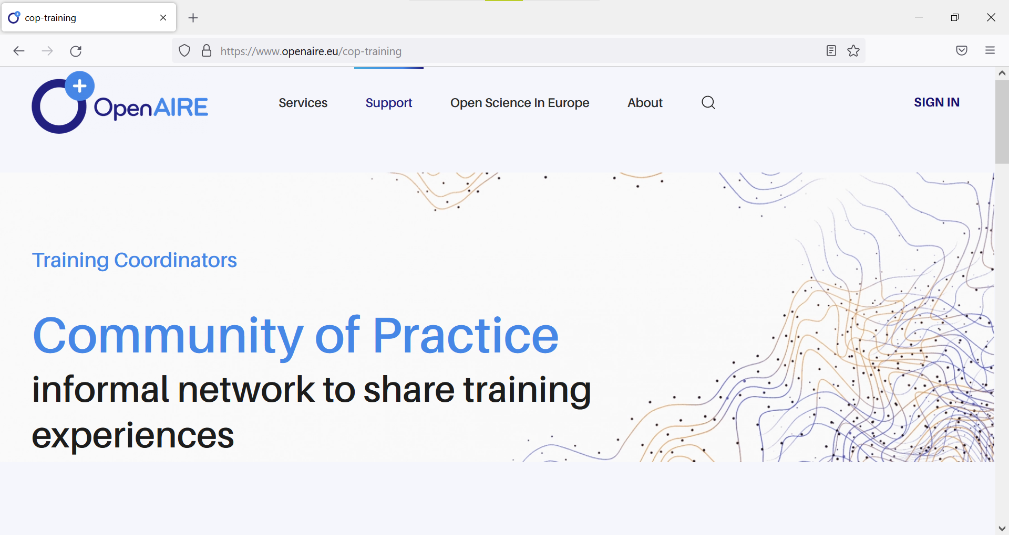
https://www.openaire.eu/cop-training

Slide 3
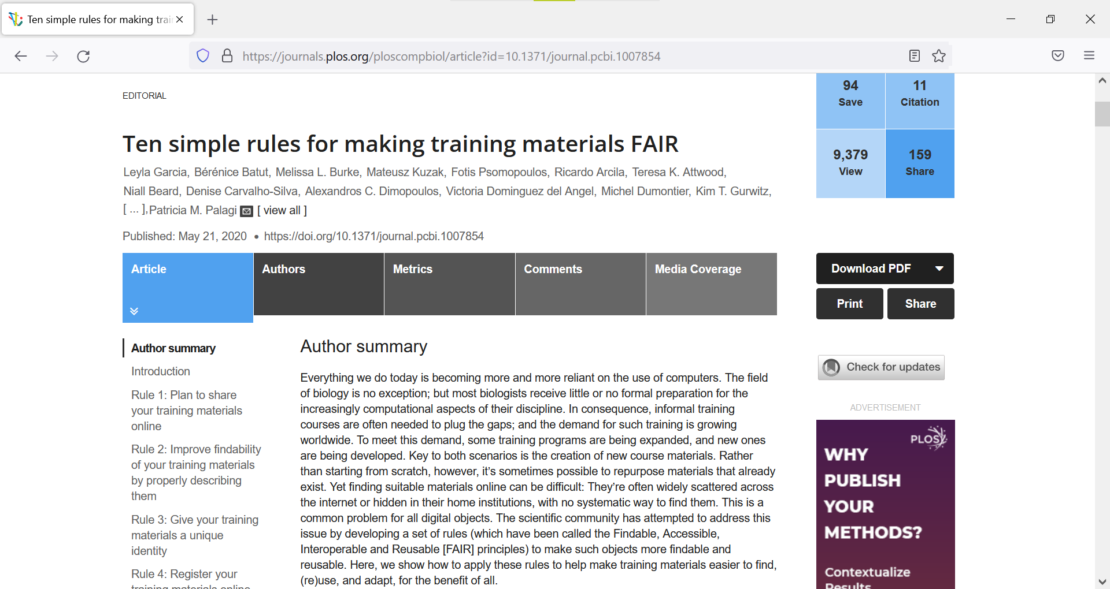
https://doi.org/10.1371/journal.pcbi.1007854

Slide 4
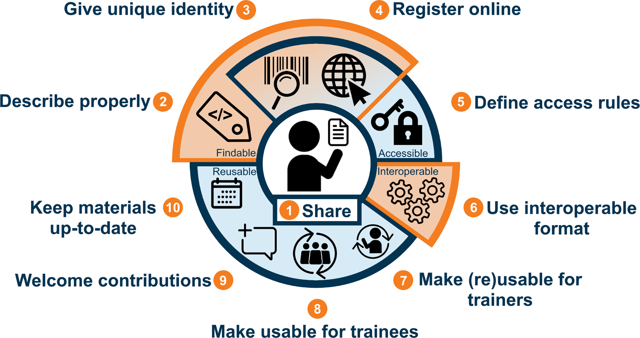
Figure 1: Ten rules for making training materials FAIR. Taken from Garcia et al 2020 https://doi.org/10.1371/journal.pcbi.1007854

Slide 5
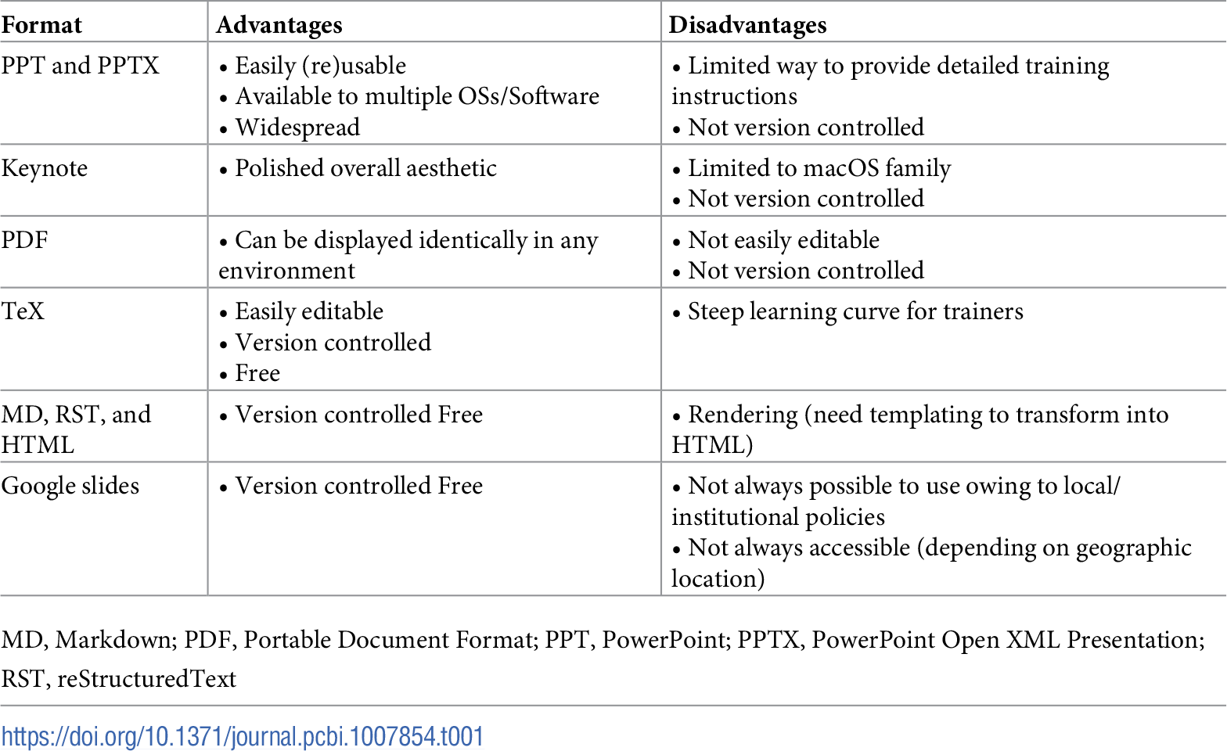
Table 1: Ten rules for making training materials FAIR. Taken from Garcia et al 2020 https://doi.org/10.1371/journal.pcbi.1007854

Slide 6
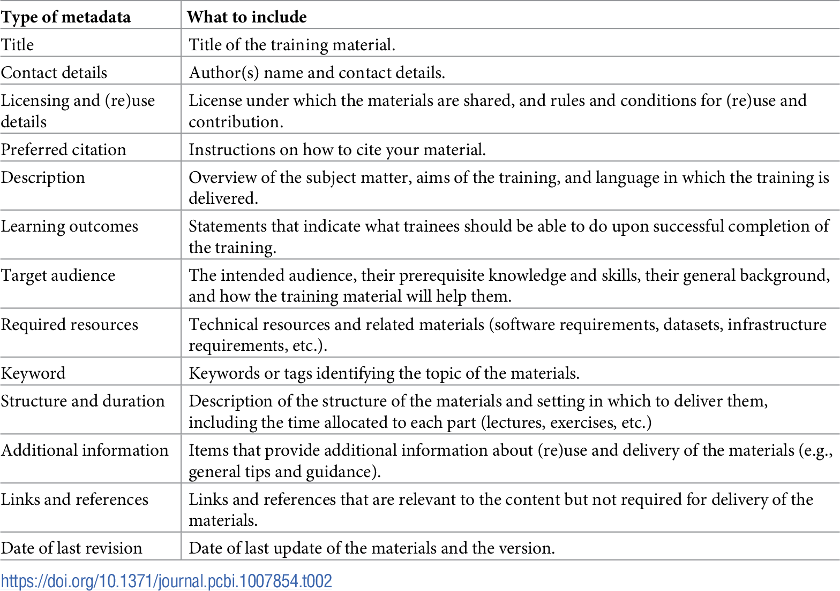
Table 2: Ten rules for making training materials FAIR. Taken from Garcia et al 2020 https://doi.org/10.1371/journal.pcbi.1007854

Slide 7
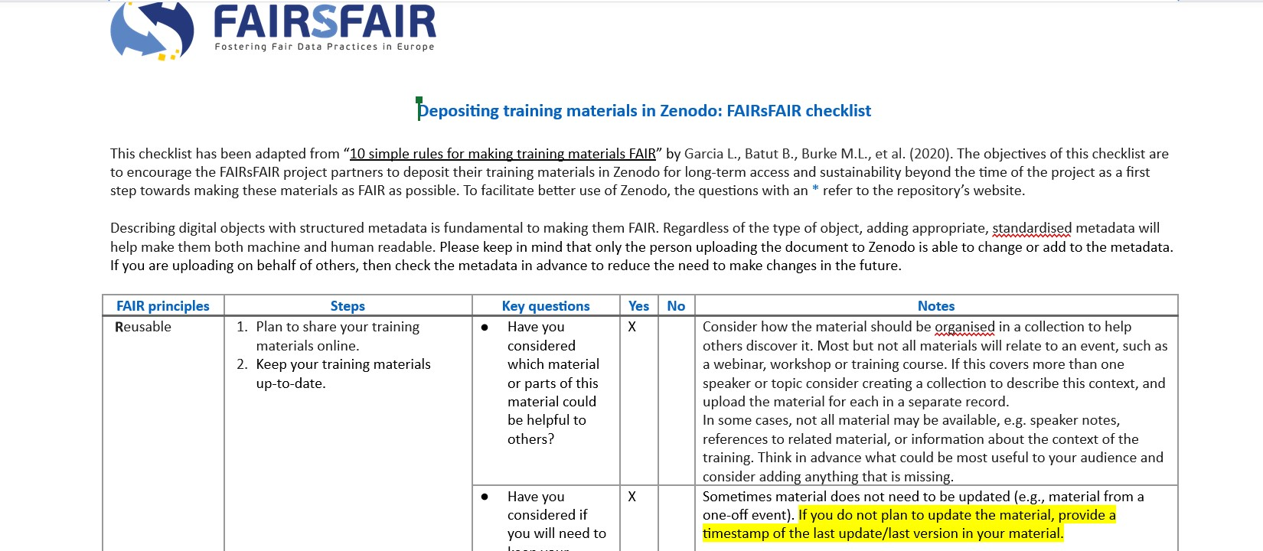
https://docs.google.com/document/d/1Bv2Tg2GlN7OW4LB_maimxoTtmNujwuX-/edit

Slide 8
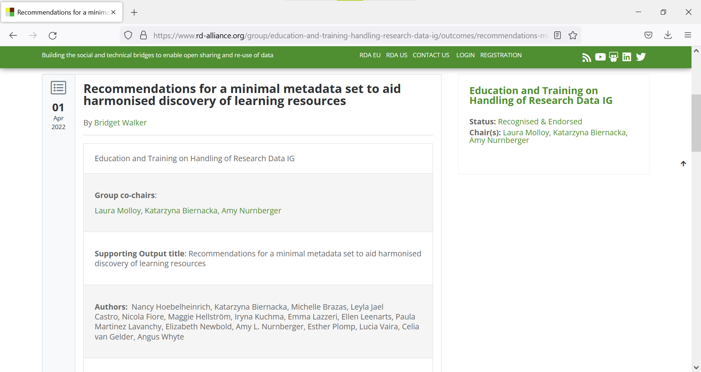
https://www.rd-alliance.org/group/education-and-training-handling-research-data-ig/outcomes/recommendations-minimal-metadata-set

Slide 9
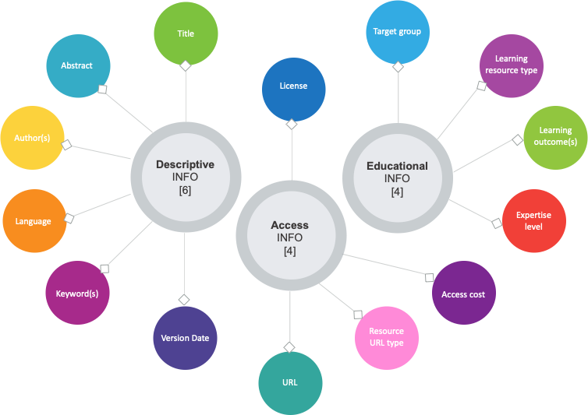
Figure 1: Minimum set of metadata for learning resources
10.15497/RDA00073

Slide 10
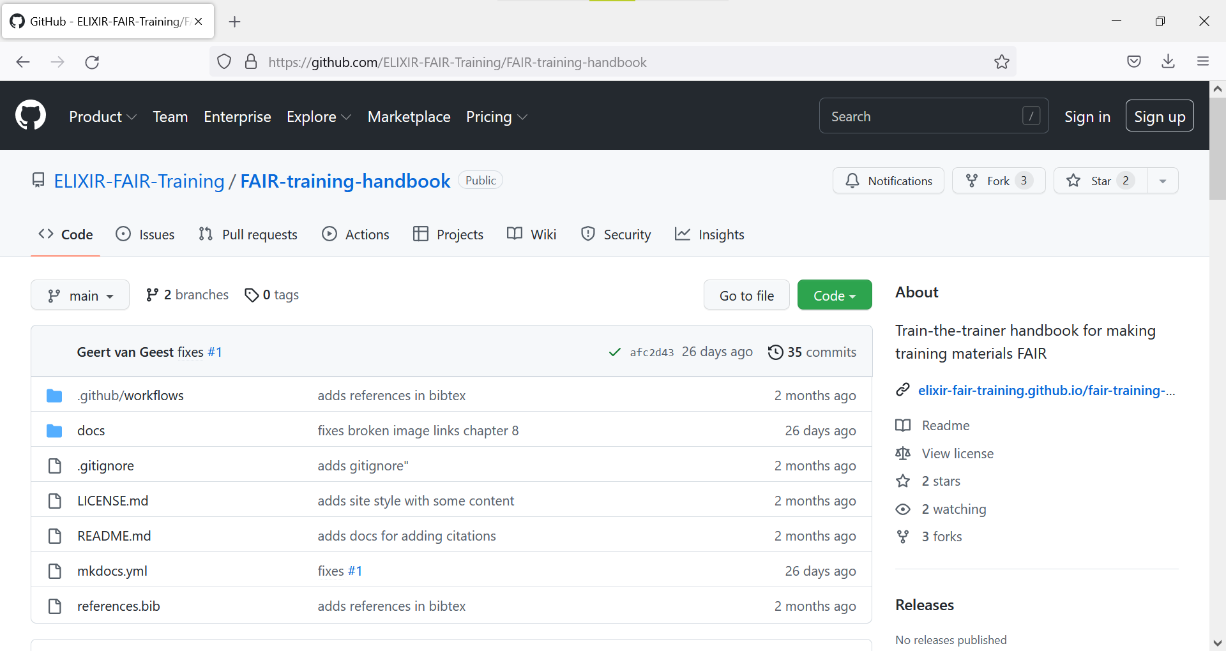
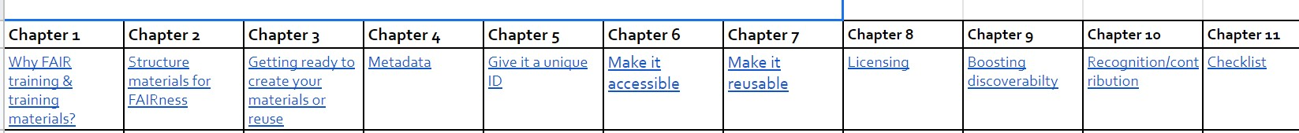
https://github.com/ELIXIR-FAIR-Training/FAIR-training-handbook

Slide 11

THANKS
Web
www.openaire.eu
Email
Iryna.kuchma@eifl.net
Twitter
@openaire_eu @irynakuchma

