Slide 1
www.openaire.eu
1st OpenAIRE Open Science Train the Trainer Bootcamp June 6-10, 2022
Evaluating the results of training & learning programmes
Iryna Kuchma, EIFL, OpenAIRE Training & Support Standing Committee
Attribution 4.0 International
#OpenAIRE_OSBootcamp

Slide 2
How do you know if you are making a difference?

Slide 3
How do you evaluate the efficacy & impact of your training?

Slide 4
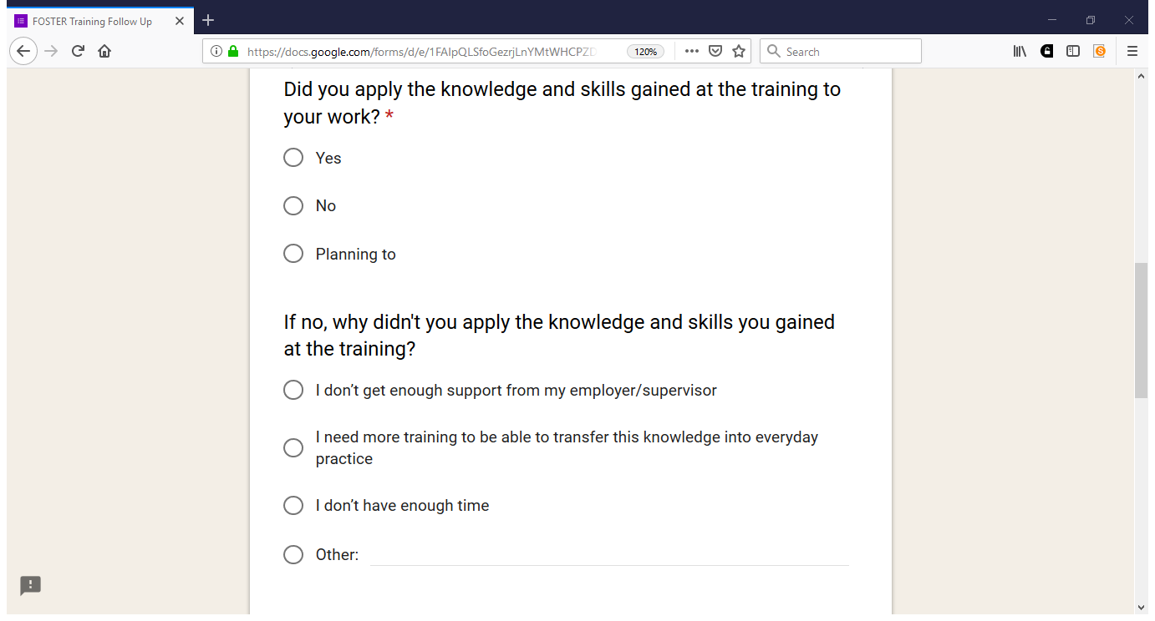

Slide 5
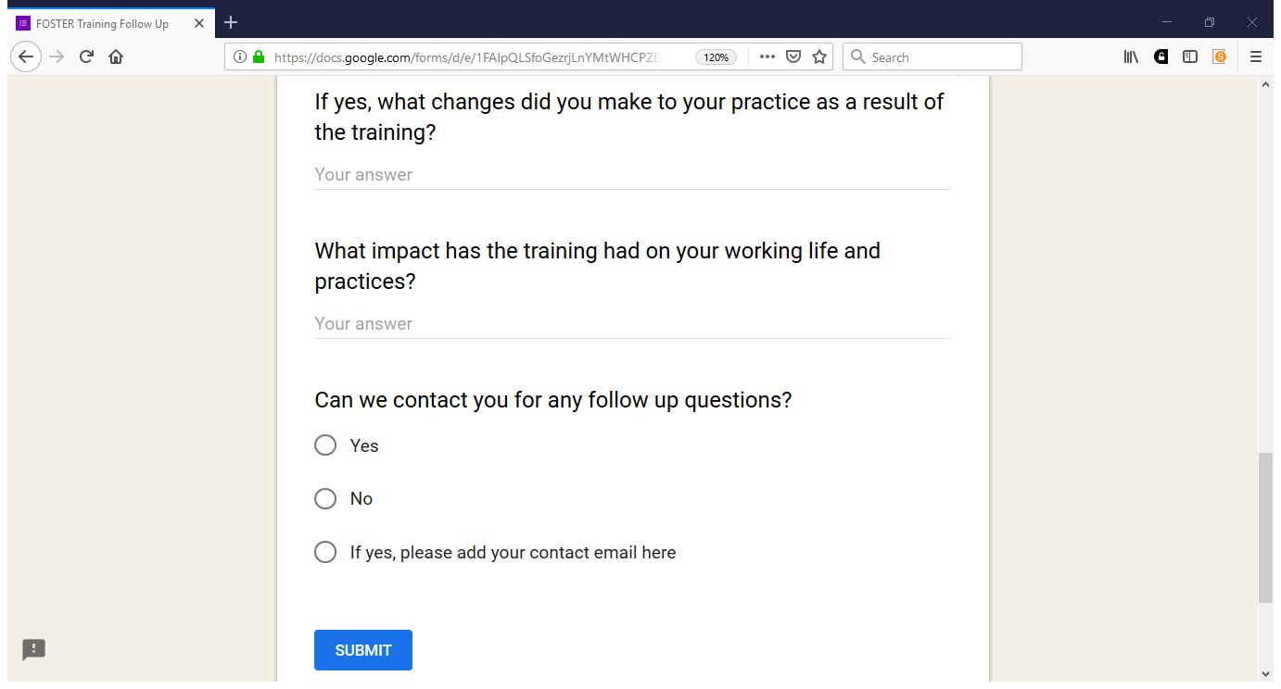

Slide 6
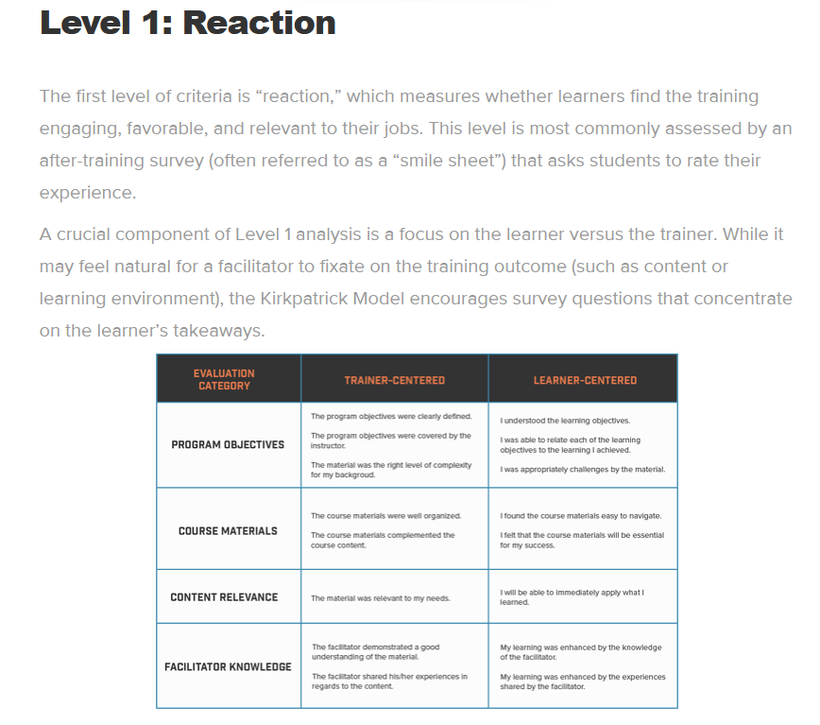
Kirkpatrick model. This model looks at four levels: https://www.ardentlearning.com/blog/what-is-the-kirkpatrick-model

Slide 7
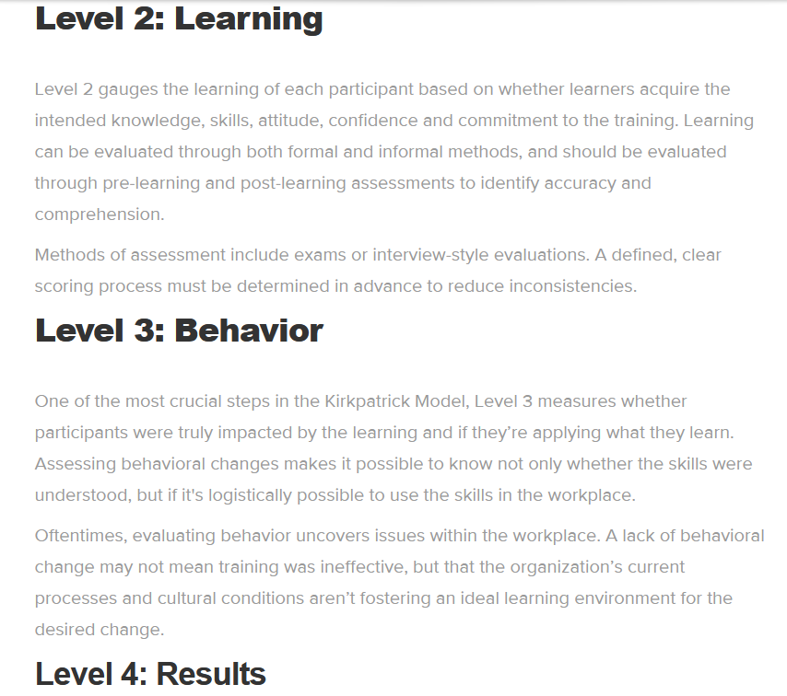
Kirkpatrick model. This model looks at four levels: https://www.ardentlearning.com/blog/what-is-the-kirkpatrick-model
How can we measure skills/community building through time in an ethical way?

Slide 8
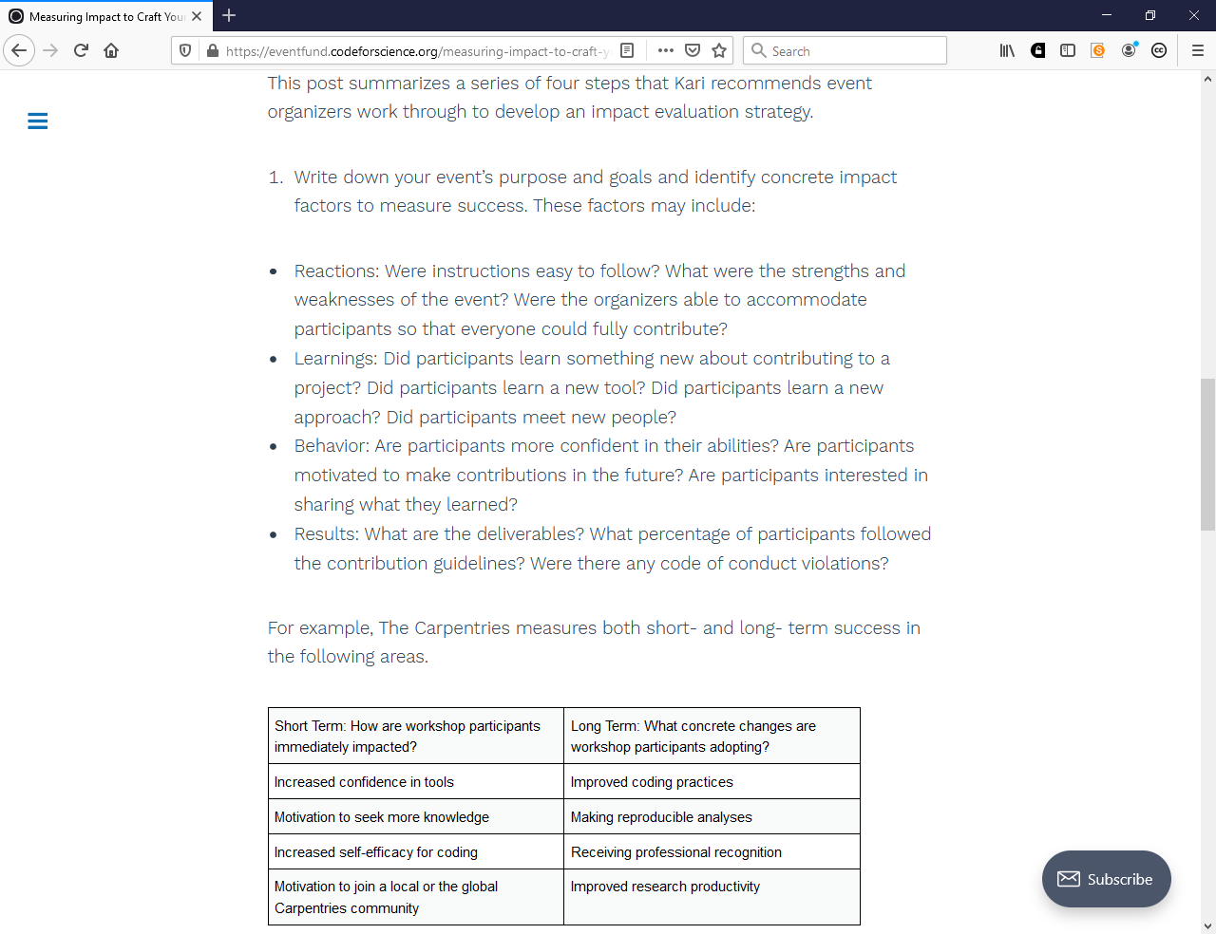
Measuring Impact to Craft Your Story by Dr. Kari L. Jordan, The Carpentries https://eventfund.codeforscience.org/measuring-impact-to-craft-your-story/

Slide 9
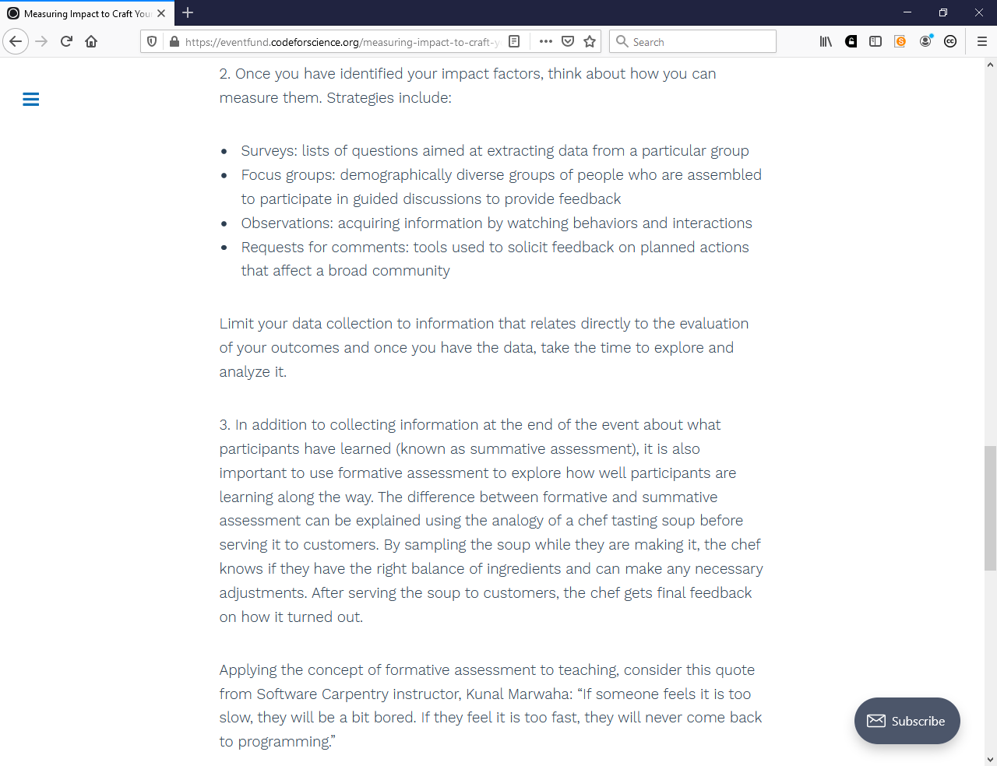
Measuring Impact to Craft Your Story by Dr. Kari L. Jordan, The Carpentries https://eventfund.codeforscience.org/measuring-impact-to-craft-your-story/

Slide 10
Any other resources on this topic you would recommend?

Slide 11
THANKS
Web
www.openaire.eu
Email
Iryna.kuchma@eifl.net
Twitter
@openaire_eu @irynakuchma

